Slide 1
Green Buildings – Part 1
Agricultural Sustainable Energy Education Network
Renewable Energy Curriculum

Slide 2
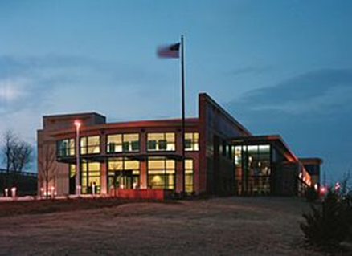
Introduction
What is Green Building?
What is the History of Green Building?
What Makes a Building Green?
Solar Heating, Cooling, and
Ventilation Systems
US EPA Kansas City Science & Technology Center

Slide 3
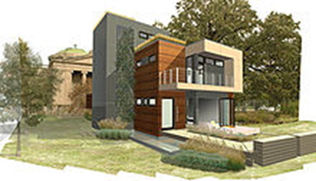
What is Green Building? (1)
Green Building refers to a structure which is constructed using processes that are environmentally responsible and resource-efficient throughout a building's life-cycle.
Processes range from siting to design, construction, operation, maintenance, renovation, and demolition.
Green Building Design involves finding the balance between building and the sustainable environment.
Blu Homes mkSolaire, a green building designed by Michelle Kaufmann

Slide 4
Although new technologies are constantly being developed to complement current practices in creating greener structures, the common objective is that green buildings are designed to reduce the overall impact of the built environment on human health and the natural environment by: (1)
1. Efficiently using energy, water, and other resources
2. Protecting occupant health and improving employee productivity
3. Reducing waste, pollution and environmental degradation.

Slide 5
Green building brings together a vast array of practices, techniques, and skills to reduce and ultimately eliminate the impacts of buildings on the environment and human health.
It often emphasizes taking advantage of renewable resources, e.g., using sunlight through passive solar, active solar, and photovoltaic equipment, and using plants and trees through green roofs, rain gardens, and reduction of rainwater run-off.
Many other techniques are used, such as using low-impact building materials or using packed gravel or permeable concrete instead of conventional concrete or asphalt to enhance replenishment of ground water.

Slide 6
Green building is defined by the Office of the Federal Environmental
Executive as “the practice of: (1)
Increasing the efficiency with which buildings and their sites use energy, water, and materials, and
Reducing building impacts of human health and the environment, through better siting, design, construction, operation, maintenance, and removal throughout the complete life cycle.”

Slide 7
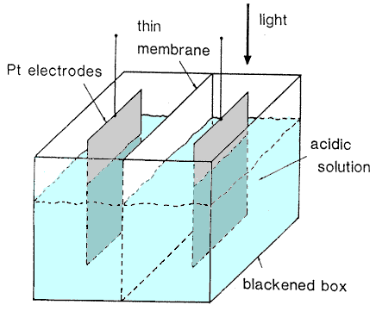
History of Green Building (2)
How Building Green Got Its Start written by: Bstone edited by: Laurie Patsalides updated: 5/2/2011
Individuals and companies have only been building green homes (buildings) for the past thirty years; still, within that time, the green movement has been constantly growing.
The history of green building dates back much further than the 1970's.
It was in the midst of the industrial revolution that Henri Becquerel first witnessed the transformation of solar energy into electrical energy, known as photovoltaic power. Around this time, the late 1800's to early 1900's, a number of solar power plants were built to utilize the sun's energy for steam power.
Henri Becquerel’s Solar Energy Device

Slide 8
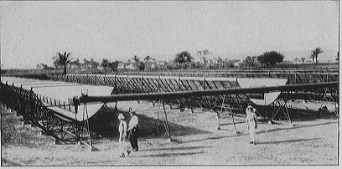
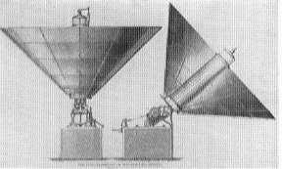
In the 1950's, solar energy was used on an extremely small-scale, making way for the solar panel solution twenty years later. (2)
During the energy crisis of the 1970's, green building moved from research and development to reality.
Builders and designers were looking for a way to reduce the reliance of buildings and homes on fossil fuels.
Solar panels were used to make more environmentally friendly homes, although only in small numbers due to high initial costs.

Slide 9
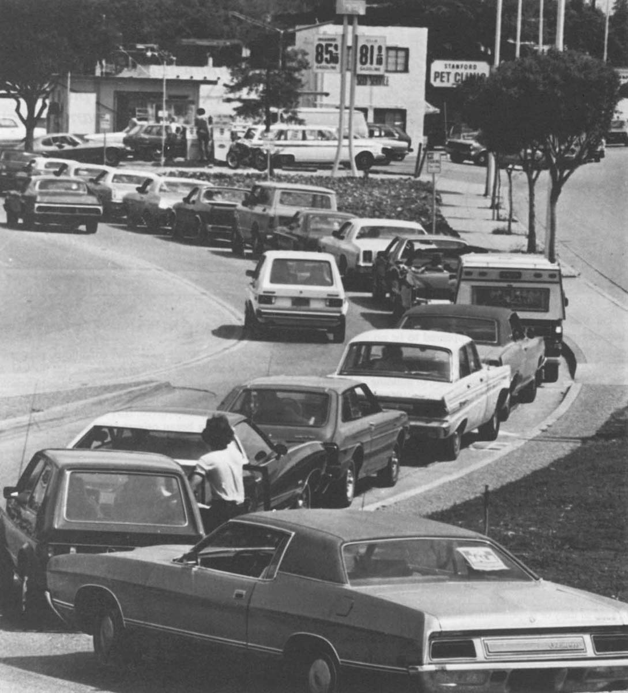
Since then, developers have been able to construct more efficient and less expensive solar panels, making solar energy more of a reality. (2)
Also, during this transition period, designers and consumers started wondering, if solar panels can make buildings more efficient, lower energy bills, and reduce the negative impact on the environment, what other steps can be taken to build even greener homes?
Now, Eco construction involves so much more than simply using solar panels.
1970’s Gas Crisis – Line at Gas Station

Slide 10
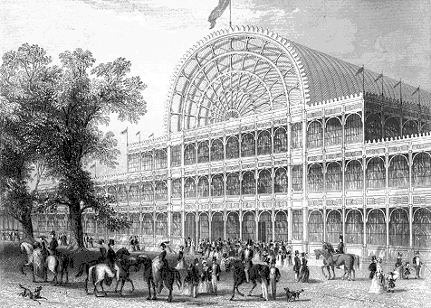
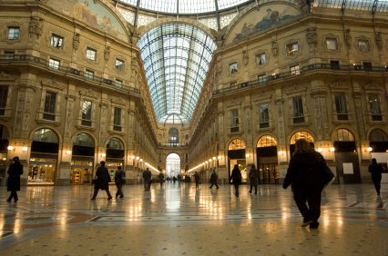
According to David Gissen, curator of architecture and design and the National Building Museum in Washington DC, structures such as London’s Crystal Palace and Milan’s Galleria Vittorio Emanuele II used methods that decreased the impact of the structure on the environment.
Systems such as roof ventilators and underground air cooling chambers were used to regulate indoor air temperature. (2)
Crystal Palace
Galleria Vittorio Emanuele

Slide 11
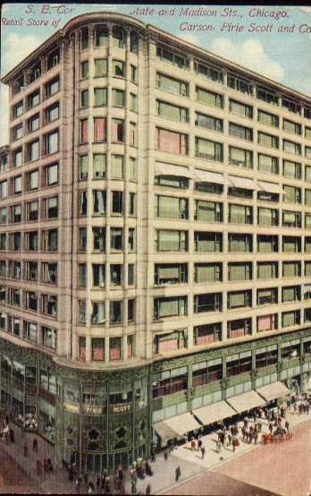
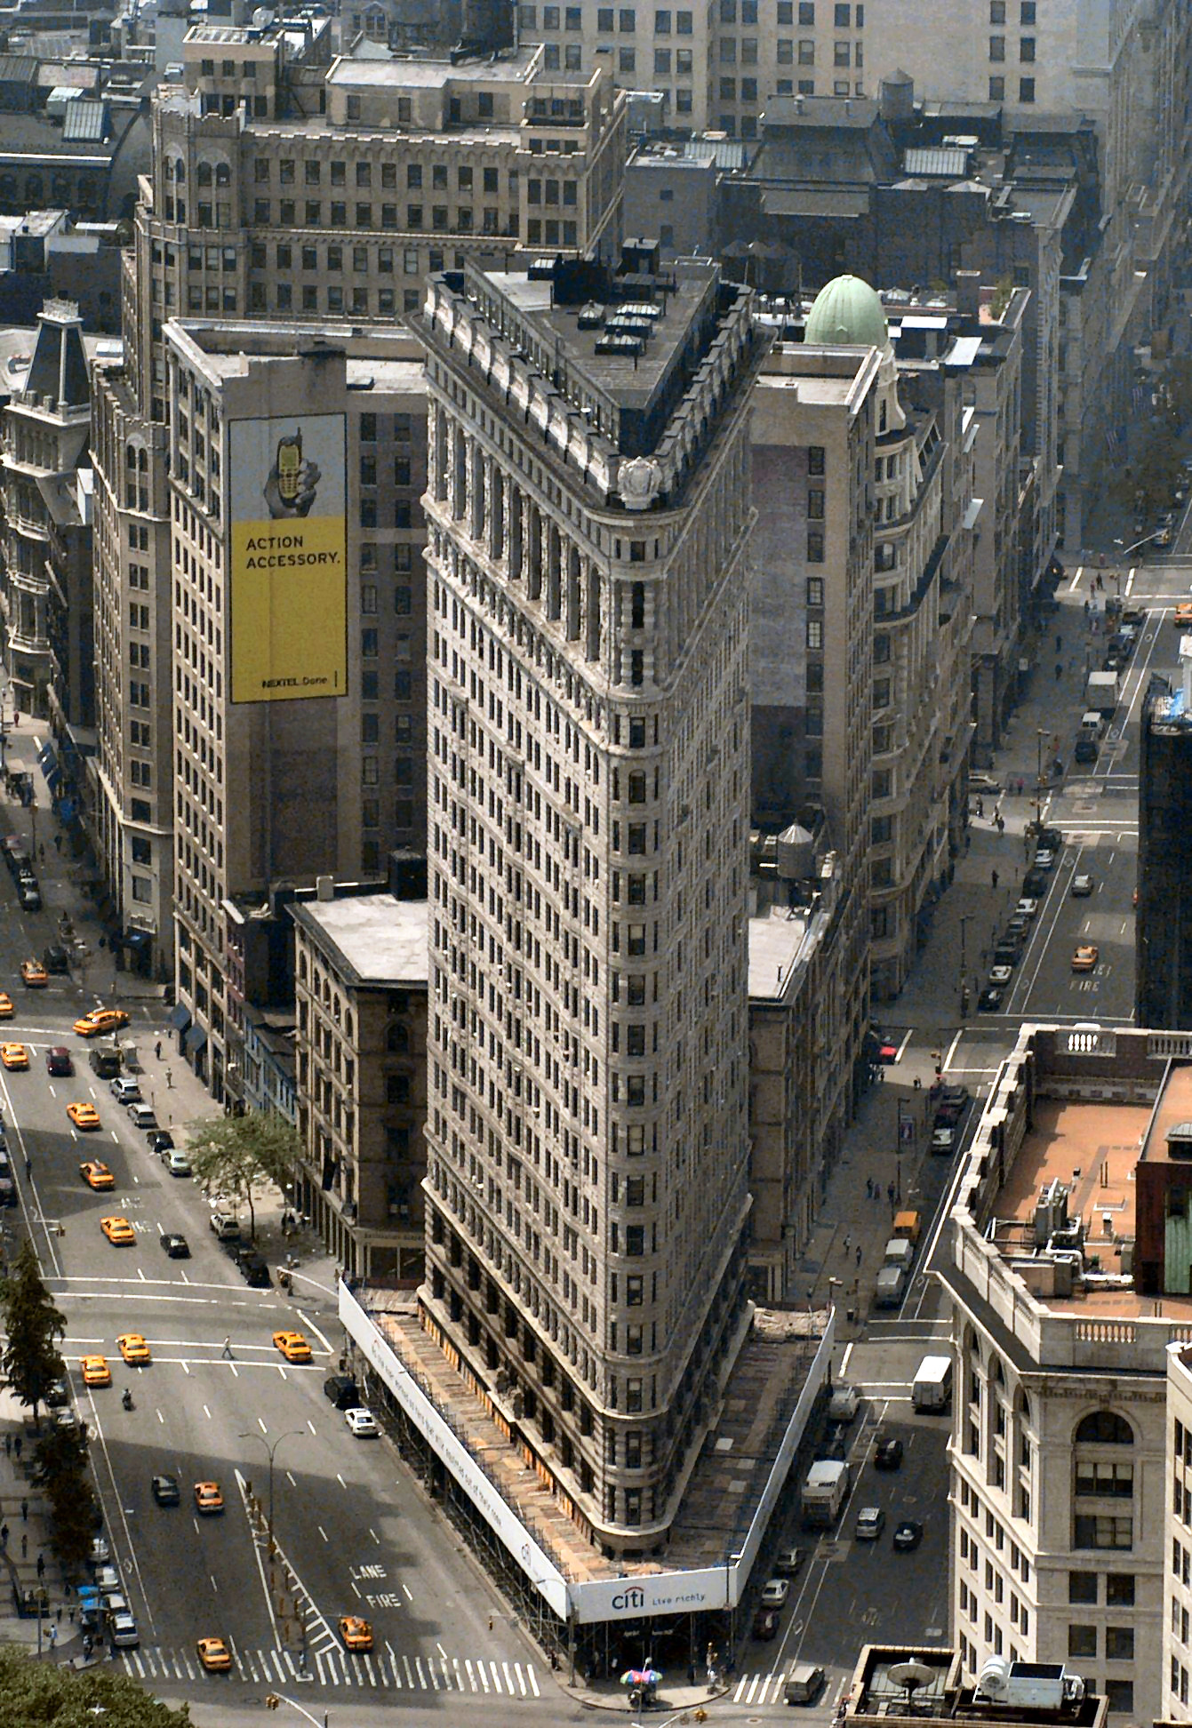
In the early twentieth century, several skyscrapers such as the Flatiron Building and the New York Times Building in New York utilized deep-set windows and the Carson Pirie Scott department store in Chicago had retractable awnings. Both of these techniques were effective in controlling interior temperature while lessoning the buildings’ impact on the environment. (2)
Carson Pirie Scott Building with Retractable Awnings
Flatiron Building in New York

Slide 12
From the 1930’s through the 1960’s, the forward thinking cooling methods
mentioned above gave way to some new building technologies that would change inner-city building construction dramatically. (2)
The invention of air conditioning, reflective glass, and structural steel popularized the enclosed glass and steel buildings that litter the American city today.
These buildings were able to be heated and cooled with massive HVAC systems that consumed huge amounts of cheap and readily available fossil
fuels.

Slide 13
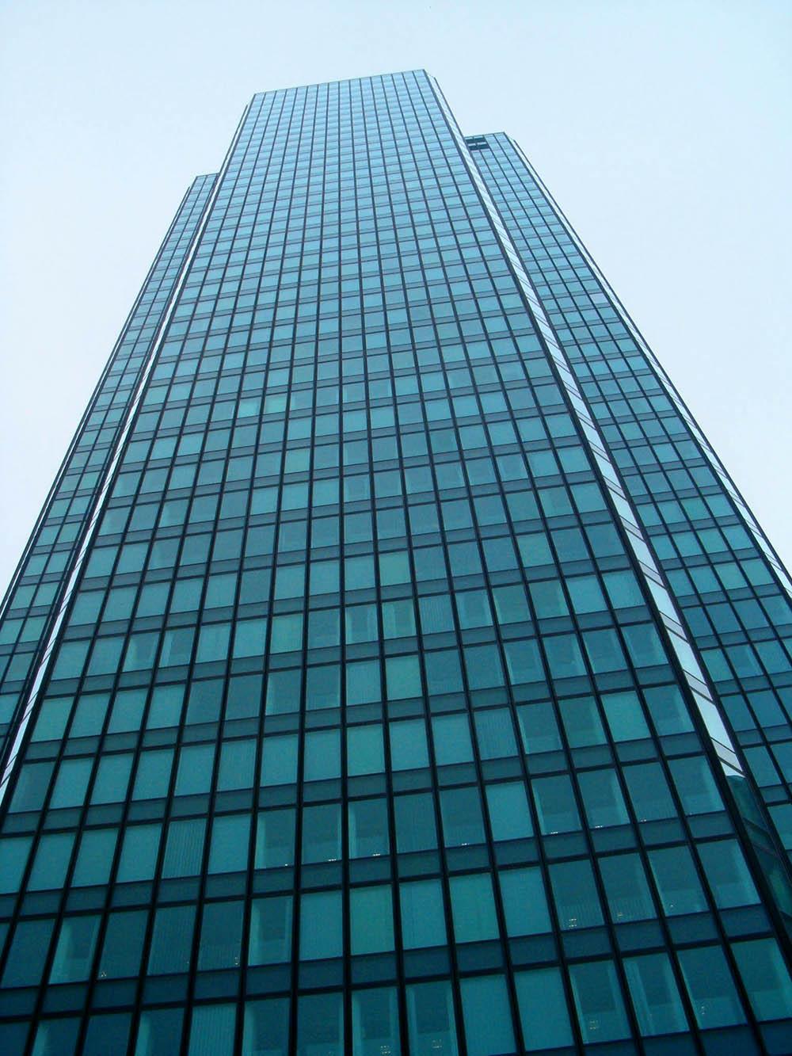
The massive consumption of energy required to inhabit these buildings made their viability tenable and entirely dependent upon energy availability and cost. (2)
Around the time that the “glass box” style high rise had become the icon of the American city (circa 1970), a forward thinking group of architects, environmentalists, and ecologists were inspired by the growing environmental movement and the higher fuel costs that were prevalent during the 1970s.
The genesis of these two scenarios ultimately resulted in the modern build green movement.
Glass Box Skyscraper

Slide 14
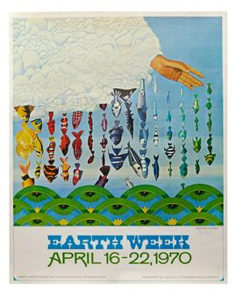
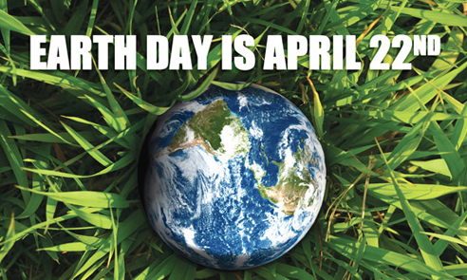
The first Earth Day, celebrated in April 1970, gave some credence to this new building concept, but the OPEC oil embargo of 1973 gave the burgeoning environmental movement, and subsequently the green build effort, the kick start it needed. (2)
With gas lines stretching for blocks, some Americans began to question the conventional wisdom that we should be so independently reliant upon fossil fuels for our energy.

Slide 15
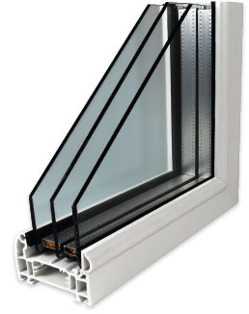
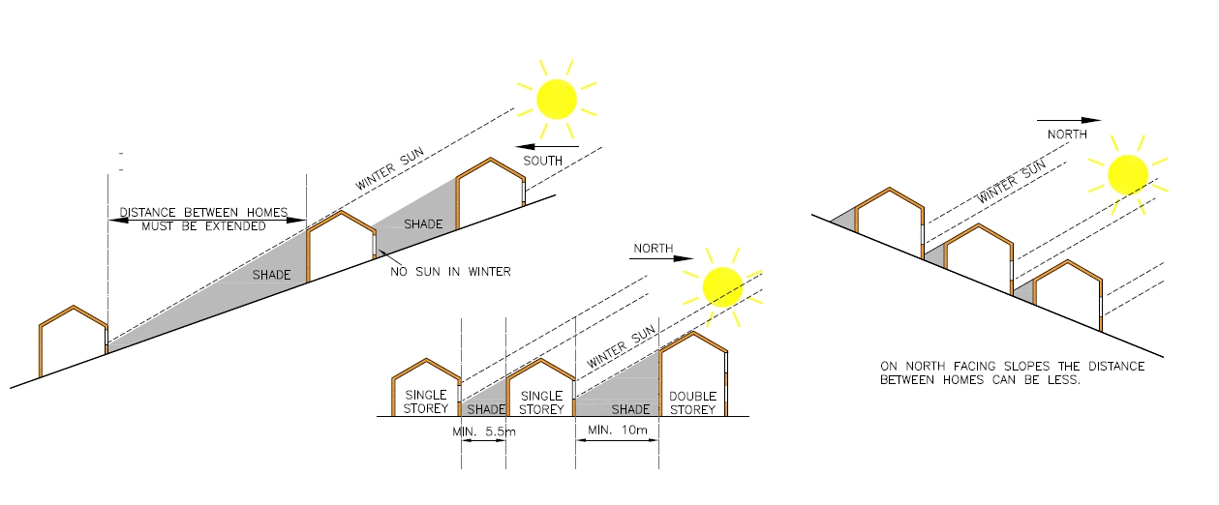
As a result of the oil embargo, amongst other energy concerns, the American Institute of Architects (AIA) formed a Committee on Energy that was broken into two camps. (2)
“One group looked toward passive, such as reflective roofing materials and environmentally beneficial siting of buildings, to achieve energy savings, while the other concentrated more on technological solutions, such as the use of triple-glazed windows.”

Slide 16
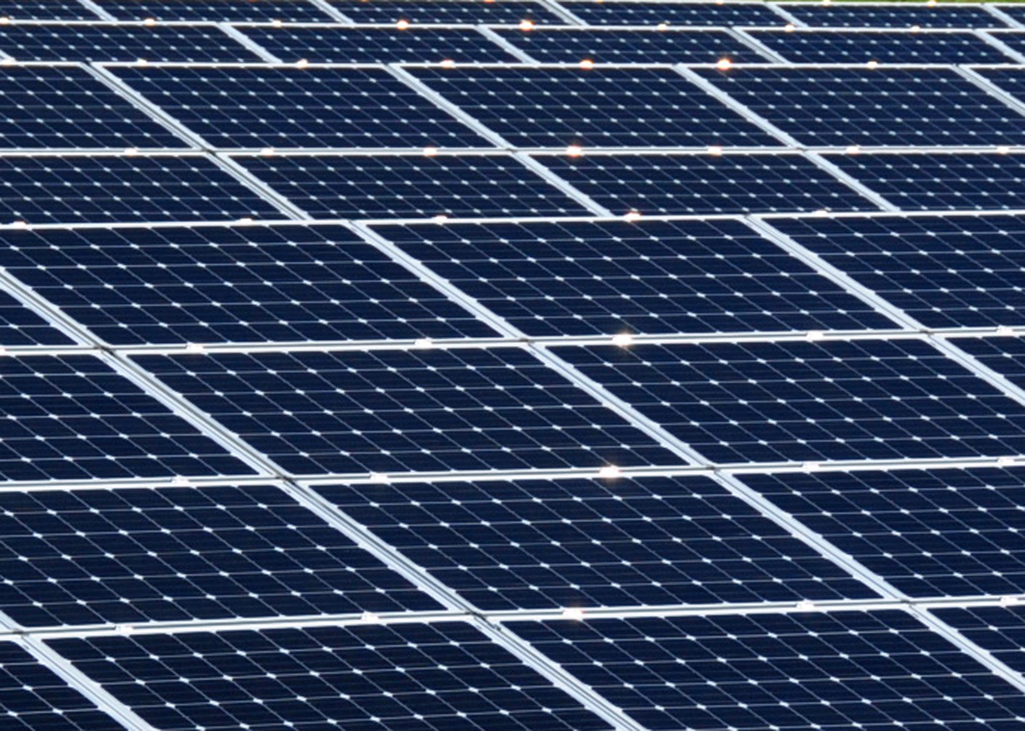
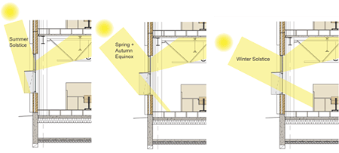
Through the late seventies, throughout the eighties, and into the early
nineties, much research was commissioned on energy efficient processes.
This research resulted in more effective solar panels, prefabricated efficient wall systems, water reclamations systems, modular construction units, and direct usage of light through windows in order to decrease day-time energy consumption. (2)

Slide 17
History of Green Building – Where are we Now? (2)
The concepts of building green and, on a larger scale, sustainability are ideas that we hear all of the time.
These two concepts, however, are rarely properly understood. “Sustainability is a systemic concept, relating to the continuity of economic, social, institutional and environmental aspects of human society, as well as the non-human environment. It is intended to be a means of configuring civilization and human activity so that society, its members and its economies are able to meet their needs and express their greatest potential in the present, while preserving biodiversity and natural ecosystems, and planning and acting for the ability to maintain these ideals for a very long time. Sustainability affects every level of organization, from the local neighborhood to the entire planet”. In short, the concept of sustainability refers to thinking holistically about how everything you do affects everything around you. It is an attempt to minimize each person’s impact on the world.

Slide 18
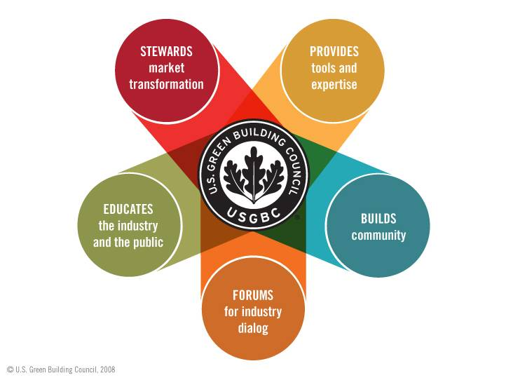
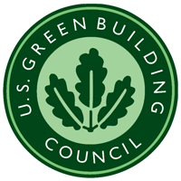
A standard needs to be established based on the research and the work that has been accomplished. (1)
The United States Green Build Council (USGBC) is the foremost leader and educator within the world of green building today.
They are the sanctioning body for LEED (Leadership in Energy and Environmental Design), the program with which points are awarded to various design applications within a building ultimately resulting in LEED certification for the building.

Slide 19
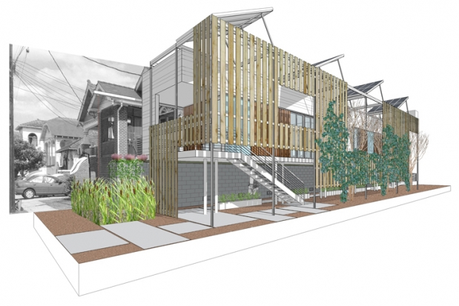
The USGBC was created to promote the design and construction of buildings that are environmentally responsible, profitable, and healthy places to live and work.
They are focused on integrating building industry sectors and leading a market transformation towards greener construction.
The organization consists of various trade associations, architects, designers, and individuals all interested in the greening of the construction business.

Slide 20
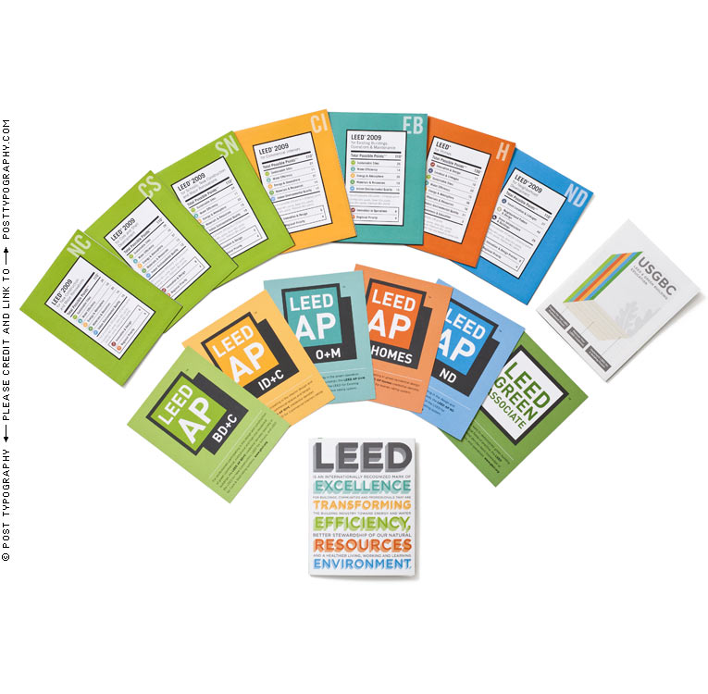
LEED (Leadership in Energy and Environmental Design) (4)
LEED is a green building certification program that recognizes best-in-class building strategies and practices.

Slide 21
To receive LEED certification, building projects satisfy prerequisites and earn points to achieve different levels of certification.
Prerequisites and credits differ for each rating system, and teams choose the best fit for their project.
LEED is flexible enough to apply to all project types. (4)
Each rating system groups requirements that address the unique needs of building and project types on their path towards LEED certification.
Once a project team chooses a rating system, they’ll use the appropriate credits to guide design and operational decisions.

Slide 22
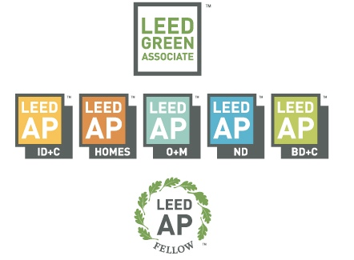
There are five rating systems that address multiple project types: (4)
Building Design and Construction
Interior Design and Construction
Building Operations and Maintenance
Neighborhood Development
Homes

Slide 23
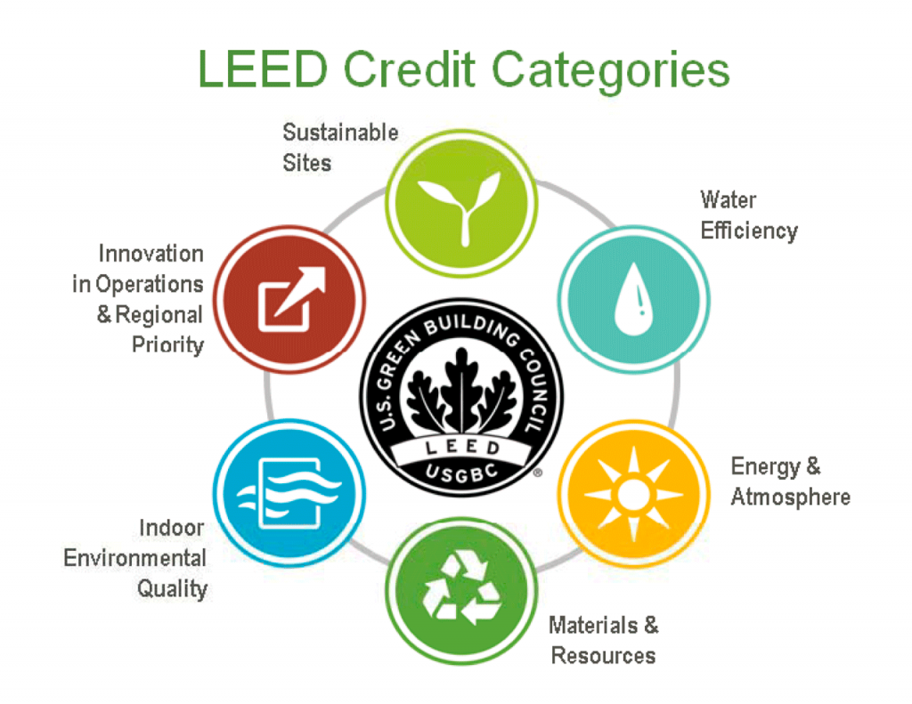
Each rating system is made up of a combination of credit categories.
Within each of the credit categories, there are specific prerequisites projects must satisfy and a variety of credits projects can pursue to earn points. The number of points the project earns determines its level of LEED certification. (4)

Slide 24
Integrative Process
requirements, while not a credit category, promote reaching across disciplines to incorporate diverse team members during the pre-design period.
Location and transportation
credits reward projects within relatively dense areas, near diverse uses, with access to a variety of transportation options, or on sites with development constraints.
Materials and Resources
credits encourage using sustainable building materials and reducing waste. Indoor environmental quality credits promote better indoor air quality and access to daylight and views.

Slide 25
Water efficiency
credits promote smarter use of water, inside and out, to reduce potable water consumption.
Energy and atmosphere
credits promote better building energy performance through innovative strategies.
Sustainable sites
credits encourage strategies that minimize the impact on ecosystems and water resources.

Slide 26
Indoor environmental quality
credits promote better indoor air quality and access to daylight and views.
Innovation
credits address sustainable building expertise as well as design measures not covered under the five LEED credit categories.
Regional priority credits
address regional environmental priorities for buildings in different geographic regions.

Slide 27
LEED for Neighborhood Development additional credit categories
Smart location & linkage
credits promote walkable neighborhoods with efficient transportation options and open space.
Neighborhood pattern & design
credits emphasize compact, walkable, vibrant, mixed-use neighborhoods with good connections to nearby communities.
Green infrastructure & buildings
credits reduce the environmental consequences of the construction and operation of buildings and infrastructure.

Slide 28
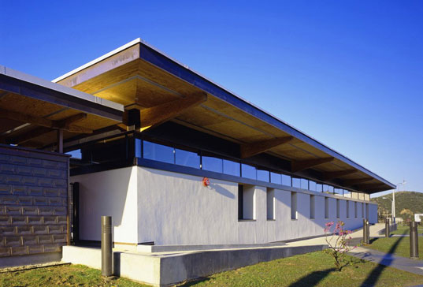
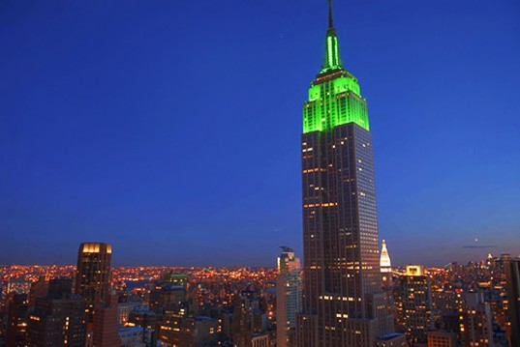
The number of points a project earns determines the level of LEED certification.
There are four levels of certification - the number of points a project earns determines the level of LEED certification that the project will receive. Typical certification thresholds are: (4)
PLATINUM
80+ Points
GOLD
60-79 Points
SILVER
50-59 Points
CERTIFIED
40-49 Points

Slide 29
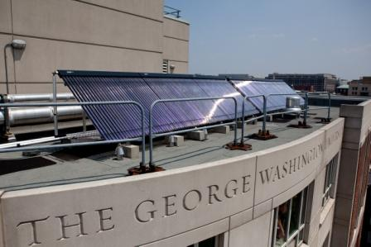
Solar Heating, Cooling, and Ventilation Systems
Solar heating & cooling (SHC) technologies collect the thermal energy from the sun and use this heat to provide hot water, space heating, cooling, and pool heating for residential, commercial, and industrial applications.
These technologies displace the need to use electricity or natural gas.
Today, Americans across the country are at work manufacturing and installing solar heating and cooling systems that significantly reduce our dependence on imported fuels. (5) http://www.seia.org/policy/solar-technology/solar-heating-cooling
A solar water heating system installed on the roof of George Washington University in Washington, DC.
(Photo courtesy of Skyline Innovations)

Slide 30
Solar Heating & Cooling Fast Facts (5)
Heating and Cooling systems can be powered by the electricity generated through photovoltaic panels.
Solar water heating systems are affordable for families. The return on investment can be as little as 3-6 years. Commercial systems help companies reduce and manage their energy bills, managing long-term costs. Meanwhile, fossil fuel prices fluctuate considerably and are expected to rise significantly over the next decade.
Water heating, space heating, and space cooling accounted for 72 percent of the energy used in an average household in the U.S. in 2010 ‐ representing a huge market potential for solar heating and cooling technologies!

Slide 31
Solar Heating & Cooling Fast Facts - Continued
In 2010, the U.S. saw 35,464 solar water heating systems and 29,540 solar pool heating systems installed, heating a total of more than 65,000 homes, businesses and pools.
Three out of four (74 percent) Americans agree, ‘the growth of the solar water heating industry will produce jobs and help the American economy.’
How Does SHC Work? (5)
SHC systems trap the heat from the sun (solar radiation) and transfer the heat to water or air for use as thermal energy.
While both SHC systems and solar photovoltaic (PV) systems involve collector panels , they are very different technologies.

Slide 32
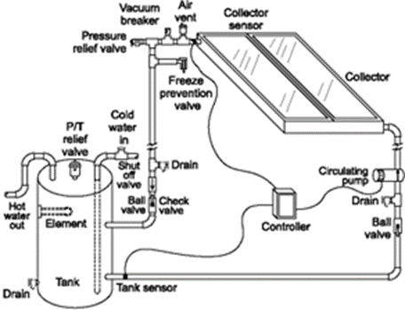
Solar water heating systems are composed of three main elements: the solar collector, insulated piping, and a hot water storage tank. While there are many design variations, essentially the solar collector gathers the heat from the sun and transfers the heat to potable water. This heated water flows out of the collector to a hot water tank, and is used as necessary. (5)

Slide 33
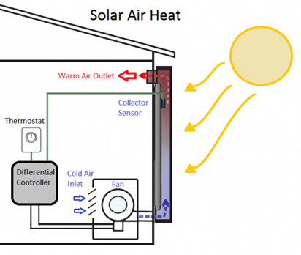
The Solar Air Heating System follows the same principals as the solar water heating system. The system captures air that has been heated by the sun and pumps it into the home as heated air. As that air cools it is captured back into the system and recycled through the collector to be reheated.
(5)

Slide 34
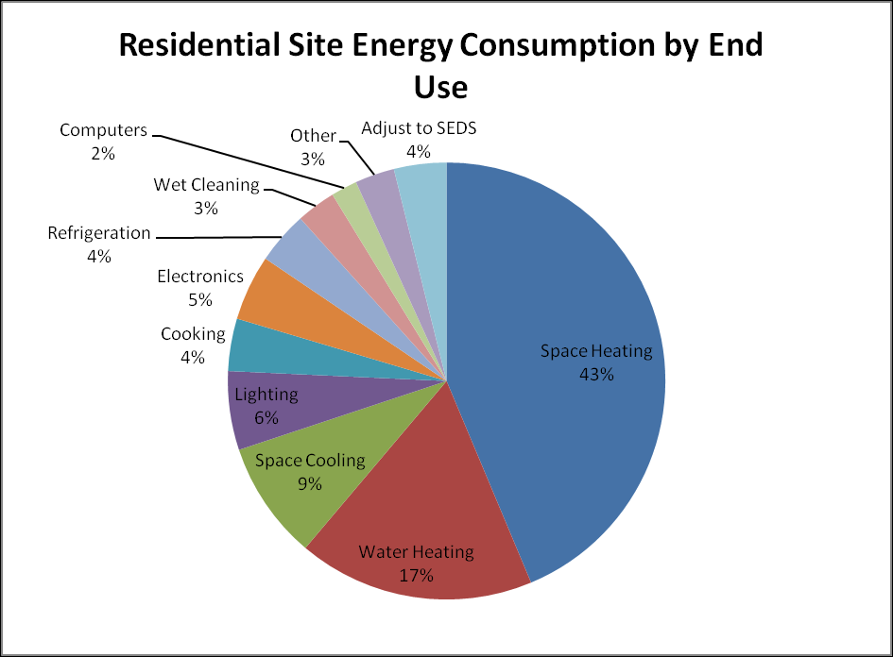
Why is the SHC important?
Water heating, space heating, and space cooling accounted for 72% of the energy used in an average household in the U.S. in 2010 ‐ representing a huge market potential for solar heating and cooling technologies! (5)
http://www.seia.org/research-resources/solar-heating-cooling-technology

Slide 35
Solar Cooling (5)
Solar energy can also be used to generate cool air.
There are two kinds of solar cooling systems: desiccant systems and absorption chiller systems.
In a desiccant system, air passes over a common desiccant or “drying material” such as silica gel to draw moisture from the air and make the air more comfortable. The desiccant is regenerated by using solar heat to dry it out.
Absorption chiller systems, the most common solar cooling systems, use solar water heating collectors and a thermal-chemical absorption process to produce air-conditioning without using electricity. The process is nearly identical to that of a refrigerator, only no compressor is used. Instead, the absorption cycle is driven by a heated fluid from the solar collector.

Slide 36
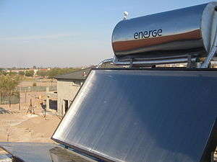
Solar thermal energy (STE) is a form of energy and a technology for harnessing solar energy to generate thermal energy or electrical energy for use in industry, and in the residential and commercial sectors. (5)
Roof-mounted close-coupled thermosiphon solar water heater.

Slide 37
Solar thermal collectors are classified by the United States Energy Information Administration as low-, medium-, or high-temperature collectors.
Low-temperature collectors are flat plates generally used to heat swimming pools.
Medium-temperature collectors are also usually flat plates but are used for heating water or air for residential and commercial use.
High-temperature collectors concentrate sunlight using mirrors or lenses and are generally used for fulfilling heat requirements up to 300 deg C / 20 bar pressure in industries, and for electric power production.

Slide 38
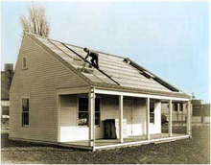
Systems for utilizing low-temperature solar thermal energy include:
means for heat collection;
usually heat storage, either short-term or interseasonal; and
distribution within a structure or a district heating network.
In some cases more than one of these functions is inherent to a single feature of the system (e.g. some kinds of solar collectors also store heat). Some systems are passive, others are active (requiring other external energy to function).

Slide 39
Low-temperature Collectors (5)
Glazed Solar Collectors are designed primarily for space heating and they recirculate building air through a solar air panel where the air is heated and then directed back into the building.
These solar space heating systems require at least two penetrations into the building and only perform when the air in the solar collector is warmer than the building room temperature.
Most glazed collectors are used in the residential sector.

Slide 40
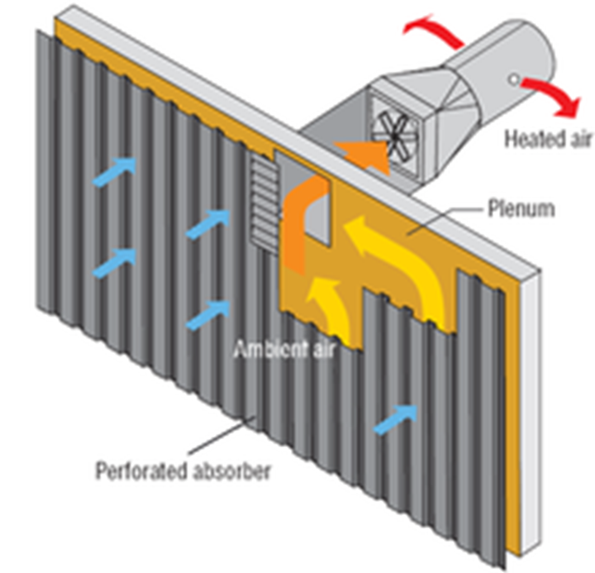
Unglazed Solar Collectors are primarily used to pre-heat make-up ventilation air in commercial, industrial and institutional buildings with a high ventilation load.
They turn building walls or sections of walls into low cost, high performance, unglazed solar collectors.
Also called, "transpired solar panels", they employ a painted perforated metal solar heat absorber that also serves as the exterior wall surface of the building.

Slide 41
Unglazed Solar Collectors – Continued
Heat conducts from the absorber surface to the thermal boundary layer of air 1 mm thick on the outside of the absorber and to air that passes behind the absorber.
The boundary layer of air is drawn into a nearby perforation before the heat can escape by convection to the outside air.
The heated air is then drawn from behind the absorber plate into the building's ventilation system.

Slide 42
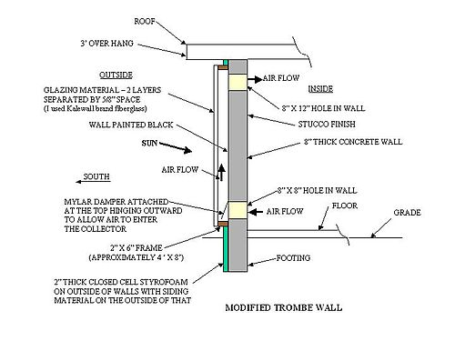
A Trombe wall is a passive solar heating and ventilation system consisting of an air channel sandwiched between a window and a sun-facing thermal mass.
During the ventilation cycle, sunlight stores heat in the thermal mass and warms the air channel causing circulation through vents at the top and bottom of the wall.
During the heating cycle the Trombe wall radiates stored heat

Slide 43
Solar-driven cooling
Is a niche market because the economics are challenging, with the annual number of cooling hours a limiting factor.
Respectively, the annual cooling hours are roughly 1000 in the Mediterranean, 2500 in Southeast Asia, and only 50 to 200 in Central Europe. However, system construction costs dropped about 50% between 2007 and 2011.
The International Energy Agency (IEA) Solar Heating and Cooling program (IEA-SHC) task groups working on further development of the technologies involved. The International Energy Agency (IEA) Solar Heating and Cooling program (IEA-SHC) task groups working on further development of the technologies involved.

Slide 44
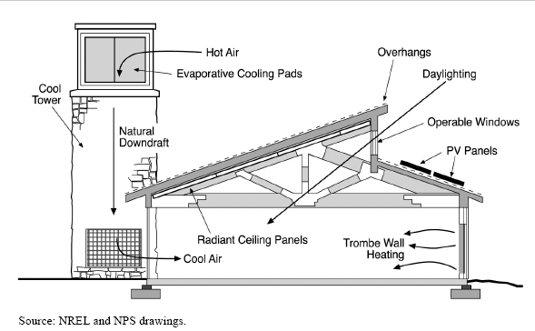
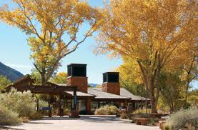
Solar Heat-driven Ventilation
A solar chimney (or thermal chimney) is a passive solar ventilation system composed of a hollow thermal mass connecting the interior and exterior of a building.
As the chimney warms, the air inside is heated causing an updraft that pulls air through the building.
These systems have been in use since Roman times and remain common in the Middle East. (6)
Zion National Park Visitors Center, Solar Chimneys

Slide 45
Medium-temperature Collectors
These collectors could be used to produce approximately 50% and more of the hot water needed for residential and commercial use in the United States.
In the United States, a typical system costs $4000–$6000 retail ($1400 to $2200 wholesale for the materials) and 30% of the system qualifies for a federal tax credit + additional state credit exists in about half of the states.
Solar thermal energy can be useful for drying wood for construction and wood fuels such as wood chips for combustion.
Solar is also used for food products such as fruits, grains, and fish. Crop drying by solar means is environmentally friendly as well as cost effective while improving the quality. The less money it takes to make a product, the less it can be sold for,

Slide 46
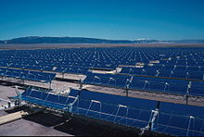
High-temperature Collectors
The efficiency of heat engines increases with the temperature of the heat source.
To achieve this in solar thermal energy plants, solar radiation is concentrated by mirrors or lenses to obtain higher temperatures – a technique called Concentrated Solar Power (CSP).
The practical effect of high efficiencies is to reduce the plant's collector size and total land use per unit power generated, reducing the environmental impacts of a power plant as well as its expense.

Slide 47
Of the three heating techniques identified here the low and medium techniques are most practical to be used in a residential and small commercial green building projects.
As explained above each of these systems can be used to heat, cool and ventilate a building. By using these techniques the green builder can address the concerns about sustainability and the environment expressed through the LEED program.
"When we tug at a single thing in nature, we find it attached to the rest of the world."
John Muir

Slide 48
References:
http://en.wikipedia.org/wiki/Green_building
How Building Green Got Its Start, written by: Bstone • edited by: Laurie Patsalides • updated: 5/2/2011
http://www.brighthub.com/environment/green-living/articles/51601.aspx
http://www.usgbc.org/leed
http://www.seia.org/policy/solar-technology/solar-heating-cooling
http://commons.wikimedia.org/wiki/File:Zion_Visitors_Center_Cool_Tower.PNG

