Slide 1
History of Horseshoeing
Matt McMillan, Ph.D.

Slide 2
History
Who is credited with making the first horseshoes?
  Egyptians and Persians
What were they made of?
  Woven Grass
  Sandals that were tied on to the hoof
  Still seen in some parts of remote Japan
    Called Waraji

Slide 3
Waraji Woven Grass Sandal

Slide 4
History
Egyptians
  Used animal skins
Genghis Khan – Mongolia – 12th Century
  Rawhide cups for cavalry horses
Where were the first metal horseshoes with nails originated?
  China
Middle East
  Wide, thin shoes used for centuries to move across desert

Slide 5
History
Greeks and Romans
  Also used sandals
Romans invented “hipposandal” 400 BC
  Iron sole fastened with leather
Shoes with nails not known until
  After 400 AD
  Not widely used until after 1000 AD

Slide 6
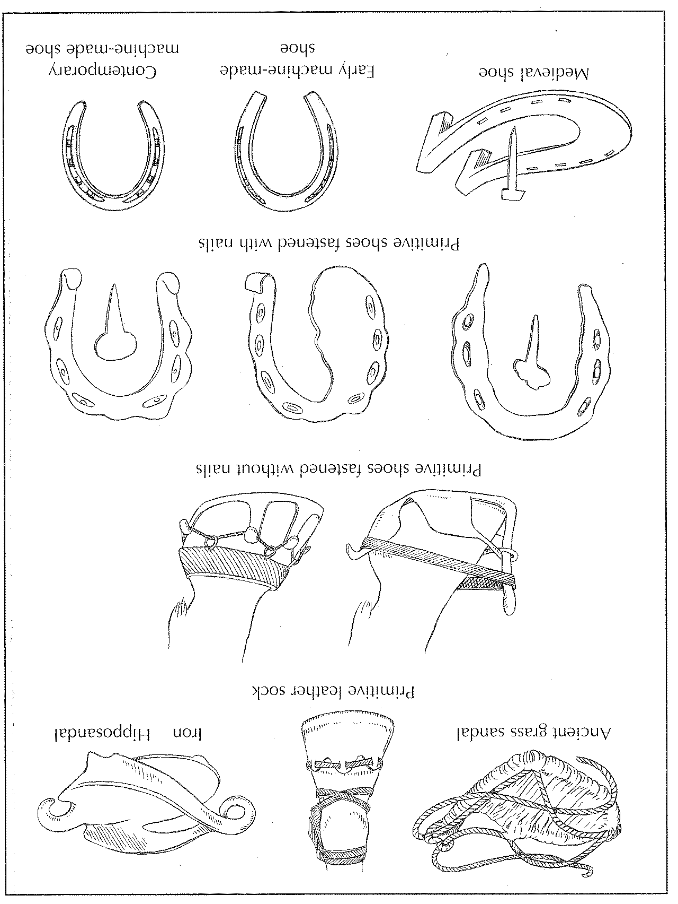

Slide 7
History
Latin word ferraius means
  Ironworker
French word ferrer means
  To shoe a horse
William the Conqueror credited with
  Introducing shoes with nails
  France to GB in 1066 AD

Slide 8
History
  Walkelin von Ferrariis
    Commissioned by William
    “Master of the Horse”
  Farrier became a title in England
  The Worshipful Company of Farriers (WCF)
    First guilds organized in London
    In existence since 1356

Slide 9
History
  Farrier’s Registration Act of 1975
    Prohibits shoeing of horses by unqualified persons in UK
  Examinations given by WCF at 3 levels
    DWCF or Diploma Exam given after
      4 years apprenticeship
      27 weeks national farrier school

Slide 10
History
AWCF or associate exam given to
  Those interested in therapeutic farriery
FWCF or fellowship exam given to
  Those interested in :
    Judging competitions
    Giving examinations
    Teaching craft

Slide 11
History
  Also Required for fellowship exam
    Fellowship thesis
    shoe collection
    Extemporaneous lecture
    Questioning period
    Shoe making exam

Slide 12
History
First farrier books began ~16th Century
Blundeville 1566
  “Fit the shoe to the foot, not the foot to the shoe”
Solleysel 1664
  Described the use of clips
  Signs of lameness

Slide 13
History
Bridges 1751
  Described the elastic mechanism of the foot
  Said to have originated:
    No foot, No horse
Farriery on the continent of Europe
  Considered a 2 man job
  Still done this way in some areas

Slide 14
History
America’s heritage comes from GB
  One person works under the horse
1834 Henry Burden
  Patented a horseshoe making machine
1857 machine was capable of
  Making 1 shoe per second

Slide 15
History
1848 Daniel Dodge
  patented horseshoe nail making machine
  Perfected 1862
1881 George Capewell
  established horse-nail company
By late 19th century
  Shoes, nails, and tools could all be bought ready made

Slide 16
History
First machine-made shoes
  Manufactured with long heel pattern
Military
  Ready made cold shoe a necessity
  No Forge
  Most military horses were shod cold

Slide 17
History
Horse populations in US
  1915 21.5 million
  1960 2.5 million
  2000 7.5 million
Today more people own fewer horses
Professional care of horses is
  In high demand

Slide 18
History
Farrier Education in US
  No organized educational system
  No legislated requirement or registration
American Farrier Association (AFA)
  Established 1971
  Offered voluntary certification since 1979

Slide 19
History
Highest Level American Exam
  Certified Journeyman Farrier (CJF)
  Equivalent to entry level British Exam
    Diploma of the Worshipful Company of Farriers
Horseshoeing Schools
  Early 20th Century
    US Army in Fort Riley, KS
Many Schools Nation wide today

