Slide 1
Equine Nutrition
Feeding Practices, Socialization,
Parasites, and Teeth

Slide 2
General Horse Feeding Practices
Water Feeding:
  Before and during prolonged exercise
    Should be allowed to consume at will
  Following Exercise
    Should be cooled down before allowing to drink
  Over consumption of water while horse is hot
    May cause colic or laminitis
  All other times
    adequate quantities is important

Slide 3
General Horse Feeding Practices
Water Feeding:
  Whether the horse drinks before or after feeding does not affect
    Feed digestibility
    Will effect intake
  Thirsty horses will reduce feed intake

Slide 4
General Horse Feeding Practices
Forage Feeding:
  What are the two feeds required for life by all horses in all situations
    Forage and water
  Ad-libitum of both is generally ideal
    Except for the overweight horse
  Why is forage required?
    For fiber
  Digestible fiber is used for
    Energy

Slide 5
General Horse Feeding Practices
Forage Feeding:
  Indigestible fiber is required for the maintenance of normal gastrointestinal:
    pH
    Motility
    Function
Also helps prevent too rapid of an intake

Slide 6
General Horse Feeding Practices
Forage Feeding:
  Idle horses have been maintained at .5% BW/d with
    Remainder of the energy needs provided in grain
    However, chances of colic were increased
  General rule of thumb:
    Feed at least 1% BW/d in forage
  Inadequate forage can not only lead to
    Digestive upsets
    Vices

Slide 7
General Horse Feeding Practices
Forages should be fed in a manner that minimizes:
  Forage losses
  Forage fecal contamination
    (↑internal parasites)
  Dust inhalation
To achieve this:
  Harvested feeds should be fed in hay racks

Slide 8
General Horse Feeding Practices
Forage Feeding:
  Feed losses are considerably higher when
    Feed is consumed on the ground rather than
    In a rack or manger

Slide 9
General Horse Feeding Practices
Grain Feeding:
  Grains are to be fed when:
    Energy needs cannot be provided by feeding forages alone
    Forages are poorly available
    Desired for other reasons
      Example: to catch

Slide 10
General Horse Feeding Practices
Grain Feeding:
  Grains and forages are generally fed at the same time
  Most horses will consume which first?
    Grain
  Grains should be fed in a feeder
  Feed by weight, not by volume!!!!!!

Slide 11
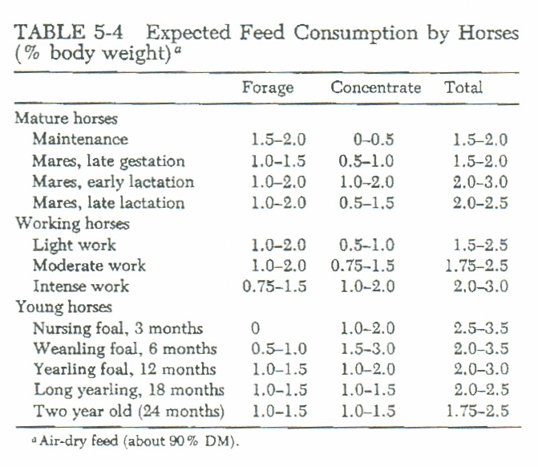
General Horse Feeding Practices

Slide 12
General Horse Feeding Practices
Feeding Frequency:
  Horse’s stomach comprises
    ~7% of the entire G.I. tract
  Horses spend what percent of their time grazing?
    50 to 70%
  When feeding grain
    Should be fed 2 to 3 times/d
  More grain fed at one time ↑ chances of
    Grain overload

Slide 13
General Horse Feeding Practices
Summary:
It is recommended that all feeds be fed to all horses:
  In equally divided amounts
  As near the same time each day
  At least twice daily

Slide 14
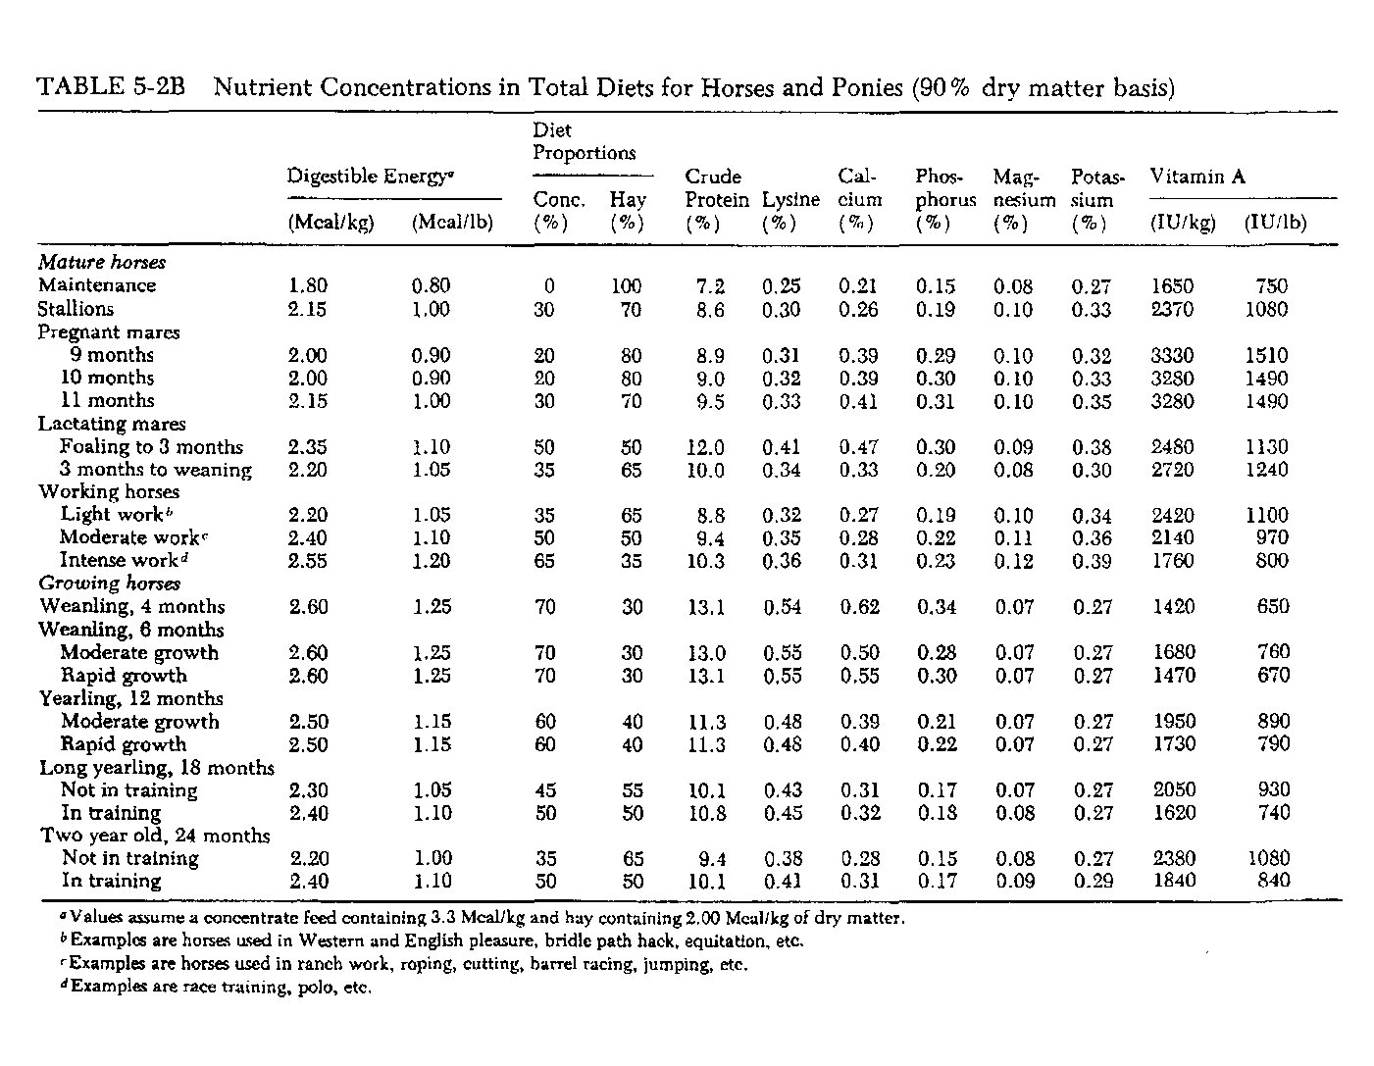

Slide 15
Monitoring Horses’ Nutritional Status
Nutritional and health status should be observed
  1 – 2 times daily
Observed for:
  Injuries
  Attitude
  Feeding behavior
    including: appetite, eagerness to eat, and amount consumed

Slide 16
Monitoring Horses’ Nutritional Status
Common causes of poor intake:
  Sore tongue or bad teeth
  Moldy or contaminated feeds
Any signs of reduced intake should
  Warrant concern
Any signs of abnormal feces should also
  Cause concern

Slide 17
Group Socialization and Feeding
Horses are very gregarious
Dominance hierarchies are present
This is important to manage when feeding in groups
Feeders should be spaced accordingly and
  Plenty of bunk space should be available
Aggressive horses may have to be separated

Slide 18
Changing Diets
Should be changed gradually
Increasing feed should be changed slowly
When feed is changed, initial intake may go down
  Does not mean the feed is bad or
  Only that the horse is not accustomed
Horses under strenuous exercise may need grain reduced on days off

Slide 19
Internal Parasites
One of the most costly and harmful disease problems
We are most concerned about:
  Large and small strongyles
  Ascarids
  Bots
  Pinworms
  Threadworms (only in foals)

Slide 20
Internal Parasites
Effect digestibility of feed
Cause damage to G.I tract effecting lifelong absorption of nutrients
Can cause colic or potential blockage
Rob nutrients

Slide 21
Internal Parasites
Should be treated every 30 to 60 d with anthelmintics
Four aspects important for the control of internal parasites:
  Choice and rotation of de-wormer or anthelmintic
  De-wormer administration schedule
  Non-dewormer management practices
  Monitoring schedule so the program can be modified

Slide 22
Teeth
Proper dental care is necessary
Horses teeth never stop growing
Chew in a circular fashion
This can cause sharp angles on the teeth
Reduced chewing may lead to colic
Also reduced feed intake

Slide 23
Teeth
Floating is necessary
Teeth should be checked every six months in young horses and annually in aged horses
Some horses may have underbites or overbites
These can be improved or corrected by initiating bite plates at an early age

