Slide 1
Equine Nutrition
General Feeding Practices
Colic

Slide 2
Water
How Much Water Should a Horse Receive?
  At rest at moderate environment eating dry forage:
    0.3 to 0.8 gal/100 lbs BW
  Amount of water needed varies with what?
    Amount, type, and quality of feed consumed
    Ambient temperature and humidity
    Health
    Physical Activity

Slide 3
Water
  How does palatability effect consumption?
  How does diet effect consumption?
  How does stage of life and level of activity effect consumption?
  How much may consumption ↑ with work at high temperatures?
    300 – 400%
    Moderate Work
      60 – 80%
    Hard Work
      120%

Slide 4
Water
  Can water always be fed free choice?
    Before & During Exercise?
      At will
    After Exercise?
      Should be cooled down
      Over consumption may cause colic or laminitis
    All other times?
      At will

Slide 5
Water
Does consumption of water effect digestibility?
  No
  May drink before or after feeding, but will not effect digestibility
What will effect intake?
Thirst

Slide 6
Forage
What are the two feeds required for life by all horses in all situations
    Forage and water
  Ad-libitum of both is generally ideal
    Except for the overweight horse
  Why is forage required?
    For fiber
  Digestible fiber is used for
    Energy

Slide 7
Forage
Are there requirements for indigestible fiber?
  Maintenance of normal gastrointestinal:
    pH
    Motility
    Function
  Also helps prevent too rapid of an intake

Slide 8
Forage
How much forage does a horse require daily?
  Idle horses have been maintained at .5% BW/d with
    Remainder of the energy needs provided in grain
    However, chances of colic were increased
  What is the general rule of thumb?
    Feed at least 1% BW/d in forage
  What does inadequate forage intake lead to?
    Digestive upsets
    Vices

Slide 9
Forage
How should forages be fed?
  In an way to ↓Forage losses
    Forage fecal contamination
      (↑internal parasites)
    Dust inhalation
  Harvested feeds should be fed in hay racks

Slide 10
Grain
When do you feed grain?
    When energy needs cannot be provided by feeding forages alone
    When forages are poorly available
    Other reasons
      To catch

Slide 11
Grain
Grains and forages are generally fed at the same time
Most horses will consume which first?
  Grain
Grains should be fed in a feeder
Feed by weight, not by volume!!!!!!

Slide 12
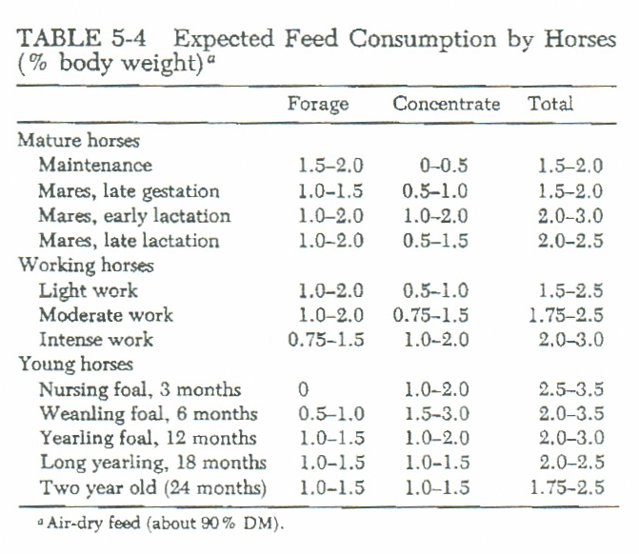
General Horse Feeding Practices

Slide 13
Grain
Feeding Frequency:
  Horse’s stomach comprises
    ~7% of the entire G.I. tract
  Horses spend what percent of their time grazing?
    50 to 70%
  When feeding grain
    Should be fed 2 to 3 times/d
  More grain fed at one time ↑ chances of
    Grain overload

Slide 14
Grain
Recommended that all feeds be fed:
  In equally divided amounts
  As near the same time each day
  At least twice daily

Slide 15
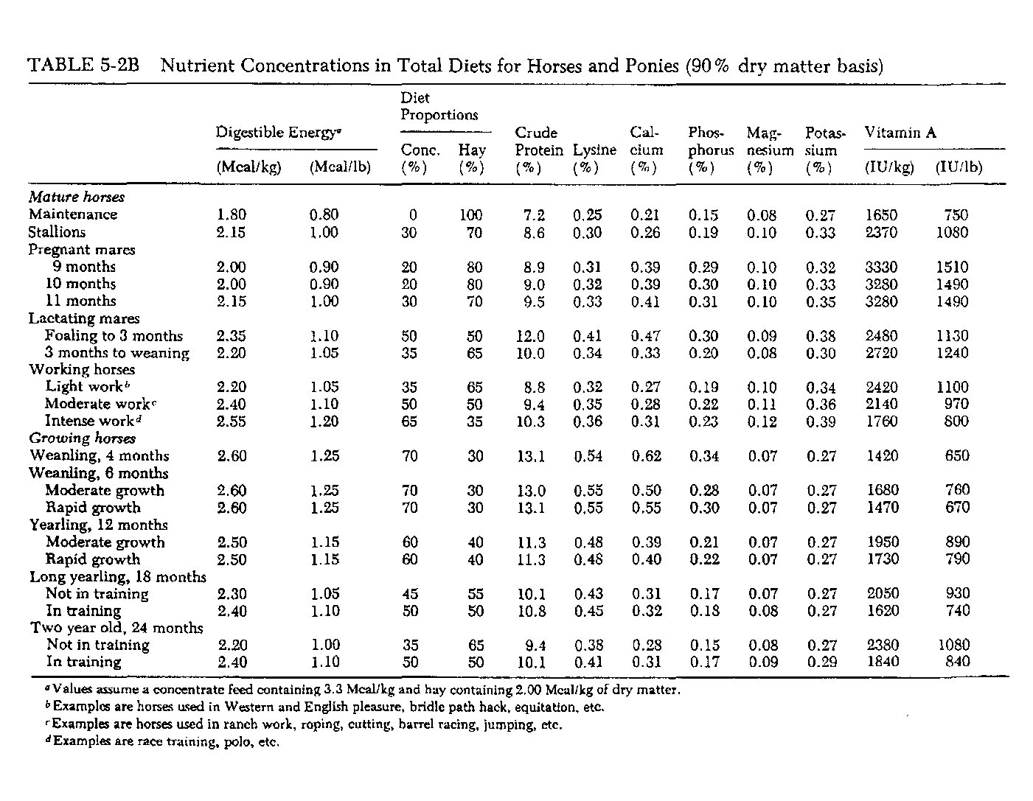

Slide 16
Changing Diets
Changed gradually
Increasing feed, changed slowly
When feed is changed, initial intake may go down
  Does not mean the feed is bad or
  Only that the horse is not accustomed
Horses under strenuous exercise may need grain reduced on days off

Slide 17
Other Considerations
Teeth
Internal Parasites

Slide 18
What Causes Colic?
Stall Confinement for more than
  15 hours per day
Feeding Large Amounts of Grain
  (> 12 lbs per day)
Participation in intensive exercise
Feeding grain before hay after a “fast”

Slide 19
Common Colic Causes
Dehydration
  Water
  Salt
  Minerals (especially electrolytes)
Inadequate Forage Quality
  Too High or Too Low
Inadequate Forage Quantity

Slide 20
So How Do We Prevent Colic?
Provide plenty of good, clean, fresh water
Provide adequate forage
  Quantity and Quality
If feeding > 5 lbs/day
  Break into multiple feeding times

Slide 21
Cellulolytic Bacteria
Regular
  De-worming
  Vaccinating
  Teeth floating
>90% of digestive upsets are due to what?
  Feed management rather than feed source!!!!!!
Very important to the health of the horse?
  Extremely Particular
  Must keep happy

Slide 22

If You Keep The Bugs Happy
You Keep The Horse Happy

Slide 23
What Makes Happy Bugs?
Lots of Water
Fermentable Food, Especially Fiber
Consistency
  Temperature
  Food source
  pH
Release of Waste Products

Slide 24
How Do We Keep Bugs Happy?
Match Feeding Program To Natural Function Of Horse’s Gut
May also use Fermentation Aids
  Yeast Cultures
  Ammonia Scavengers (yucca)
  Probiotic Cultures
  Pathogen Scavengers

Slide 25
(%)

Slide 26
Effect of Digestion Aids on
Mare’s Milk Composition
g/100 g or head/10 g milk

Slide 27
Effect of Digestive Aids on Bone Growth
Height at withers (cm)
Days of Age

Slide 28
Yucca
Excessive protein converted to
  Ammonia in L.I.
  Ammonia toxic
Yucca can bind ammonia
  Can conserves critical amounts of water and electrolytes

Slide 29
Probiotic Cultures
Introduce highly beneficial bacteria to
  Fermentation vat
    Improves ecology of fermentation process
    Increases overall digestibility
    Reduces susceptibility to pathogenic bacteria

Slide 30
Pathogen Scavengers
Mannan-Oligossacharides
  Bind certain pathogenic bacteria and mycotoxins:
    E. Coli and Salmonella
    Prevents infection of intestinal mucosa
  Used successfully in treatment of
    Colitis in both human and equine medicine
    Also used to treat ulcers and colics

Slide 31
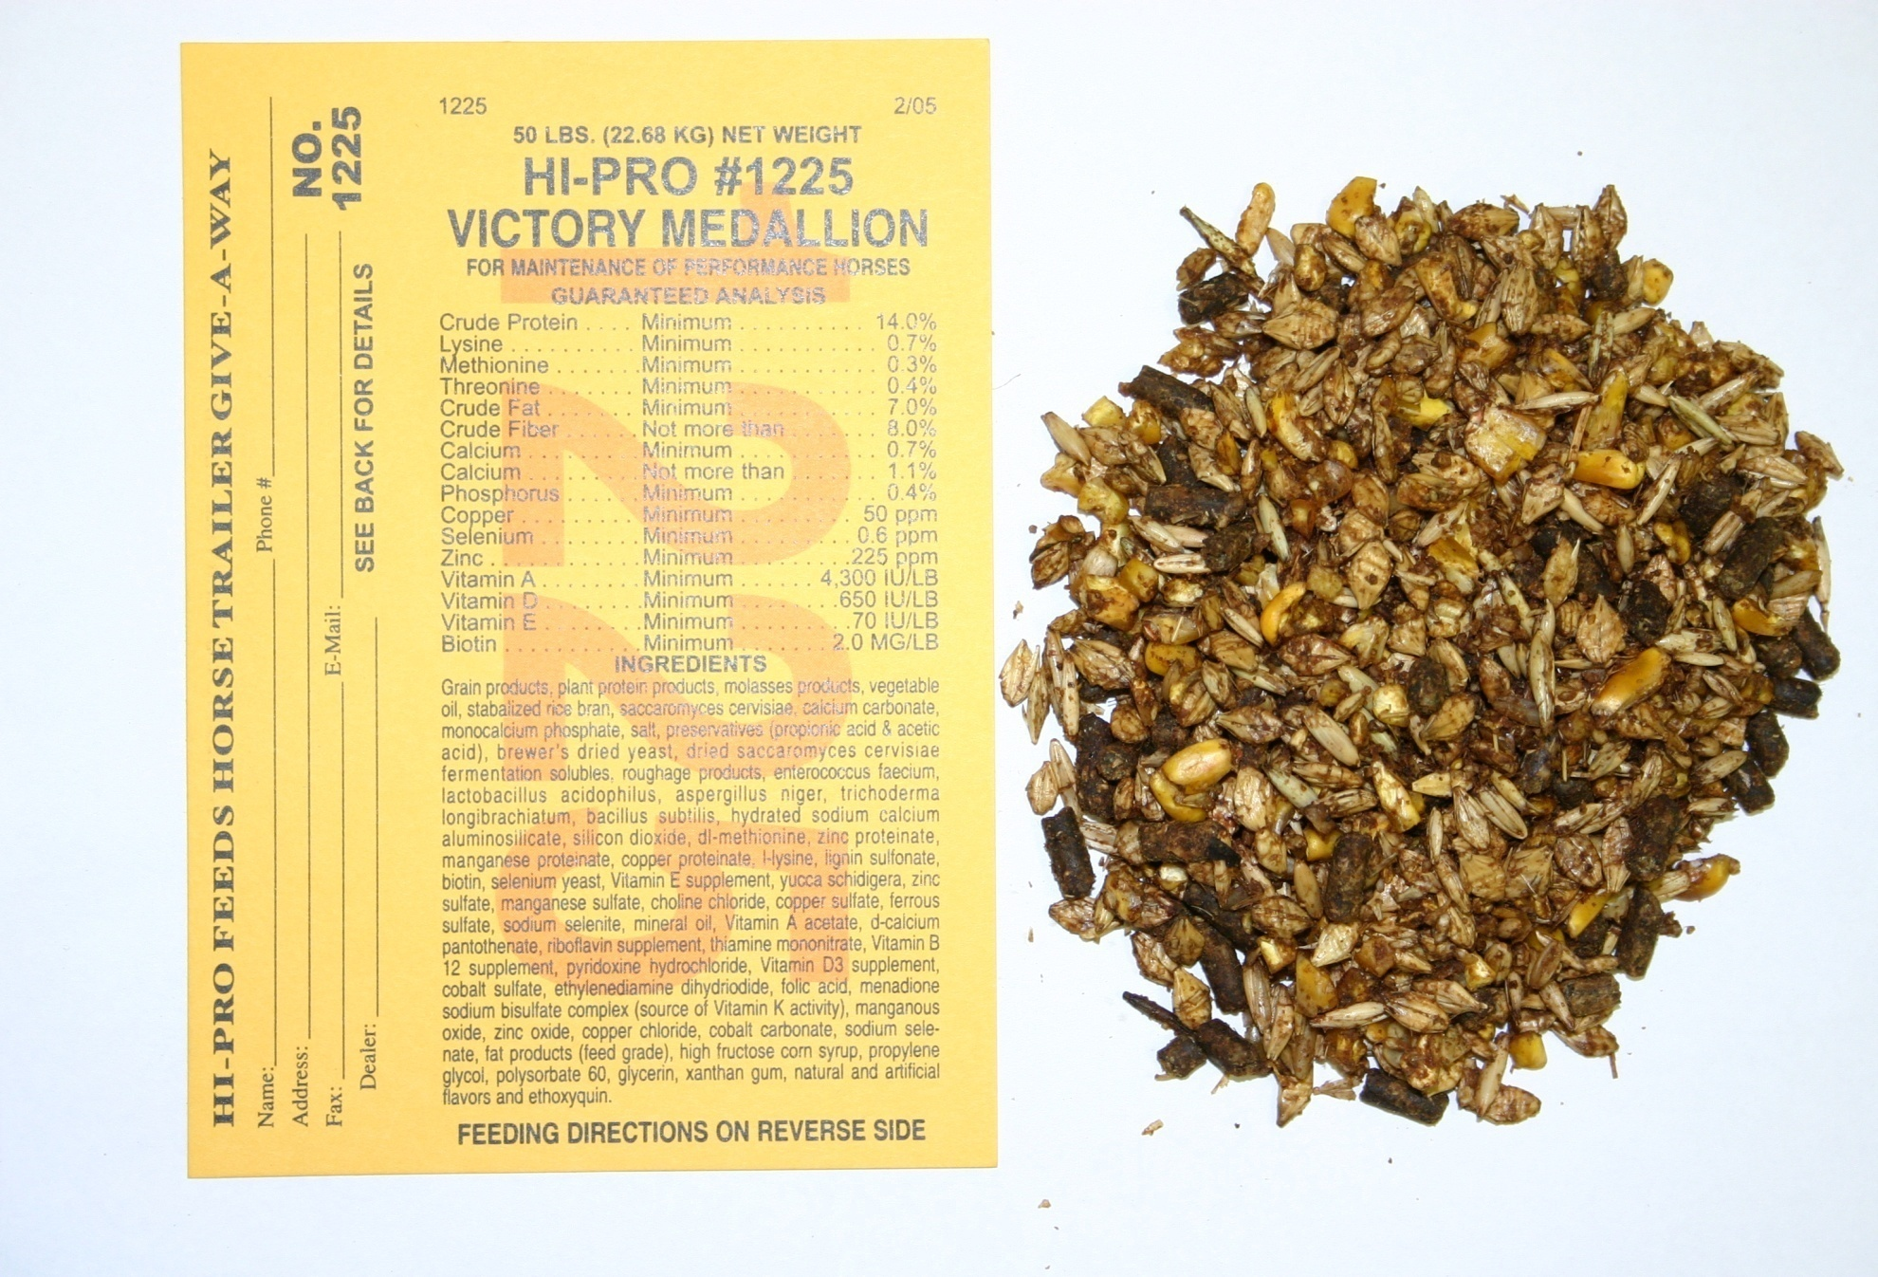

Slide 32
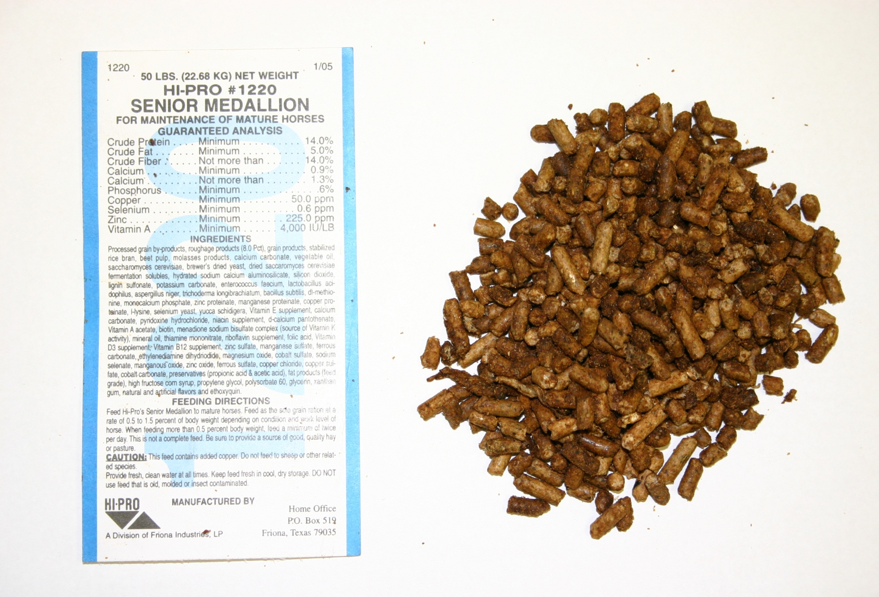

Slide 33
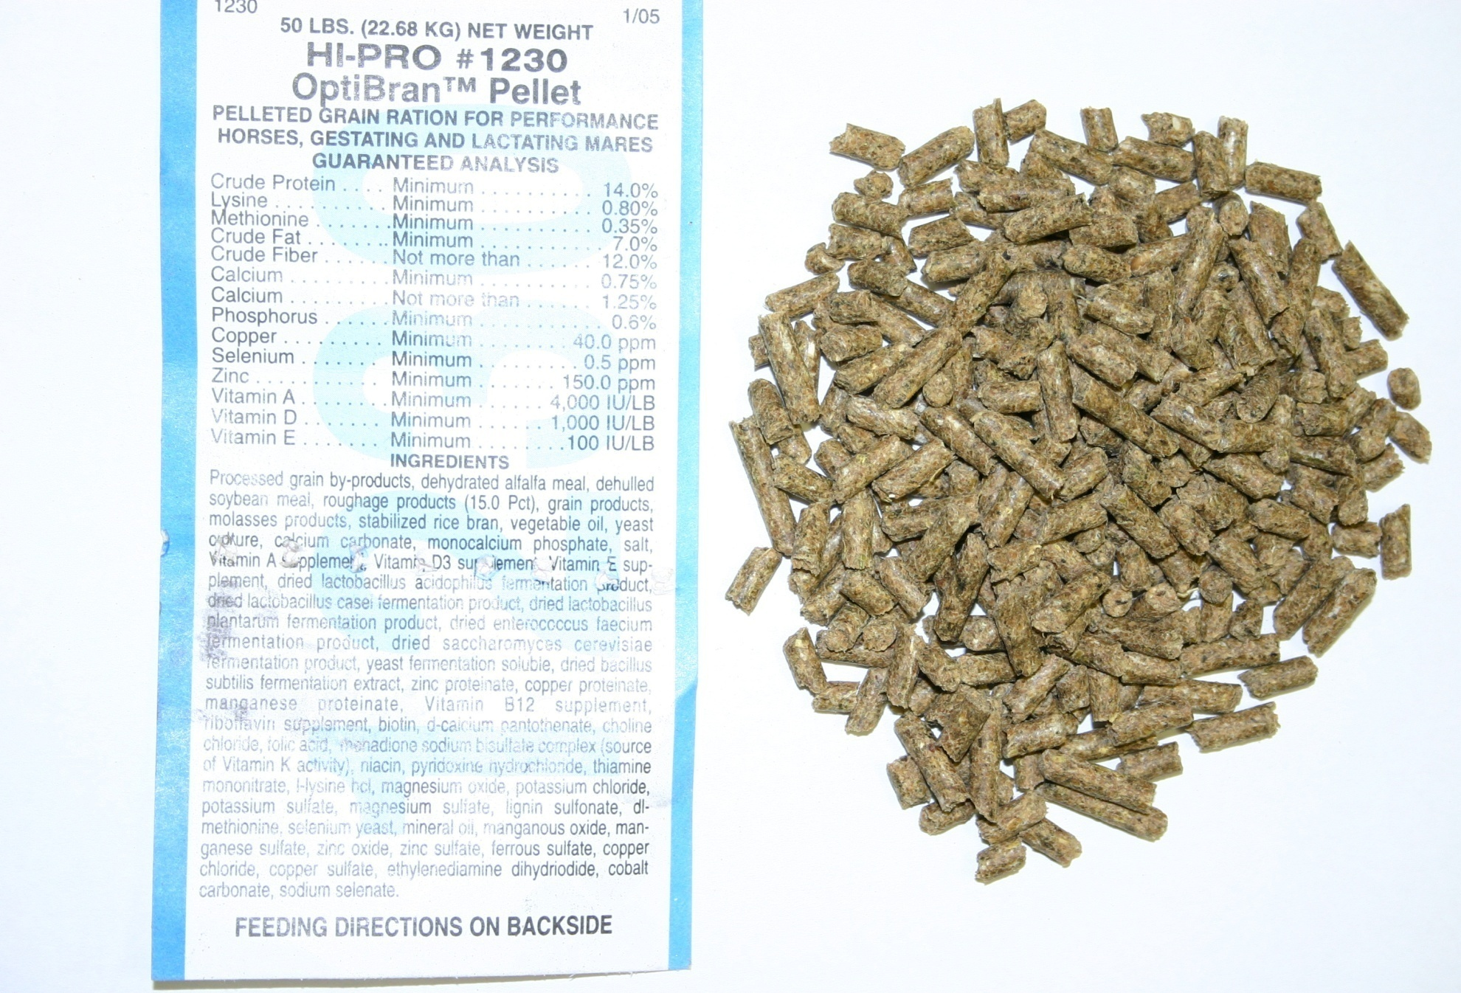

Slide 34
Practical Guidelines
Feed & Treat Horses Like Horses!
Feed as much good quality forage as possible
  Helps to increase gut water and pH
Get as much water into them as possible
Be as consistent as possible
  In quantity and quality

