Slide 1
Careers in Horticulture

Slide 2
Careers
Education
Research
Golf and Sports Turf
Landscape Design
Parks & Gardens
Sales & Marketing
Owner & Entrepreneurship

Slide 3
Education
Teach on the High School or Collegiate level
Plant Science
Floral Design
Fruit and Vegetable
Production
Greenhouse Management
Salary $42,000

Slide 4
Research
Work with a seed company on producing the latest crops for farmers in the food industry
Monsanto
Genetically Modified Organisms
Round-Up Ready Crops

Slide 5
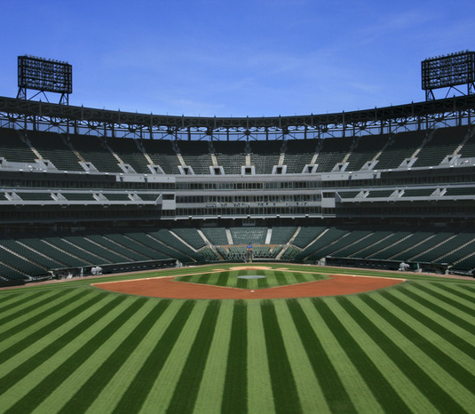
Golf and Sports Turf
Manage major athletic fields
Maintain golf course
Salary $44,000

Slide 6
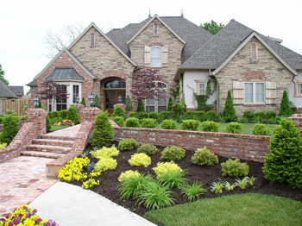
Landscape Design
Design concepts seen through to installation
Residential
Commercial
Design
Install
Salary $23,000
With Exp. $57,000

Slide 7
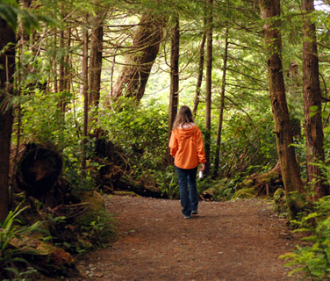
Parks and Gardens
Restore and Maintain public parks and gardens

Slide 8
Sales and Marketing
Work with or work for a nursery or wholesaler
Duties possibly include:
Selling products to flower shops or other retailers
Marketing those items as an employee

Slide 9
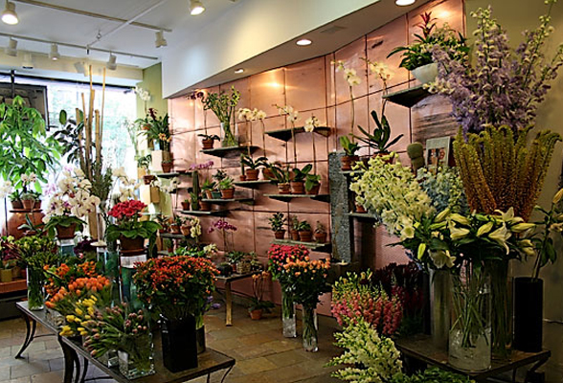
Owner & Entrepreneurship
BE YOUR OWN BOSS!
Not impossible, but rarely happens successfully without experience.
Landscape Design
Designer
Floral Shop
Golf Management
Public Garden
Nursery

