Slide 1
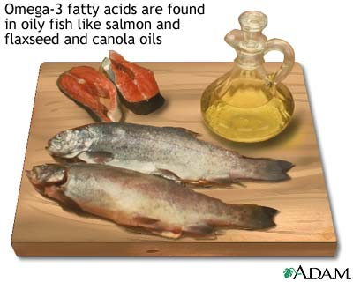
Fats and Fatty Acids
Equine Nutrition AGR 479/564

Slide 2
Introduction
Why are fats or oils used in equine diets?
To increase in energy density
Substitute energy for CHO’s
However, even more so
Improved energetic efficiency
Enhanced BC
Diminished excitability

Slide 3
INtroduction
What are other benefits to fat?
Carriers for A,D,E, and K
Supply essential fatty acid
Linoleic
α – Linolenic
How are fatty acids designated?
By the number of C atoms they contain
Number of double bonds present

Slide 4
Introduction
Long chain fatty acids contain
16 to 20 C
Medium chain fatty acids contain
6 to 10 C
Short Chain or VFA’s
2 to 5 C
Saturated fatty acids contain how many double bonds?
Zero

Slide 5
Introduction
How many double bonds does a monounsaturated fatty acids contain?
One
Polyunsaturated Fatty Acid?
Two or more
How are fatty acids further described?
Position of the first double bond relative to the methyl end of the molecule
Examples: Omega 6 and 3 Fatty Acids

Slide 6
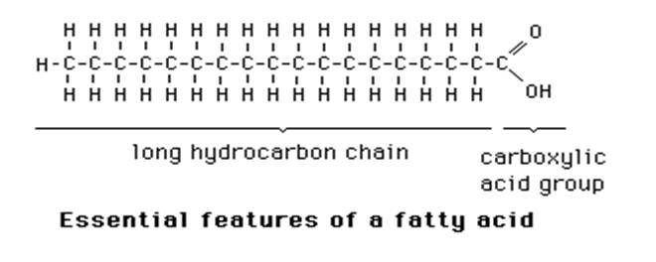
Fatty Acids
What type of fatty acid?
Long Chain Saturated Fatty Acid
Stearic Acid

Slide 7
Fatty Acids
What type of fatty acid?
Long Chain Monounsaturated Fatty Acid
Oleic Acid

Slide 8
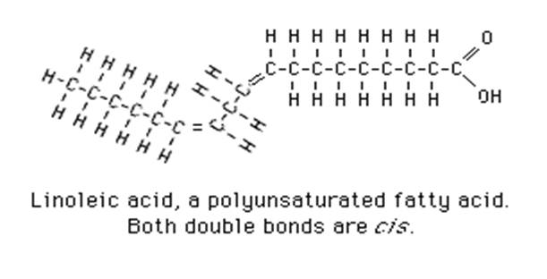
Fatty acids
What type of fatty acid?
Omega 6 or Omega 3?
Long Chain Polyunsaturated Fatty Acid

Slide 9
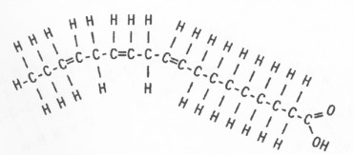
Fatty Acids
What type of Fatty Acid?
Omega 6 or Omega 3?
Long Chain Polyunsaturated Fatty Acid
Omega 3 Fatty Acid
α – Linolenic

Slide 10
Sources of Dietary Fat
Both animal and vegetable fats have been fed
Vegetable sources have been more commonly fed, Why?
More palatable
Cheaper
What are some examples of vegetable fat that is fed?
Corn Oil – known to be most palatable
Soybean Oil – probably most commonly used
Canola Oil (High in Omega 3’s)
Flax oil (High in Omega 3’s)
Sunflower, Safflower, Coconut, Peanut
Stabilized Rice Bran

Slide 11
Sources of Dietary Fat
Examples of Animal Sources:
Fish Oil – menhaden
Higher in Omega 3 FA
Generally less palatable
Beef Fat – no longer used

Slide 12
Fat Digestibility
Does added fat decrease fiber digestion
In cattle – yes
In horse – no
Why?
Recent research has found that fiber digestion will not be affected when up to 15% total fat is added to the diet

Slide 13
Metabolic Responses to Exercise
Fat supplementation has found increased stamina in low intensity workouts
This was not true at high intensities
Metabolic change must occur for high fat diets to become effective
3-5 weeks

Slide 14
Athletic performance
Hypotheses of increased performance due to fat supplementation include:
↓ metabolic heat
Enhanced stamina due to muscle glycogen sparing
Faster race performance times
Results are controversial
Behavior
Some research has eluded that fat supplementation may reduce excitability

Slide 15
Essential fatty Acids
Linoleic Acid and α – Linolenic
Both Polyunsaturated Fatty Acids
Linoleic Acid: Omega 6 Fatty Acid
α – Linolenic: Omega 3 Fatty Acid
Both are essential in the diet
Examples of Fats rich in Omega 6’s include:
Soy, corn, sunflower, safflower
Examples of Fats rich in Omega 3’s include:
Linseed or flax and Fish oil

Slide 16
Essential fatty Acids
Soy and canola do also contain α – Linolenic Acid
Fatty Acids in fish are rich in long chain omega 3 FA
Omega 3 and Omega 6 FA can produce
Different structures once in the body
Research has shown that increased omega 3 FA may provide many benefits
Reduced amount of omega 6 FA has shown to reduce inflammatory response

Slide 17
Essential fatty Acids
Other Benefits to Omega 3 FA:
↑ brain function
↑ heart health
↑ immune response
Deficiencies of EFAs has not been reported
No adverse effects have been seen from fat supplementation

