Slide 1
Identification &
Breeds
Lecture 4

Slide 2
Horse Identification
Stallion or Stud?
Gelding
Mare
Colt
Filly
Weanling
Yearling
Foal

Slide 3
Donkeys and Mules
Intact male donkey?
  Jack
Female donkey?
  Jenny
Male donkey bred to female horse?
  Mule
Male horse bred to female donkey?
  Hinny

Slide 4
Mule
Male Mule
  Mule
Gelded Mule?
  John Mule
Female Mule?
  Molly

Slide 5
Mules
Generally infertile?
  Number of chromosomes
    Horse 64
    Donkey 62
    Mule and Hinny 63
Light
  Medium
  Heavy weight

Slide 6
Mules
Some say
  More patient
  Sure-footed
  Hardy
  Outlive horses
No offspring from male mule
Female mules on rare occasion have given birth

Slide 7
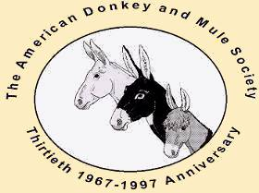
American Donkey and Mule Society
Lewisville, TX
Established 1967
  Donkeys
  Mules
  Zebra hybrids
Miniature to Mammoth
Zorse
Zedonk

Slide 8
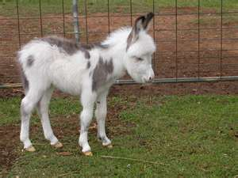
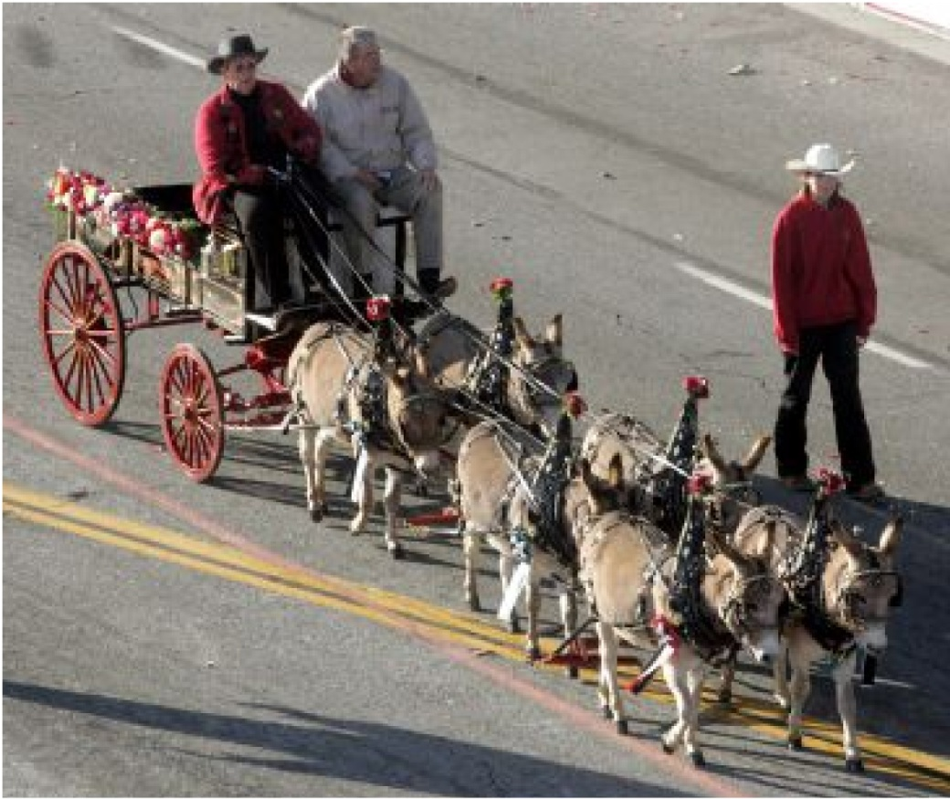
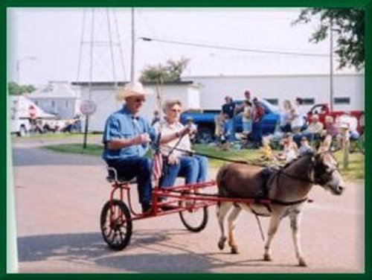
Miniature Donkeys

Slide 9
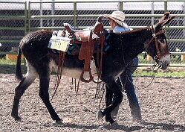
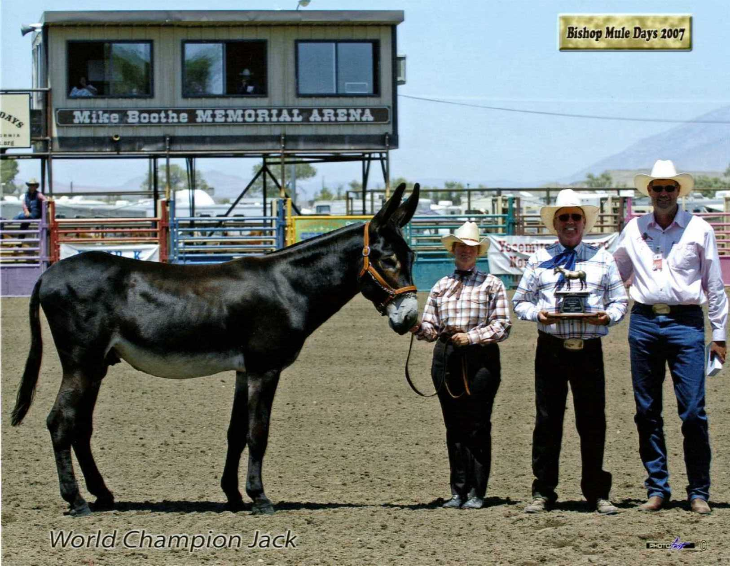
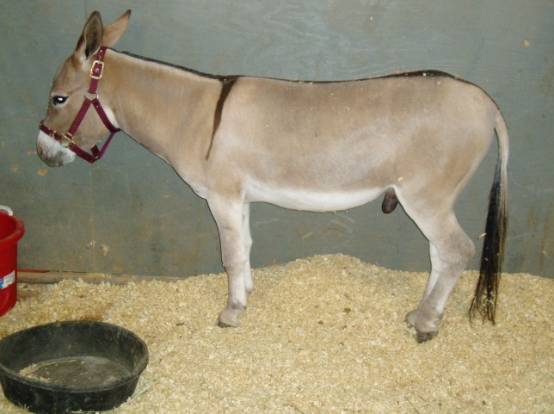

Donkeys

Slide 10
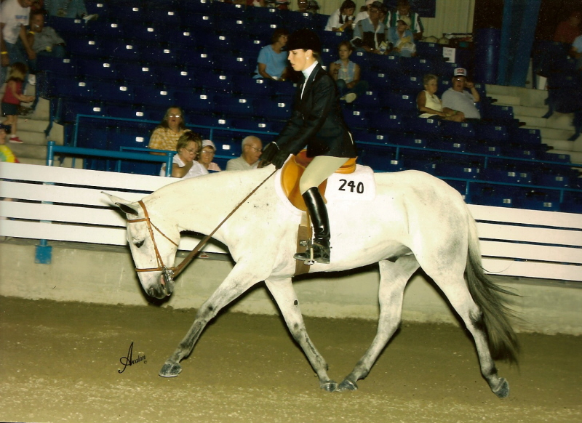
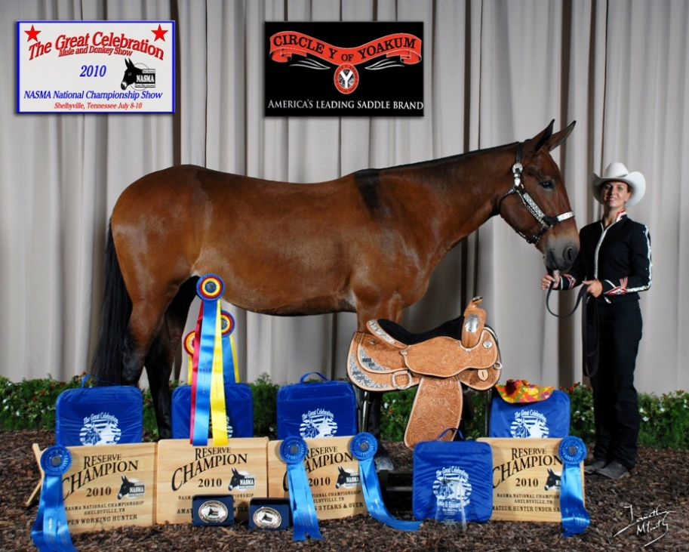
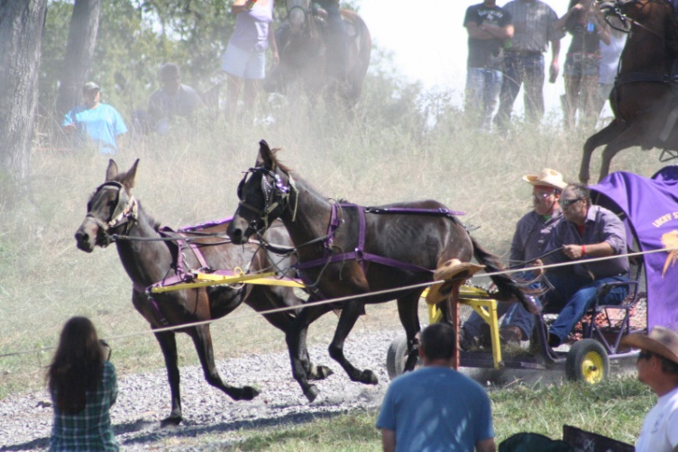
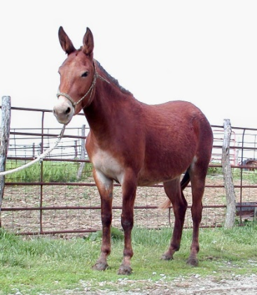
Mules

Slide 11
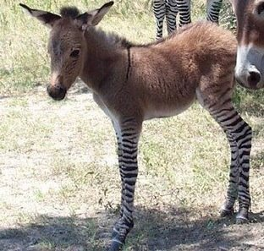
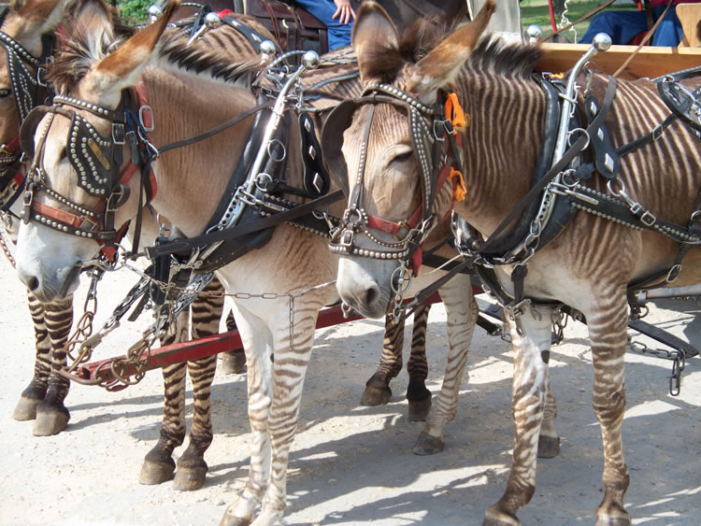
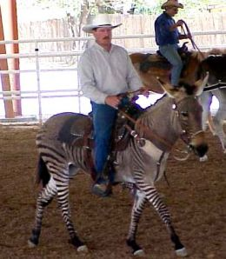
Zedonks

Slide 12
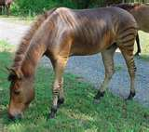
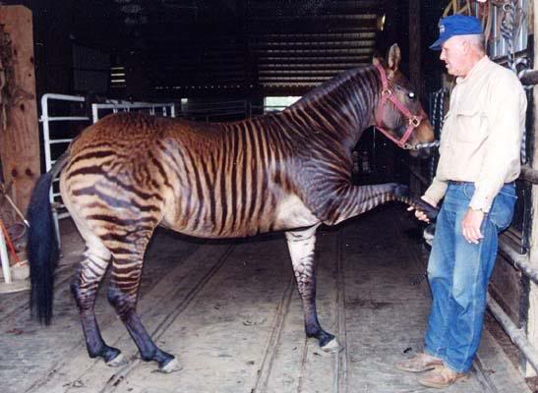
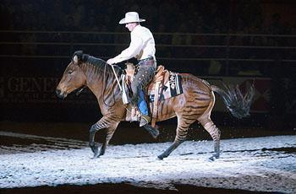
Zorses

Slide 13
Light Horse Breeds

Slide 14
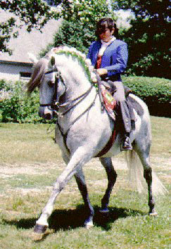
Andalusian
Highly regarded
  Since the Middle Ages
Known as
  Purebred Spanish Horse
~80,000 in U.S.

Slide 15
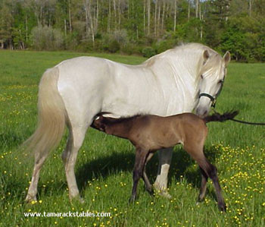
Andalusian
White and light gray
  Occasionally bay
Renowned for
  Ability to learn
  Superb temperament

Slide 16
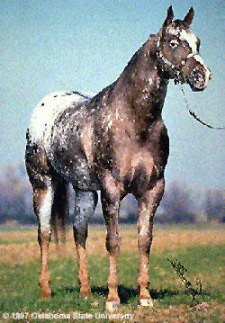
Appaloosa
Nez Perce
  First tribe to breed
  Washington, Oregon and Idaho
International breed registry
  ApHC
  Located in
    Moscow, Idaho

Slide 17
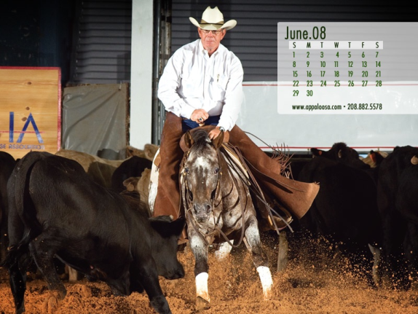
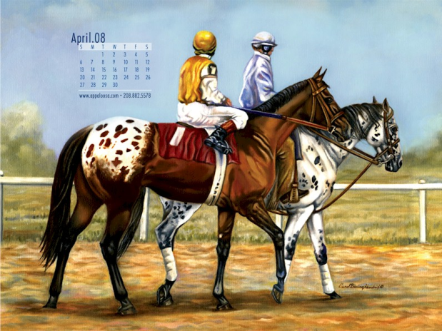
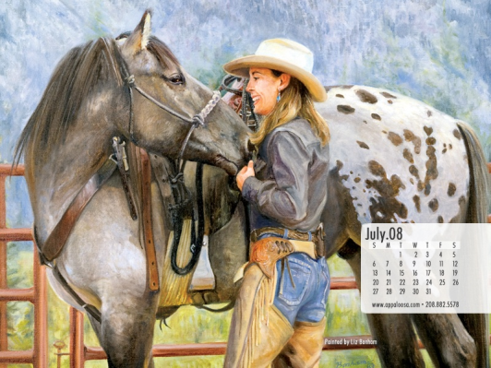
Appaloosa
How many on record?
  ~500,000
Common coat colors?
  Leopard
  Blanket

Slide 18
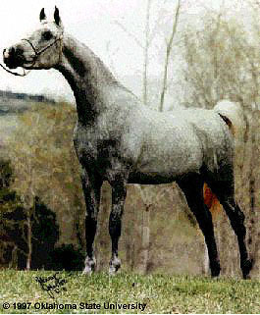
Arabian
Bred for endurance in desert
  Egyptian and Polish
Arabians genetics in
  All breeds of light horses
What are main characteristics?
  Head
  Prominent Eye

Slide 19
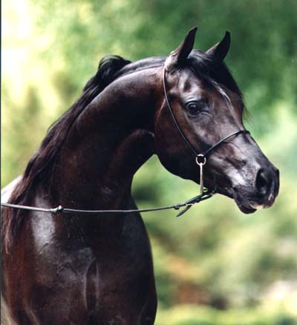
Arabian
Swan like neck
Flat back and croup
High tail carriage
Colors?
  Gray, Chestnut, Bay and Roan
  Occasional Solid Black
14.2 and 15.2 hands
  Weigh ~800 and 1,000 pounds

Slide 20
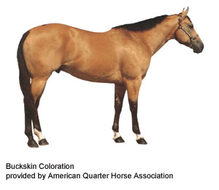
Buckskin
Originated from
  Spanish Sorraia
International Buckskin Horse Assoc
American Buckskin Registry Assoc
Registry claims
  Stamina
  Determination
  Harder feet, better bone
  Generally hardier than other horses

Slide 21
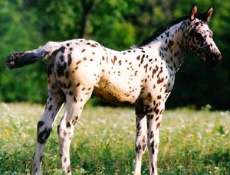
Colorado Ranger Horse
Not a type of Appaloosa
  Can be double registered
Bred for
  Cow savvy
  Performance
No color preference
  Some colored
  Some are not

Slide 22
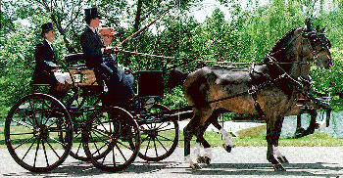
Hackney
Responsible for improvement in
    Quality of life
    Public roadways in Britain
Swift trotting horse

Slide 23
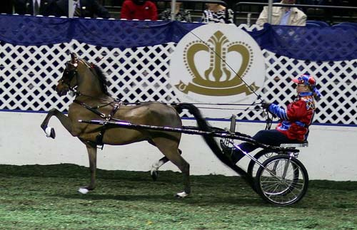
Hackney
Considered
  Ultimate Driving Machine of 1880s
  America and in Britain
Hackney Stud Book Society
  England 1883

Slide 24
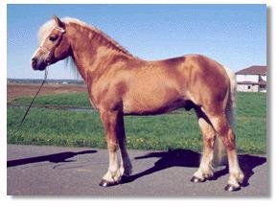
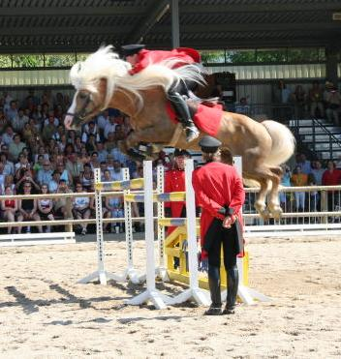
Haflinger
Developed
  Austria and Northern Italy
  Known for handling rough terrain
American Haflinger Registry
  1998
  Pale chestnut to dark chestnut
  Pale mane and tail

Slide 25
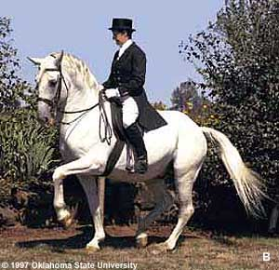
Lipizzan or Lipizzaner
Breeding dates back to
  Early 1560's
  Spanish Riding School
Dominate color?
  Gray
Noted for
  Sturdy body
  Brilliant action
  Proud carriage
  Intelligent and docile disposition

Slide 26
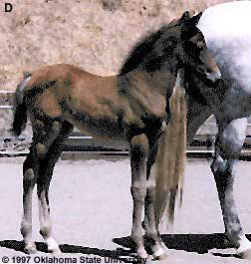
Lipizzan or Lipizzaner
Born
  Black-brown
  Brown or mouse-grey
Turn white
  Between the ages of 6 and 10
Averaging height?
  14.3 to 15.3 hands

Slide 27
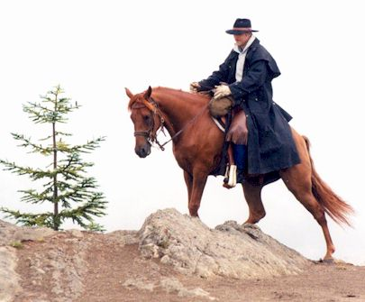
Missouri Fox Trotter
Developed in
  Ozarks
  19th century
Considered
  Easy riding, durable
  Travel long distances
  Sure-footed

Slide 28
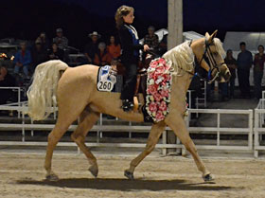
Missouri Fox Trotter
Distinguishing characteristic
  Fox trot gait
  Walks with the front feet
  Trots with the hind feet

Slide 29
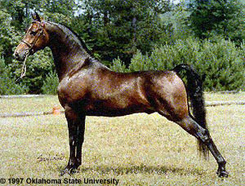
Morgan
Justin Morgan
  School teacher
  Owned the first Morgan
Breeding was unknown
14.2-15.2 hands

Slide 30
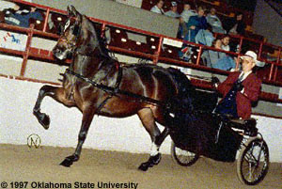
Morgan
Color?
  Chestnut
  Bay
  Brown
    Less Prominent:
      Black
      Palomino
      Buckskin
      Few grays

Slide 31
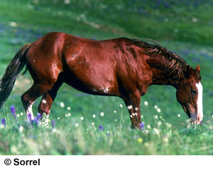
Mustang
Feral horse
  Western U.S.
Derived from?
  Spanish horses
Changed lives of
  Native Americans

Slide 32
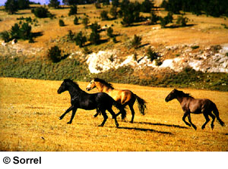
Mustang
Population began in
  20th century
  ~ 2 million
Current population
  ~ 30,000

Slide 33
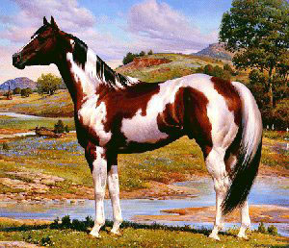
Paint
Stock-type conformation
  Natural intelligence
  Willing disposition
In past
  AQHA crop outs
Current
  One paint parent
  Also have one
    QH or Thoroughbred parent

Slide 34
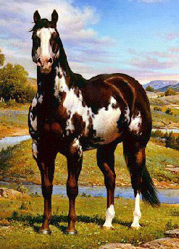
Paint
Colors Patterns?
  Overo
  Tobiano
  Tovero
Not to be confused with Pinto
Double registry is possible

Slide 35
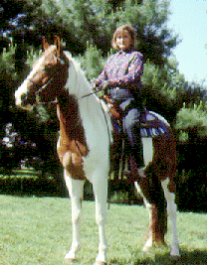
Pinto
Color Breed
  Not a stock Breed
  Does not require genetic ancestry
Does not accept horses with
  Appaloosa
  Draft
  Mule breeding

Slide 36
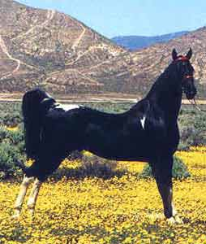
Pinto
Does not have consistent
  Conformation
  Bred for color
Four types of conformation:
  Saddle type
  Stock type
  Hunter type
  Racing type

Slide 37
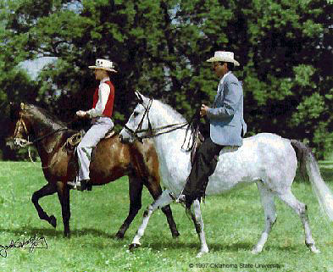
Paso Fino
Spanish Heritage
Lateral four-beat gait
Basic gaits in order of speed are the
  Paso fino
  Paso corto
  Paso largo
Makes for a very smooth ride
Also trot and canter

Slide 38
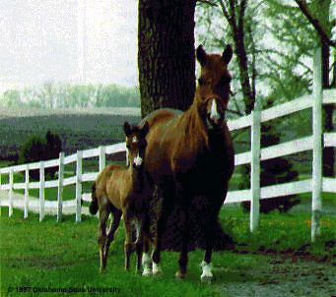
Paso Fino
13.2 hands to 15.2 hands
  Chestnut
  Bay
  Palomino
  Black
  Grey
  Roan
  Pinto
Ridden and trained
  English and Western

Slide 39
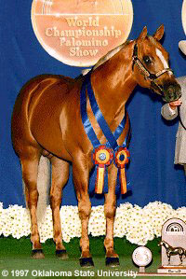
Palomino
Palomino Horse Breeders of America
Color registry for horses
  Standing between
    14 & 17 hands
  Exhibiting body color
    Variations from light to dark

Slide 40
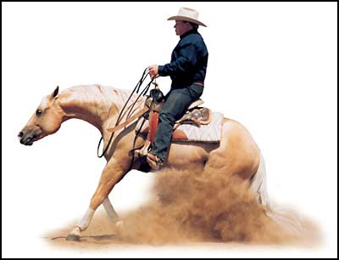
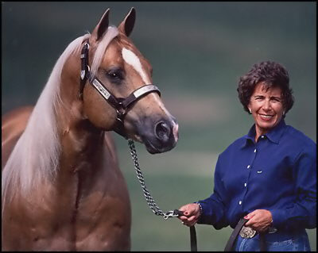
Palomino
Three Divisions:
  Stock Type
  Saddlebred Type
  Pleasure Type
May also be registered
  Morgan
  Quarter
  Saddlebred
  Arabian
  Jockey Club
  Tennessee Walking Horse

Slide 41
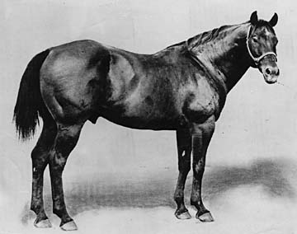
Quarter Horse
Named for what?
  Speed at the quarter mile
  Quick to start, easy to handle
  Good Temperament
  Cow sense
First registered QH was
  Wimpy
  Won Fort Worth Stock Show 1941
  Owned by King Ranch

Slide 42
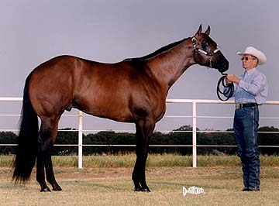
Quarter Horse
Very versatile breed
Originated from
  Arab, Turk and Barb breeds
  Thoroughbred was a major influence
Must have verification of
  Parentage

Slide 43


Racking Horse
Known for:
  Beauty and Stamina
  Calm disposition
Smooth easy lateral gait
  Walking horse blood lines
Rack
  Walk Hind
  Trot Front
    Hooves hit ground 1 at a time

Slide 44

Saddlebred
First mentioned in U.S.
  1776
Successful as
  Cow horses to jumpers
  Dressage to carriage horses
Display a large amount of
  Animation in their travel

Slide 45

Standardbred
Fastest harness horse in world
Foundation sire?
  Hambletonian 10
Average 15.2
Weighing 800-1000 lbs
Trotters and Pacers

Slide 46

Tennessee Walking Horse
Breed developed from:
  Standardbreds
  Morgans
  Thoroughbred
  Narrangansett Pacers
Prominent characteristic
  Smooth running walk

Slide 47

Tennessee Walking Horse
Also known for
  Flat foot walk and canter
  All gaits very smooth
Very popular with
  Southern plantation owners

Slide 48

Thoroughbred
Traces back to three foundation sires:
  Darley Arabian
  Godolphin Arabian
  Byerly Turk

Slide 49

Thoroughbred
The Jockey Club
Records of Racing
  Dates back to
    Long Island in 1665
Travel
  35-40 mph
Will not allow A.I.

Slide 50
Warmbloods

Slide 51

Dutch Warmblood
Dressage
Jumping
3-day event
Driving
Known for
  Temperament
  Adaptability
  Soundness

Slide 52


Hanovarian
Noble, balanced horse with
  Impulsion
  Elegant
  Elastic movements
Home is in Lower Saxony in Northern Germany
  Formerly Kingdom of Hanover
  Breeding for over 400 years

Slide 53

Holsteiner
Breeding in Germany for 750 yrs
One of Greatest German Sporting Horses
  Jumping
  Dressage
  Driving
  Eventing
Stands 16-17 hands

Slide 54

Swedish Warmblood
Breeding linked to
  Thoroughbred
  Fresian
  Hanovarian
  Trakehner
Known for
  Elegance
  Jumping ability
  Ability to absorb intense training
Medalists in every Olympiad since 1912
  Most often in Dressage

Slide 55

Trakehner
East Prussian origin
  1732
  Trakehnen, East Prussia
  Stands 16-17 hands
Thoroughbred and Arabian blood later introduced
Excels in
  Dressage and jumping
  Excellent temperament

Slide 56
Draft Horses

Slide 57


Belgian
Carried knights into battle
Provided genetic material
  All the modern day draft breeds

Slide 58


Clydesdale
Developed and derived from Scotland
Feathers
Commonly :
  Bay
    Black
    Brown
    Chestnut
    Roan

Slide 59

Friesian
One of oldest
  Domesticated breeds in Europe
Native to
  Friesland
  Northern Netherlands
Traditionally used
  Harness

Slide 60

Friesian
Also found
  Circuses
  Driving competitions
Very long mane and tail
  Feathers
Always black
  Only white star on forehead is permissible

Slide 61


Percheron
Le Perch mares
  Mated to Arab stallions
France
Black or gray

Slide 62

Shire
Origin has been lost
Thought to have originated in England
War Horse
  Strength
  Courage
  Aptitude
  Very large breed

Slide 63
Ponies

Slide 64


Chincoteague (shinko - teeg) Pony
Descend from
  Wild horses on Assateague island
  Off the coast of Maryland
Thought to have been
  brought over in the 17th century
Stand 12-13 hands

Slide 65




Miniatures
Height breed
Must measure no more than 34”
American Miniature Horse Association

Slide 66


Ponies of America (P.O.A.’s)
Founded in 1954 in Iowa
Distinctive breed
  Possesses color of Appaloosa
Influence by:
  Arab
  Thoroughbred
  QH
  Appaloosa
  Welsh and Shetland Pony

Slide 67


Shetland
Possible, oldest breed in Britain
Named after island of origin
Stands on ~9.3 to 10.2 hands

Slide 68


Welsh Pony and Cob
Original home
  Wales
Under 15 hands
Worked in
  Coal mines
  Ranches
  Postman routes

