Slide 1
AGRI 4373
Equine Reproduction
Dr. Matt McMillan

Slide 2
Introduction
What's the big deal about Equine Reproduction?
What types of jobs are available breeding horses?
How much money spent annually on breeding?
What kind of controversy is found?

Slide 3
Thoroughbred
American Jockey Club
  Offices in Lexington, KY and NYC
  Formed in 1894
How much money does generated annually?
  $34 Billion
How many jobs created?
  470,000

Slide 4
Thoroughbred
How many horses registered annually?
  More than 30,000 in U.S.
  More than 118,000 worldwide
Registered horses must have unique names that are not currently in competition
What rules apply to registering a Thoroughbred Foal?
  Registered Sire and Dam

Slide 5
Thoroughbred
Artificial Insemination, Embryo transfer, and cloning are not allowed: Why?
  Possible error in assigning parentage
    DNA and Blood Testing can eliminate
  Economic Reasons
    Stallion has a limited number of mares than can be covered in a year
    Helps to reduce overpopulation
    Some stallions may still cover over 200 mares in a year
    Also preserves high prices paid for horses

Slide 6
Thoroughbred
What problems may occur with closed Stud Book?
  Loss of genetic Diversity
What are thoroughbreds worth?
  2007 Keeneland Sales Reported:
    9,124 sold
    Total value of ~$815 million
    Average Price ~ $90,000
      19 horses sold for $1,000
      19 horses sold for over $1 million

Slide 7
Keeneland
Current Keeneland Graduates:
  I’ll Have Another
  Bodemeister
  Creative Cause
Finished 1-2-3 in the 2012 Preakness

Slide 8
Thoroughbred
Highest price paid at auction for a Thoroughbred was set in 2006
  $16,000,000
    2 year old colt named The Green Monkey
    Injuries limited him to only 3 career starts before being retired to stud in 2008
    He never won a race
  In 1986 Kentucky Derby winner Ferdinand
    Exported to Japan to stand at stud
    Was ultimately slaughtered in 2002
      Presumably for pet food

Slide 9
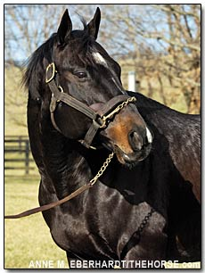
Thoroughbred
Storm Cat
  Foaled in 1983
  Progeny earnings =
    Over $115 million
  Stud fee from 2002 to 2007
    $500,000 per mare

Slide 10
American Quarter Horse
Headquarters
  Amarillo, TX
Formed in 1941
World’s largest breed registry and membership organization
  Over 2.7 million registered QH in U.S.
  Over 380,000 registered internationally
Very versatile Breed

Slide 11
American Quarter Horse
Sire and Dam must be registered QH
  One parent may be Thoroughbred
Must have original name
  Name can be reused if following criteria are met:
    Must be deceased as evidenced by AQHA records
    Does not have a performance record
    Does not have offspring with performance record
Must not have excessive white

Slide 12
American Quarter Horse
Parentage must be verified under certain circumstances
  Parents was < 2 yrs of age at time of conception
  Result of embryo transfer
  Cooled transported semen
  Frozen semen
  More than 48 months of age at time of registration
  Dam was exposed to > 1 stallion within 30 d
  White markings exceeding limitations
  Descendant of Impressive

Slide 13
American Quarter Horse
Allows:
  Artificial Insemination
  Frozen and Cooled Semen
  Embryo Transfer
  Recipient mares
Does not allow:
  Cloning
    What about
      Scamper?
      Royal Blue Boon?

Slide 14
American Quarter Horse
What is the American Quarter Horse Worth?
2010 NCHA 2 Year Old Prospect Sale
  2.7 million in total sales
  High seller $120,000
  $17,700 was average price
2010 NRHA Futurity Prospect Sale
  1.4 million in total sales
  High seller $200,000

Slide 15
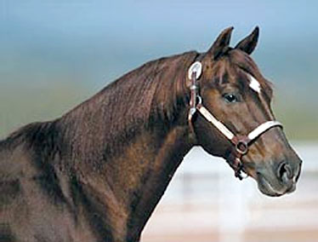
American Quarter Horse
High Brow Cat
  All time leading
    Cutting Horse Sire
  Progeny earnings=
    over $40 million
  2011 Breeding Fee
    $22,500 per mare

Slide 16
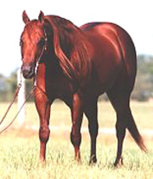
American Quarter Horse
Topsail Whiz
  Deceased
  #1 All time Leading Reining Sire
  Progeny earnings=
    More than $6.8 million

Slide 17
Arabian Horse Association
Formed in 1908
Headquarters
  Aurora, Colorado
Arrived in U.S with Spanish Conquistadors
Over half million in U.S. today
Highest selling Arabian stallion sold for $11 million in 1984

Slide 18
Arabian Horse Association
Registration:
Pure breeds vs. half breeds
Parentage verification
Artificial insemination allowed
  Cooled or frozen semen ok
Embryo transfer allowed
  Recipient mares allowed

Slide 19
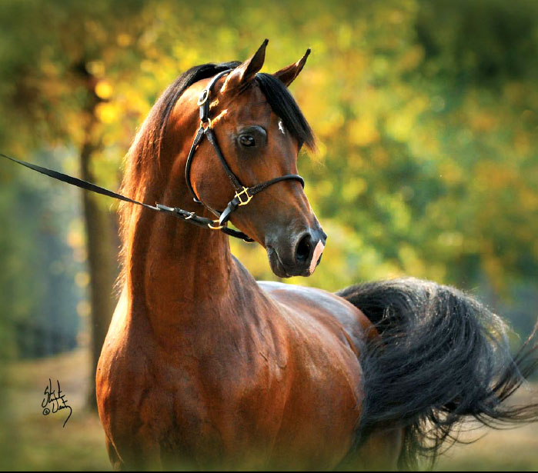
Arabian Horse Association
Baske Afire
  1 leading sire of
    Halter and performance horses
    Both the U.S. and Canadian Nationals
  2011 Breeding Fee
    $5,000

