Slide 1
Equine Nutrition
Colic
Bugs
Value Added Products
Feed manufacturing
Practical Guidelines

Slide 2
What Causes Colic?
Stall Confinement for more than
  15 hours per day
Feeding Large Amounts of Grain
  (> 12 lbs per day)
Participation in intensive exercise
Feeding grain before hay after a “fast”

Slide 3
Common Colic Causes
Dehydration
  Water
  Salt
  Minerals (especially electrolytes)
Inadequate Forage Quality
  Too High or Too Low
Inadequate Forage Quantity

Slide 4
So How Do We Prevent Colic?
Provide plenty of good, clean, fresh water
Provide adequate forage
  Quantity and Quality
If feeding > 5 lbs./day
  Break into multiple feeding times
Regular de-worming, vaccinating, and teeth floating regimes
Side note: >90% of digestive upsets are due to feed management rather than feed source!!!!!!

Slide 5
Cellulolytic Bacteria
Where are they located?
  Cecum and Large Intestine
Are they important to the health of the horse?
  Of course
Are they very particular?
  Extremely
If we don’t keep them happy what may occur?
  Bad news

Slide 6

If You Keep The Bugs Happy
You Keep The Horse Happy

Slide 7
What Makes Happy Bugs?
Lots of Water
Fermentable Food, Especially Fiber
Consistency
  Temperature
  Food source
  pH
Release of Waste Products

Slide 8
How Do We Keep Bugs Happy?
Match Feeding Program To Natural Function Of Horse’s Gut
Use Fermentation Aids
  Yeast Cultures
  Ammonia Scavengers (yucca)
  Probiotic Cultures
  Pathogen Scavengers

Slide 9
Fermentation Aids
How do fermentation aids benefit the horse?

Slide 10
(%)

Slide 11
Effect of Digestion Aids on
Mare’s Milk Composition
g/100 g or head/10 g milk

Slide 12
Effect of Digestive Aids on Bone Growth
Height at withers (cm)
Days of Age

Slide 13
Why Yucca?
Excessive protein is converted to
  Ammonia in large intestine
  Ammonia is toxic to bugs and horses
Yucca can bind ammonia formed in large intestine
  This effectively conserves critical amounts of water and electrolytes
Bottom Line: increases stamina!!!

Slide 14
Probiotic Cultures
Introduce highly beneficial bacteria to
  Fermentation vat
    Improves ecology of fermentation process
    Increases overall digestibility
    Reduces susceptibility to pathogenic bacteria

Slide 15
Pathogen Scavengers
Mannan-Oligossacharides
  Bind certain pathogenic bacteria and mycotoxins such as:
    E. Coli and Salmonella
    Thereby preventing them from infecting intestinal mucosa
  Used successfully in treatment of
    Colitis in both human and equine medicine
    Also used to treat ulcers and colics

Slide 16
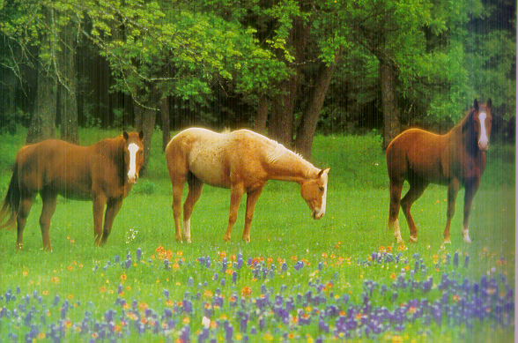
What About Organic Minerals?

Slide 17
How Do Organic Minerals Work?
Zinc, Manganese and Copper play significant roles in what?
  The chemical reactions responsible for preventing oxidation in the body
Organic forms of Zn, Mn and Cu help:
  The anti-oxidation reactions work more effectively

Slide 18
Broodmare Intake vs Requirement
(1st Half Gestation)

Slide 19
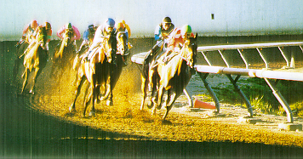
Organic Selenium
Improves anti-oxidant activity and
  Improves overall health
Increases stamina
Boosts immune function
Increases fertility

Slide 20
Organic Selenium
Reduced after birth expulsion times
  < 30 minutes
  Improved rebreeding
Increased IgG and IgM levels in mare’s milk
Reduced respiratory disease in
  Growing and performance horses

Slide 21
When Are Organic Minerals Needed?
Pregnant Mares & Growing Horses
  Improved reproduction
  Improved skeletal development
High Performance Horses
  Increased stress resistance
  Reduced problems with tie-ups
Horses with poor skin, hair or hoof condition

Slide 22
Value Added Products
Yeast Culture
Yucca Shiderga
Pro-Biotics
Mannanoligosaccharides
Organic Trace Minerals
Organic Selenium
Stabilized Rice Bran
Amino Acids

Slide 23
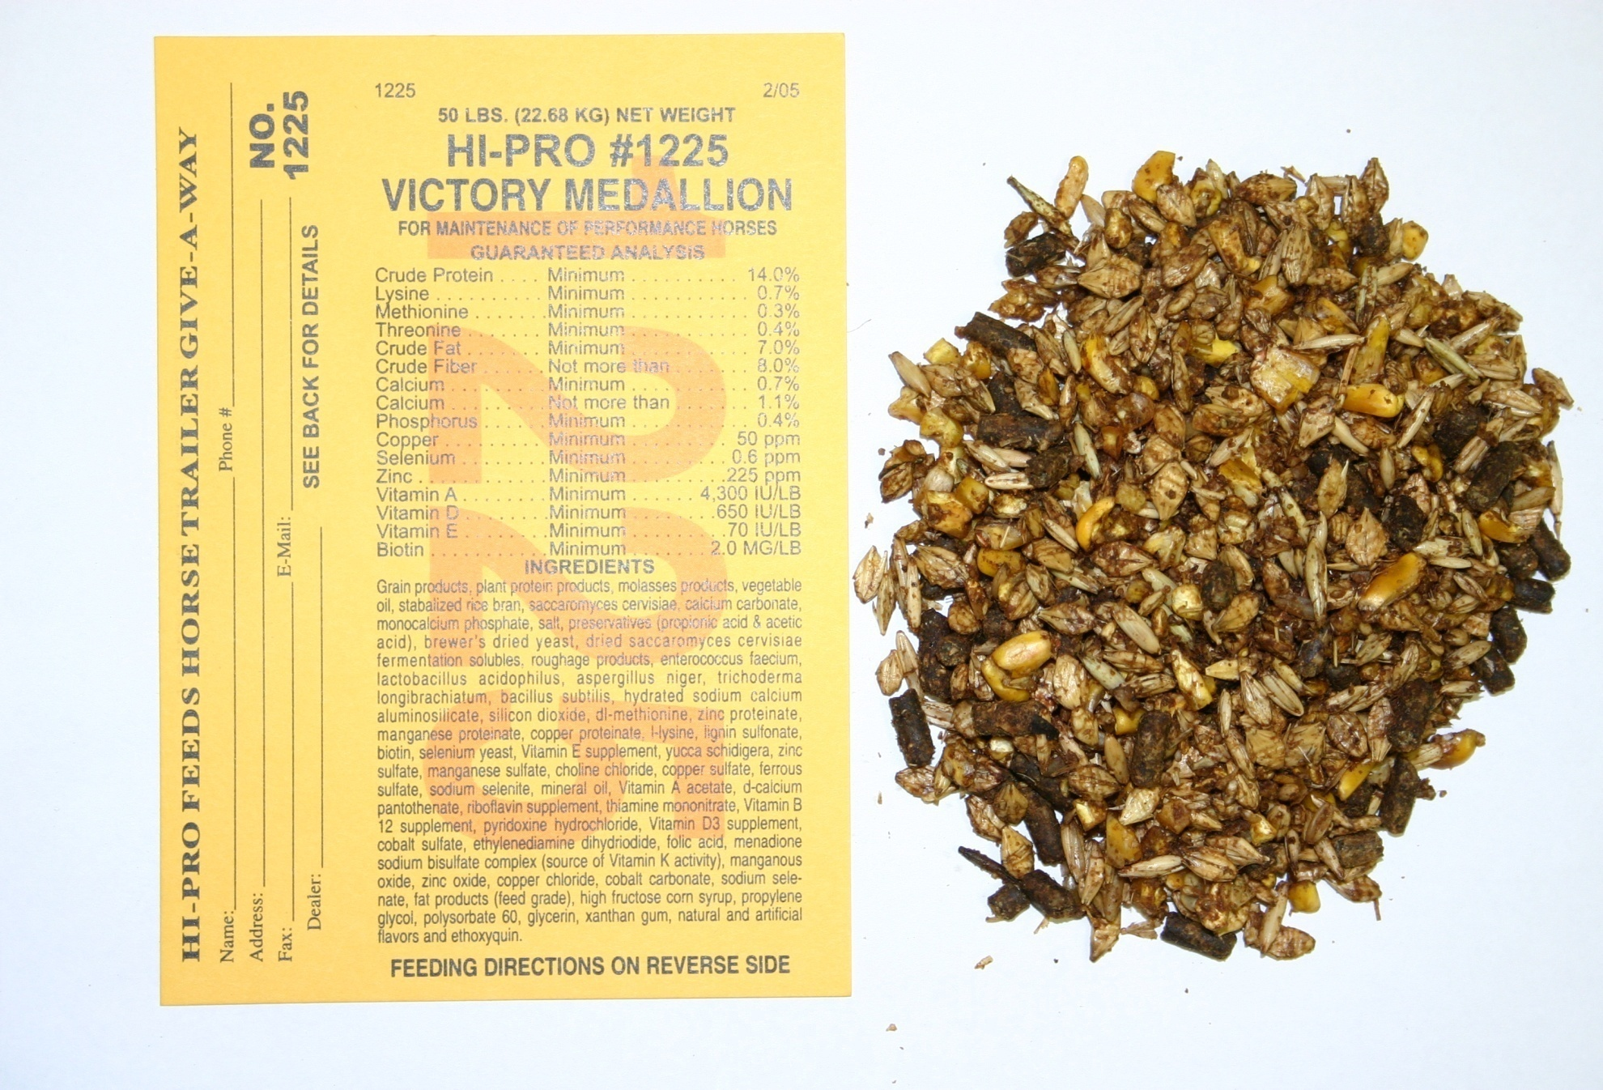

Slide 24
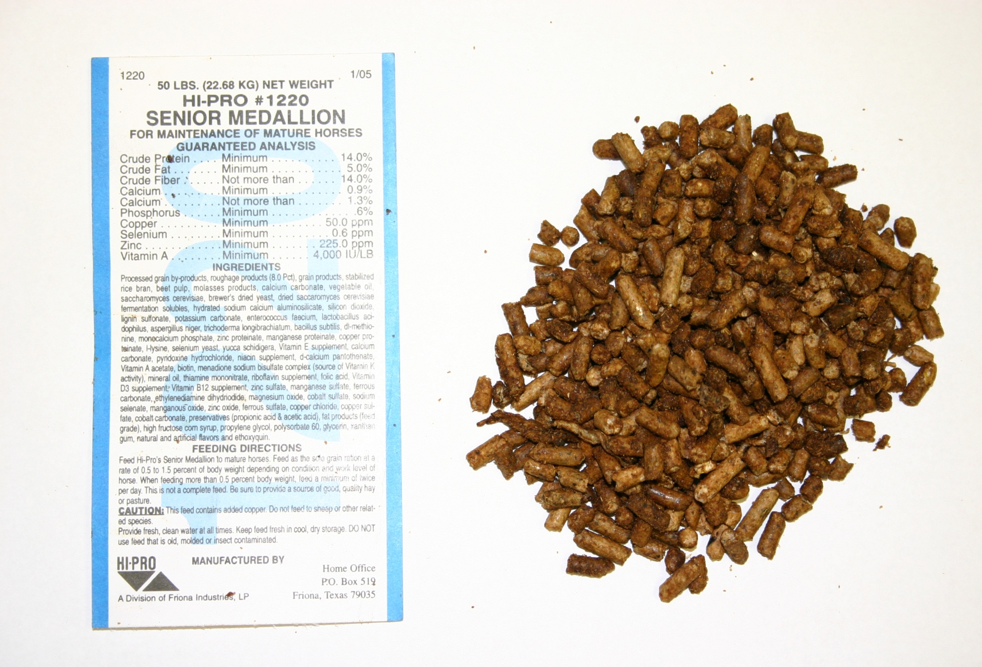

Slide 25
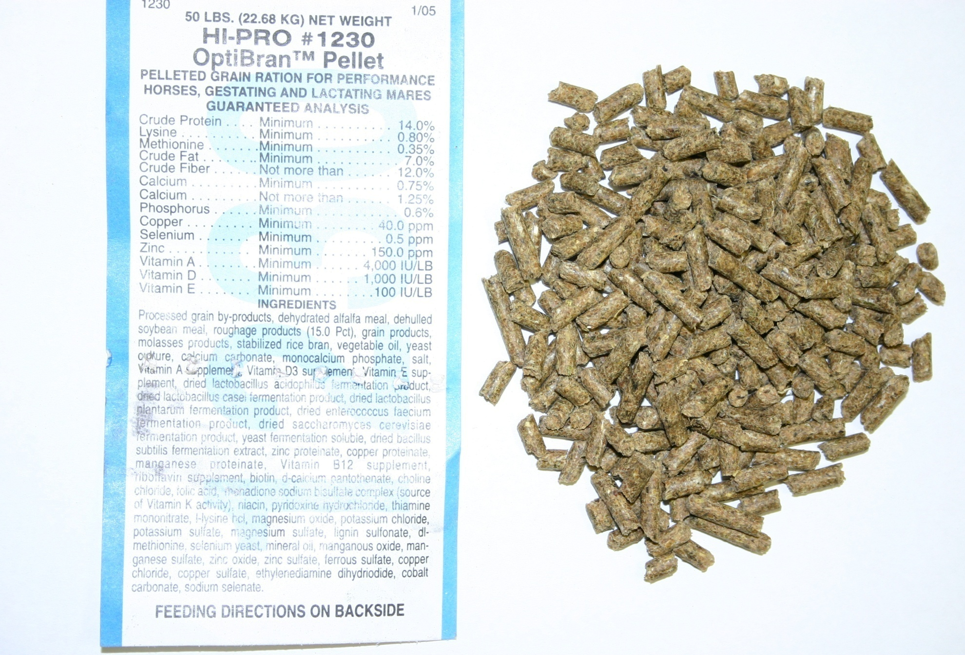

Slide 26
Practical Guidelines
Feed & Treat Horses Like Horses!
Feed as much good quality forage as possible
  Helps to increase gut water and pH
Get as much water into them as possible
Be as consistent as possible
  In quantity and quality

Slide 27
Practical Guidelines
Incorporate Fermentation Aids When Needed
  Broodmares
  Weanlings
  Performance
  Bad-Doers and Colicers
Make sure mineral nutrition is adequate

