Slide 1
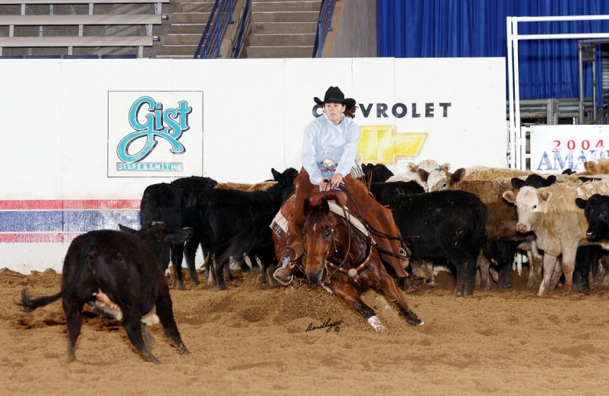
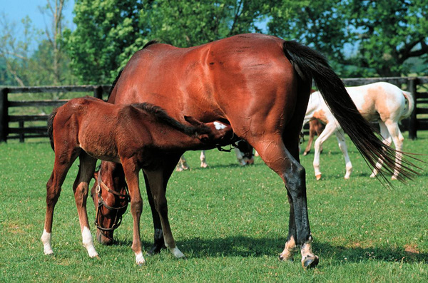

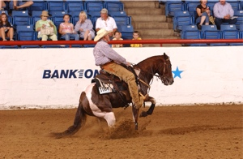
AGRI 3364 Equine Science
Matt McMillan, Ph.D.
Assistant Professor

Slide 2
Matt McMillan, Ph.D., PAS
Background
Born: San Angelo, TX
Graduated High School: Allen, TX
B.S. Animal Science TTU 1997
M.S. Animal Science ASU 2000
Ph.D. Animal Nutrition TTU 2004
Hi-Pro Feeds 2005
SHSU 2006 - Present

Slide 3
Evolution of the Horse
  Did not occur in a straight line
  Many horse like animals branched off
  Now one genus is the only surviving branch of a once large evolutionary bush
    Equus

Slide 4
History and Evolution
Kingdom: Animalia
Phylum: Chordata
Class: Mammalia
Order: Perissodactyla
Family: Equidae
Genus: Equus
Specie: several

Slide 5
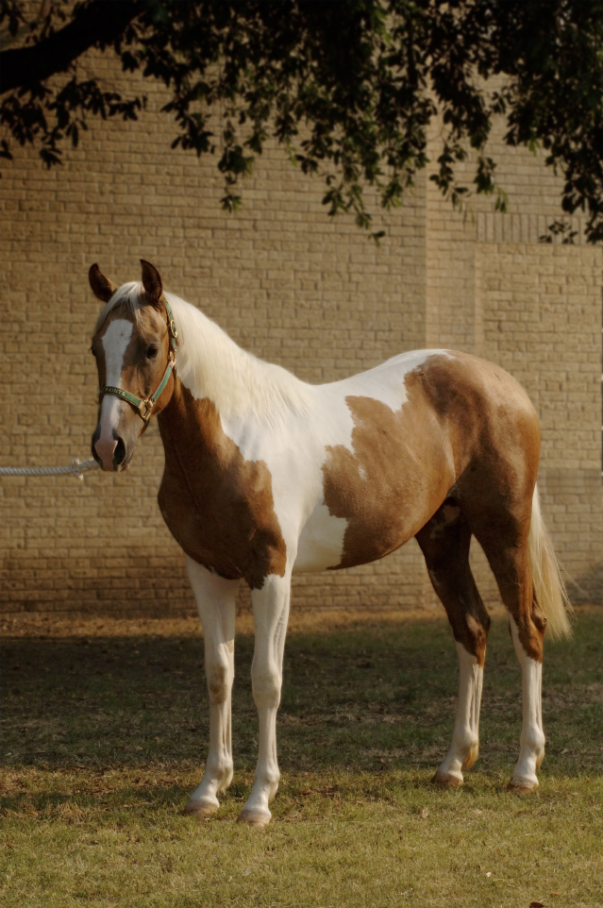
Species
Equus caballus
  True horse
  Once had several subspecies

Slide 6
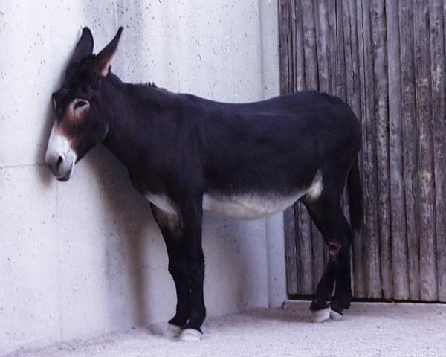
Species
Equus asinus
  The true asses and donkeys of northern Africa

Slide 7
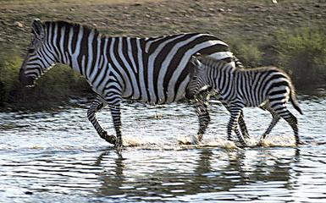
Species
Equus burchelli
  Plains Zebra of Africa – “typical” zebra
  Several Subspecies
  Wide vertical stripes
  Thick horizontal stripes on the rump
  Found in Eastern and Southern Africa

Slide 8
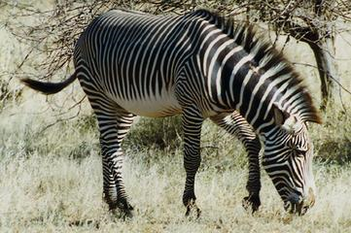
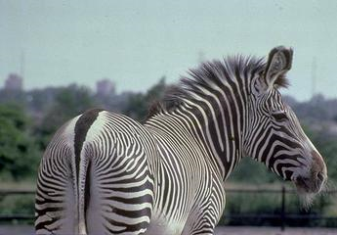
Species
Equus grevyi
  Grevy’s zebra, most horse like zebra
  Native to Eastern Africa
    Big Zebra with very narrow vertical stripes & huge ears

Slide 9
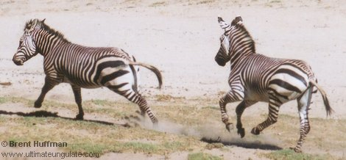
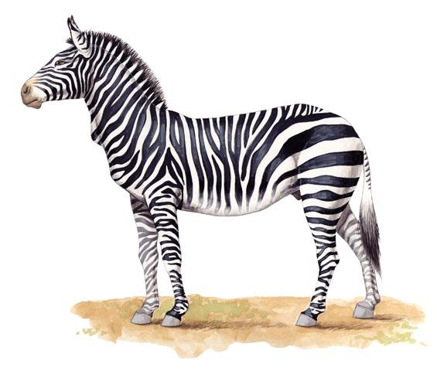
Species
Equus zebra
  Mountain Zebra of South Africa
  Gridiron pattern on rump
  Dewlap

Slide 10
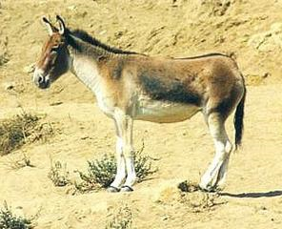
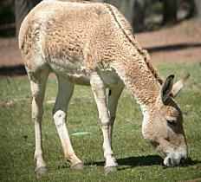
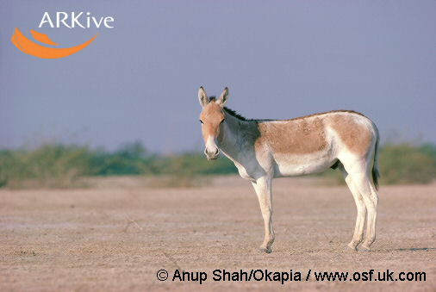
Species
Equus hemionus
  Several Sub-species:
    Desert-adapted Onagers of Asia
    Indian Wild Ass
    Asian Wild Ass
    Mongolian Wild Ass
    Syrian Wild Ass

Slide 11
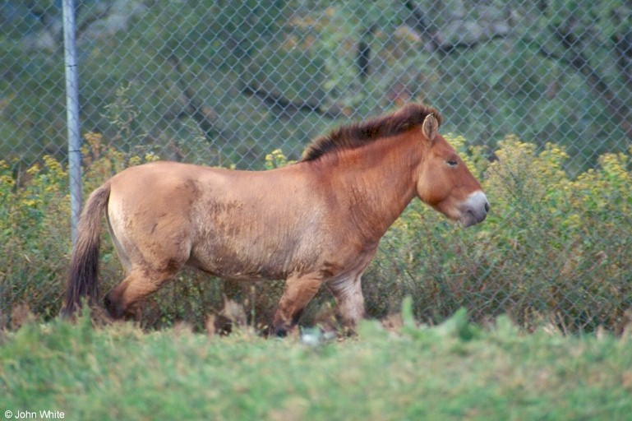
Species
Equus przewalski
  Oldest living specie of horse
  Not discovered until 1879
    Russian Captain named Nikolai Przewalski
    Discovered in Mongolia
  Ancestor of modern horse
  Cannot be domesticated
  Characteristically Dun

Slide 12
Evolution of the Horse
What is the earliest known ancestor of the horse?
  Eohippus
    a.k.a. Hyracotherium or dawn horse
    ~ the size of a fox (8 -18” at shoulder)
    Four functional toes on each front foot
    Three toes on hind feet

Slide 13
Eohippus
Structure of teeth suggest
  Browser
Earliest remains found in
  North America
Thought to have lived
  ~54 million years ago
Remains also found in
  Europe dating 50 million years old

Slide 14
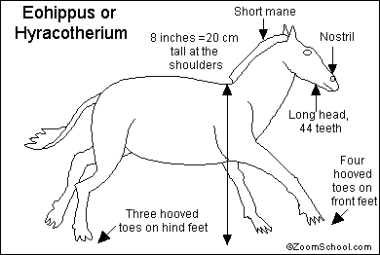

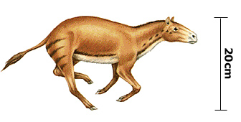
Eohippus
Alert ears, doglike, furry coat, swishing tail
Long face w/ 44 teeth
  Unlike today’s horse
    36 -42
Both front and back toes replaced by tiny hooves

Slide 15
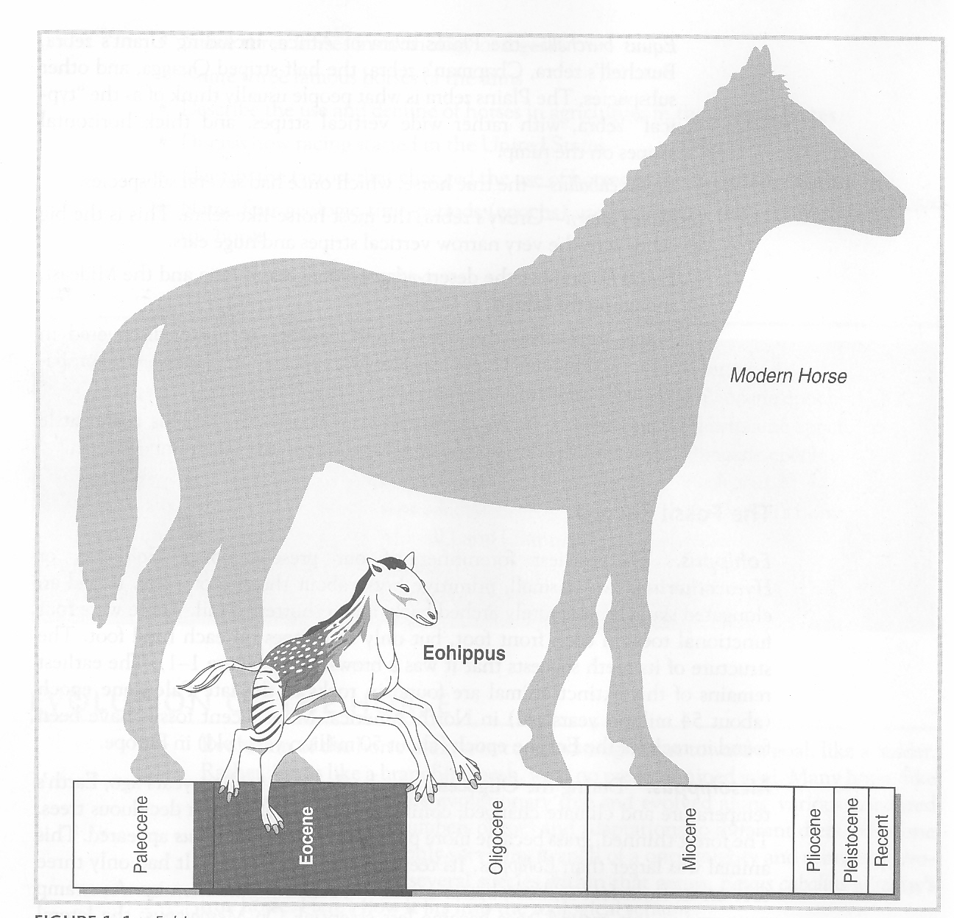

Slide 16
Evolution of the Horse
Mesohippus
  Lived ~ 35 million years ago
  Earth’s temperature and climate had changed
  Forest thinned and grass became more prevalent
  Mesohippus appeared

Slide 17
Mesohippus
A.k.a. “Middle Horse”
Larger than Eohippus
  24” at shoulder
Teeth had further evolved but 44 remained intact
Only had three toes on front
  Was better suited to outrun predators
Lateral supporting toes decreased in size
  Middle toe strengthened

Slide 18
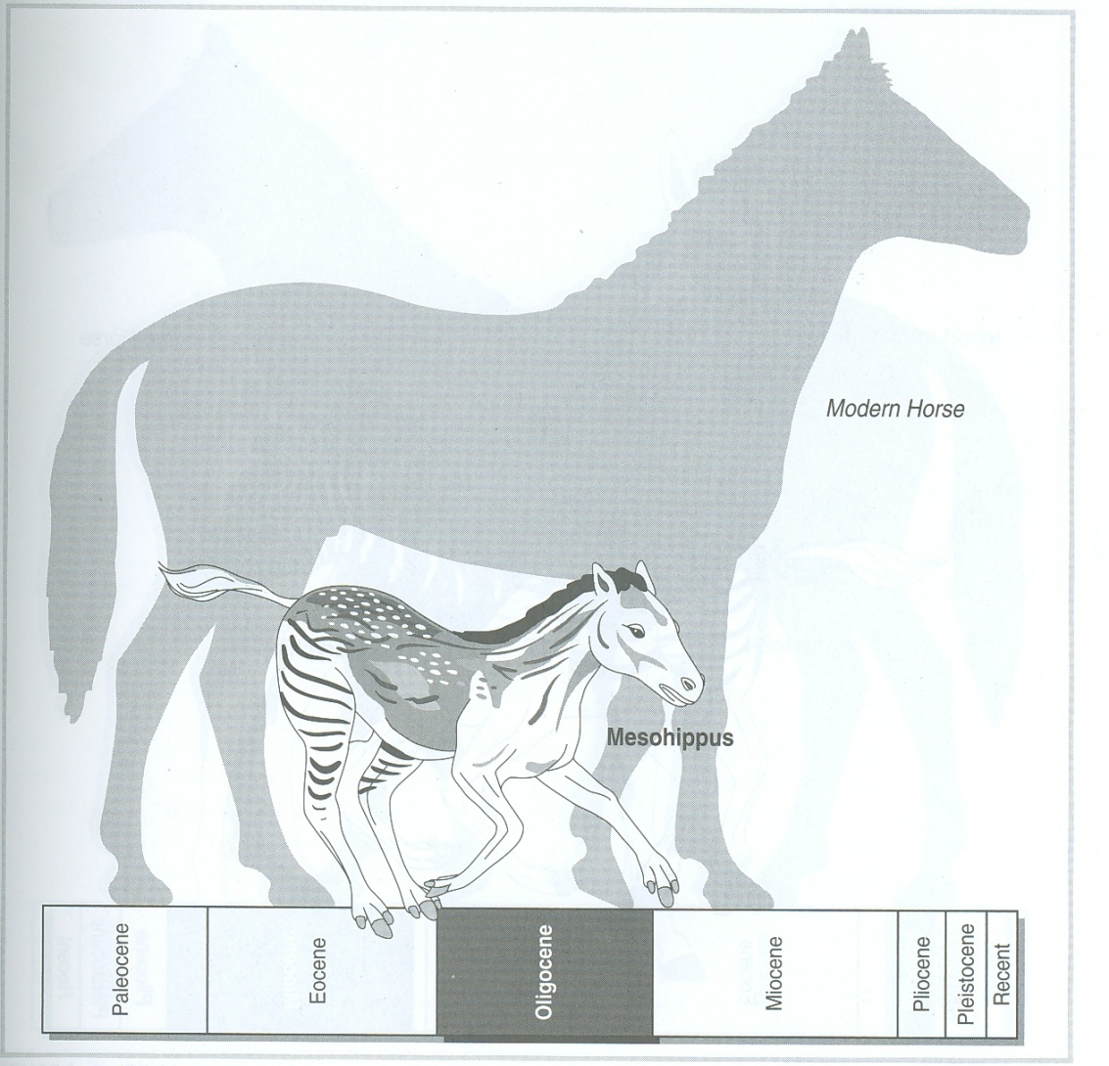
Mesohippus
Toes now ended in little hooves
  Still had a pad behind them
Became extinct in Europe and North America
  ~ 7 million years ago

Slide 19
Merychippus
  Lived ~ 20 million years ago
  Completely new type of horse
  Evolved in North America
  Adapted to hard grasses of plains
  Beginning of grazing horse of today

Slide 20
Merychippus
Stood ~35”
Increasingly gregarious
Developed complicated grinding teeth similar to present day horses
Lateral toes diminished
  No longer touched the ground
Main toe thickened and hardened

Slide 21
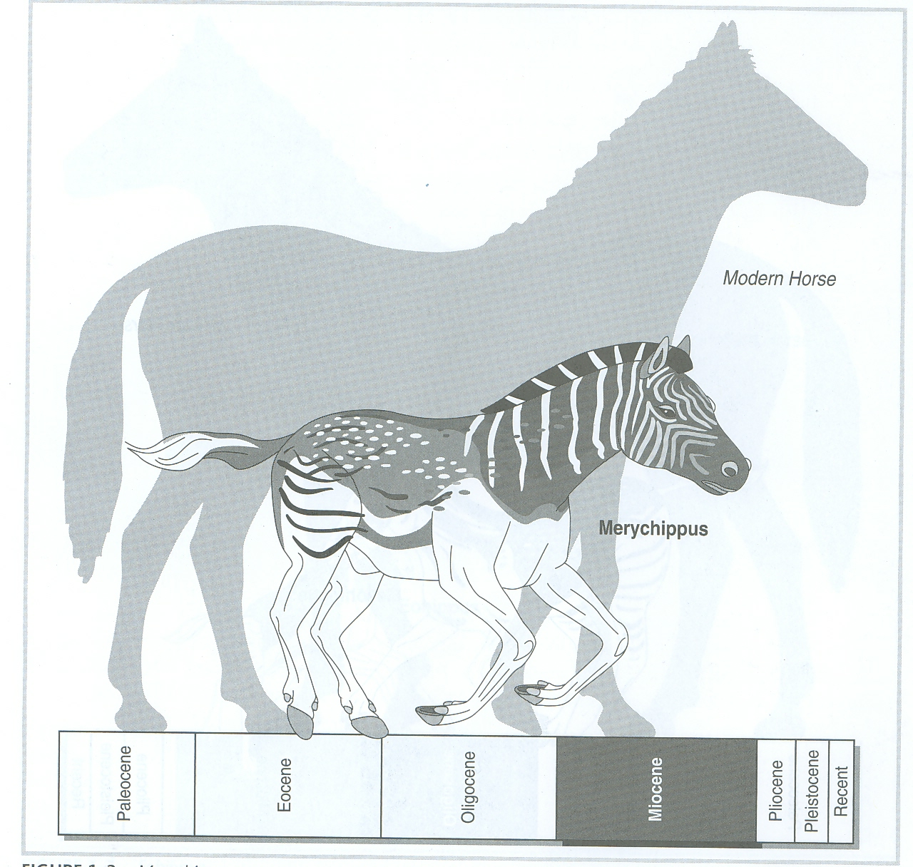

Slide 22
Pliohippus
  Developed ~5 million yrs ago
  Branch of horses crossed into Asia
  Quickly multiplied
  Spread to Europe
  North America
    Horse developed into the final model

Slide 23
Pliohippus
First true monodactyl
  One-toed animal
Used speed to flee from predators
Further evolution of teeth and limbs
Spread into
  South America, Asia, Europe, and Africa

Slide 24
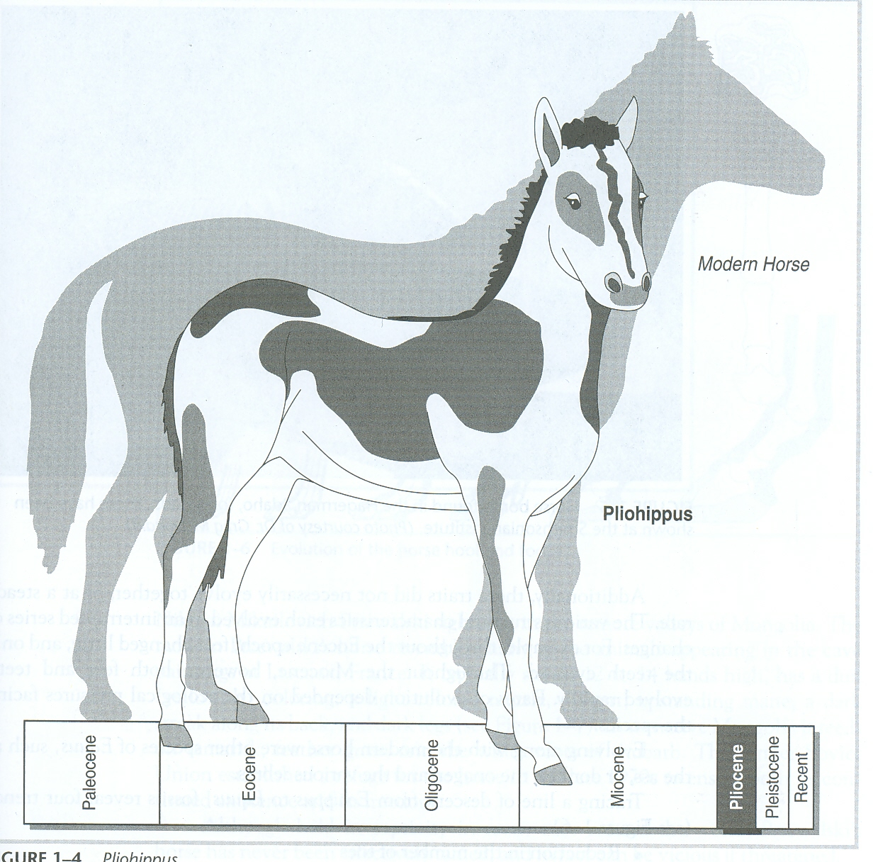

Slide 25
Equus caballus
~2 million years ago
Modern day horse
Became extinct in N. America
  ~8,000 yrs ago
Was not to return until
  Spanish arrived in 1400’s

Slide 26
How Evolution Works
Common evolutionary trends are
  Not seen in all horse lines
On the whole, horses
  Progressively larger
  Some then grew smaller
Many evolved
  Complex facial pits

Slide 27
How Evolution Works
Most recent horses (5 to 10 millions yrs)
  Were three-toed, not one-toed
Why did one-toed animals prevail?
  All of the three-toed lines became extinct
How are rates of evolution determined?
  Ecological pressures facing the specie at the time

Slide 28
Four Trends of Equus Evolution?
  Reduction in the number of toes
  Increase in the size of the cheek teeth
  Lengthening of the face
  Increase in body size

Slide 29
