Slide 1
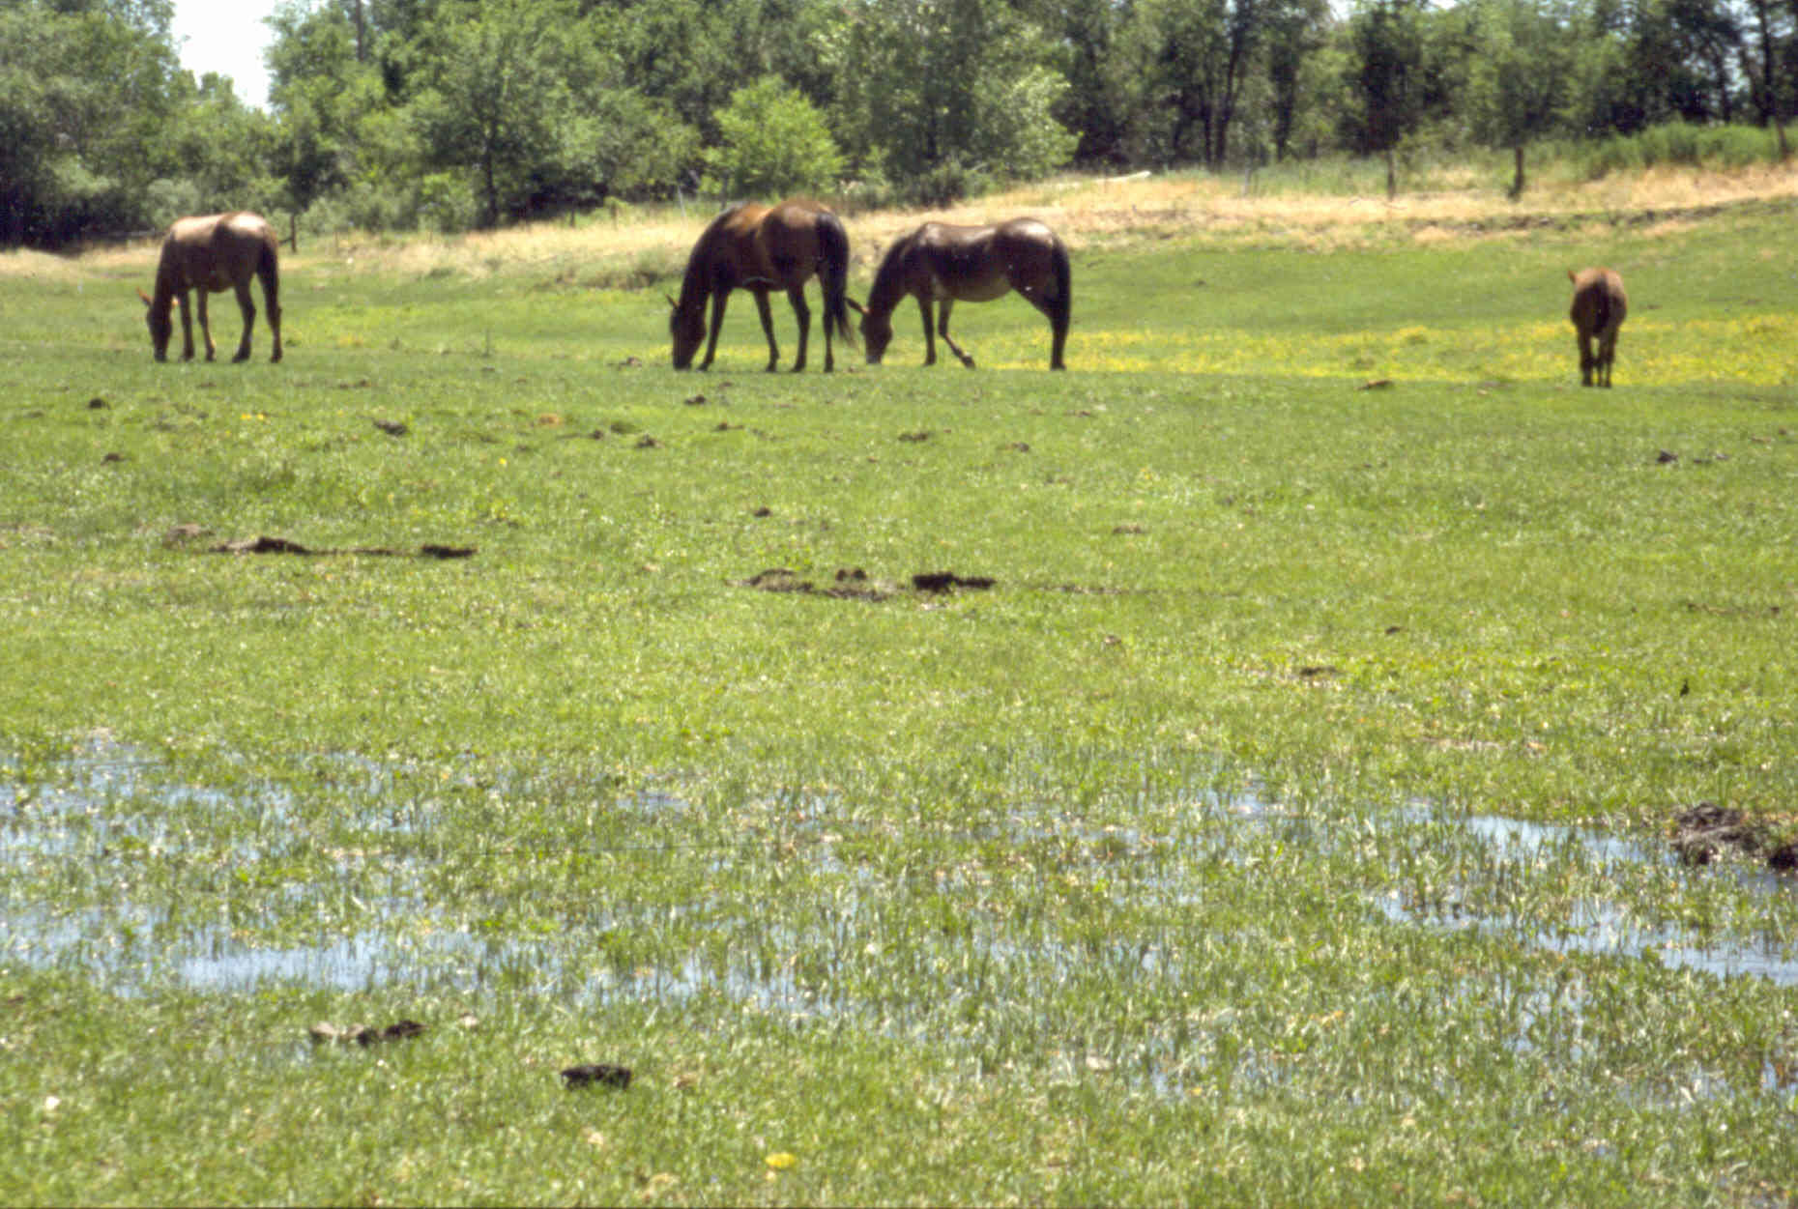

Managing Animals to Avoid Negative Impacts
Developed by:
Holly George, University of California Cooperative Extension
Susan Kocher, University of California Cooperative Extension
Bruce Miller, Utah State University
Melody Hefner, University of Nevada Cooperative Extension
With Contributions From:
Cinda Williams, University of Idaho
UNCE, Reno, NV
Notes:
Module 5, Lesson 3 - This lesson is the third of four in this series, which focuses on animal ownership and land management. This lesson, lesson 3, focuses on how to avoid negative animal impacts to the land, wildlife, and your neighbors. Lesson 1 focused on the benefits and costs of keeping animals on your property. Lesson 2 discussed caring for animals, including tips on nutrition, safety and health care. Lesson 4 will bring all we have learned together by developing and/or designing a grazing system for your property. In these four workshops, we’ll give you information or sources of information on the most common domestic species including horses, cattle, sheep, pigs, poultry, and exotic animals. We will be going through exercises to allow each of you to work through some of your management goals for your property and see how animals fit in. We will also be playing some farm simulation games.
Instructor: Ask participants what is wrong with this picture.

Slide 2
We’ll be covering:
What negative impacts can animals have on land and wildlife?
How can these impacts be avoided or minimized?
What are some strategies for dealing with wildlife?

Slide 3
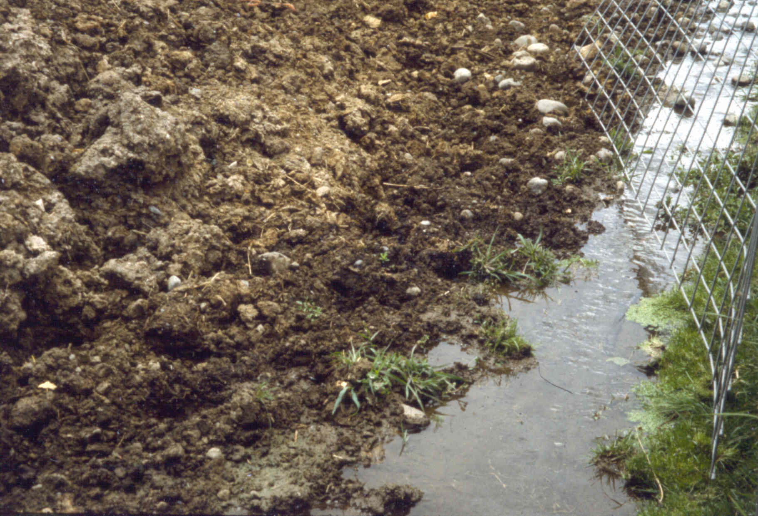
What impacts can animals cause?
UNCE, Reno, NV
Notes:
Instructor: Ask participants to enumerate the impacts animals can cause. Note answers on board or flip chart.

Slide 4
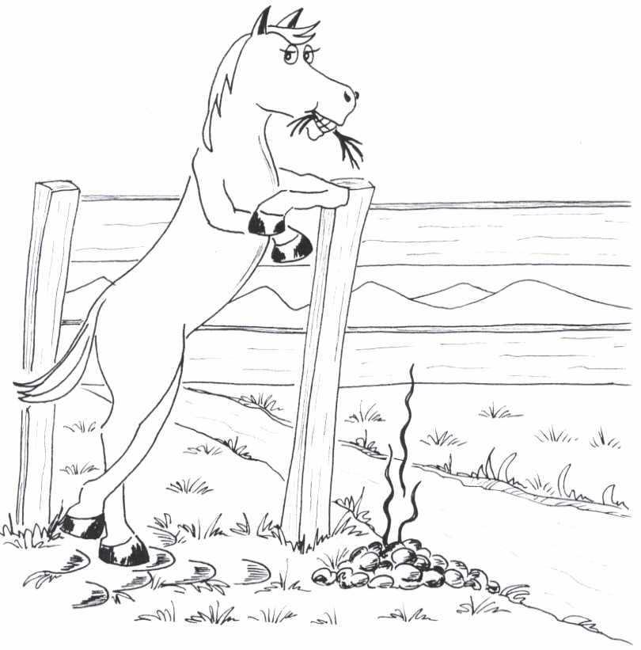
What parts of animals cause impacts?
mouths
bodies
hooves
manure
A. Miller
Notes:
Hooves – trampling affects soil
Mouths – eating grass affects pasture, cribbing fences and facilities
Manure – affects water quality, is a potential pollution sources, and makes visual and olfactory impacts
Bodies – damage vegetation and structures, transport weeds
These impacts are all natural phenomena. They only become problems when the impacts become too concentrated.
Graphic by A. Miller, Black Dog Graphics.

Slide 5
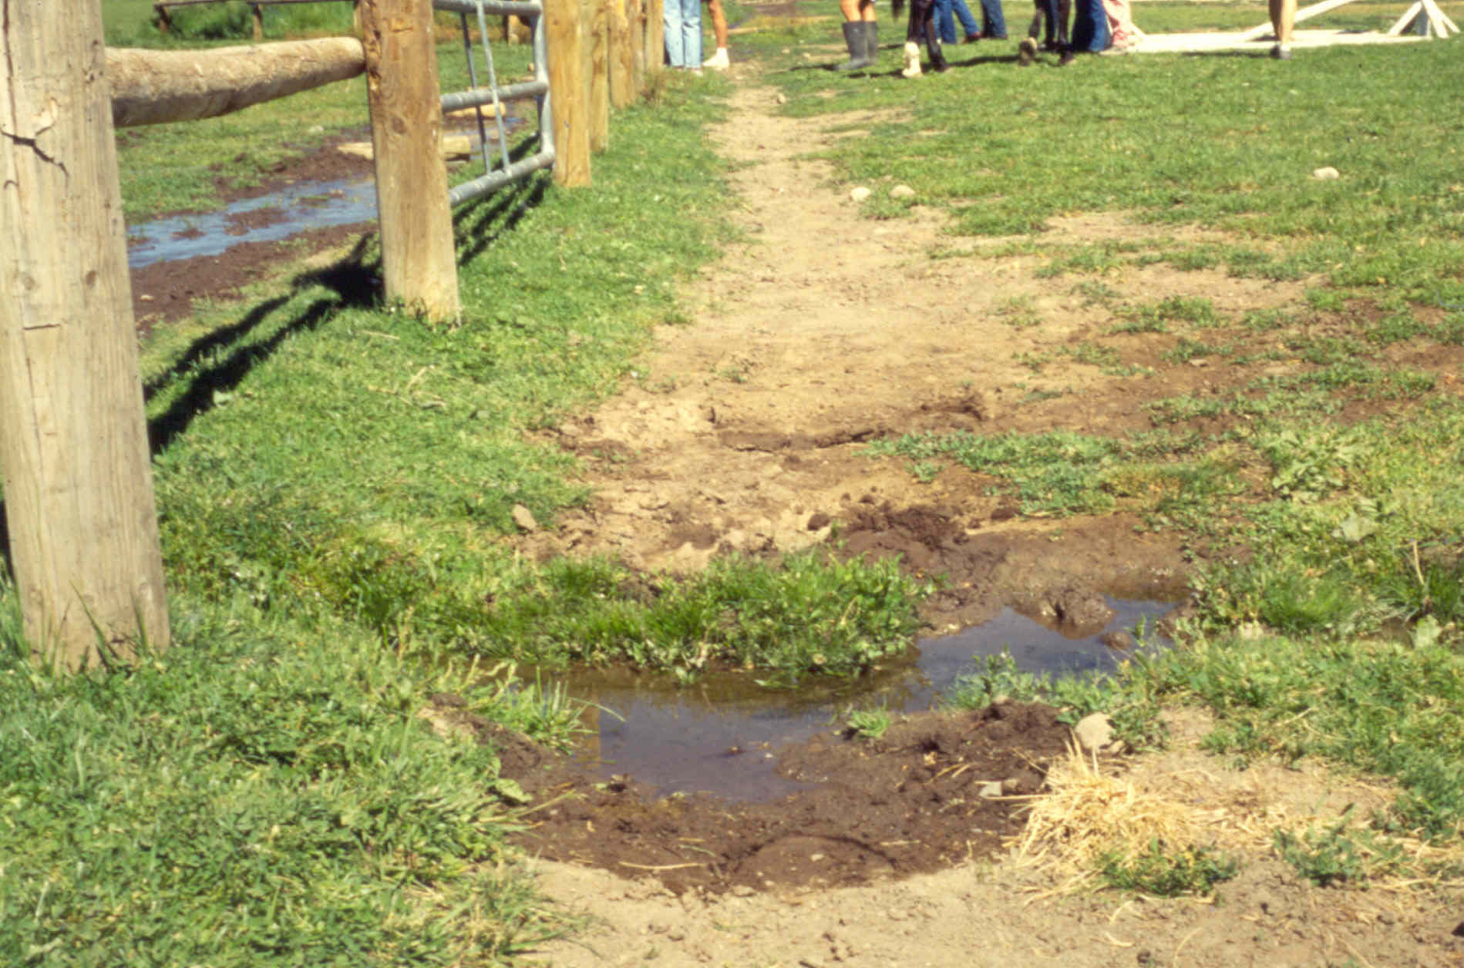
Impacts from hooves
On pastures
  Compaction
  Trails
  Reduced productivity
On stream banks
  Trampling
  Erosion
  Pollution
UNCE, Reno, NV
Notes:
Impacts from hooves
On pastures
Compaction
Trails
Reduced productivity
On stream banks
Trampling
Erosion
Pollution

Slide 6
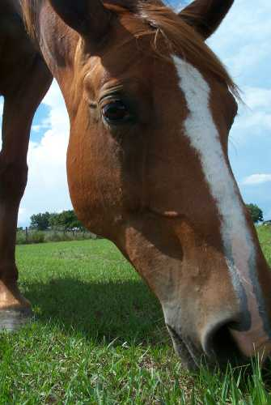
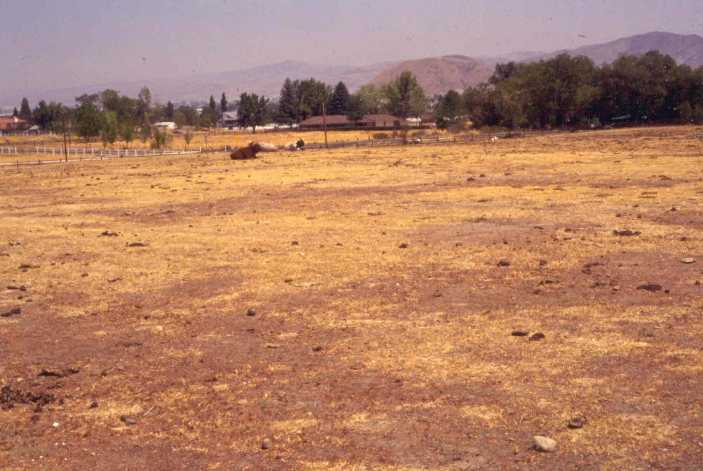
Impacts from mouths
Overgrazing plants can weaken their root structure, plants don’t recover
Pasture productivity decreases
Soil erosion increases
www.farmphoto.com
UNCE, Reno, NV
Notes:
Impacts from mouths
Overgrazing plants can weaken their root structure; plants may not recover
Pasture productivity decreases
Soil erosion increases

Slide 7
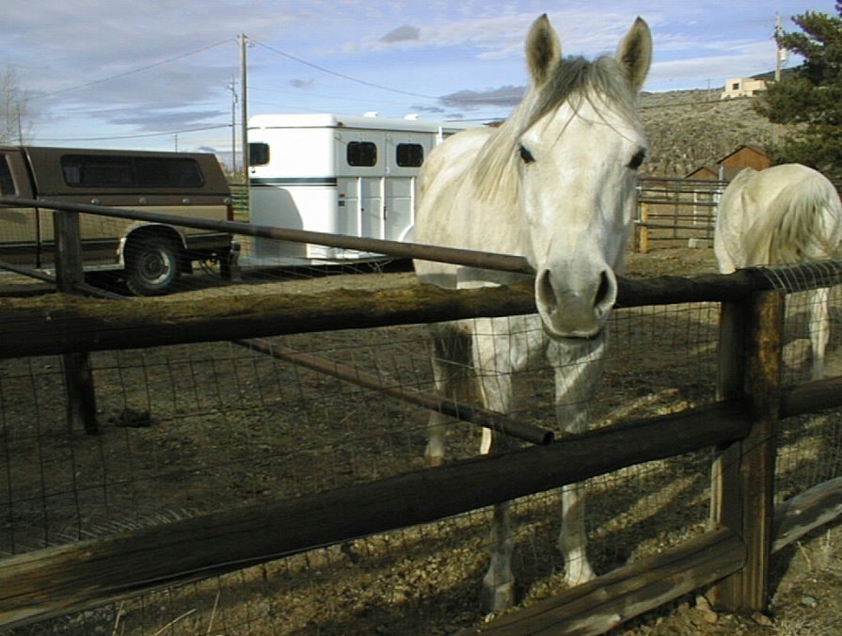
Impacts from bodies
Objects in the pasture are damaged
  Trees, posts, irrigation works, fences
Weed seeds and pests are transported
UNCE, Reno, NV
UCCE
Notes:
Impacts from bodies
Objects in the pasture are damaged - trees, posts, irrigation works, fences
Weed seeds and pests are transported

Slide 8
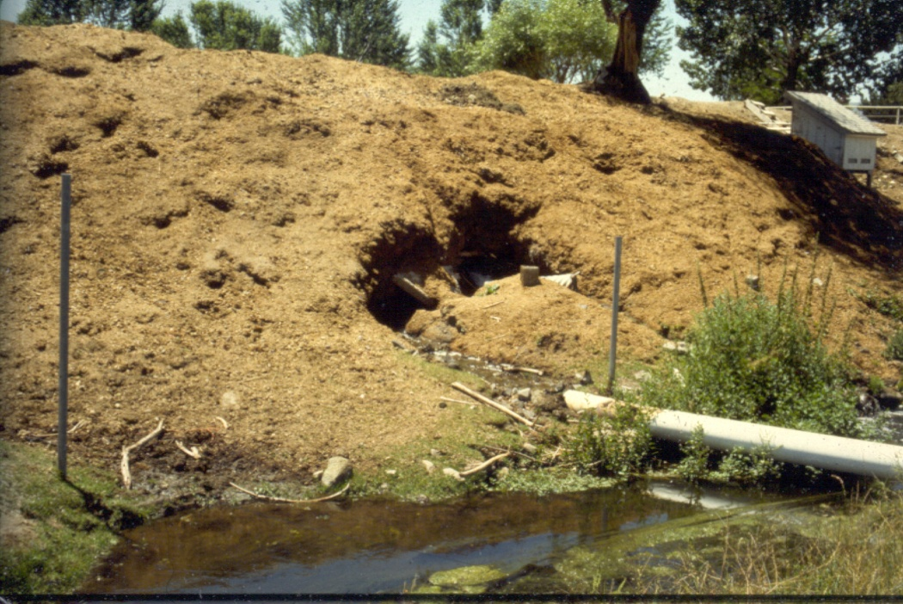
Impacts from manure
Polluted runoff
Odor
Dust
Insects and parasites
UNCE, Reno, NV
Notes:
Impacts from manure
Polluted runoff
Odor
Dust
Insects and parasites

Slide 9
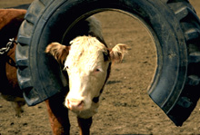
How to avoid impacts?
Good grazing management avoids hoof and mouth impacts
Good facility design avoids animal body impacts
www.usda.gov
Notes:
Proper grazing management can avoid a lot of the impacts previously discussed. Remember to keep the amount of grass harvested by animals less than half of the plant height, so that plants can recover. Remember that the grass blades and plant leaves are “solar panels” that capture sunlight and convert it into food for the plant. You must keep sufficient leaves to capture this sunlight and replenish the carbohydrate reserves in the roots. This requires monitoring your pastures carefully. Control the amount of TIME animals are given access to the pasture relative to the growth rates of plants. Avoid grazing regrowth until the plants have had an adequate rest period. During slow growth, animals can stay in the pasture longer; during fast growth periods, animals may start grazing regrowth of the more palatable grasses before grazing all the existing grass in the pasture. Moving animals and mowing the older growth will keep all of the plants in the pasture in good condition, ensuring that the animals use all plant species equally and allowing pastures recovery time after grazing. The basics of good pasture management were covered in Module 4. Lesson 4 of this module (Module 5) will cover grazing systems.
Good facility design avoids animal body impact by minimizing the damage animals can do. This includes:
Flashing on wood fences to avoid cribbing
Flashing or fences around trees to keep the shade but limit the damage animals can do to the trees
Armoring gutters, etc. on buildings to limit damage
Build facilities with southern exposures to take advantage of natural shade in summer and passive solar heat in winter
Pastures, paddocks, sacrifice areas, etc. located away from wellheads or water sources to limit potential pollution
Instructor: The basics of pasture management were covered in Module 4 and the basics of facilities design were covered in Lesson 1 of this module, Module 5.

Slide 10
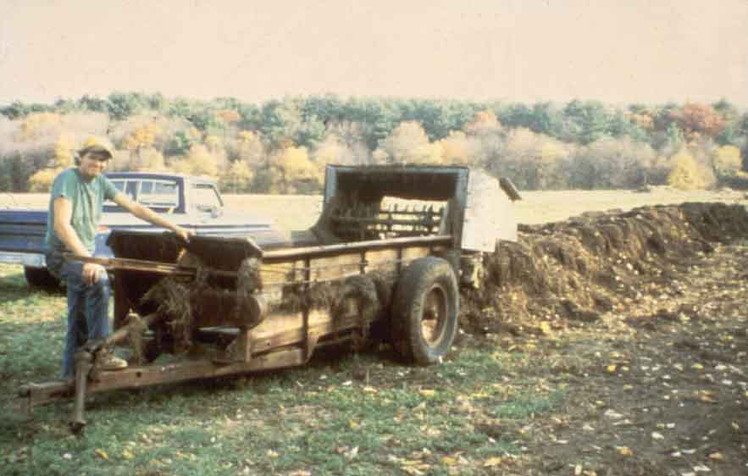
Good manure management
Keeps livestock healthy
Returns nutrients to the soil
Improves pastures and gardens
Protects the environment
OSU Extension Service
Notes:
Managing the waste materials from your animals is as much a part of owning them as feeding them.

Slide 11
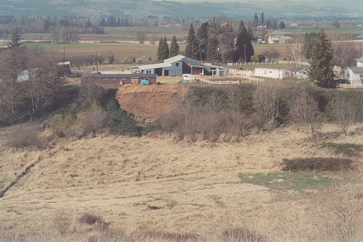
Poor manure management
Livestock
get sick
Unsanitary
conditions
Complaints
from neighbors
Increased insect and parasite populations
Harms environment
USU, Logan, UT
Notes:
When an individual does not take this charge seriously, it may lead to decreased performance or illness in the livestock, unsanitary conditions for the stock and owners, complaints from neighbors, increased insect populations and environmental degradation. This photo is an example of out-of-sight, out-of-mind. Sooner or later, that pile of manure is going to get too big to keep out of sight.

Slide 12
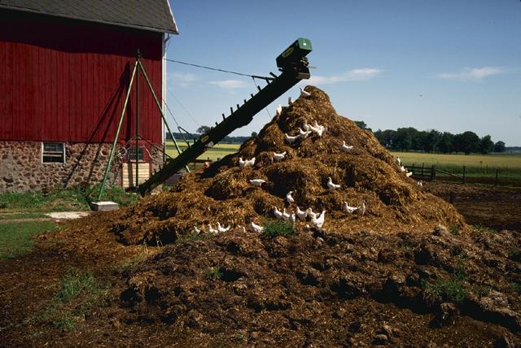
How much manure do animals produce?
Example: How much manure will be produced by two horses in a small stable for three months in the winter.
www.usda.gov
Notes:
Instructor: Ask participants who presently own animals to answer the question; if no one owns animals, ask participants to estimate the volume.

Slide 13
Horse manure production
2 horses, 1000 pounds each
  WEIGHT: 50 lbs/day x 2 = 100 pounds
  VOLUME: .81 cubic feet/day
WEIGHT: 50 lbs/day x 30 days/month x 3 months = 4500 pounds of manure
VOLUME: 0.81 cu ft/day x 30 days/month x 3 months = 73 cubic feet of manure
Notes:
Seventy-three (73) cubic feet is equivalent to a 4-foot by 4-foot by 4.5-foot box; or, you can think of it as 73 of the one-cubic-foot bags of steer manure you can buy at the garden center.

Slide 14
How much manure will your animals produce?
Animal | Volume cu ft/day | Weight lbs/day | Moisture percent
Beef | 1.02 | 63 | 88
Ducks | 0.73 | 46 | 75
Goats | 0.63 | 40 | 75
Horse | 0.81 | 50 | 78
Sheep | 0.63 | 40 | 75
Notes:
This slide shows just a few of the figures given to you on the attached Livestock Manure Production Tables Information Sheet. Each of these figures is based on 1000 pounds of the animal(s) listed. For the horse, this figure may represent less than one horse and the figure for ducks probably represents a minimum of 100 ducks. Sheep, goats and beef, like all other animals, vary in weight by age, species and general health. You can estimate the manure production for one of your animals if you know its average weight.
The next section is designed to get you to determine the actual amount of manure that your animals will produce. There is a handout that estimates volumes that you may expect and a worksheet to assist you with the calculation. Please take five minutes to complete your worksheet, using the numbers for the types of animals that you currently own or plan to own.
Instructor: Give participants a few minutes to complete the worksheet then share the results with the class.

Slide 15
Nutrient value of manures
Animal | N lbs/ton | P₂O₅ lbs/ton | K₂O lbs/ton
Beef | 11.3 | 8.4 | 9.5
Chicken | 27.3 | 23.5 | 13.2
Goat | 22.0 | 5.4 | 15.1
Horse | 12.1 | 4.6 | 9.0
Sheep | 22.5 | 7.6 | 19.5
Notes:
It is important to note that these numbers are not the same as the numbers on the fertilizer bag. This is the pounds of nutrients, in the form noted, per ton of manure, not a percentage of the total weight. For example, the nitrogen content of horse manure is 12.1 pounds per 2000 pounds of manure. A 12.1 nitrogen number on a bag of fertilizer indicates that the fertilizer is 12.1 percent nitrogen. A ton (2000 pounds) of this fertilizer would contain 242 pounds of nitrogen.

Slide 16
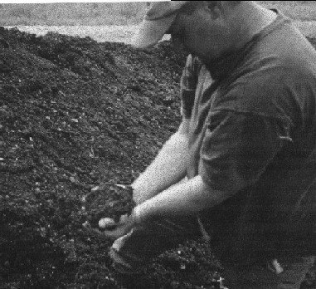
Manure can be a resource
Livestock remove nutrients from land while grazing
Returning manure to soil promotes soil fertility and plant growth
Important nutrients
  Nitrogen (N)
  Potassium (K or K2O)
  Phosphorus (P2O5)
www.senecaway.com/compost.htm
Notes:
Think of manure as a resource – one you can use to your benefit. Returned to your land, it will improve your soil’s texture and nutrient levels.

Slide 17
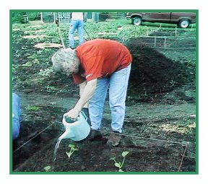
Can I use all my manure?
How much will you have?
Where can you safely store or compost it?
Where can you safely incorporate it in or on your property?
whatcom.wsu.edu/ag/compost
Notes:
Too much of anything is bad – certainly this is the case with manure! Manure management requires an interim storage area or compost area and a place to incorporate the manure, either on your property or on another property. Caution should be used when incorporating the manure as too much manure will burn existing vegetation. Uncomposted or incompletely composted manure can be a source of weed seeds and salts, affecting seed fertility and existing vegetation growth. Additionally, incorporating uncomposted manure can initially rob soil of nitrogen; nitrogen is necessary in the decomposition process.

Slide 18
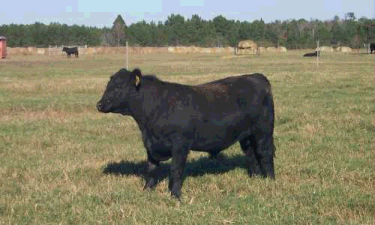
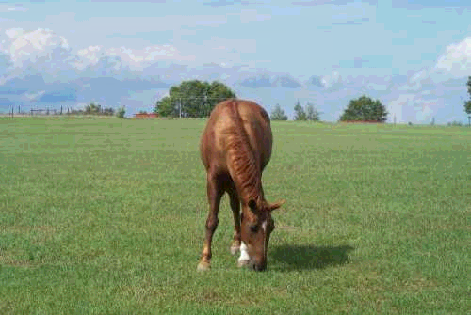
How much manure is enough?
To provide annual phosphorus needs for a one acre pasture:
  one 1000-pound cow
  one 1400-pound horse
  three market (150-pounds) hogs
  twelve 100-pound sheep
  225 laying hens
www.farmphoto.com
Notes:
As a general guideline, spreading the manure from one 1000 pound cow, one 1400-pound horse, three market (150-pounds) hogs, twelve 100-lb sheep or 225 laying hens may provide the annual phosphorus needed on a one acre pasture. As stated in the Module 2 Lessons on soils, you should ascertain the need for phosphorus in the soil before you add it. Some areas of the western U.S. have phosphorus rich soils.
Photo sources: www.farmphoto.com

Slide 19
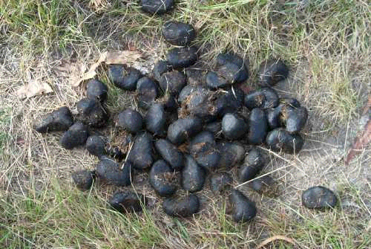
Effective management depends on
Collection
Storage
Application
Removal
www.farmphoto.com
Notes:
Now for a moment let’s think about the complexities of the manure removal systems you might use ☺. Of course, the number and types of animals kept on your property have a large impact upon your waste management considerations. Think for a moment of the difference between the amounts of manure excreted by a rabbit versus a horse! There is not only a great difference in the amount of manure that must be managed, but also in the manner in which the animals are housed.

Slide 20
Manure collects in:
Pasture
Cages
Bedded stall or barn
Dry lots/confinement areas, paddocks, corrals or other “sacrifice areas”

Slide 21
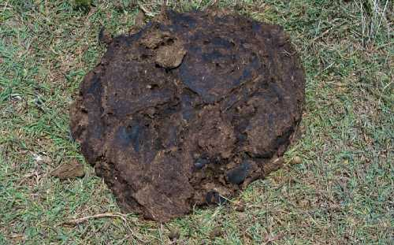
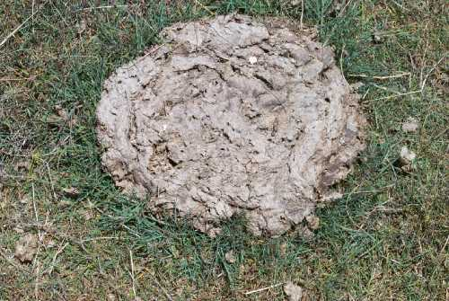
Pasture collection
Requires the least amount of effort
Natural weathering reduces volume up to 60 percent
Nutrients are directly recycled
May require occasional dragging of pasture to break up and distribute the manure
www.farmphoto.com
www.farmphoto.com
Notes:
Manure management for animals kept on pasture requires the least amount of effort. Natural weathering may reduce the volume of manure by up to 60 percent and the nutrients may be recycled immediately. Occasional dragging of the pasture to break up and evenly distribute the manure may be necessary. Some people just kick the manure piles - obviously not the fresh ones - as they are checking their pastures for grass growth or grazed height, weeds, etc. Concerns with this management system are water quality and pollution issues. If there is a gully washer storm or fast snow melt, where will the contaminated water from your pasture flow?

Slide 22
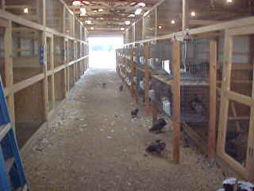
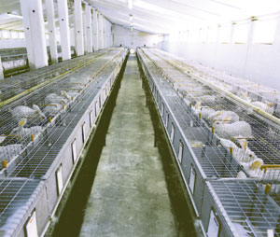
Cage collection
Small animals like rabbits, fur animals and poultry/birds
Manure drops through cage and is removed
Waste includes bedding material such as straw or wood shavings
www.rockingranch.com
Notes:
Small animals (rabbits, fur animals and poultry/birds) are often caged. Waste materials drop through the cage and onto collection trays and then are periodically removed. Animals may also be housed on a floor that usually contains a bedding material such as straw or wood shavings. Generally, this bedding material is also compostable.

Slide 23
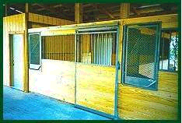
Bedded stall or barn
Horses, cattle, swine, and poultry
Manure and soiled bedding are removed by manual cleaning
www.nationalhorsestalls.com
Notes:
Some species commonly found in bedded stalls or barns include horses, cattle, swine, and poultry. Manure and soiled bedding are periodically removed, usually by manual cleaning.
Of course, the time span between cleanings is highly variable and dependent upon specie, personal standards, and type of housing. On the extreme ends of the continuum are show horses or cattle, whose stalls may be cleaned several times per day, to a poultry building, which may only be cleaned once or twice per year.

Slide 24
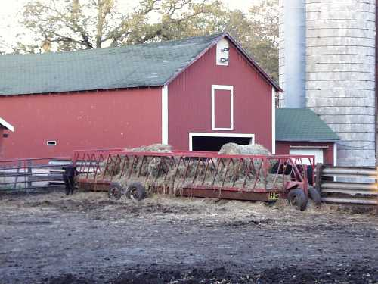
Dry lots, corrals or other confinement areas
www.farmphoto.com
Notes:
These areas are usually outside, exposed to the elements. They have the additional problem of mud during the wet seasons. Manure is confined within the enclosure, but problems with runoff contamination can occur.

Slide 25
Manure storage considerations
Distance from streams, ponds, wells
Prevailing wind direction
Slope of ground
Soil type
Notes:
Manure storage should occur at least 150 feet away from any surface water and from wells or wellheads to limit ground water contamination.
Obviously if there is a prevailing wind direction, you would want to make sure that the manure storage area is not placed up wind from your house or outside entertaining or living areas. Please also consider where your neighbors’ living areas are and plan accordingly.
Flat areas are the best for manure storage, since they greatly reduce the chance of runoff.
Sandy soils drain quickly, moving contaminants through the soil profile easily. This can also affect ground water.

Slide 26
Manure storage - avoiding runoff
Install buffer strips
  Vegetated area between storage and stream
Install berms or ditches
  Prevents water from entering or leaving storage area
Notes:
Install buffer strips, which are grassy or vegetated areas between the storage and the stream or other water body.
Install berms or ditches to prevent water from entering or leaving the storage area.

Slide 27
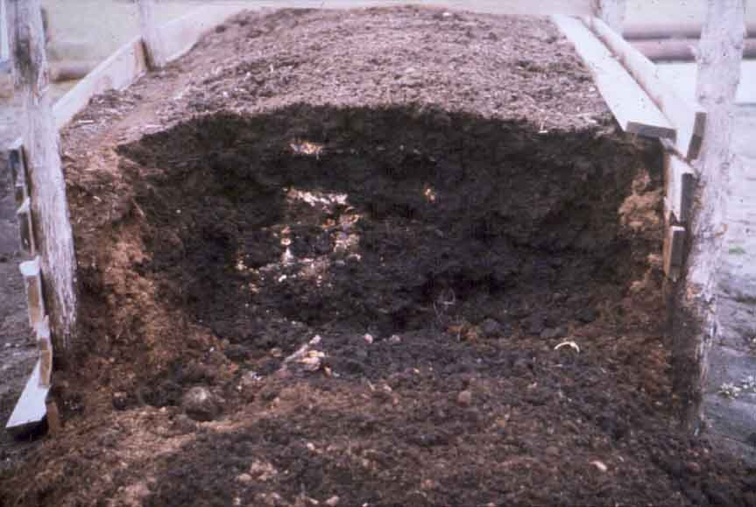
Composting
Reduces volume
Kills parasites
Reduces weed seeds
Reduces odor
Provides slow release fertilizer
Provides soil amendment

Slide 28
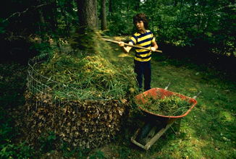
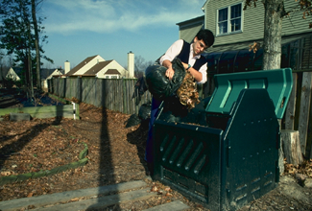
Composting requirements
Oxygen
Moisture
Correct carbon to nitrogen ratio (30:1)
Temperature (120-160 F)
www.nhq.nrcs.usda.gov
Notes:
Oxygen: Piles must be turned to oxygenate.
Moisture: Piles can not have too much or too little. In wet areas, a cover is actually required to keep the compost pile dry enough; in dry areas, the compost pile may need to be watered.
Correct Carbon to Nitrogen ratio (30:1): Horse manure, with a 50:1 carbon to nitrogen ratio, requires addition of nitrogen, in the form of grass clippings, hay, or N fertilizer.
Temperature (120-160 F): These temperatures are generated by microbial action

Slide 29
What do I do with the manure?
Apply it to your property
Arrange with gardeners, landscapers, or farmers to remove it
  most interested in composted manure
Haul it yourself
  most expensive
Landfilling (bury on your property)
  not recommended, expensive and potential for runoff increases

Slide 30
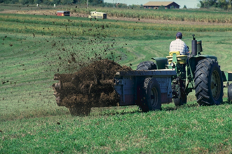
Tips for safe manure/compost application
Minimum of 100 feet from water source (if flat ground)
Away from natural drainages
Incorporate as soon as possible
www.nhq.nrcs.usda.gov
Notes:
Apply a minimum of 100 feet from water source (if flat ground). This includes well heads, artificial ponds and irrigation ditches.
Apply away from natural drainages. Manure or compost needs to be kept out of ephemeral drainages (those with water only part of the year or that contain water only after storm activity).
Incorporate manure/compost as soon as possible. This reduces runoff of nutrients and odor. If the ground is flat, there is less likelihood of runoff.

Slide 31
Tips for safe manure/compost application
Monitor soil’s nitrogen content to avoid overapplication
Complete the composting process to prevent spreading weed seeds
Consider seasonal conditions – winter, wet conditions, etc.
Notes:
Monitor the soil’s nitrogen content to avoid overapplication. As stated before, too much manure will burn existing vegetation.
Weed seed is a concerns if composting is not complete. Complete composting reaches a fairly hot temperature (160 degrees) that will kill most weed seeds. If composting is not complete, there may be viable weed seeds left – weed seeds you have now incorporated in your landscape somewhere.
There are also seasonal considerations: winter, wet conditions, etc. Most chemical reactions occur faster under “warm” conditions. Composting and decomposition work fastest when the ground is not frozen. Manure or compost may be applied to frozen ground if the ground is flat. When the ground is saturated with water, there is a greater potential for runoff.

Slide 32
The bottom line (no pun intended)
Manage manure to maintain healthy animals and healthy land
Applying manure to your property increases the nutrient value and organic content of your soil
Notes:
If you have not completed the manure management exercise, there may be time to finish at the end of class. You may, of course, continue working on the exercise during the break. After a short break, we will switch gears and discuss some management techniques for dealing effectively with wildlife.
BREAK

Slide 33
Impacts to and from wildlife

Slide 34
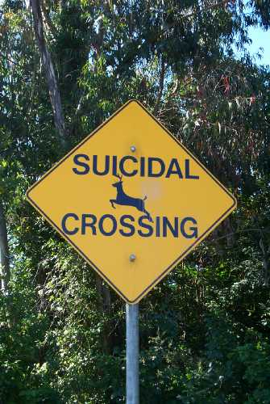
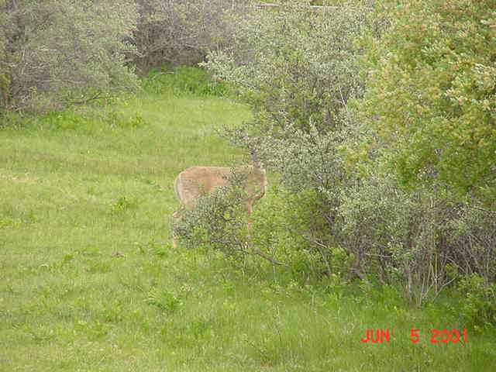
Impacts to and from wildlife
Habitat loss
Dependence on artificial feeding
Disease
www.farmphoto.com
NRCS, Bozeman, MT
Notes:
Keeping domestic livestock has profound impacts on wildlife. In many cases placing livestock on the landscape reduces the habitat available for wild animals to thrive and reproduce. In other cases, feed directed at livestock is eaten by wildlife, elevating the numbers of these animals past a natural level that can be sustained without human help. The most serious impact is disease, which can be passed back and forth between livestock and wild animals. It is difficult to control disease in wildlife populations.
All these factors lead to consequences for wildlife.

Slide 35
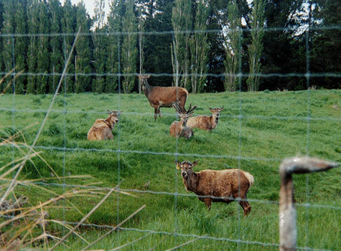
Habitat loss
Fencing
  Displaces some animals
  Subdivides and fragments habitat
www.farmpicures.com
Notes:
Wildlife inhabited most of the areas you live in and dominated it before domestic animals were introduced. Bringing in domestic animals has directly displaced some wildlife that previously grazed on range and forest lands.
The fencing set up to manage livestock serves to subdivide the habitat and fragment what’s left, making it difficult for some wildlife to move to the areas of habitat left to them.

Slide 36
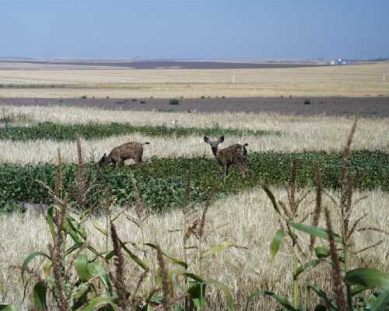
Artificial feeding
Attracts some species to feeding areas
Changes species balance
Can make some species become more vulnerable to predators
www.farmphoto.com
Notes:
In the other direction, producing crops or pastures for livestock can attract wildlife to an area. This can lead to artificially high levels of animals living in an area, beyond the level that can be sustained by natural habitats. Congregating these animals in feeding areas can also make them more vulnerable to predators.

Slide 37
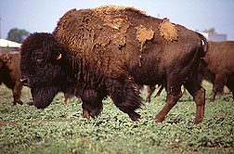
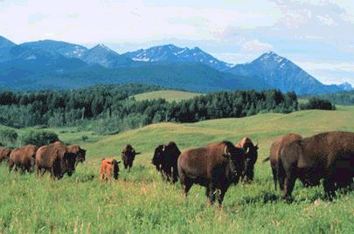
Spread of disease
Domestic to wild
Wild to domestic
www.ars.usda.gov
www.montana.edu/wwwcbs
Notes:
The interaction between wildlife and livestock can lead to the spread of disease back-and-forth, harming both.
A new vaccine against brucellosis in cattle may also protect bison against the disease. Bison and elk are the last major sources of cattle brucellosis in the United States. In an experimental study, ARS researchers vaccinated 10 female bison with the new vaccine, B. abortusstrain RB51. The vaccinated animals’ immune response was comparable to that of cattle vaccinated with RB51. None of these vaccinated bison shed live bacterium into the environment. This is important in protecting other wildlife, such as moose.
Instructors: Any local diseases should be inserted here.

Slide 38
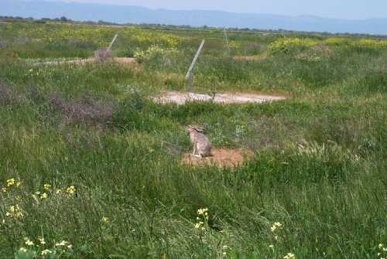
Setting wildlife goals
What wildlife is common in your area?
Do you want to encourage or discourage wildlife?
What type of wildlife do you want to encourage?
What type of wildlife do you want to discourage?
www.farmphoto.com
Notes:
As with all other factors discussed to date, you will have to set some wildlife goals for your property. First and foremost, do you know what type of wildlife inhabit your surrounding areas? Is this wildlife permanent/resident or seasonal/migratory?
Do you want to encourage or discourage wildlife? At first glance, this question seems like a no-brainer. It is pretty universal to want to limit access by mountain lions, bears and other predators to our property. And most everyone likes birds, except those of you with fruit trees. And who doesn’t like to see a squirrel, except those folks with bird feeders and those folks with squirrels presently living in their attics or crawl spaces.
The point is, it is not unreasonable to decide that you want to have certain types or species of wildlife and you want to completely discourage other types or species of wildlife. It is not unreasonable to want to limit the access to or exclude wildlife from certain portions of your property. Anyone with a bird feeder or birdhouse understands this concept. Deciding in advance what wildlife you are trying to encourage or discourage and doing a little advance research can help you achieve your goals.

Slide 39
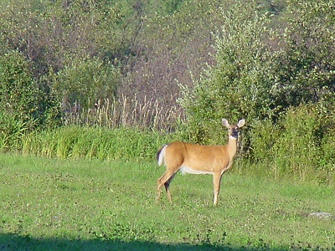
Encouraging wildlife
www.usda.gov
Notes:
Decide what type or species of wildlife you want to attract.
Evaluate your current property assets, including wildlife needs:
Food – a variety of plant species and types
Water – streams and ponds – natural or artificial sources
Shelter – safety, shade, cover, nesting

Slide 40
Plant selection should:
Include foods and shelter plants for the wildlife you want to attract
Be diverse, for the most diverse wildlife
Be species specific, if that’s the goal
Mix sizes, heights and types, evergreens and deciduous
Incorporate native species
Take into account your landscape’s needs/abilities
Notes:
If you have existing wildlife habitat, great. If you don’t and you want to add some, here are some plant suggestions.
Include foods and shelter plants for the wildlife you want to attract. Nuts, grains, berries, and cones for birds and small animals, woody vegetation (shrubs and brush) plus grasses for browsers like deer and elk.
Be diverse to attract the most diverse wildlife. The greater the diversity of food and shelter, the greater the diversity of wildlife attracted to the habitat.
Be species specific, if that’s the goal. If you know what you want to attract, be sure to include plants specifically for the food and shelter needs of that species.
Mix sizes, heights and types of vegetation, including both evergreens and deciduous plants. This will provide the best year-round food and shelter for wildlife.
Incorporate native species. Plants specifically adapted for your environment will have the least problems and require the least maintenance.
Take into account your landscape’s needs/abilities. If the area you have set aside is not irrigated, do not choose plants that require more water than naturally available. Keep in mind the eventual size of the trees and shrubs you are planting. Realize that if you are planting wildlife food sources, you should probably allow time for the plants to become established before allowing wildlife to browse them.
Instructor:Customize this discussion to local conditions and interests.

Slide 41
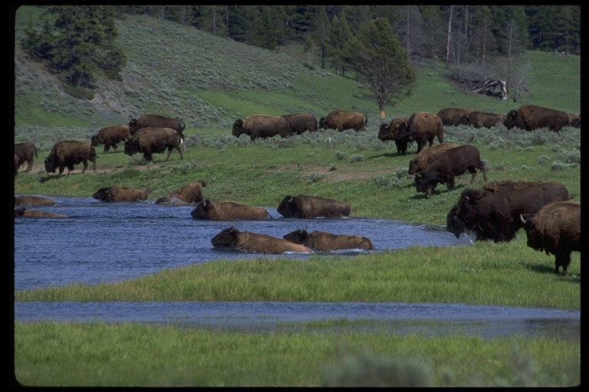
Water for wildlife
All life needs water, including wildlife
Wildlife can use natural or artificial sources
dlp.cs.berkeley.edu
Notes:
All life needs water, including wildlife.
Wildlife can use natural or artificial sources.
Instructor: Customize this discussion to local conditions and interests.

Slide 42
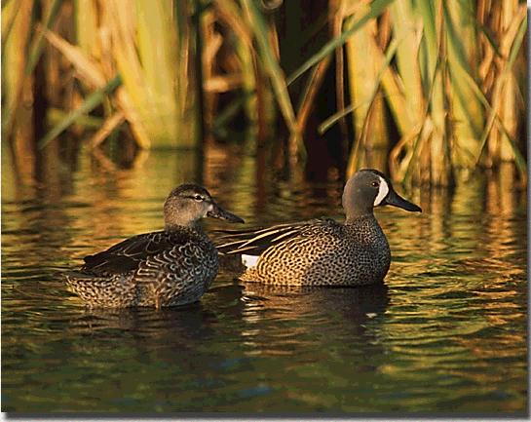
Natural water sources
Should have:
Plants along edges to provide stability
Buffer areas of taller plants to provide cover for animals
A variety of plants, giving wildlife a variety of habitats
birdsofoklahoma.net
Notes:
Instructor: Customize this discussion to local conditions and interests.

Slide 43
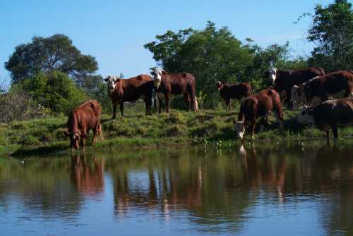
Artificial ponds or water holes
Should provide:
Both shallow and deep areas
Rocks along the edges
Plants along edges to provide stability
Buffer areas of taller plants to provide cover for animals
www.farmphoto.com

Slide 44
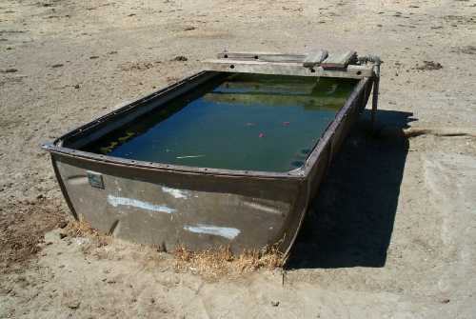
Artificial water sources
Troughs, tanks, etc should have ramps to aid small animals and birds that might otherwise drown
On demand water sources for livestock should be routinely checked for problems
www.farmphoto.com
Notes:
Instructor: Customize this discussion to local conditions and interests.

Slide 45
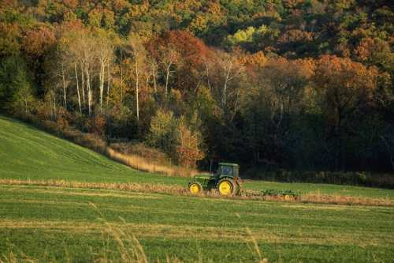
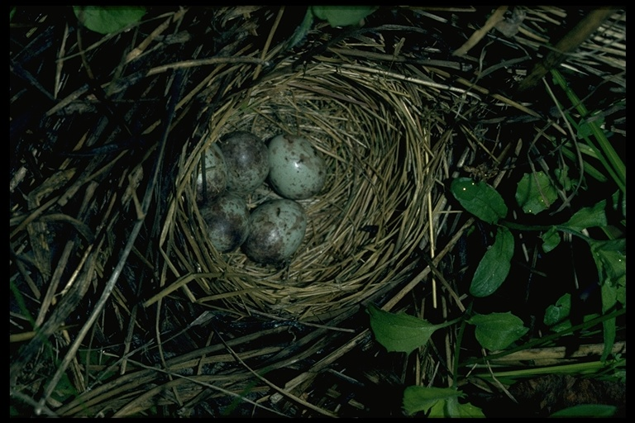
Shelter/nesting habitat
Provides shade, cover for nests, and safety from predators. Examples:
  Grasses, shrubs for small animals and birds
  Evergreen trees for year-round protection
  Snags for certain birds and small animals
www.farmphoto.com
dlp.cs.berkeley.edu
Notes:
Keep in mind that the way that cover is arranged in relationship to food and water determines whether habitat is usable to wildlife. While an island of habitat on your property is a good start, ideally you want a continuous path of shelter, perhaps along a fence line. If you can implement this concept with your neighbors or in your community, you will be well on your way to encouraging wildlife.
Instructor: Customize this discussion to local conditions and interests.

Slide 46
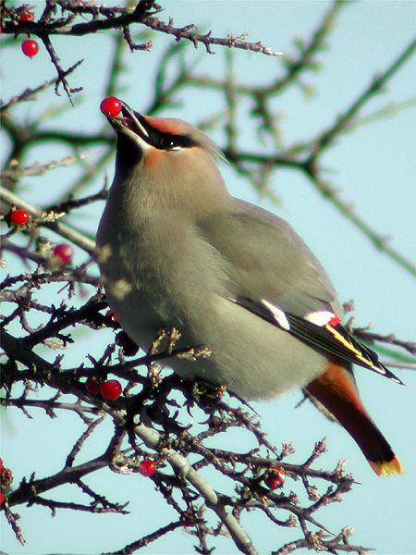
For birds
Need combination of shrubs, trees, and grasses
Leave occasional downed and standing snags for nests and perches
dlp.cs.berkeley.edu
Notes:
Birds require diverse food sources and nesting sites/nesting materials.
Instructor: Customize this discussion to local conditions and interests.

Slide 47
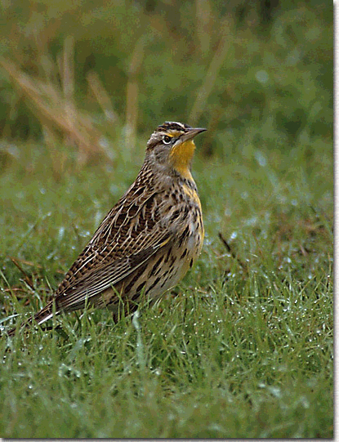
Avoiding impacts to wildlife requires
Pasture/Landscape management
Appropriate fencing
Pet management
Livestock management
birdsofoklahoma.net
Notes:
Each of the listed factors will be discussed next in some detail.
Instructor: Customize this discussion to local conditions and interests.
http://birdsofoklahoma.net/Westmedlark01.htm

Slide 48
Pasture/landscape management to encourage wildlife
Keep wildlife needs in mind
  Allow access to water
  Avoid early season mowing and chemical weed control in tall grass
  Control noxious weeds
  Keep corridors of habitat
  Manage fuels to reduce fire hazards
Notes:
Keep habitat needs in mind.
Allow access to water
Avoid early season mowing and chemical weed control in tall grass
Control noxious weeds – they reduce habitat value and can eventually take over
Keep corridors of habitat, along fence lines if possible
Manage fuels to reduce fire hazards
Instructor: Customize this discussion to local conditions and interests.

Slide 49
Fencing considerations to encourage wildlife
Type and species of wildlife
Continual or seasonal access needs
Localized or full access
Notes:
When wildlife is desirable, property owners need to use wildlife friendly fences. As in all the other discussions, this is dependent on the type and species of animal you wish to allow access to your property.
In general, a fence no more than 40 inches high, with multiple wires (smooth or barbed) at set spacing of 16, 22, 28 and 40 inches from the ground will allow antelope, deer and elk to pass through with minimal fence damage while containing your livestock. Especially important is the 12-inch gap between the two highest wires; this helps keep animals from getting tangled in the wires. There are wooden fences that allow access to wildlife also. These are generally more expensive, but may handle heavier snowfall better.
One consideration is if you only wish to allow seasonal migration or continuous access. Sections of fence can be temporarily dropped for migratory purposes and for seasonal access.
You may want to allow access to pasture or a portion of property, but discourage access to other portions, like the vegetable garden, your backyard and patio and/or the pet runs (kennels, etc.). The next discussion will be on fencing to discourage wildlife.
Instructor: Customize this discussion to local conditions and interests.

Slide 50
Fencing to discourage wildlife
Type and species of wildlife
Additional purpose(s) of fencing
Type of fencing
  Net wire
  Electric
  Electric modification of existing fences
  Portable electric fences
Notes:
In general, a six foot or taller fence will discourage most wildlife, especially if the fence is also electrified. A multiple strand fence, as discussed before, but with closer spaced wires can be an effective deterrent to wildlife, provided of course than you don’t have a heavy snowfall that makes your originally 6-foot fence an effectively 2 foot to 3 foot fence. These closer spaced wires can also aid in keeping out smaller animals, such as raccoons, and some predators. This type of fencing can be installed to protect garden, pet containment areas and human “play” areas, allowing wildlife access to other portions of your property if you wish. Protection of small areas can be achieved through the use of electrical fencing or electric modification of existing fences. Portable electric fences can provide protection of certain areas for short periods of time.
Some other considerations should be mentioned here to minimize conflicts with wildlife. The success of various types of fencing in keeping out predators has ranged from 0 to 100 percent. Density and behavior of coyotes, terrain and vegetative conditions, availability of prey, size of pastures, season of the year, design of the fence, quality of construction, maintenance, and other factors all help determine how effective a fence will be. Fencing is most likely to be cost-effective when the potential for predation is high, when there is potential for a high stocking rate, or when electric modification of existing fences can be done. Fencing is effective when incorporated with other means of predation control. For example, guarding dogs and fencing have been successfully used together to achieve a greater degree of success than either method used alone. An electric fence may help keep a guard dog in and coyotes out of a pasture. If an occasional coyote does pass through a fence, the guard dog can keep it away from the livestock and alert the producer by barking.
Fencing can also be used to concentrate predator activity at specific places such as gateways, ravines, or other areas where the animals try to gain access. Traps and snares can be set at strategic places along a fence to effectively capture predators. Smaller pastures are easier to keep free from predators than larger ones. Fencing is one of the most beneficial investments in predator damage control and livestock management if practicality warrants its use.
As a final note, fences can pose problems for wildlife. Barrier fences, in particular, exclude not only predators but also many other wildlife species. This fact should be considered where fencing intersects migration corridors for wildlife. Ungulates, such as deer, usually jump fences, and it is not uncommon to find deer that have become entangled in the top wires of fences.

Slide 51
Minimizing wildlife conflicts
Limit access to your home
Limit access to your yard
Reduce the attractiveness of your living areas
Reduce the temptations to predators
Notes:
What are some additional practices you can use to minimize wildlife conflicts? Each of these topics will be discussed in some detail next.
Instructor: Customize this discussion to local conditions and interests.

Slide 52

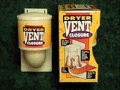
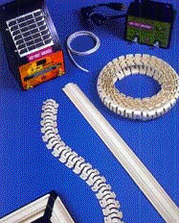
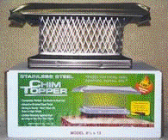
Limit access to your home
www.crittercontrol.com
Notes:
Limit access to your home.
In addition to being a good fire control measure, removing overhanging limbs can substantially reduce the access to your attic, crawl spaces and chimneys by squirrels, raccoons and other invaders.
Check your house (or other structures), especially the attic, garage and chimney, for any holes greater than ¼-inch. These should be blocked or screened with building materials resistant to gnawing or prying, like steelwool.
Screen all vent, fan and window-type openings.
Keep doors and windows in good repair.
Tighten the eaves and replace any loose or decayed boards.
Seal off any foundation openings with 12-inch wire mesh, sheet metal or concrete.

Slide 53
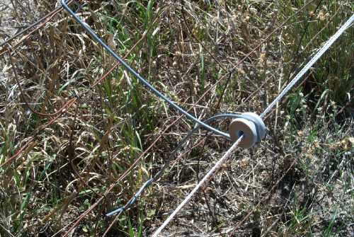
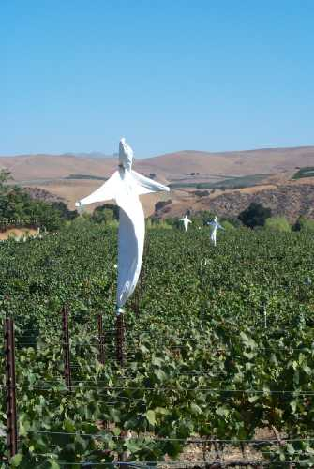
Limit access to your yard
www.farmphoto.com
www.farmphoto.com
Notes:
Limit access to your yard.
Fence your yard with at least a 6-foot high fence. If especially dangerous or persistent wildlife becomes a problem, augment the fencing with electrified fencing material.
Use of other deterrents, such as nightlights, motion detectors, scarecrows, loud sound or music may be effective, but the position of these objects may need to be changed periodically for maximum effectiveness.

Slide 54
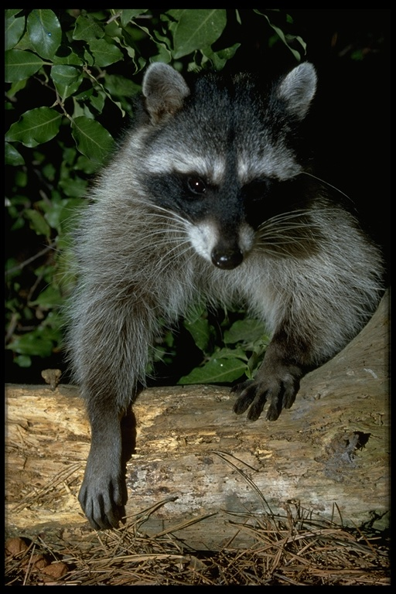
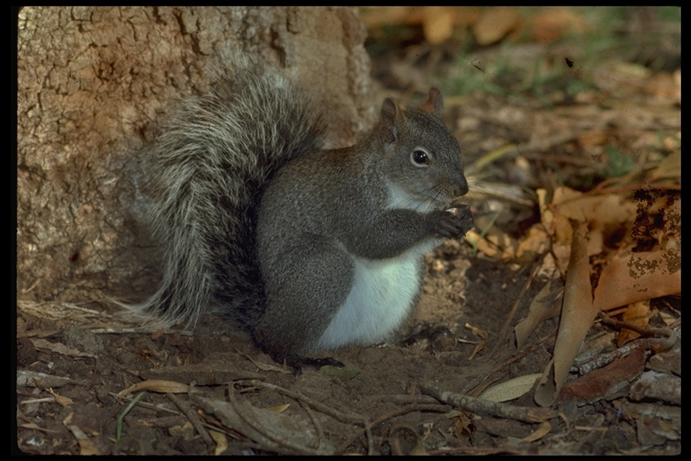

Make your property less attractive to wildlife
dlp.cs.berkeley.edu
Notes:
Reduce the attractiveness of your living areas.
Remove bird feeders or use squirrel-proof bird feeders. Remove acorns and other nuts from the yard to reduce small wildlife.
Do not leave pet food outside; it attracts many different types of animals, including raccoons and skunks plus stray dogs and cats.
Discourage deer and other browsers by removing supplemental food sources, using plants that deer do not like to eat in your formal landscape and using repellants.
Do not feed wildlife in general. Putting out food for deer and elk can cause nutritional problems, disease and even death. Additionally, this can lure in predators that will not discriminate between wildlife, livestock or pets.
One of the biggest food sources for wildlife is our trash. Store garbage in plastic or metal containers with tight fitting lids. If at all possible, keep the containers in a closed shed or garage until trash-collection day. If you live in bear country, there are specially designed “bear-proof” trash containers. The Division of Wildlife for your area probably has designs or suggestions.
Bears do pose a larger problem, in more ways than one! In addition to getting into your garbage, bears will also go for your barbeque grill grease and bird suet. Put the former inside and latter high up in a tree, along a high wire between trees, or bring them in at night. Since bears are omnivores, you should also be cautious of putting fruit rinds or other tasty items in your compost pile or using them as a mulch.

Slide 55

Reduce the temptations to predators
UCCE
Notes:
Reduce the temptations to predators.
Livestock and pets attract predators. This can be a real danger and all effort should be made to reduce predator access to your property. In addition to management techniques already discussed, measures to limit, reduce and control predators will be discussed in both the pet management and livestock management sections.

Slide 56

Pet management strategies
Remove pet food from wildlife access.
Control your pets, especially at night.
If you confine your pets outside, make sure the area is safe.
UCES
Notes:
Remove pet food from wildlife access.
As covered before, this is a real magnet for some predators, large and small.
Control your pets, especially at night.
Uncontrolled pets are a threat to wildlife. Domestic cats kill small mammals and birds. Dogs on the loose can harass and kill both livestock and wildlife. Many states, counties, cities and other municipalities have laws allowing law enforcement officers to destroy dogs seen chasing livestock or wildlife – and then fine the pet owner.
Uncontrolled or roaming pets are also a food source for some wildlife. Let’s face it, most of your dogs and cats are no match for a couple of coyotes, let alone a mountain lion or bear.
If you confine your pets outside, make sure the area is safe.
If your pets are outside at night, make sure they have some sort of safe area that they could hide in. Make sure also that the area is fenced appropriately.
Instructor: Customize this discussion to local conditions and interests.

Slide 57

Livestock management
Some domestic animals attract predators
  Lions, coyotes, dogs
  Raccoons, skunks
www.aphis.usda.gov
Notes:
In addition to all the strategies mentioned so far, you may want to consider the following when it comes to predators and livestock management:
Fence livestock enclosures appropriately, including using electric fencing if feasible.
As mentioned before, there are many types of deterrents – most of which require relocation to maintain their effectiveness.
Remove brush and trees within a quarter mile of buildings and livestock to reduce mountain lion predation. This appears to be in direct opposition to wildlife goals, but if you’ve got mountain lions…
Lambing and farrowing should occur in protected enclosures to limit or prevent predation on young livestock.
If you have a consistent, persistent predator problem, there are some additional management techniques you may wish to implement.

Slide 58

Predator avoidance
Move animals
Guard animals
Destroy pest animals
www.lgd.org
Notes:
http://www.lgd.org/workphotos.html

Slide 59

Move animals
Moving animals into a barn or night pen will reduce access by predators
UCCE
Notes:
Moving animals into a barn or night pen will reduce access by predators. The combination of fencing, moving animals at night and including guard animals in the herd has been found to be highly effective in reducing predation.

Slide 60


Guard animals
Dogs
Llamas
Donkeys
UNCE, Reno, NV
Notes:
The addition of guard animals to livestock pens will decrease predation.

Slide 61
Guard dogs
Not shepherds or herders - protectors
  Great Pyrenees, Akbash, Kommodores, Anatolian Shepards, Maremmas
Pros
  Effective - 85% of respondents in a Colorado survey rated dogs’ performance at deterring predators as excellent or good
  Deters many species of wildlife
Cons
  May be aggressive to people
  Must be started as very young pups
Notes:
Colorado Study: Andelt, W. F., 1995, updated 2001, Livestock Guard Dogs, Llamas and Donkeys, Colorado State University Cooperative Extension fact sheet no. 1.2218, 7p. Downloadable at: http://www.ext.colostate.edu/PUBS/LIVESTOCK/01218.html#top

Slide 62

UCCE

Slide 63


Llamas
PROS
  80% of owners rated them as effective or very effective
  Most effective for coyotes and dogs
  Need less training
  Need no special food
  Live longer than dogs
CONS
  May be afraid of mountain lions (who isn’t!)
www.farmphoto.com
texnat.tamu.edu/ranchref
Notes:
Statistics source is from Colorado Study: Andelt, W. F., 1995, updated 2001, Livestock Guard Dogs, Llamas and Donkeys, Colorado State University Cooperative Extension fact sheet no. 1.2218, 7p. Downloadable at: http://www.ext.colostate.edu/PUBS/LIVESTOCK/01218.html#top
http://texnat.tamu.edu/ranchref/predator//cougars/cougars.htm

Slide 64


Slide 65

Donkeys
PROS
  Least expensive
  Somewhat effective against dogs and coyotes
CONS
  Not as effective as dogs or llamas
  59% of Texas sheep producers rated donkeys good or fair
www.donkeybreedsociety.co.uk
Notes:
Statistics source is from Colorado Study: Andelt, W. F., 1995, updated 2001, Livestock Guard Dogs, Llamas and Donkeys, Colorado State University Cooperative Extension fact sheet no. 1.2218, 7p. Downloadable at: http://www.ext.colostate.edu/PUBS/LIVESTOCK/01218.html#top
http://www.donkeybreedsociety.co.uk

Slide 66
Destroying pest animals
Some may be destroyed without permit
Some require a permit
Some may not be destroyed
Notes:
Despite all your best efforts, you may still experience predation on your livestock. In that case, destroying pest animals may be your only solution.
In order to do this, it’s important to first know the rules and regulations in your area. Some animals may be destroyed without a permit, some will require a state permit, and some may not be destroyed at all due to their status as endangered, threatened, or protected.
Instructor: Please customize the discussion here to local conditions and regulations.

Slide 67

Regulations in local area
Dogs
Coyotes
Foxes
Mountain lions
Bears
Wolves
texnat.tamu.edu/ranchref
Notes:
Instructor:Customize this discussion to local conditions and interests.
http://texnat.tamu.edu/ranchref/predator

Slide 68
Resources to help
Federal trappers
Local agricultural commissioners
Local branch of the U.S. Department of Fish and Wildlife
Local health department
Notes:
Instructor: This section should be customized for your local area. A good way to present this information is with the help of a guest speaker from your state’s wildlife regulatory agency.

Slide 69
Living with wildlife
Determine local wildlife population
Determine wildlife goals for your property
  Complete exclusion
  Open access
  Combination
Determine available wildlife habitat on your property
Modify your property and facilities appropriately to achieve your goals

Slide 70
The Farm Game
Design or redesign your property layout and facilities, especially the portion dedicated to animal uses, to avoid impacts to the land and wildlife. Include:
  Manure storage areas and schedules
  Fencing or strategies for avoiding predation or limiting wildlife access
  Landscaping or features to attract desirable wildlife
Notes:
With the maps that class members have brought in of their properties, have each participant design or redesign their property layouts and facilities, especially the portion of their operation concerned with animals, to avoiding impacts to the land and to wildlife. This design or redesign should be done on a Mylar overlay. Remember: “land” includes your neighbors’ land also. This Mylar overlay will be added to participants’ Animal Ownership Goals/Management Plan forms filled out in Lessons 1 and 2 of this module.
Participants map the proposed or existing location of their manure management areas on their own properties and set up management schedules.
Participants should include existing or proposed fencing, feeding areas and facilities. What is the goal of the proposed or existing fencing, feeding areas and facilities? Are they to encourage or discourage wildlife? Are they to limit predation? Are these fences, feeding areas and facilities adequate for achieving their goals?
Participants should include existing or proposed landscaping or other features to attract desirable wildlife.
Have the class break into teams of two. Each person should explain their system to their partner and how it avoids impacts.

Slide 71
Notes on grazing management
Terms: grazing, overuse, and overgrazing
Negative impacts of uncontrolled grazing
Controlled grazing methods
Factors that can be controlled
Stocking rate

Slide 72
Grazing, overuse, and overgrazing
2 misconceptions:
  mere presence of livestock does NOT = direct conflict with wildlife species
  these terms are NOT synonymous
grazing = consumption of standing forage by domestic or wild ungulates
overuse = grazing that leads to excessive removal of the current years growth (cag)
overgrazing = continued overuse that results in regressive changes in plants and soils

Slide 73
Grazing, overuse, and overgrazing
overgrazing (not grazing or overuse) results in altered plant communities or sites altered from their ecological potential.
overgrazing is a relative term
moderately overgrazed might contain a slightly altered plant community
heavily overgrazed would support an entirely different plant community.

Slide 74
Negative impacts of unmanaged or incorrectly managed grazing
  remove residual cover needed for ground nesting birds
  create undesirable, and maybe irreversible, shifts in succession, loss of habitats in more advanced stages.
  alter habitats so that habitat selection mechanisms are not triggered
  become direct competitors with wild ungulates, causing reduction in wild populations
  reduce floral diversity needed for mammal, bird, and insect communities
  damage shrubs, reducing biomass or mast production, that are important food or cover plants for some wildlife

Slide 75
Controlled grazing strategies
Environmental protective grazing (EPG)
  livestock are cautiously managed and strictly controlled to protect fragile environments and prevent overuse and/or overgrazing of wildlife habitats
Strategic grazing
  use of livestock as a manipulative tool in wildlife habitat management to create specific habitat conditions

Slide 76
Environmental protective grazing
conservatively stocked so that most sensitive sites are protected
receive adequate planned rest and deferment
grazing timed around wildlife life cycles and phenological development of key plants
closely monitored to prevent overuse of key plants and areas
managed to leave certain amounts of residual cover for wildlife (rather than take ½ leave ½ policy)

Slide 77
Strategic grazing
create weedy patches for upland game bird feeding or to concentrate wild ungulates
through planned rest, can be used to maintain tall residual cover for nesting sites
promote grass regrowth that is more nutritious than standing dead matter
reduce volume of unwanted dead material and increase wildlife access to forbs and green growth
stimulate lateral sprouting of shrubs
create horizontal diversity (patchiness) of herb layer
prevent or retard shifts to seral stages not desired for wildlife habitat

Slide 78
Strategic grazing
cause shifts to lower seral stages that may be more desirable
create bare ground for feeding, dusting, display sites for upland and passerine birds
create bushier forms of trees and shrubs that may provide better cover
increase shrub production by removing competitive understory

Slide 79
Animal Unit concepts
Animal unit is the amount of forage consumed by 454kg (cow & calf)
AUM = Animal Unit Month = how much consumed in the specified amount of time
AUE = Animal Unit Equivalent = is the proportion of animal units of different species based on their relative consumption

Slide 80
What can be manipulated
Stocking Rate
Number of animals units for a given kind of animal per total area grazed (takes into consideration productivity of the land being grazed).
Duration of grazing
Time a given area of land is occupied.
Frequency of grazing
How ofte a plant or area is grazed.
Rest
Length of time plants are allowed to recover after defoliation (grazing) - traditionally 'resting' a pature meant leaving it ungrazed for a full year.
Timing
Grazing or rest relative to important events in the life cycle of wildlife species and/or pehnological stage of plant species or groups.
Kind of animal
Animal species - different species select different plants or plant parts and therefore, they affect habitats in different ways
Stocking rate
Duration of grazing
Frequency of grazing
Number of animals units for a given kind of animal per total area grazed (takes into consideration productivity of the land being grazed).
Time a given area of land is occupied.
How often a plant or area is grazed.

Slide 81
What can be manipulated
Duration
Timing
Kind of animal
Length of time plants are allowed to recover - 'resting' a = leaving it ungrazed for a full year.
Grazing or rest relative to important events in life history of wildlife species and/or phenological stage of plants.
Animal species - different species select different plants or plant parts and therefore, they affect habitats in different ways

Slide 82

Stocking rate
R = stocking rate #ha/AU
I = intake (454kg*0.02*days)
P = Productivity (kg/ha)
v = allowable use (%)
B = amount reserved for wildlife (kg/ha)

Slide 83

Stocking rates

Slide 84
Grazing systems
Characteristics of grazing systems
  number of pastures (amount of fencing)
  number of days in a cycle (rotation)
  grazing period (duration)
  rest period
  number of rests (frequency) per cycle
  length of cycle
  rests per calendar year

Slide 85
Grazing systems
Year-long grazing systems
  continuous yearlong, Merrill - deferred rotation, S. African switchback, HILF, short duration
Season-long grazing systems
  rest-rotation systems
  continuous season-long

Slide 86

Grazing systems

