Slide 1
Electricity from Hydropower Energy
Agricultural Sustainable Energy Education Network
Renewable Energy Curriculum

Slide 2
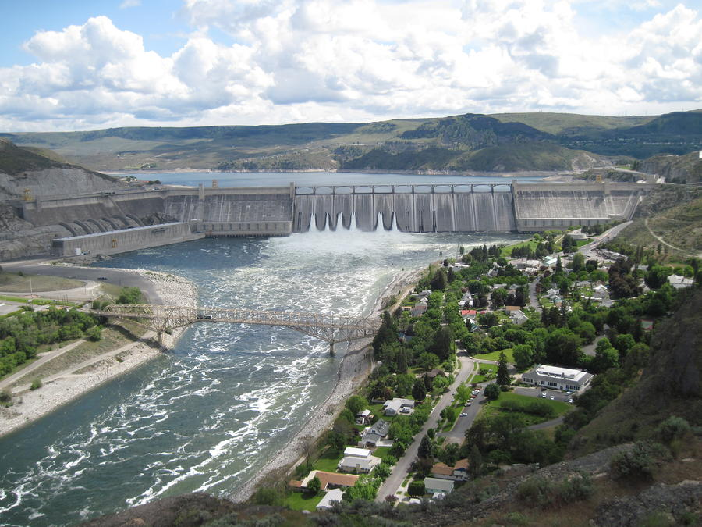
Introduction
Hydropower accounted for approximately 6% of total U.S. electricity generation in 2014 [1]
The importance of hydropower varies by geographic region: the Columbia River Basin provides approximately 40% of total U.S. hydroelectric generation [2]
Because hydroelectric generation depends on precipitation, its availability fluctuates from month to month and year to year
The Grand Coulee Dam, operated by the U.S. Bureau of Reclamation, is the fifth-largest power plant operating in the world and the largest in the U.S., with a net summer capacity of 6,809 megawatts [3]
[4] Grand Coulee Dam (Washington State)

Slide 3
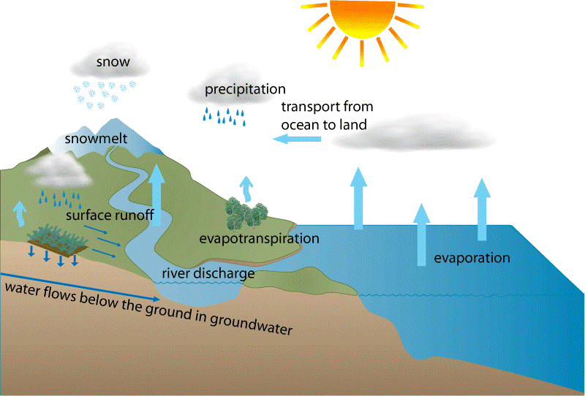
The Water Cycle
Hydropower relies on the water cycle, which is driven by the sun, making it a renewable power source

Slide 4
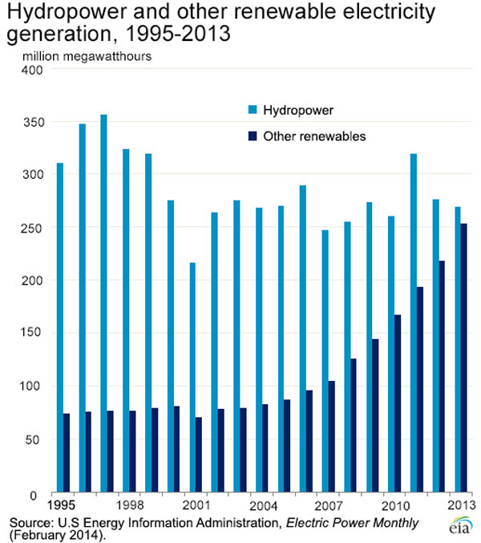
Leading Renewable Energy in U.S.
Hydropower has been the leading renewable energy in the U.S. for many years
However, electricity from non-hydropower renewables has almost quadrupled since 1990
Wind and solar represent 72% of new electricity generation capacity added in 2014 [5]
How much hydropower is there in the U.S.?
The U.S. had 101,000 megawatts of conventional hydropower and pumped storage capacity as of 2014, according to the Department of Energy. With 1 megawatt enough to power 750-1,000 average American homes according to Electric Power Supply Association, that is sufficient generating capacity to produce electricity for approximately 75 to 101 million homes. [6]

Slide 5
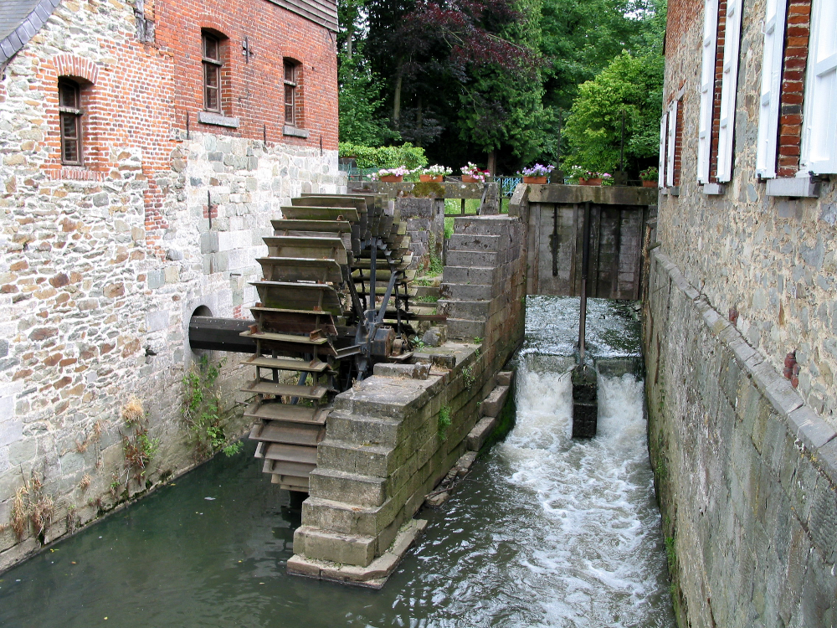
Brief History of Hydropower
Humans have utilized water wheels to perform work for thousands of years
Applications pursued by the Greeks and others:
Grinding wheat into flour
Sawing wood
Powering textile mills and manufacturing plants
The evolution of modern hydropower turbines began in the mid-1700’s [7]
French hydraulic and military engineer Bernard Forest de Bélidor wrote Architecture Hydraulique, describing vertical- and horizontal-axis machines
1849 – James Francis invents the Francis Turbine (most widely used turbine today) [8]
Watermill of Braine-le-château, Belgium (12th century) [9]

Slide 6
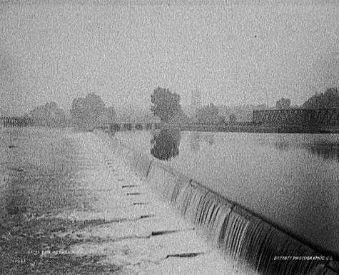
Brief History of Hydropower
Direct current (DC) technology
1880 – water turbine drove a brush arc light dynamo to provide theater and storefront lighting in Grand Rapids, Michigan
1881 – a similar set up in a flour mill provided street lighting at Niagara Falls, New York
Alternative current (AC) technology
1882 – Fist hydroelectric power plant:
Appleton Hydroelectric Power Plant in Appleton, Wisconsin
Turbine coupled to an electric generator
Appleton Hydroelectric Power Plant [11]
Sources: [10]

Slide 7
Brief History of Hydropower
1886 – About 45 water-powered electric plants in the U.S. and Canada
1887 – San Bernardino, Ca., opens first hydroelectric plan in the west
1889 – Two hundred electric plants in the U.S.
1901 – First Federal Water Power Act
1902 – Bureau of Reclamation established
1907 – Hydropower provided 15% of U.S. electrical generation
1920 – Hydropower provided 25% of U.S. electrical generation
1931 – Construction begins on the Hoover Dam
1933 – Tennessee Valley Authority established
Sources: [10] [12]

Slide 8
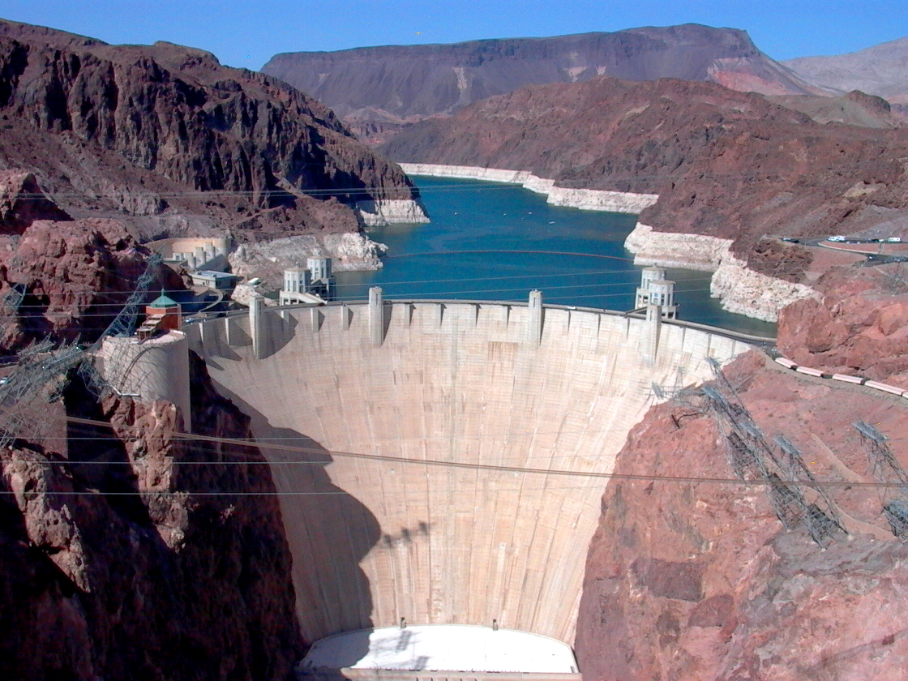
Brief History of Hydropower
1935 – Federal Power Commission authority extended to all hydroelectric projects built by utilities engaged in interstate commerce
1937 – The Hoover Dam begins to generate power on the Colorado River
1940 – Hydropower provided 40% of electrical generation. Conventional capacity tripled in U.S. since 1920
1980 – Conventional capacity nearly tripled in U.S. since 1940
Today – About 6-8% of U.S. electricity comes from hydropower
The Hoover Dam [26]
Sources: [10] [12]

Slide 9
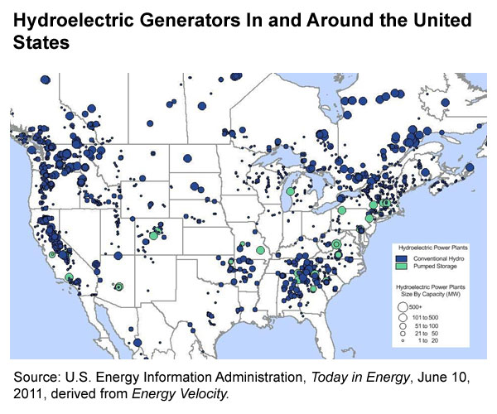
Types of Hydroelectric Plants
Conventional Hydroelectric Generators
Operating expenses financially more affordable than other forms of electricity generation
Limited by geography and seasonal constraints
Large concentration of capacity in the Pacific Northwest, contributing to low wholesale and retail electricity prices in that region
Non-conventional Hydroelectric Generators
Pumped-storage (commercialized)
Hydrokinetic axial flow (demonstrated)
Wave buoy turbines (demonstrated)
Source: [13]

Slide 10
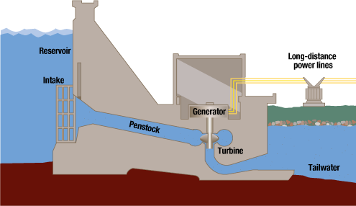
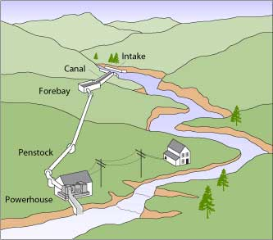
Conventional Hydroelectric Generators
Most existing hydroelectric generators were built before 1980
Recent changes to hydroelectric capacity have been small
Two methods:
Run-of-river: flow of waterway (usually a river) is utilized to turn a turbine
Allows little control over generator output
Storage: a reservoir is created using a dam that controls flow over a turbine
Some control of generation by controlling spillway water flow but constrained by total reservoir water levels
Reservoir method [14]
Run-of-river method

Slide 11
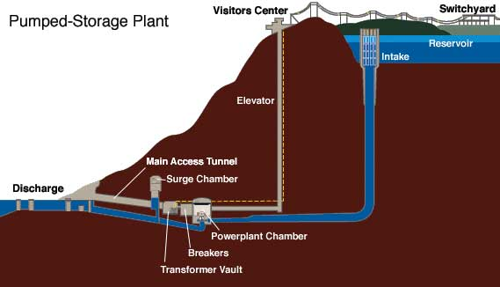
Pumped Storage Hydroelectric Systems
Water is pumped to high elevations during periods of low demand for electricity (nights and weekends)
The stored water can later be released to turn the turbines and generate electricity as it flows back into a lower reservoir
Schematic of Tennessee Valley Authority’s
Raccoon Mountain Pumped Storage Plant [14]

Slide 12
Source: [15]

Slide 13
Hydroelectric Facilities
The federal government, through the Bureau of Reclamation and Army Corps of Engineers, operates a total of 133 hydroelectric power plants – representing 8% of the country’s hydroelectric facilities
The other 92% of U.S. hydroelectric facilities are operated by the private sector, public utilities, and state or local governments
According to the Federal Energy Regulatory Commission (FERC), which regulates non-federal projects, these entities operate 1,623 hydropower facilities
These facilities also come in all shapes and sizes, most of them much smaller than the large federal hydropower dams
FERC records show that approximately 89% of non-federal facilities have a capacity of less than 30 megawatts
Source: [16]

Slide 14
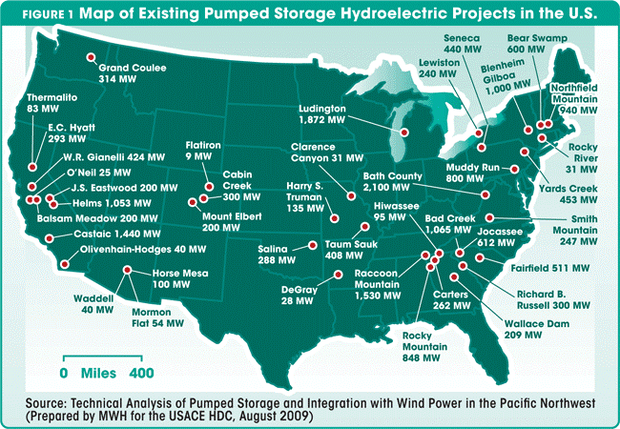
Existing Pumped-Storage Hydroelectric Projects in the U.S. (2009)

Slide 15
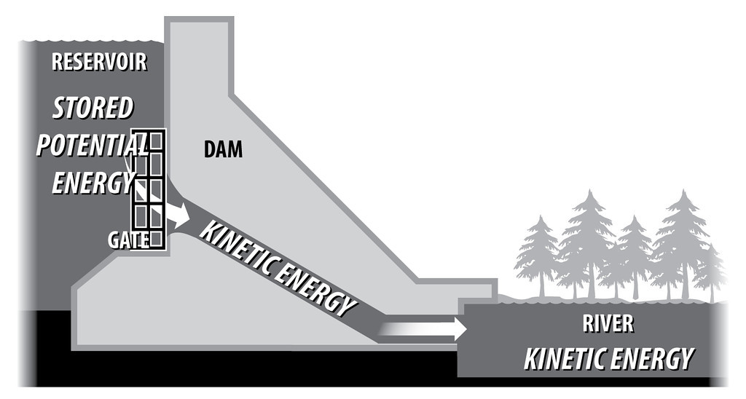
Producing Electricity from Hydropower
Source: [15]

Slide 16
The Francis Turbine
Developed by James B. Francis in 1849
Inward-flow reaction turbine that combines radial and axial flow
Most common water turbine in use today
Wicket gates around the outside of the turbine's rotating runner control the rate of water flow through the turbine for different power production rates
The speed range of the turbine is from 83 to 1000 rpm
The generators which most often use this type of turbine, have a power output which generally ranges just a few kilowatts up to 800 megawatts
Source: [18]
Source: [17]

Slide 17
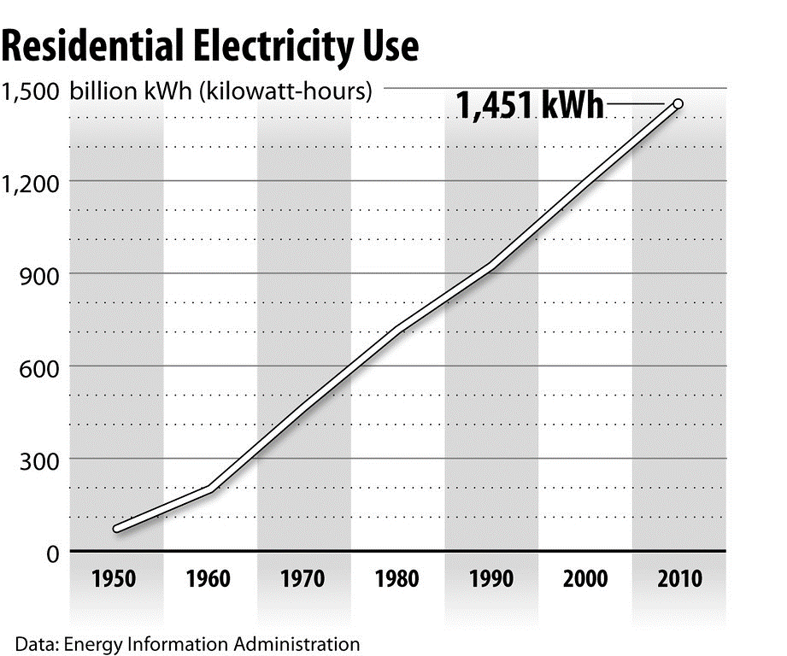
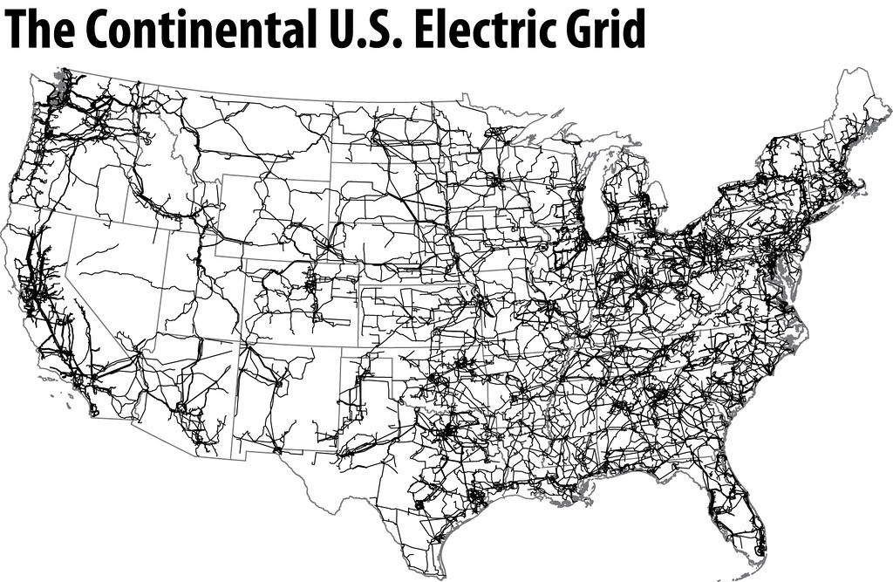
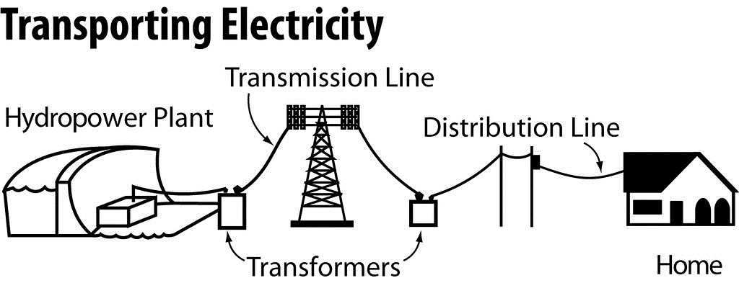
(160,000 miles of HV transmission lines)
Source: [15]

Slide 18
Hydroelectric Energy Production as a Percentage of Total Electric Power Generation (2011)
Source: [19]

Slide 19
Hydropower Advantages and Disadvantages
Advantages | Disadvantages
Reduces consumption of fossil fuels for electricity consumption | Dirt can build up at dams, decreasing their effectiveness
Reduces production of pollution, such as particulate matter | Large-scale wildlife habitat destruction due to river valley flooding
Can prevent uncontrolled flooding | Dam construction forces people to leave their homes if they live in or near the flooded river valley
Provides water for irrigation | Very expensive to build
Creates areas for certain types of recreation, such as boating and fishing | Reduces areas for certain types of recreation, such as camping, hunting, hiking
Is a renewable source | Interferes with natural wildlife migration patterns, such as salmon
Source: U.S. Department of Energy

Slide 20
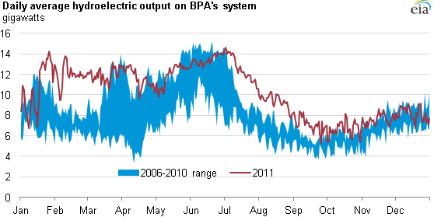
Seasonal Variations of Hydroelectric Generation
Depending on the season and precipitation, the hydroelectric share of total generation varies from 4% to 10%
Precipitation, snowpack, drought conditions, and other meteorological factors contribute to water availability for generation through hydroelectric dams
In the Pacific Northwest, hydroelectricity production is generally highest in late winter and spring due to snowpack melt
Most hydroelectric generators in the U.S. were co-located at dams originally built for other purposes, such as flood control, municipal water supply, and irrigation. Operations are affected by environmental considerations associated with water use, fish populations, and impact on wildlife in surrounding areas.
Daily average hydroelectric output on Bonneville Power
Administration’s system
[20]
Source: [13]

Slide 21
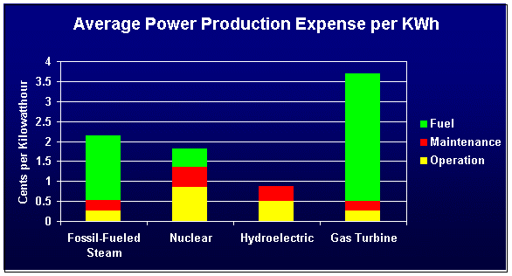
Cost of Hydropower
The cost of generating hydroelectric power lies almost entirely in the construction of the dam and power plant
Once in place, its costs are largely limited to equipment maintenance, with no further costs for fuel and its transportation
As long as there is sufficient water to run the turbines, electricity can be produced very cheaply
Compared even to mature nuclear plants, hydropower costs less than half as much to produce, at under 0.9 cents/kilowatt-hour (kWh). It then joins the stream of power transmitted and sold in the wholesale and retail markets at the same prices as electricity generated by other means, complete with premiums for peak demand production.
But dams and reservoirs are expensive to build. The cost of the proposed Marvin Nichols reservoir in northeast Texas, for example, has been estimated at $3.4 billion (2014)
Source: [21]

Slide 22
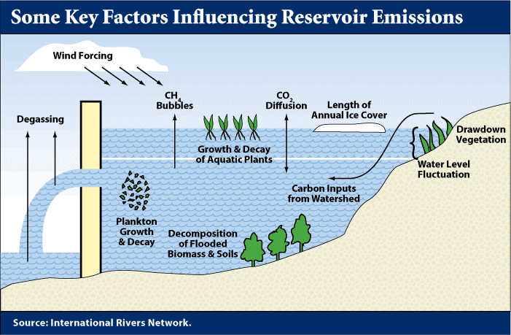
Environmental Impact
The most obvious impact is the destruction of a river ecosystem and its replacement with a reservoir. This displaces flora and fauna and disrupts any activity dependent on aspects of the prior ecosystem, such as bottomland timber.
Reservoirs collect sediment, eventually these sediments build up, making the reservoirs shallower
Because reservoirs created behind dams vastly expand the surface area of the water body, evaporative water loss increases significantly
Recent research has found that reservoirs and hydroelectric dams, previously thought of as zero-emissions power sources, actually do emit greenhouse gasses, particularly methane from the decomposition of organic materials
Hydroelectric dams remain a low-emission method of generating electricity compared to fossil fuel power plants
Source: [22]

Slide 23
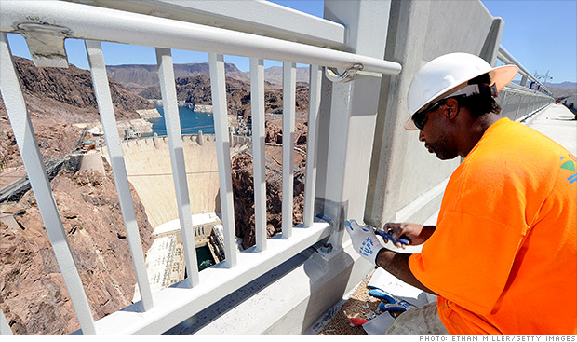
Hydropower Job Employment
The hydropower industry accounts for approximately 200,000-300,000 jobs (National Hydropower Association)
Most jobs concentrate in the operation, maintenance, and permitting of existing dams
The average pay is $65,000/year
Between 25% and 50% of dam workers are expected to retire in the next 5 years
In comparison, Oil & Gas industry accounts for approximately 2.6 million jobs
Coal mining industry accounts for 206,000 jobs (National Mining Association)
With the right policies, the hydropower industry could add 1.4 million new cumulative direct, indirect and induced full time equivalents (FTE) jobs by 2025
Source: [23]

Slide 24
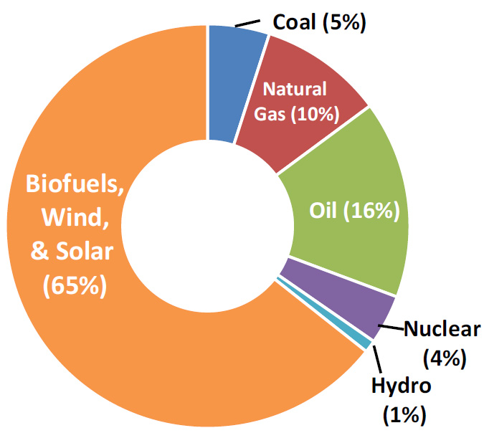
Hydropower Subsidies
Hydropower is such a mature technology that often it is not included in discussions and incentive programs for renewable energy
Renewable energy tax credits (1% of total budget) are available for hydroelectric power production
Federal ownership of a number of dams allows the U.S. government to set subsidized prices for the electricity they produce
2010 Federal Energy Subsidies.
Source: U.S. Energy Information Administration,
U.S. Treasury Department, and OMB

Slide 25
State (Texas) and Federal Oversight
If any new hydroelectric plants were built, most of the laws affecting them would concern the dam and reservoir rather than the generating plant.
In Texas, the water in rivers belongs to the state, and state regulation covers dams and reservoirs unless they are built on federal land.
Federal environmental regulations concerning wetlands and wildlife protection also could come into play, depending on the site.
The Federal Energy Regulatory Commission (FERC)
licenses hydropower projects [24]

Slide 26
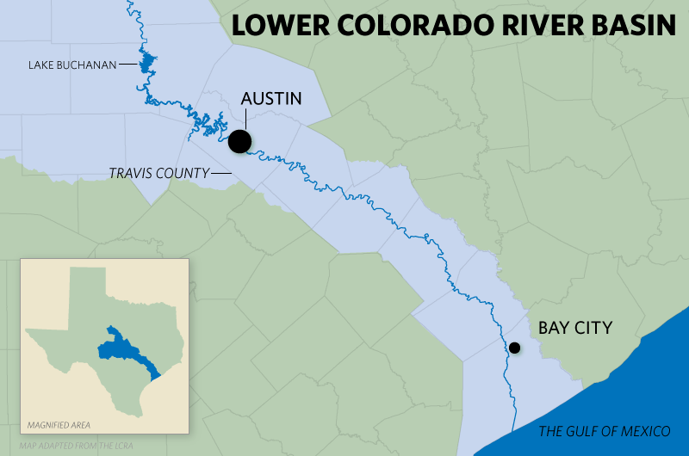
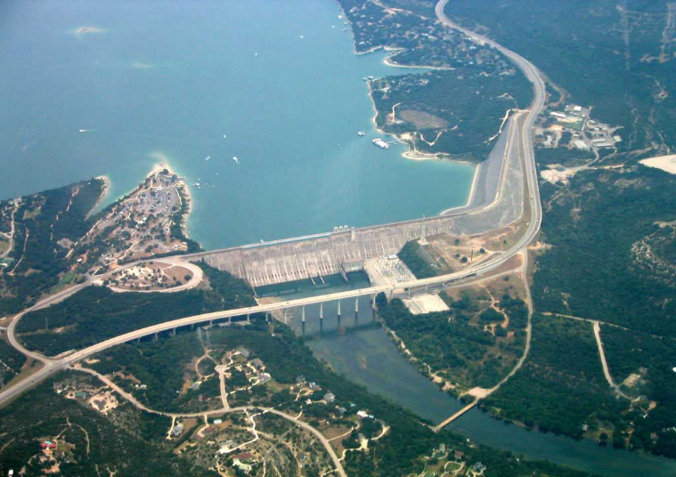
Hydropower in Texas
Hydroelectricity made its largest impact on Texas in the mid-1930s, as part of the rural electrification efforts of the New Deal
Following the Tennessee River Authority’s hydroelectric dams, the Lower Colorado River Authority (LCRA) was able to build four of an eventual six dams on the Colorado River between 1935 and 1941
At the end of 1946, 15% of Texas’ electricity came from hydropower but its share fell to less than half of that within about seven years due to a booming Oil and Gas Industry
Hydropower’s availability for use during peak demand enhances its economic value, but in largely semi-arid Texas, water usually is not released from reservoirs solely to generate electricity, so its economic potential is not always realized.
In the long run, the role of Texas dams in controlling flooding and preventing property damage has proven more economically important to the state than hydroelectric power
[25]
[26]
Source: [22]
Mansfield Dam

Slide 27
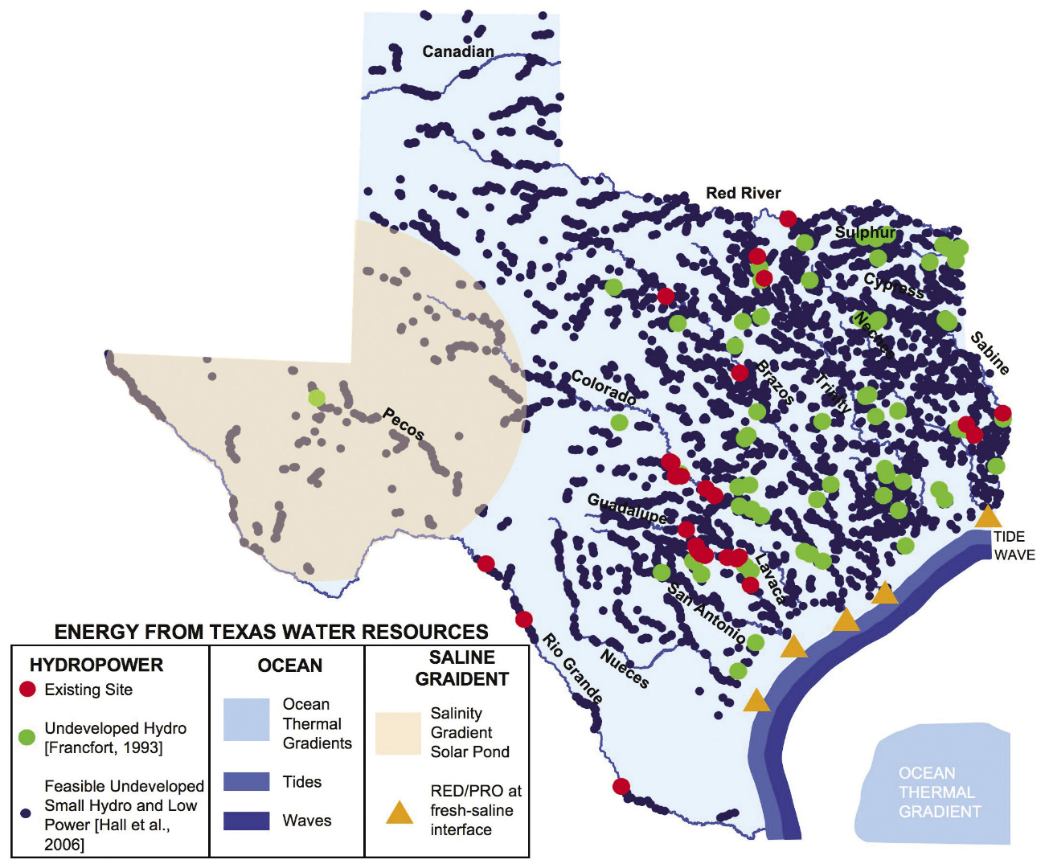
Hydropower in Texas
As of 2006, Texas has only 23 dams with hydroelectric power plants out of hundreds of medium to large dams around the state
These 23 dams have a total generating capacity of 673 megawatts, although the amount of electricity they actually produce annually is well below the maximum potential of generating 100 percent of the time
In 2004, Texas hydropower plants operated at an average 22 percent capacity factor, and in 2006 the capacity factor averaged only 11 percent.
Hydropower production is limited by droughts or other factors that affect surface water flows.
[27]
Source: [22]

Slide 28
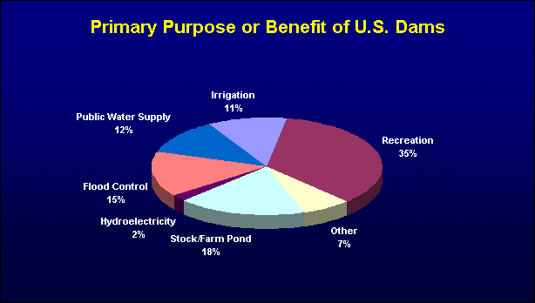
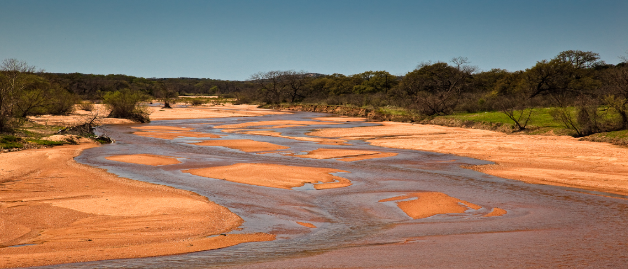
Hydropower in Texas
Most of Texas’ terrain does not lend itself to large-scale hydroelectric projects
In 2004, hydro accounted for 0.62% of the state’s electrical capacity and only 0.34% of electricity actually produced
While Texas has some identified potential for additional hydroelectric capacity, the likelihood of its development is not high
Reservoirs can face opposition from the public and policy-makers, and all the new reservoirs being proposed by water planners are intended for storing water supplies
Even if all of the state’s potential hydroelectric sites were dammed and supplied with generators, the total capacity would still be less than 1.5% of the current state total
Texas simply does not have many big-river/big-drop settings that would justify overcoming the hurdles of land acquisition, construction cost and ecosystem destruction inherent in dam building and reservoir creation
[21]
[28]
Llano, Texas
Source: [22]

Slide 29
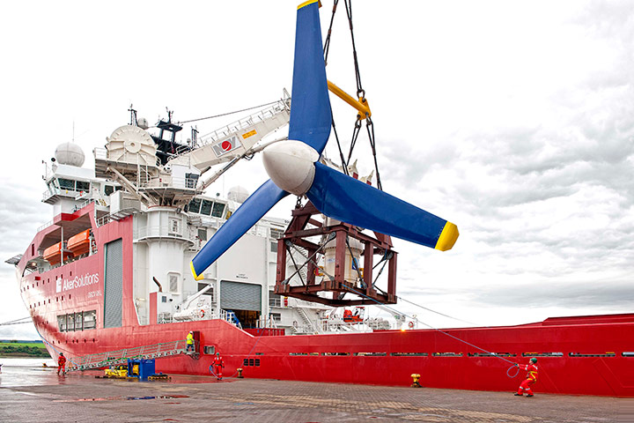
Full Growth Potential of U.S. Hydropower
Depending on policy changes, the U.S. hydropower industry could install 60,000 MW of new capacity by 2025, which is only 15% of the total untapped hydropower resource potential in the U.S.
The hydropower industry will focus on projects that maximize the benefits of existing infrastructure:
Adding new, more efficient generating equipment to existing facilities
Adding electricity generating capacity to dams that have none today
Other areas of growth include closed-loop pumped storage systems, and potentially new technologies such as hydrokinetic, tidal and wave power
AR1000 tidal turbine by Atlantis Resources [29]
Source: [16]

Slide 30
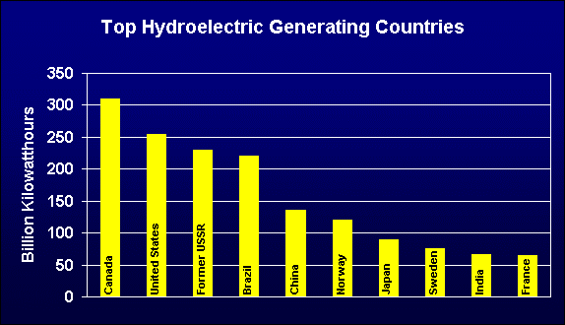
Hydropower in the World
World-wide about 20% of all electricity is generated by hydropower
U.S. second largest producer of hydropower behind Canada
Norway produces more than 99% of is electricity on hydropower
New Zealand uses hydropower for 75% of its electricity
Source: [21]

Slide 31
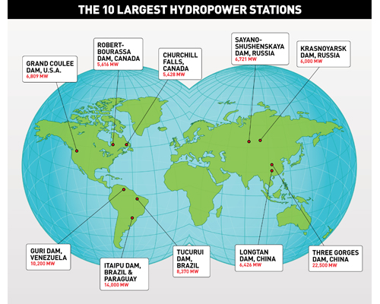
Hydropower in the World
The 10 Largest Hydropower Stations
ROBERT-BOURASSA DAM, CANADA
5,616 MW
SAYANO-SHUSHENSKAYA DAM, RUSSIA
6,721 MW
KRASNOYARSK DAM, RUSSIA
6,000 MW
CHURCHILL FALLS DAM, CANADA
5,428 MW
GRAND COULEE
DAM, U.S.A
6,809 MW
GURI DAM, VENEZUELA
10,200 MW
TUCURUI, BRAZIL
8,370 MW
LONGTAN DAM, CHINA
6,426 MW
THREE GORGES DAM, CHINA
22,500 MW
ITAIPU DAM, BRAZIL & PARAGUAY
14,000 MW

Slide 32
Hydropower in the World
Three Gorges Dam in China is the largest hydroelectric power plant (2014)
22,500 MW
13 years of construction
607 feet high
1.5 miles wide
400 mile long reservoir
26 hydropower turbines
Cost $20-25 billion
[30]
Three Gorges Dam (China)

Slide 33
References
[1] http://www.eia.gov/tools/faqs/faq.cfm?id=427&t=3
[2] http://www.eia.gov/todayinenergy/detail.cfm?id=16891
[3] http://www.usbr.gov/pn/grandcoulee/pubs/factsheet.pdf
[4] http://fineartamerica.com/featured/grand-coulee-dam-lawrence-scott.html
[5] https://www.ferc.gov/legal/staff-reports/2014/nov-infrastructure.pdf
[6] http://www.hydro.org/tech-and-policy/faq/#494
[7] Hydroenergy and its energy potential – P.K. Chadda (2009)
[8] https://targetstudy.com/knowledge/invention/96/water-turbine.html
[9] https://en.wikipedia.org/wiki/Watermill#/media/File:Braine-le-Ch%C3%A2teau_JPG02.jpg
[10] http://energy.gov/eere/water/history-hydropower
[11] “Dam across river, Appleton, Wis.,” 1880-1889. Prints and Photographs Division, Library of Congress. Reproduction Number LC-D4-4783 DLC.
[12] http://www.hydro.org/tech-and-policy/history-of-hydro/
[13] http://www.endofcrudeoil.com/2011/11/importance-of-hydropower-for-us.html
[14] http://www.tva.gov/power/hydro.htm
[15] http://need-media.smugmug.com/Graphics/Graphics/17024036_Bdmf8C/1289371553_7cxVffp#!i=1289371553&k=7cxVffp

Slide 34
References
[16] http://www.hydro.org/tech-and-policy/faq/
[17] http://en.wikipedia.org/wiki/Francis_turbine
[18] http://www.andritz.com/group/gr-news/gr-gallery.htm
[19] http://www.targetmap.com/viewer.aspx?reportId=9437
[20] http://www.eia.gov/todayinenergy/detail.cfm?id=5070
[21] http://www.wvic.com/Content/Facts_About_Hydropower.cfm
[22] http://comptroller.texas.gov/specialrpt/energy/pdf/19-Hydropower.pdf
[23] http://money.cnn.com/2014/01/08/news/economy/hydro-jobs/
[24] http://www.eoearth.org/view/article/152743/
[25] http://www.texastribune.org/2011/06/19/dwindling-lakes-growing-water-demand-central-texas/
[26] http://www.helicopterpirates.com/Pictures/20030809Castroville/MansfieldDam.jpg
[27] http://www.seco.cpa.state.tx.us/publications/renewenergy/energyfromwater.php
[28] http://jefflynchdev.wordpress.com/2010/04/06/texas-landscape-safari-preparation-ball-heads/
[29] http://www.scottish-enterprise.com/knowledge-hub/articles/case-study/attract-investment/meygen?intcmp=hp04-2015wk20
[30] http://www.britannica.com/topic/Three-Gorges-Dam

