Slide 1
Horse Science
Height and Teeth

Slide 2
Height
How do we determine height?
  In hands
  1 hand = 4 inches
  Measure to withers
Mature height of QH must be at least?
  14.2 hands
  How tall?
  = 14 hands x 4” + 2” = 58”
  = 4 foot 10 inches

Slide 3
Teeth
Horse Cuts Baby Teeth
  8 days
    center incisors (top and bottom)
  8 weeks
    intermediates
  8 months
    corners

Slide 4
Teeth
Cups Go Out of Baby Teeth
  1 year
    centers (top and bottom)
  1½ years
    intermediates
  2 years
    corners

Slide 5
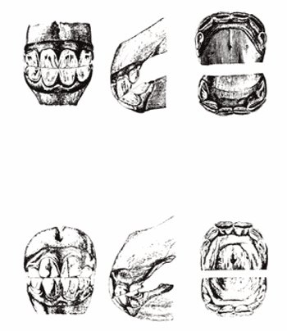
One to Three Years

Slide 6
Teeth
Horse Cuts Permanent Teeth
  2½ years
    Centers (top and bottom)
  3½ years
    Intermediates
  4½ years
    Corners
  A five year-old horse is said to have what?
    A "full mouth"

Slide 7
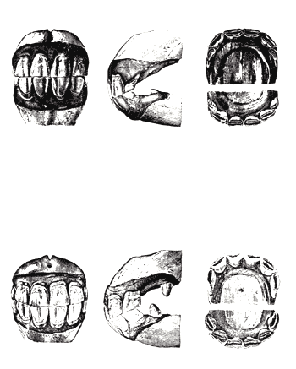
4 to 5 Years

Slide 8
Teeth
Cups Go Out of Permanent Teeth
  6 years - lower centers
  7 years - lower intermediates
  8 years - lower corners
  9 years - upper centers
  10 years - upper intermediates
  11 years - upper corners
An 11 yr-old horse is said to have a "smooth mouth" because all the cups are now gone.

Slide 9
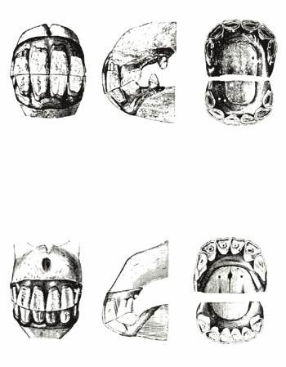
7 to 15 Years

Slide 10
Teeth
7 and 11 year hook on the upper corners
Galvaynes groove
  appears on the upper corners when a horse is ~11 and gets longer with age

Slide 11
As Horse Gets Older
What happens?
  Angle of incidence increases
  Teeth wear down
  Gums recede
  Teeth become more triangular in shape

Slide 12
Teeth
Wolf Teeth
  Located in front of molars
  usually in the upper jaw
  sometimes in lower as well
Canine Teeth
  Between incisors and molars
  Appear at 4-5 years
  Almost always found in males
  Only seen occasionally in females

Slide 13
Teeth
Number of Teeth
  Young Horse
    24 Temporary Teeth
  Mares
    36-38 - Mature Mouth
    Depends on whether canines appear or not
  Stallions
    40-42 - Mature Mouth

