Slide 1

Energy Efficient Houston
Jennifer Ronk, PG, CEM, PMP

Slide 2

Who Is HARC?
Notes:
HARC is a research hub providing independent analysis on energy, air, and water issues to people seeking scientific answers.
We are focused on building a sustainable future that helps people thrive

Slide 3
City of Houston Sustainable Energy
Energy Efficiency
  Government Buildings and Infrastructure
  School
  Commercial Spaces
  Residential Homes
Renewable Energy

Slide 4
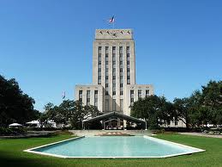
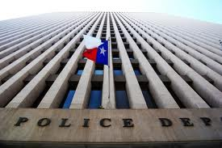
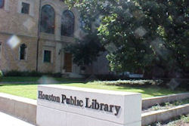
City Building Energy Audits
Audited over 2 Million Square feet of space in over 40 facilities, including City Hall, police stations, libraries, and office space.

Slide 5



Audit Recommendations
Controls Systems
HAVC systems
Lighting upgrades
Water retrofits

Slide 6
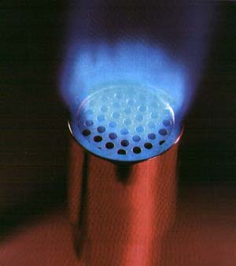



Results - City Building Retrofits
  >5,000,000 kWh
  >$600,000
  >130,000 therms
  >4,000 tons avoided CO2
Notes:
<JEN>
We have completed a third party review for energy audits at over 40 different city facilities, including City Hall, City Hall Annex, Police Headquarters, and the Hobby Center. Even though the work is still in progress, these projects have already saved:
Over 5 milling kWh of electricity
Over 130,000 therms of natural gas
Avoided over 4,000 tons of CO2 emissions
Saved over $600,000

Slide 7

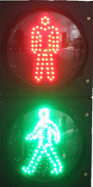
Traffic Lights an Pedestrian Signs
1,700-signal project citywide
Payback time of less than one year
Because the energy use is so low, engineers are designing battery backups for power outages
Notes:
The city of Houston in 2007 began a $1 million effort to replace 300 traffic signals with LEDs downtown, in Midtown and near the Texas Medical Center, Public Works Department spokesman Gary Norman said. That program expanded into a $16 million, 1,700-signal project citywide; today, Norman said just 398 signals remain to be converted. The city has received a grant to help complete the work, he said, which will begin this spring and take about a year

Slide 8
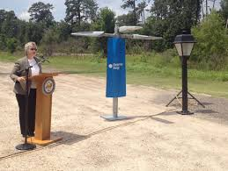
LED Streetlights
5 year plan to replace 165,000 streetlights to LEDs
Reduce energy use by 70 Million kWh/yr
10 year savings estimated at $28 Million

Slide 9
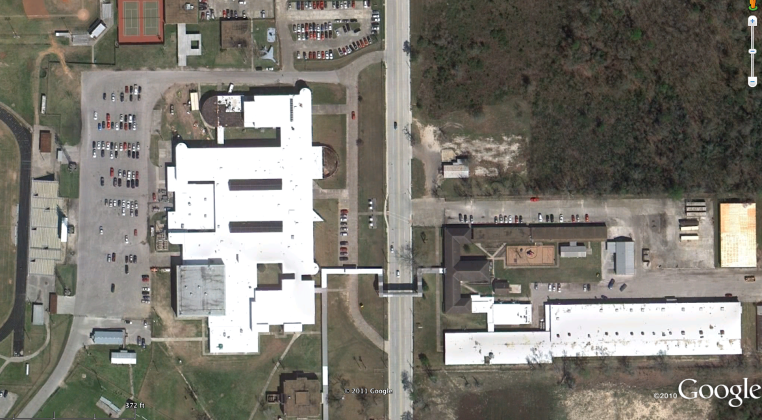
School - NFISD Cool Roof
Highly reflective roof replacement for two high school buildings
250,000 sq. ft.
Exceeds Energy Star standard
Estimated annual energy savings $56,700
Replaces leaking roof while improving AC performance
Notes:
<DAVID>

Slide 10
Commercial Building Program
Energy Efficiency Incentive Program (EEIP)
ARRA (“Stimulus”) funded
Required a CEM or PE to conduct an energy audit that HARC reviewed to approve
Provided a 40% incentive payment upon achieving a minimum 15% energy savings over the existing baseline

Slide 11
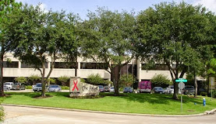
EEIP - The Rose
The Rose provides breast health care, from mammograms to biopsies to treatment, to over 33,000 women every year, regardless of their ability to pay.
2-Story 33,000 square foot medial office building
Energy audit was conducted
HVAC system was upgraded and control systems were installed
Interior and exterior lighting upgrades
Window film
Reflective Roof
Project cost ~200k, 3.3 year simple payback
Energy savings of $36,000/year

Slide 12

EEIP – Hotel Derek
Hotel Derek is a fourteen story upscale hotel in the Galleria area of Houston
Energy audit conducted and reviewed by HARC
Upgraded to LED lighting in lobbies, hallways and rooms
Upgraded to Direct Digital Controls (DDC) from pneumatic
Demand Control Ventilation
Add Variable Frequency Drives on Air Handling Unit motors
  Total project cost $338,000
  Savings of 1.28 million kWh per year
  23.7% reduction in total building energy
  Thanks to the incentive, the payback was 1.4

Slide 13
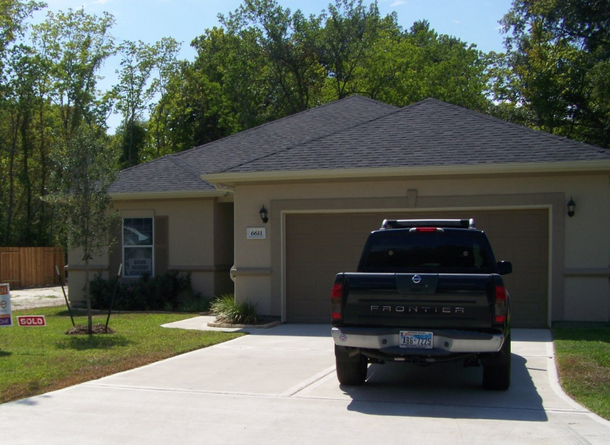
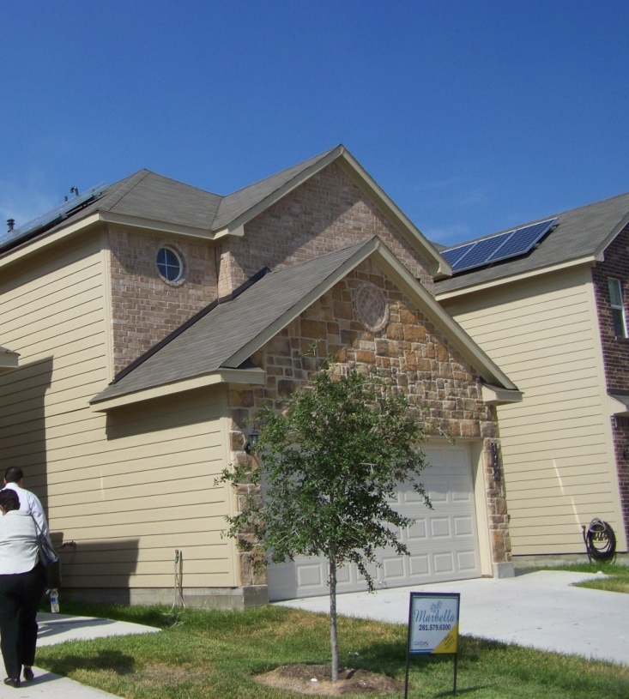
Residential: 5 Star Program
ARRA funds to purchase energy efficient upgrades for HOPE homes
Providing new, very high efficiency homes in hard to develop areas at affordable prices
Private home builders coupled with third party verification of energy savings
  Energy Star HERS Rating = 85
  5 Star Homes to date HERS Rating = 20 or less
Notes:
<David>

Slide 14
Renewable Energy
Solar Houston Initiative
Rooftop Solar Challenge
High-Visibility Demonstration Projects
Largest Municipal Renewable Energy Purchaser

Slide 15
Solar America Cities
Through the U.S. Department of Energy's Solar America Cities partnership, 25 major U.S. cities are working to accelerate the adoption of solar energy technologies for a cleaner, more secure energy future. The Solar America Cities program has engaged over 180 organizations, including municipal, county, and state agencies, solar companies, universities, utilities, and non-profit organizations. These partners have made a commitment to power their cities with clean, safe, reliable energy -- solar energy.
http://www.solaramericacities.energy.gov/
Notes:
The U.S. Department of Energy has named Houston as one of the 25 U.S. Solar America Cities working to accelerate the adoption of solar energy technologies for a cleaner, more secure energy future. Through the Solar America Cities effort, the DOE is working to rapidly increase the use and integration of solar energy in communities across the country.
DOE recognizes the important role of local governments in accelerating widespread solar energy adoption. As the nation's centers of electricity consumption, cities are uniquely positioned to reduce global climate change, strengthen America's energy independence, and support the transition to a clean energy economy by converting to solar energy sources.
DOE has taken a three-pronged approach to indentifying and overcoming barriers to urban solar implementation, then sharing lessons learned and best practices to facilitate replication across the nation.
Solar America Cities Partnerships are cooperative agreements between DOE and 25 large U.S. cities to develop comprehensive, city-wide approaches to increasing solar energy use.
Solar America Cities Special Projects, funded through the American Recovery and Reinvestment Act, tackle key barriers to urban solar energy use that were identified through the 25 city partnerships. Read more about these special projects.
Solar America Cities Technical Outreach is an effort to share the best practices developed through the partnerships and special projects with hundreds of other local governments, accelerating solar

Slide 16
Solar Houston Initiative
Advance Technologies
Public outreach
Education
Improve the market
High visibility demonstrations
Affordable housing
Support schools
Notes:
The Solar Houston Initiative is focused on identifying and over-coming barriers associated with establishing a solar infrastructure that is incorporated into the overall energy system of the City of Houston.
Cities across the country are realizing the benefits of solar energy:
Power from secure, domestic energy
Sustainable, "green" urban development
Clean energy production that helps meet greenhouse gas reduction targets and climate change goals
Development of new economic opportunities.
The Solar Houston Initiative will leverage the expertise of diverse and experienced project partners to achieve a sustainable solar infrastructure in the city. Project partners will develop a plan to make solar energy cost-competitive by 2015 through the following: Develop and implement significant market-changing activities including:
The advancement of current and new technologies
Public outreach
Education programs.
Develop and implement significant market-changing activities including:
Houston-specific solar energy advancement policies
Regulations and legislation that promote cost-effective solar energy utilization
Identify high visibility locations for demonstration sites and install solar energy systems
Implement solar programs in focused neighborhoods such as affordable housing areas
Work with schools to integrate solar education into the curriculum

Slide 17
Solar Houston Plan
Describes Houston Activities
Compares Houston Activities to Best Practices
Provides an Action Plan
  Continue training for code officials
  Maintain www.SolarHosutonTX.org
  Expand use of GBRC
  More high visibility demonstration projects
  Find methods of addressing the financial barrier.
Notes:
Action Plan – Support changes at the state level to net metering, solar carve out in the RPS, stay involved with other cities in the state
Local – continue to use the GBRC to outreach, take advantage of the free training for code and permit people, more demonstrations projects, outreach to Retail Electric Providers

Slide 18
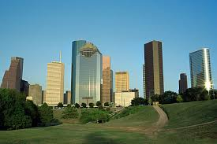

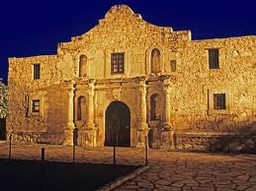
Rooftop Solar Challenge I

Slide 19
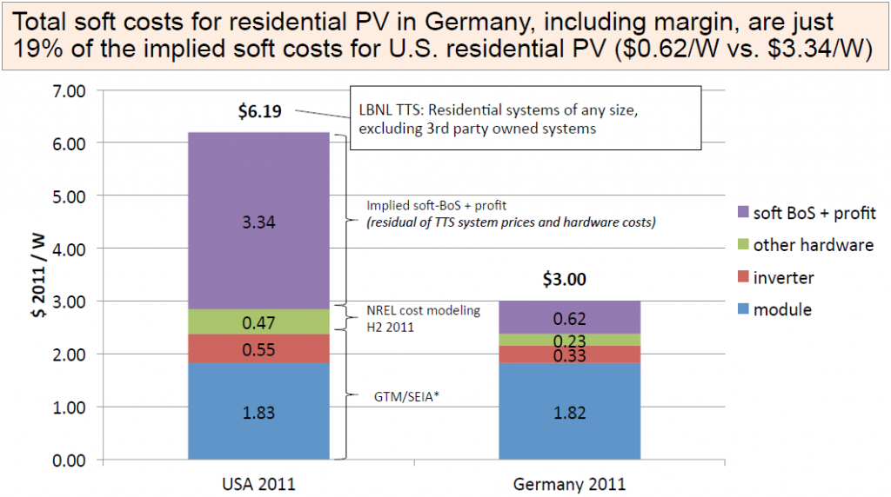
Texas Collaboration – RSC I

Slide 20
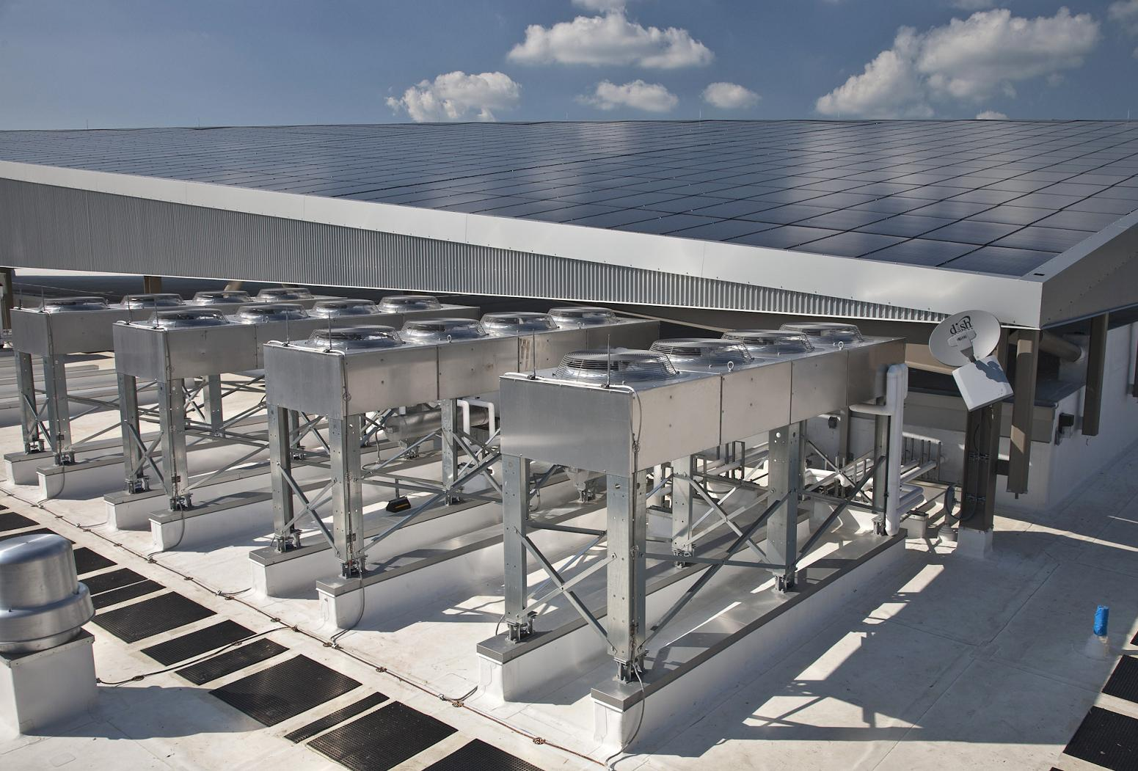
DOE Rooftop Challenge
Goal to reduce the “soft costs of solar”
  Financing
  Permitting
  Interconnection
  Information
Notes:
Building on the Solar America Cities Work, The 3 Texas Solar America Cities (San Antonio, Austin, and Houston) recently applied for a DOE challenge grant to lower the soft costs of solar. HARC got letters of support for the is project from CenterPoint, Reliant, Green Mountain Energy, and Solar Installers in the City, and worked closely with both GSD and the Permitting Department. When we get the grant, HARC will coordinate with all of the stakeholders to help fine ways to streamline the permitting and interconnection process, and find other creative ways to reduce the soft costs and encourage deployment. One of the desired outcomes is, to the extent possible, harmonize the permitting and interconnected processes in all three cities. If successful, there will be a second phase of the project to share lessons learned with surrounding communities. We are hoping to have a decision on this grant by the end of the year.

Slide 21
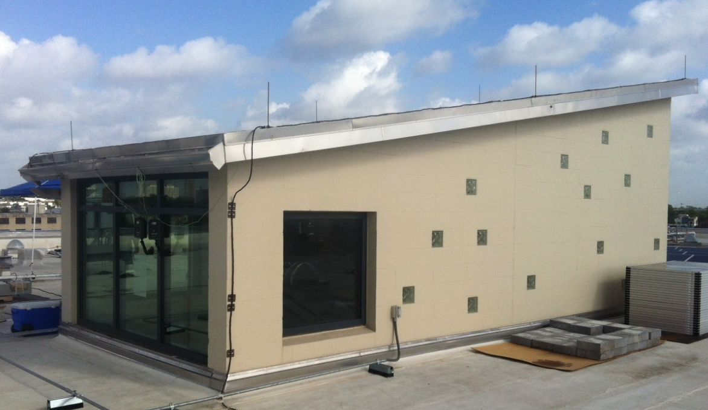
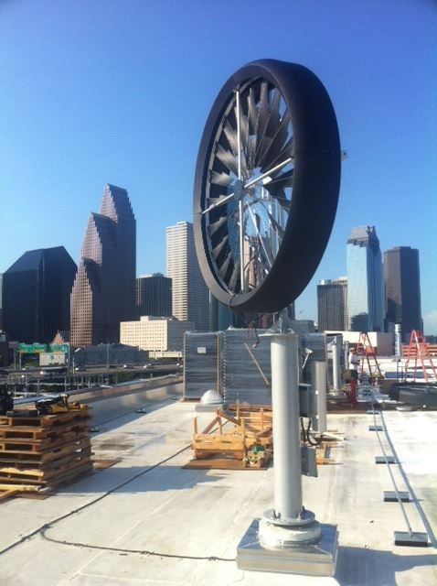
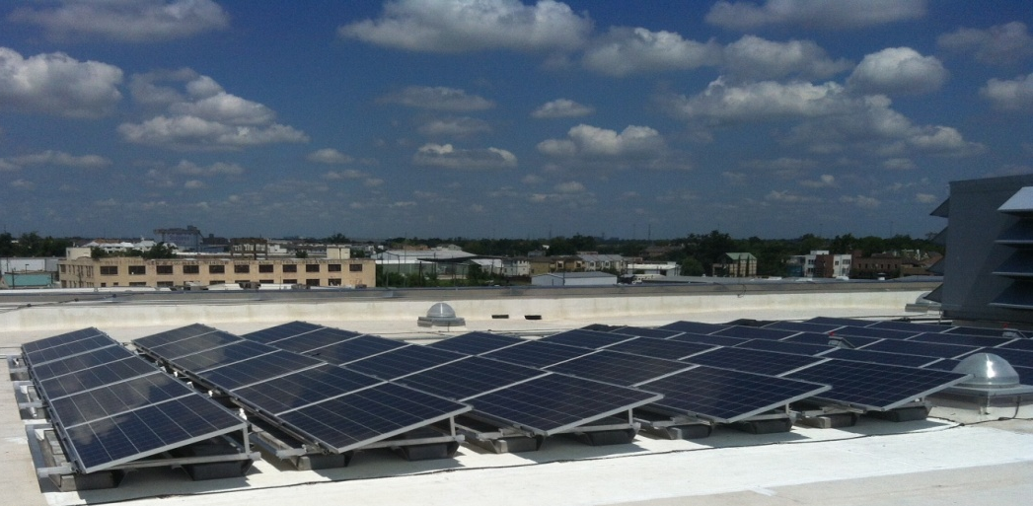
1002 Washington Permit Building
Notes:
<JEN>
This 1923 former rice warehouse at the far eastern end of Washington Ave., used more recently as an annex for the Downtown post office on the other side of I-45, will become the city’s new permit office
4-story concrete-and-brick building, which sits on a 2 1/2-acre site Downtown
Home of the City’s Green Building Resource Center
Recently notified of SECO’s intention to award an ARRA-funded Distributed Renewable Energy grant that will allow the City to demonstrate 4 different small-wind turbines and 3 different solar energy technologies.

Slide 22
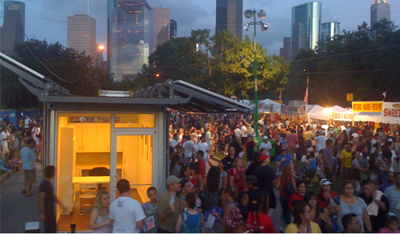
Solar Generators
Solar Powered Adaptive Container for Everyone
Notes:
<JEN>
After Hurricane Ike, the city realized that somethin like a sSolar Generator would be helpful to the community, so that residents could recharge wheelchair batteries, possibly refrigerate medicine, and recharge cell phone batteries. HARC wrote a grant to SECO and the City received a 1.2 Million dollar award to purchase solar generators. We wrote the RFQ for the project, and were of the committee that selected a technology designed by a professor at U of H, the Solar Powered Adaptive Container for Everyone. The container is made of a used chipping container, with 20 foldable solar panels, and a 3 to 5 day battery bank. The use of the shipping container really set this technology apart from others. Residents can use the interior of the unit instead of trying to recharge outside, they can be equipped with small energy efficient refrigerators to store medicine, and most importantly, unlike generators that are only used in the event of a power outage, these off the grid units can be used all the time for storage, extra office space, HISD is even going to host 2 units that will then also be used to educate students on solar energy.

Slide 23
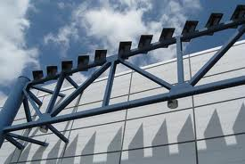
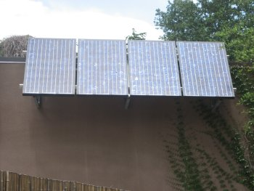
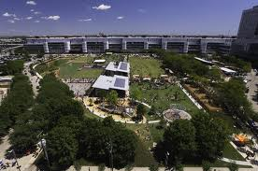

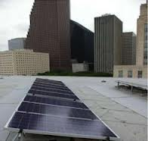
Other Solar Demonstrations
Notes:
Zoo, City hall annex, discover green, GRB

Slide 24

Energy Efficiency & Solar
Important to plan, so that any electrical generation is the right size for the expected use

Slide 25

Why EE and Renewables?
Economics
Environment
Better
  LEDs – more options, long life
  Variable speed AC – more consistent temperature increases comfort
  Magnetic induction cook top – best performing cook tops
  Etc., etc., etc.

Slide 26

Conclusions
Economics are important BUT there are other features and functions that also have value
Time upgrades correctly to have maximum value
Make sure to look at energy systems

Slide 27
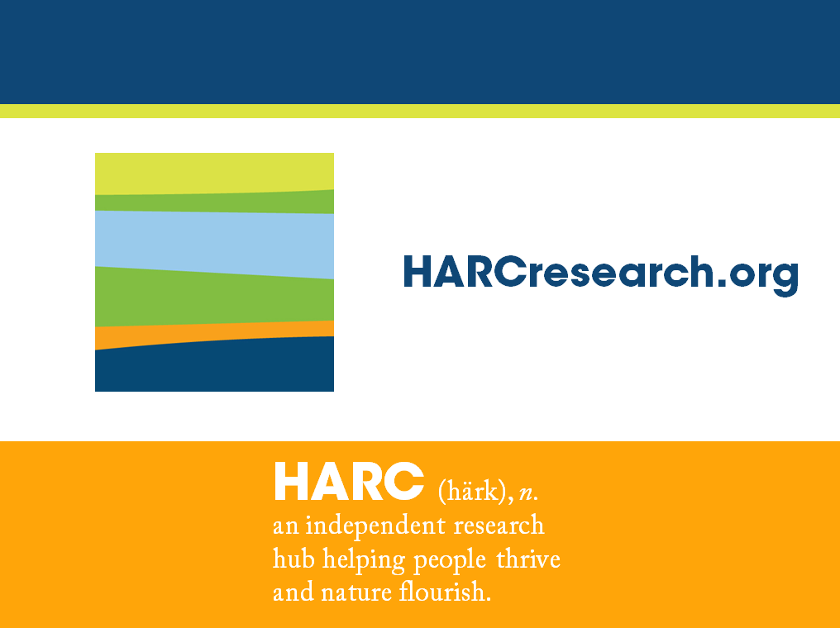

Jennifer J. Ronk, PG, CEM, PMP
Program Director Energy Efficiency & Environmental Science
jronk@HARCResearch.org

