Slide 1
Protein and Amino Acids
Equine Nutrition

Slide 2
Introduction
Protein is a major component of most body tissues including:
  Muscle
  Bone
  Cartilage
  Tendons and Ligaments
  Hair and Hooves
  Enzymes, hormones, and antibodies
What are proteins made up of?
  Peptides
  Amino acids

Slide 3
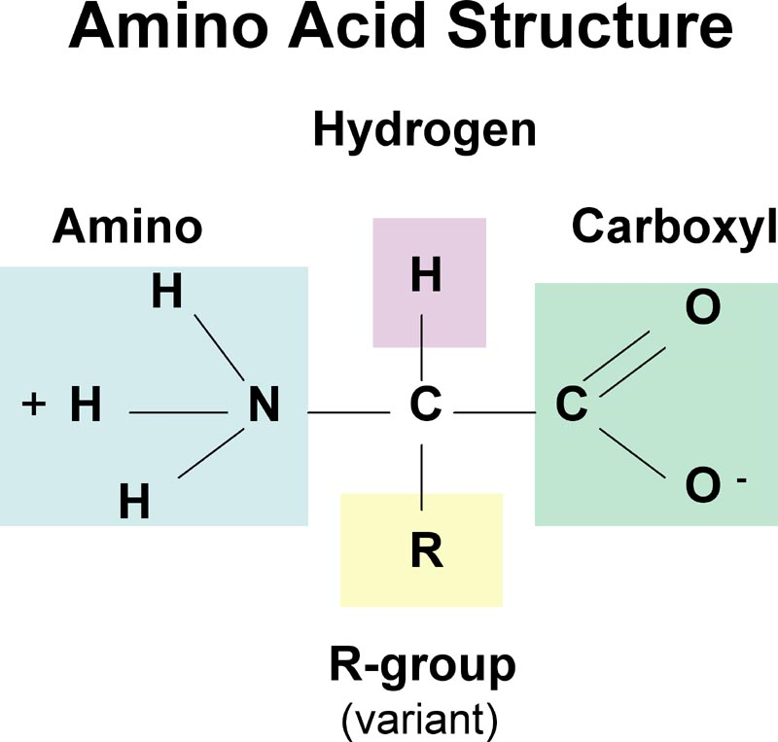
Introduction
What is an amino acid?
How many primary amino acids are important in most protein make-ups?
  20

Slide 4
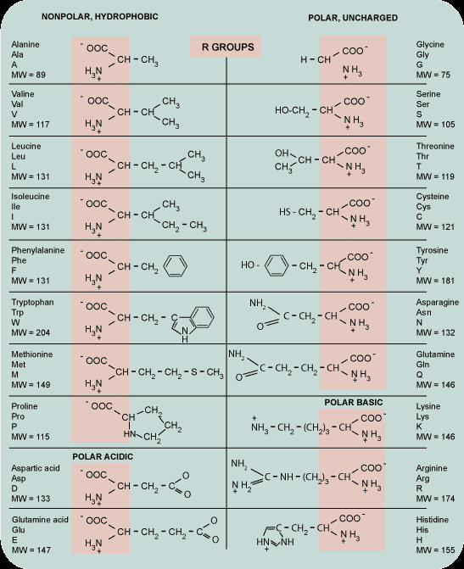
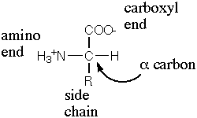

Slide 5
Introduction
What differentiates one protein from another?
  Types of amino acid incorporated into a protein chain
  Length of protein chain
Horse’s requirement is actually for what?
  Amino acids
What’s the difference between an essential and non-essential amino acid?
  Essential cannot be synthesized in the body in sufficient quantities

Slide 6
Introduction
Do horses have essential amino acid requirements? Do ruminants?
  One – Lysine
  Two – Threonine
  Three - Methionine
  No
How many essential amino acids have been established for the non-ruminant?
  PVT MAT HILL
    Phenylalanine
    Valine
    Threonine
    Methonine
    Arginine
    Tryptophan
    Histidine
    Isoleusine
    Leusine
    Lysine

Slide 7
Introduction
What is a limiting amino acid?
  All necessary amino acids required for a protein to be made must be present at the same time
    A limiting amino acid is not present in adequate quantities when protein synthesis is taking place
    This will limit protein synthesis
So what is the challenge when feeding horses protein?
  Provide adequate quantities that will allow for sufficient concentrations of circulating amino acids in the blood
  Important so that synthesis of
    Tissues, enzymes, hormones, and tissue repair can take place when necessary

Slide 8
Protein Digestion and Utilization
Where is dietary protein mainly digested?
  Stomach and small intestine
Enzymatic digestion occurs in the stomach via
  Pepsin
    Can break down specific amino acid bonds
  Pancreatic proteases continue breakdown
    Secreted into S.I.
    Enable absorption of A.A. and di-peptides
    Di-peptides are hydrolyzed into A.A. in gut wall
    NPN are also absorbed in S.I.

Slide 9
Protein Digestion and Utilization
Some protein and NPN may escape foregut digestion
  Enter into hindgut to produce
Does the horse produce microbial protein?
Yes, but:
  Unlike the ruminant, no evidence that amino acids from microbial protein synthesis are absorbed in sufficient quantities to contribute to the A.A. pool
This suggests what?
  Quality of protein is important in the horse’s diet
  Amino acid profiles are important
  While microbial amino acid synthesis occurs, it is not significant enough to provide for amino acid requirements

Slide 10
Protein Digestion and Utilization
Can you feed NPN to horses?
  Yes, but not useful in most circumstances
  Maybe useful when protein requirements are deficient
  Generally considered little to no benefit to the horse
Is it toxic?
  Only at extreme high levels

Slide 11
Protein Digestibility
What is protein quality?
  A function of the amino acid profile
Digestibility of the protein source
  The higher the digestibility (especially foregut)
  The higher the absorption of amino acids
  More contribution to the amino acid pool for tissue synthesis and repair

Slide 12
Protein Digestibility
How can we determine Protein digestibility?
  Function of two things
    DMI
    CP concentration
As both go up, digestibility goes up

Slide 13
Protein Digestibility
Apparent Total Tract CP Digestibilities:
  Alfalfa
    73 – 83 %
  Coastal Bermudagrass
    57 – 64%
  Fescue and Bromegrass
    67 – 74%
Differences in foregut and hindgut digestibility
  Alfalfa
    Pre-cecal = 28.5 %
  CBG
    Pre-cecal = 16.8%

Slide 14
Protein Digestibility
Research has found that relative pre-cecal digestion of protein appears to be
  25 – 30 % when diet consists only forage
  70 – 75 % when diet contains protein supplements such as SBM or CSM

Slide 15
Protein Bioavailability
Proteins that are digested in the _______ are potentially available to contribute to the amino acid pool, whereas those that pass to the ________ are not.
Does quality of protein generally dictate where digestion will occur?
  Higher quality proteins will generally be digested in S.I.
Quality of protein is further determined by what?
  Amino Acid Profile

Slide 16
Protein Bioavailability
Why do substrates have different protein digestibilities?
  Different amino acid profiles
  Different amounts of CP
Is all CP digestestible?
  No
Is it a good indicator of quality?
  Generally, yes
How do we determine CP
  N x 6.25
So, if lab results indicate 2.24% N
  What would be the CP of the substrate?

Slide 17
Maintenance Requirements of Protein
When energy is deficient and CP is adequate
  Weight loss will occur
When CP is deficient and energy is adequate
  Weight loss will occur
How do we calculate maintenance requirements?
  Maint. AVG = BW x 1.26g CP/kg BW/d
1000 lb horse =
  453.59 kg
How many g of CP needed?
  571.52g

Slide 18
Maintenance Requirements of Protein
So, if the horse is consuming 2.5% BW/d in feed and hay, what % CP does he need to receive to meet his CP requirements?
454g = 1 lb
571.52/454=1.258 lbs CP / 25 = 5.03%
If the horse is consuming all 25 lbs in coastal bermudagrass hay with a CP value of 14% and a digestible protein value of 60%. Is he meeting his CP requirements? Is there excess?
  25 lbs x .14 = 3.5 lbs CP consumed / d
  3.5 lbs x .60 digestibility = 2.1 DP
  2.1DP / 25 = 8.4% DP
  8.4 – 5.03 = 3.37% excess

Slide 19
Maintenance Requirements of Protein
Lysine Requirements in maintenance:
  Lysine (g/d) = CP requirements x 4.3%
What are the lysine requirements for the 1000 lb horse consuming 2.5% BW/d
  571.52g/d x .043 =
  24.57g lysine/d
How many lbs of lysine is being consumed/d at 2.5% BW consumption
  24.57/454=.054 lbs

Slide 20
Growth Requirements for Protein
  Protein and energy intakes are
    The major nutrient factors influencing growth
  Restricting either restricts growth
    Quality still extremely important
    Urea was found to not be effective
  Lysine extremely important
  Threonine followed by methionine
    Thought to be the next two limiting amino acids
  Amino Acid supplementation to diets
    Have shown increases in ADG

Slide 21
Growth Requirements for Protein
CP Requirement= (BW x 1.44g CP/kg BW) + ((ADG x 0.20)/E)/0.79
E = efficiency of use of dietary protein
  4-6 months = 50%
  7-8 months = 45%
  9-10 months = 40%
  11 months = 35%
  12 months and older = 30%
  400 lb weanling, 5 months of age, gaining 1.8 lbs/d

Slide 22
Protein Requirements for Pregnancy
Received little attention
Deficient Protein could lead to
  Higher incidence of early fetal loss
  Slower return to ovulation
Maintenance ration generally acceptable in early pregnancy
  CP=BW x 1.26g CP/kg BW/d (conception – 4 months)
  CP BW x 1.26g CP/kg BW/d + fetal gain (month 5 – parturition)
Amino Acid requirements have not been addressed

Slide 23
Protein Requirements for Lactation
Quality still very important
  Urea not utilized effectively
Milk production varies from 1.9% to 3.3% BW
Milk protein content
  Early lactation
    3.1 to 3.3%
  Late lactation
    1.6 to 1.9
Research suggests that amino acid profile could be very important

Slide 24
Protein Requirements for Lactation
CP Lactation = BW x 1.44g CP/kg BW/d + milk production (kg/d) x 50g CP/kg milk
1000 lb horse producing 2.5% milk/d
653.17+566.99=1220.16g CP/d

Slide 25
Protein Requirements for Exercise
Some research shows that the exercising horse requires additional protein for:
  Developing Muscle
  Repair of damaged muscle
Generally achieved though increased DMI
Where might other N be lost?
  Sweat

Slide 26
Protein Requirements for Exercise
Requirements for exercise is based on the fact that:
  Additional muscle appears to be gained during conditioning
  N is lost in sweat
Therefore, needs increase above maintenance as work load intensifies
  Light work = BW x 0.089g CP/kg BW/d
  Moderate Work = BW x 0.177g CP/kg BW/d
  Light work = BW x 0.266g CP/kg BW/d
  Light work = BW x 0.354g CP/kg BW/d

Slide 27
Ideal Protein
Is this quality?
  Based on formulating a diet with amino acids
    Not just in the correct amount
    Also in the proper ratios to one another
Ideal protein is defined as:
  A protein that includes the minimum quantity of each essential amino acid compatible with maximum utilization of the protein as a whole
Amino Acid profiles

Slide 28
Protein Deficiency
Results in decreased growth despite adequate energy
  Energy is generally first limiter to growth
Could also lead to:
  Weight loss in older horses
  Fetal loss in pregnant mares
  Decrease in milk production
In exercising horses:
  Loss of muscle
Other indicators of deficiency include:
  Reduced feed intake
  Poor hair growth
  Reduced hoof growth

Slide 29
Protein Excess
No problems have been found
  Other than economic loss
Will result in increased urea leading to increased urination
  Increase water lose
Other concerns include environmental awareness
  Excess N excretion may become a problem

Slide 30
Summary
Total tract and pre-cecal digestibility vary with what?
  Protein source
  Protein concentration in diet
Important to consider:
  Amino Acid profiles
  Prececal digestibilities of feedstuffs
Factors affecting A.A. digestion include:
  Site of digestion
  Feedstuff variation
  Biological Value of Protein
  Protein Intake
  Amount Consumed
  Transit time through digestive tract

