Slide 1
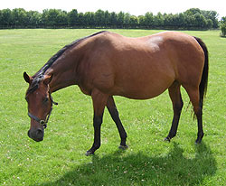
Lecture 3
Pregnant Mare Management

Slide 2
Management
Proper mare management is essential:
  To ensure the birth of a live foal
Mare classifications:
  Pregnant
  Open
  Barren
  Maiden
  Wet

Slide 3
Mare Classifications
Pregnant mares
  Will foal in current season
Open mares
  Not pregnant and not bred in previous or current season
Barren mares
  Not pregnant but bred in the previous or current season
Maiden mares
  Never been bred
Wet mares
  Nursing a foal

Slide 4
Barren Mares
What causes a mare to become barren?
  Old Age
  Poor Breeding Conformation
  Uterine Infection
  Improper Nutrition
  Other
At 16 yrs of age a mare’s reproductive abilities begin to decrease

Slide 5
Barren Mares
Poor breeding conformation increases with age
Pneumovagina or “windsucking”
  Primary cause of uterine infections
  Caslicks can be used to correct
What are the major cause of infertility?
  Uterine infections

Slide 6
Body Condition
To breed efficiently, mares must be
  In proper body condition
Poor nutrition results in thin mares
Lower energy intake before foaling appears to
  Delay time of ovulation (post-foaling) by as much as a week
Pregnancy rates at 60 to 90 days are less for thin mares (foal heat)

Slide 7
Body Condition
Body condition score is an excellent management tool
  Correlates to body fat (1 to 9)
1 = extremely emaciated
9 = extremely obese
On a scale of 1 to 9, mares should be between 5.5 and 7.5

Slide 8
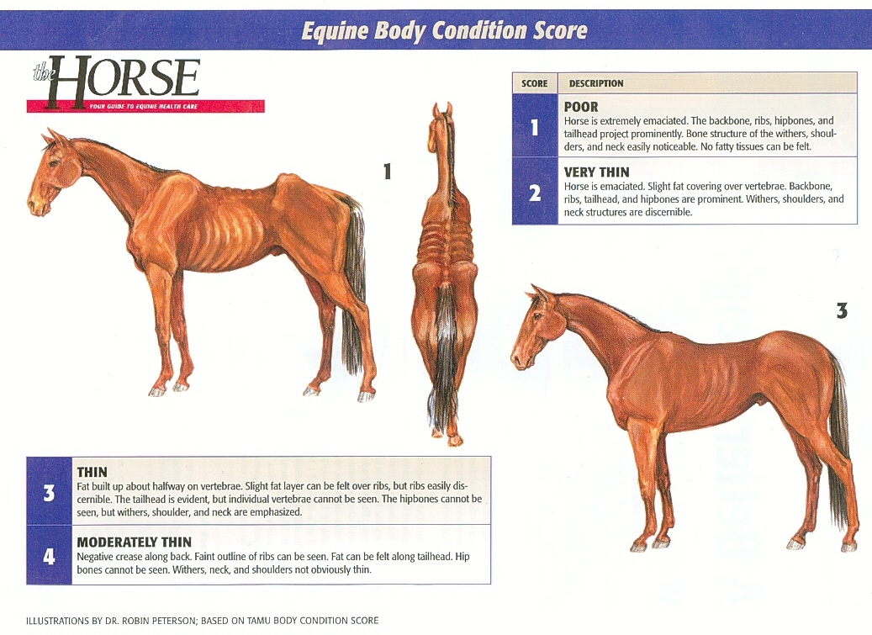
Body Condition Scoring

Slide 9
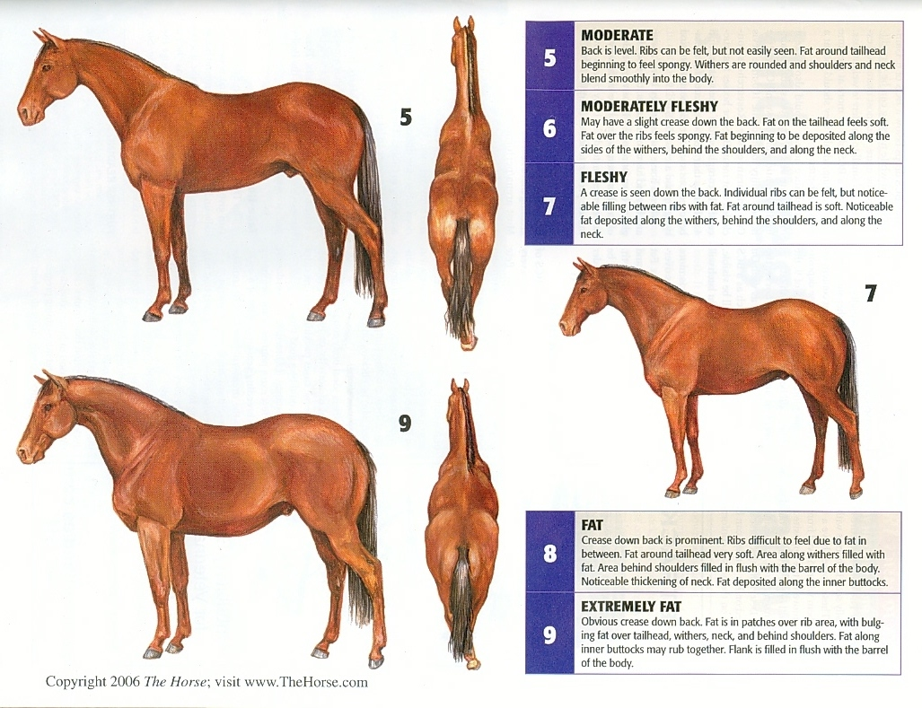
Body Condition Scoring

Slide 10
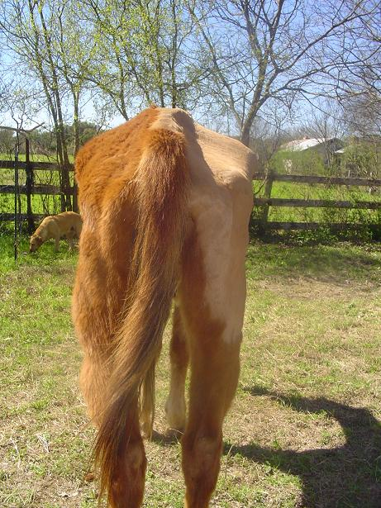
What Score Would this Be?

Slide 11
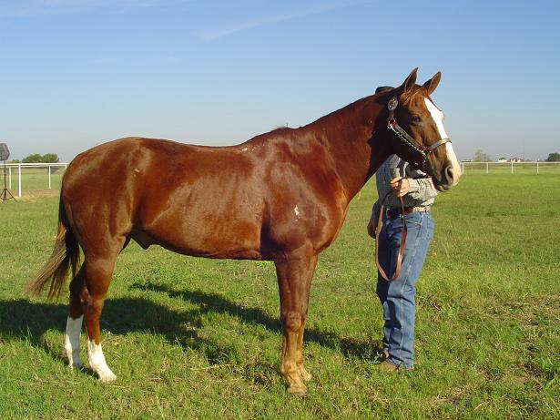
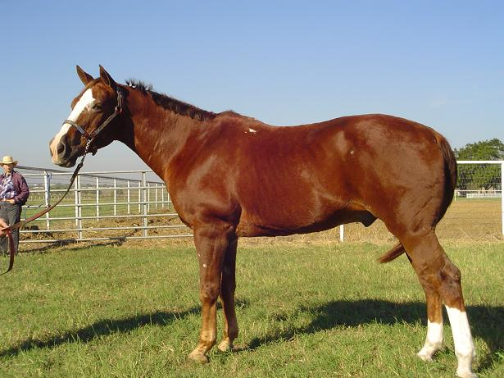
What Score Would this Be?

Slide 12
Health Care
Mares should be on a current, scheduled vaccination, de-worming, and hoof care program
Vaccines:
  Tetanus 30d prior to foaling
  EW Encephalomyelitis 30d prior to foaling
  Influenza 30d prior to foaling
  Rhinopnuemonitis

Slide 13
Health Care
Rhinopneuomonitis
  Respiratory Form
  Abortion Form
    Can cause abortion as early as fourth month of pregnancy
    Most occur in last four months
    Pregnant mares should be vaccinated annually
    Should be vaccinated during
      Third, fifth, seventh, and ninth month

Slide 14
Health Care
Vaccines in some areas for:
  West Nile Virus
  Rabies
  Botulism
  Strangles
Regular de-worming throughout pregnancy except in last 30 days
No unnecessary drugs during first 60 days nor last 30 days

Slide 15
Feeding
First 8 months
  Maintenance
Increased needs during last 3 mo. Of gestation and lactation
Many mares are grazed on pasture during early pregnancy

Slide 16
Feeding
If proper body condition is maintained
  Grain may be unnecessary in early pregnancy
Weight fluctuations should be avoided
Dystocia
  Cattle vs. Horses

Slide 17
Expected Feed Consumption by Mares
(% Body Weight)
Forage Conc. Total
Late Gestation 1.0-1.5 0.5-1.0 1.5-2.0
Early Lactation 1.0-2.0 1.0-2.0 2.0-3.0
Late Lactation 1.0-2.0 0.5-1.5 2.0-2.5

Slide 18
Foaling Preparation
Vaccines provide passive immunity for foal through?
  Colostrum
Check pre-foaling mammary secretions
  Waxing

Slide 19
Foaling Preparation
A properly prepared foaling place reduces what?
  Risk of disease
  Foaling stall vs. Pasture foaling
  Straw vs. shavings
Wrapping mare’s tail

Slide 20
Foaling
Three stages of labor:
Stage 1:
  Restless; lie down, roll, stomp feet, act colicky, may or may not eat
  May go on for 12 to 24 hours
  Stage ends with breaking of water

Slide 21
Foaling
Stage 2:
  Birth occurs
  Most foals are born in 20 to 30 minutes
  Fetal placenta containing foal separates from uterus during process
  Birth must occur rapidly at this point to prevent hypoxia

Slide 22
Foaling
Stage 3:
  Uterus shrinks and placenta is expelled
  Placenta should be expelled naturally
  After expelled, should be examined
  If still attached after 2 to 3 hours call veterinarian
  Retained placenta can cause serious complications

Slide 23
After Foaling
Foal will weigh
  ~10% of mare’s body weight
Navel should be treated with solution
Nursing should be observed
Enema is suggested to remove meconium
Foal Heat Breeding
Weaning

