Slide 1
Equine Nutrition
Lecture 2
Anatomy and Physiology of the Digestive Tract

Slide 2
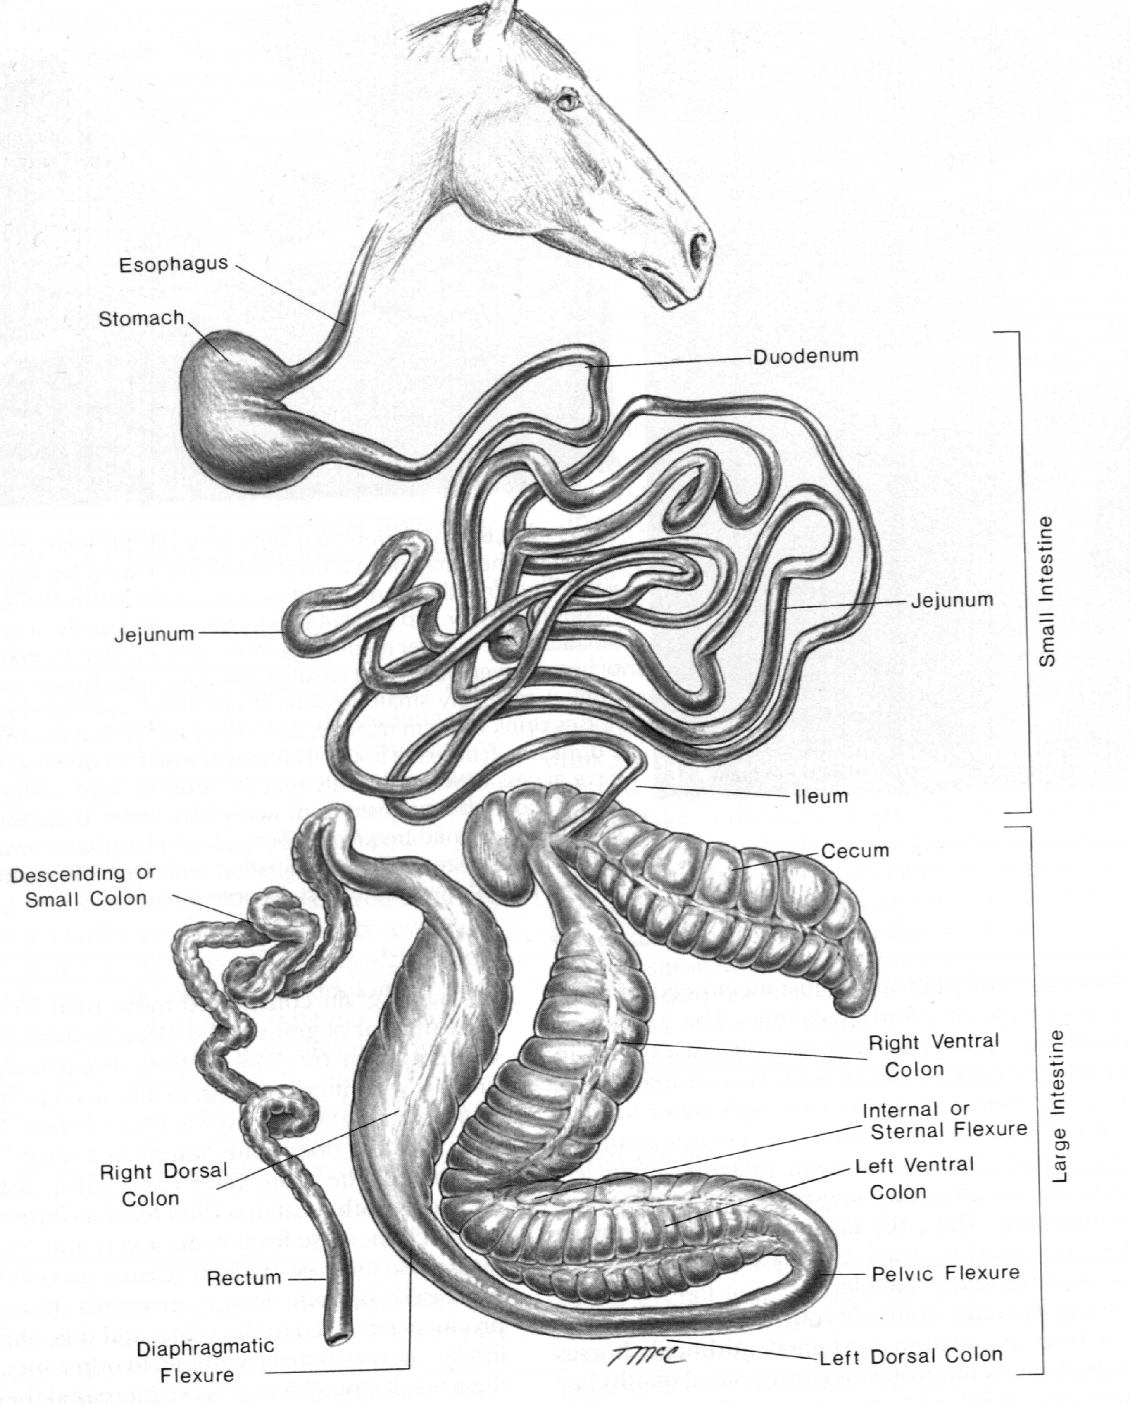
Equine Digestive System

Slide 3
Mouth
Upper lip
  Strong, mobile and sensitive
  Used to place forage between teeth
Tongue used to
  Move ingested material to cheek teeth
Upper and lower incisors present
  Unlike ruminants
  Allows close shearing of forage

Slide 4
Mouth
Ingestion of forage is
  Slower than cattle and sheep
Number of chews per minute is similar
  73-92 horses
  73-115 sheep
DMI per bite ~ half than sheep
  Horses need longer daily periods to graze

Slide 5
Mouth
How many chewing movements does it take for 1 kg concentrate to be digested?
  800 to 1200
How many chewing movements does it take to for 1 kg concentrate of long stem hay?
  3000 to 3500

Slide 6
Mouth
Abnormal or diseased teeth can cause
  Digestive disturbances and colic
  Older horses with worn teeth are at higher risk
Horses have two sets of teeth
  Deciduous teeth
  Permanent teeth
    Never stop growing and maintenance is required

Slide 7
Mouth
Saliva
  Feed stimulates secretion
  Copious amounts produced
  No enzymes present
  Bicarbonate and Sodium Chloride present
    Provides buffering capacity
  Provides lubrication to prevent choking
    Also allows for some microbial fermentation in proximal region of stomach

Slide 8
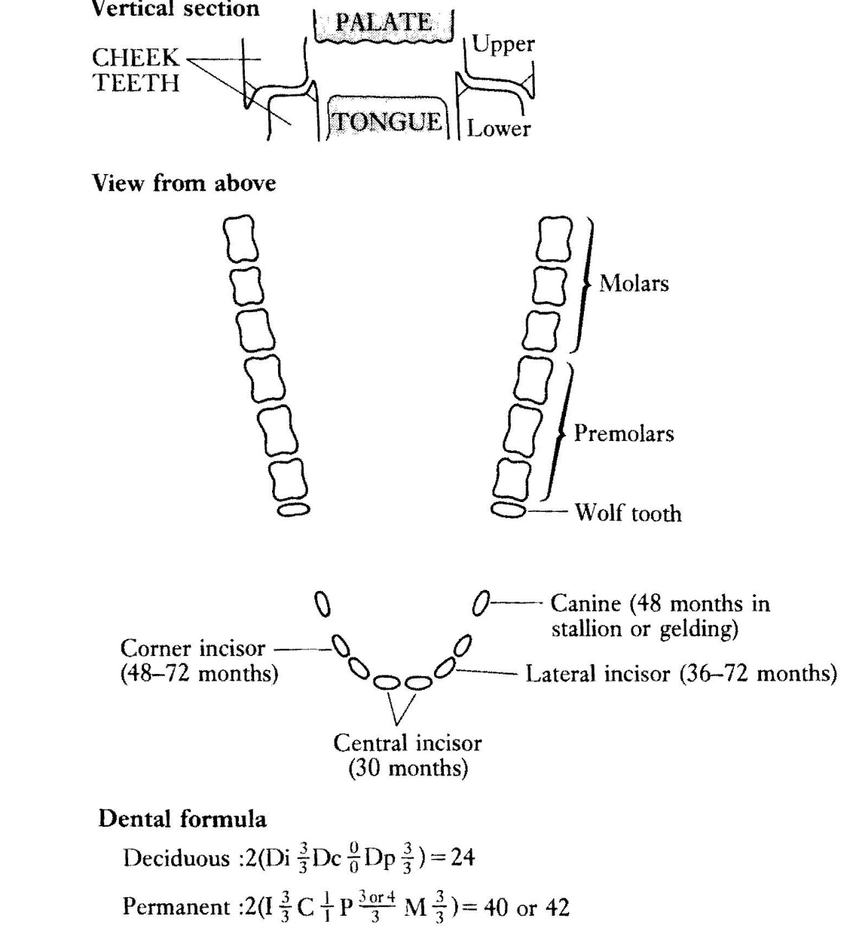

Slide 9
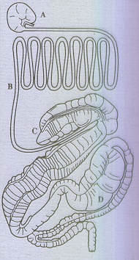
Stomach
  Represents ~ 10% of GI tract
How many gallons can the stomach of an 1100 lb horse capacitate?
  2 to 5
Why is there no need for a large compartment?
  Constant grazers
pH ranges from 1.5 to 5.5

Slide 10
Stomach
  Most digesta is held in the stomach for short periods of time
    Two to six hours
    How fast do liquids pass through the stomach?
    75 % gone within 30 minutes
  Entrance of stomach is guarded by cardiac sphincter
    Function of valve generally does not allow horse to vomit

Slide 11
Stomach
Almost half the mucosal surface is lined with squamous instead of glandular epithelium
Glandular mucosa is divided into:
  Fundic (5.4) and pyloric (2.6) regions
    Fundic mucosa contain
      Parietal cells that secrete HCl (substrate?)
      Zymogen cells which secret pepsin (substrate?)
    Pyloric Region
      Secretes the polypeptide hormone gastrin in to the blood plasma

Slide 12
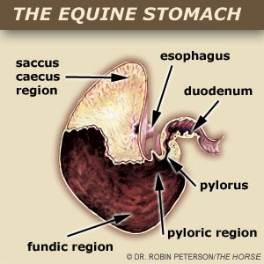

Slide 13
Stomach
What triggers the secretion of gastrin?
  A meal
What triggers the cease of gastrin secretion?
  Distention of stomach wall
Most prolonged gastrin secretion occurs
  When horses eat hay freely

Slide 14
Stomach
Some fermentation takes place
  Primarily yields lactic acid
  Occurs in esophageal, fundic, and saccus caecus regions
  All lined by squamous cells
  As digesta approaches pylorus pH falls
    ↑ HCl → ↑Pepsin → ↓ fermentation
Protein digestion is slight, why?
  Small stomach
  Short dwell time

Slide 16
Gastric Ulceration
Two General Types:
  Squamous Ulceration
  Glandular Ulceration
One research study indicated:
  TB’s in training = 80%
  TB’s off one month = 52%
Clinical signs generally include colic and pronounced teeth grinding
In general, ↑ grain = ↑ ulceration

Slide 17
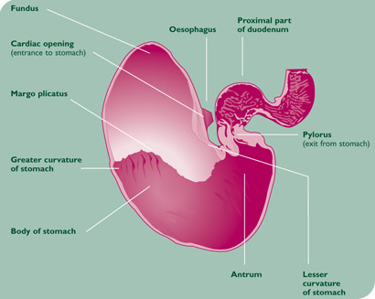
Squamous Ulceration
The dorsal region is covered by squamous epithelium and ulcers occur here as a direct result of extended exposure to acid secretions. Many equine stomach ulcers occur in the area near to the esophagus. In foals the developing cell lining is thinner than in adults, making foals especially prone to gastric ulceration

Slide 18
Glandular Ulceration
The ventral region is covered in glandular epithelium and ulcers occur here when the protective mucus layer is compromised e.g. due a side-effect of certain medications, enabling acid erosion of the stomach wall.

Slide 19
Small Intestine
  Divided into three parts:
    Duodenum
    Jejunum
    Ilieum
  How long?
    50 - 70 feet long
    3 – 4 “ diameter
  May hold up to 10 to 12 gallons Some food passes
    In as little as 15 minutes
    Most takes 10 hrs

Slide 20
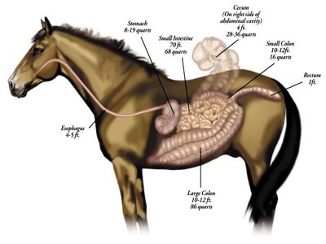
Gastro-intestinal Tract

Slide 21
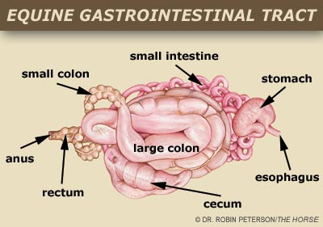

Slide 22
Small Intestine
Pancreatic juices secreted due to:
  Food in stomach
  Mediated
    Vagal nerve fibers in S.I.
    Presence of HCl in duodenum
      Stimulates secretin production in blood
    Secretin
      Controls secretions in duodenum
      Also increase pancreatic juice secretion by 4 to 5 times
      Creates buffering effect

Slide 23
Small Intestine
Other pancreatic secretions present include:
  Trypsin (protease)
  Lipase
Bile
  Secreted by liver
  Stimulated by HCl in duodenum
  Stored in gall bladder?
  Fat digestion
Bicarbonate content ↑ towards ileum
  Buffer to large intestinal VFA’s

Slide 24
Small Intestine
  What is digested in the S.I.?
    Fat
    Protein
    50 -70% soluble CHO’s
    Vitamins and Minerals also absorbed
    Liquids pass through rapidly
      Reach cecum 2 to 8 hrs post ingestion
      5 hours later, liquid reaches colon

Slide 25
Small Intestine
What leaves the small intestine?
  Fibrous Feed residues
  Undigested feed starch
  Protein
  Microorganisms
  Intestinal Secretions
  Cell debris

Slide 26
Large Intestine
What occurs in the LI?
  Fermentation of digesta by microorganisms produces:
    VFA’s
    Lactate
  Slow in comparison to the digestion of
    Starch and protein
  What is located at distal end of illeum that allows fermentation?
    Cecum

Slide 27
Cecum
3 to 4‘ in length
Holds 7 to 8 gallons
Contains bacteria
What is digested?
  Large amounts of fiber
  ~ ½ of the soluble CHO’s ingested
Absorption can also occur
Bacterial protein
  Produced, digested, and absorbed

Slide 28
Ascending Colon
10 to 12 ‘ long
Diameter of 8 to 10”
Holds 14 to 16 gallons
Four Portions:
  Right ventral colon
  Sternal flexure or left ventral colon
  Pelvic Flexure to the left dorsal colon
  Diaphragmatic flexure to the right dorsal colon (connects to small colon)

Slide 29
Ascending Colon
Passage of particulate matter and liquids slow
  36 to 48 hrs
  What is digested in the Colon?
Nearly all
  CF
  Cellulose
  Over 50% soluble CHO’s
  Passes through S.I. into cecum

Slide 30
Cecum and Colon
Digestion depends almost entirely on:
  Constituent bacteria and ciliate protozoa
  Walls contain only mucous-secreting glands
  No digestive enzymes

