Slide 1
Lecture 4
Anatomy and Physiology of the Stallion

Slide 2
Introduction
The ability of a stallion to produce:
  Adequate, fertile spermatozoa is essential for an economically successful breeding season
Current foaling rates are between 55 and 60%
Reproductive efficiency can be improved through a better understanding of the stallion’s:
  Anatomy
  Physiology
  Behavior

Slide 3
Anatomy
Includes:
  Two testes attached with epididymides
  Two different ducts
  Vas Deferens
  Urethra
  Penis
  Accessory sex glands:
    Bulbourethral – Cleanses the Urethra
    Prostate – Buffering Agents
    Vesicular – Source of Simple Sugars

Slide 4
Testes
Site for production of spermatozoa
  (spermatogenesis)
Testosterone
Size related to ability to produce sperm
What effects sperm production?
  Daylength
Cryptorchidism

Slide 5
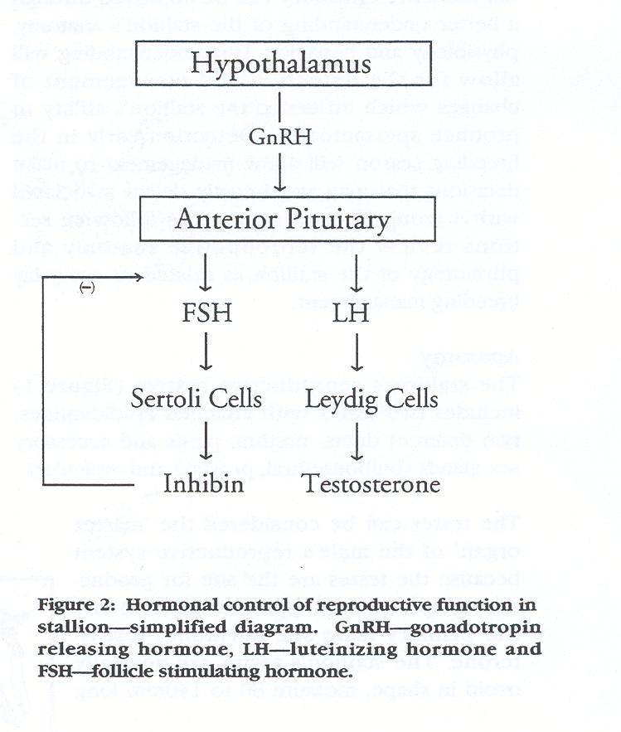
Hormonal Control
Includes:
Pineal Gland
  Melatonin
Hypothalamus
Pituitary gland
Testes

Slide 6
Hormonal Control
Sertoli cells:
  Located within the testes seminiferous epithelium
  Function primarily in supporting spermatozoa development
  Also secrete a number of proteins to regulate FSH and proteins that bind testosterone

Slide 7
Hormonal Control
Leydig cells:
  Located between the seminiferous tubules
  Under the influence of LH
  Responsible for testosterone production
  Also secrete estrogens
    Physiological function unclear

Slide 8
Testosterone
Necessary for normal sexual behavior and testicular function
Proteins produced by Sertoli cells which bind testosterone are
  Responsible for maintaining testicular concentrations
  These concentrations control release of GnRH

Slide 9
Sperm Production
Spermatogenesis occurs in testes
Process requires ~57 days
Stored where?
  Epididymis
    Further maturation takes place
    Migration ~ 8 day

Slide 10
Sperm Production
Testes are suspended within the scrotum by the
  Spermatic cord
  Cremaster muscle
    Cold weather vs. Hot weather

Slide 11
Anatomy
Penis:
Vascular
Stimulated through Teasing
Ejaculate includes:
Fluid portions of the testicular
Epididymal and Accessory Sex Gland secretions (also referred to as seminal plasma)

Slide 12
Ejaculate Fractions
Three Fractions:
Bulbourethral Portion
  Cleanses the urethra
Sperm rich fraction
  45% of ejaculate volume
  75% spermatozoa
Sperm poor fraction
  Gel portion
  Typically discarded in AI

Slide 13
