Slide 1
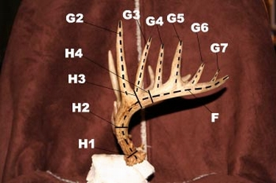
Whitetail Antler Scoring
Zachary Nowak
8/26/2013

Slide 2
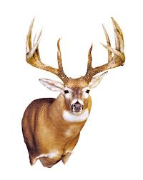
Objectives
Define and Demonstrate how to score a typical Whitetail Buck.

Slide 3
Whitetail Antler Scoring
Consists of 4 main Measurement
Inside Spread (at widest point)
Length of Points
Length of main beams
Circumference 4 counts on each beam at narrowest point

Slide 4
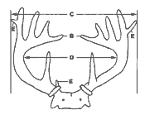
Width Measurements
Inside Spread (at widest point).
  Measured at a right angle to the center line of the skull at widest point between main beams.
  Enter this measurement again as the Spread Credit if it is less than or equal to the length of the longer main beam;
  if greater, enter longer main beam length for Spread Credit.

Slide 5
Length Measurements
Length of Main Beam
  is measured from the center of the lowest outside edge of burr over the outer side to the most distant point of the main beam.

Slide 6
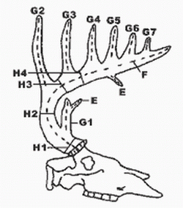
Length Measurements
G‑1‑2‑3‑4‑5‑6‑7. Length of Normal Points:
  Normal points project from the top of the main beam.
  They are measured from nearest edge of main beam over outer curve to tip.

Slide 7
Circumference Measurements
H‑1‑2‑3‑4. Circumferences
  H-1 is taken at the base of the antlers right above the burr at the smallest point.
  H-2 is taken between the brow point “G-1” and the second point “G-2”.
  ETC.
  If brow point is missing, take H-1 and H-2 at smallest place between burr and G-2. If G-4 is missing, take H-4 halfway between G-3 and tip of main beam

Slide 8
Deductions
Deductions are made by totaling up the differences in the right and left beams and subtracting it from the total measurements.

Slide 9
References
Boone and Crockett Club. (2013). Scoring. Retrieved from http://www.boone-crockett.org/index.asp

