Slide 1
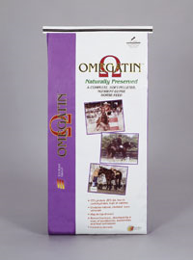




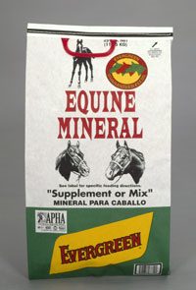
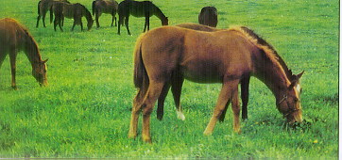
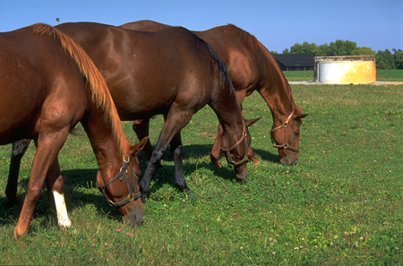

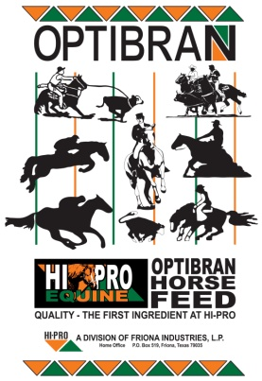
Equine Nutrition
Matt McMillan, Ph.D.

Slide 2
Equine Nutrition
Why are we concerned with equine nutrition?
How did the wild horse evolve and survive?
  Reduction in the number of toes
  Increase in the size of the cheek teeth
  Increase in body size
  Evolution of hindgut

Slide 3
Equine Nutrition
What are the consumption habits of the wild horse today?
  Continuous grazers
  High fiber, low starch diets
  Unconfined
What are the general consumption habits of the domesticated horse today?
  Meal eaters
  High fiber, High Starch diets
  Confined

Slide 4
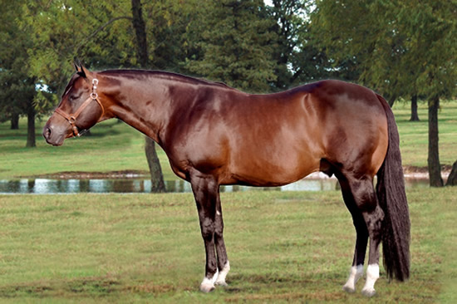
Nutrients
What is a nutrient?
  Any constituent that is necessary for the support of life

Slide 5
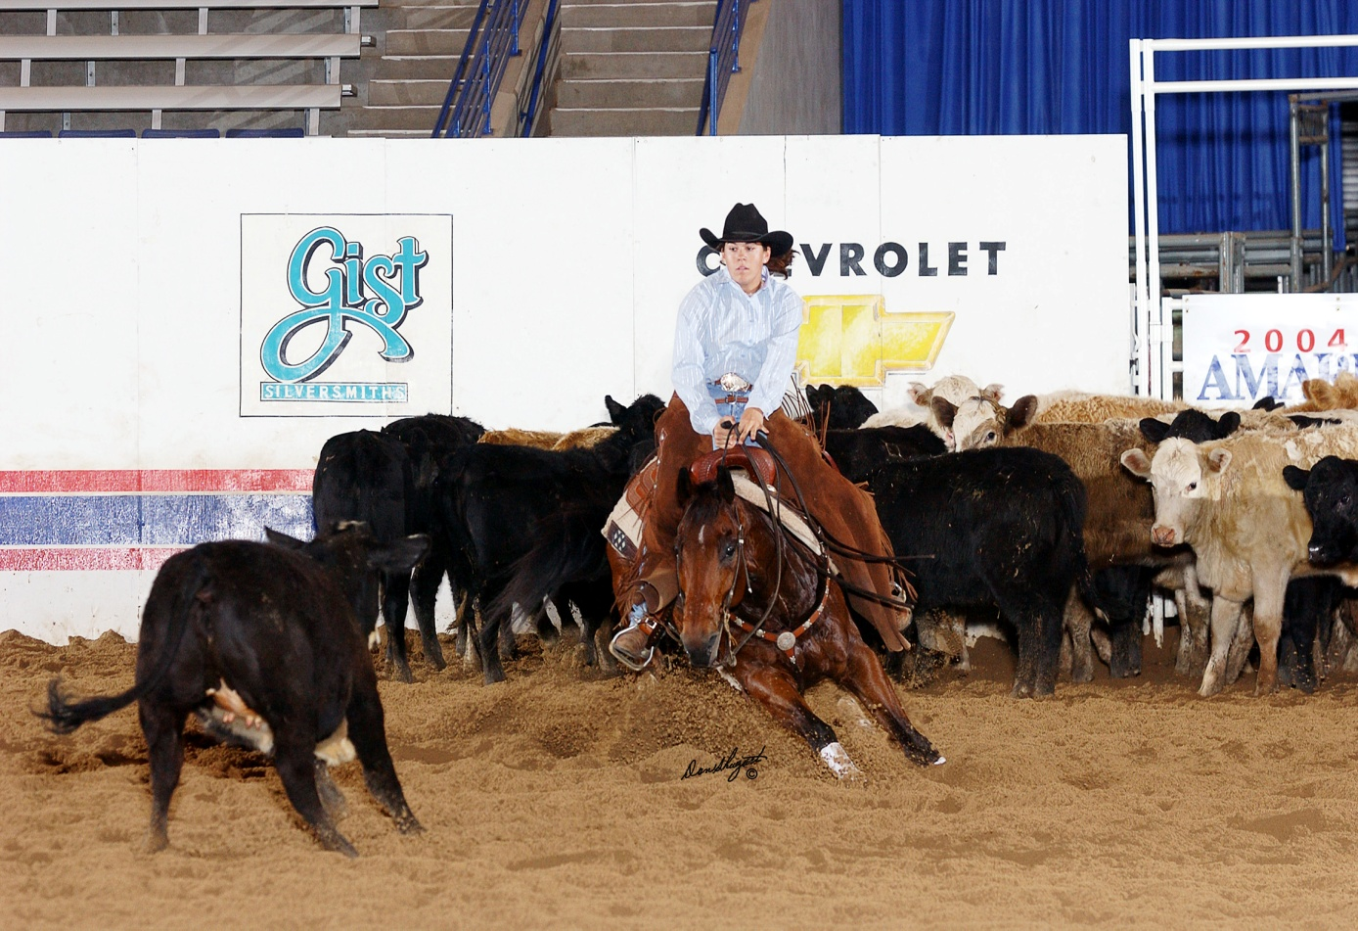
What Are the 8 Basic Nutritional Requirements That Every Horse Needs?
W
E
P
V
M
S
F
Water
Energy
Protein
Vitamins
Minerals
Salt
Forage
Oxygen

Slide 6
Nutrients
So how do nutrients support life?
  Used in the components of body structure
  Enhance or are involved in chemical reactions in the body (i.e. metabolism)
  Serve as a source of energy
  Aid in transporting substances into, throughout, and/or out of the body
  Assist in the regulation of body temperature
  Affect feed palatability and therefore consumption

Slide 7
Nutrients
Can some nutrients fill a number of life support functions?
    Water and several minerals are needed for all of the functions
      Except as sources of energy
    Proteins, CHO’s, and fats may be used for?
      Energy
      Also are components of body structure

Slide 8
Nutrients
What occurs when nutrients are either inadequate or excessive in amount?
  Effects occur on the body function(s) that that particular nutrient serves
    Ex: Water Deficiency:
  Dehydration → Colic
    Ex: Protein Excess:
  ↑ Urine Volume → Dehydration → Electrolyte Imbalance

Slide 9
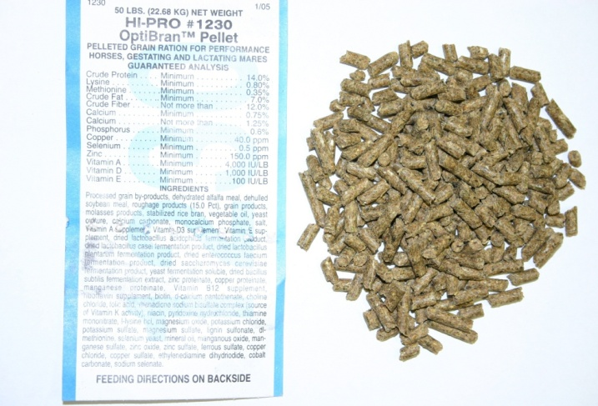
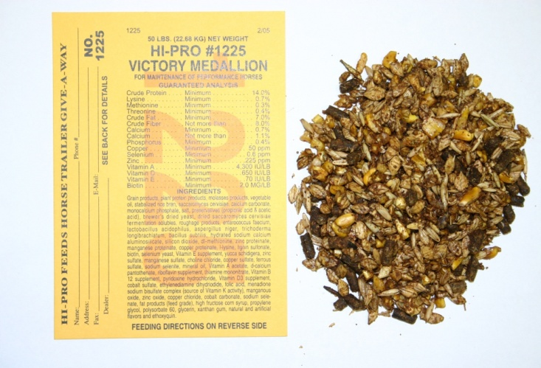
Nutrients
How do nutrients vary in feed?
    Appearance
    Palatability
    Quantity and Quality of Nutrients

Slide 10
Nutrients
Feeds contain nearly the entire spectrum of different nutrients
However, they differ in the amount of which nutrients they contain
  Ex: Grass Hay vs. Corn vs. Soybean Meal
    Crude Protein, Crude Fiber, and CHO content
    All are present in each feedstuff, but in different amounts

Slide 11
Nutrients
What must occur for nutrients to be utilized?
  Must be released from the feed that has been ingested
  Must be broken down sufficiently for digestion
  Must be absorbed into the body by the digestive tract

Slide 12
Equine Digestion
What is digestion?
How does equine digestion differ from other animals?
Digestively speaking what do we call a horse?
  Why?
Are horses efficient in their digestive abilities?

Slide 13
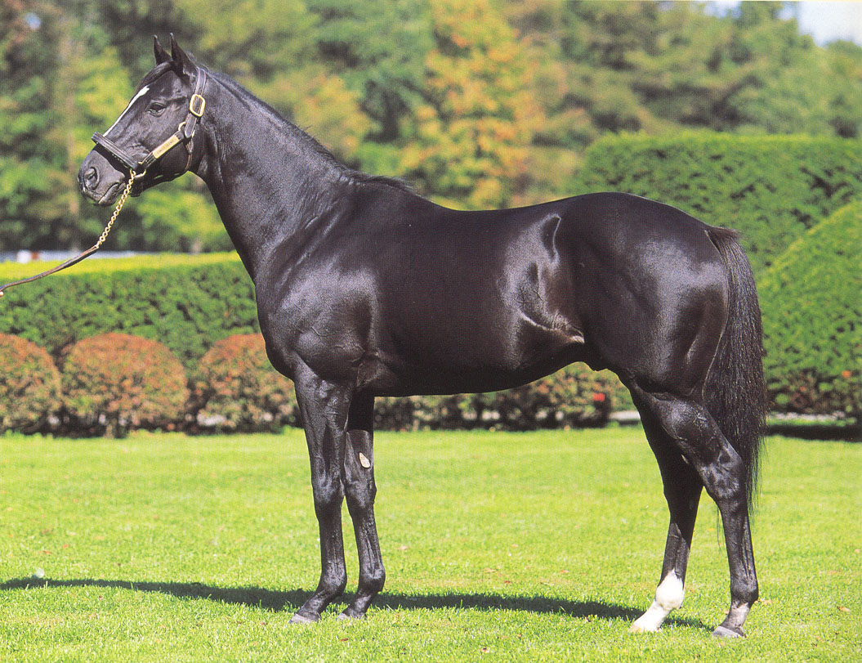
This is Not a Horse!
Sunday Silence

Slide 14
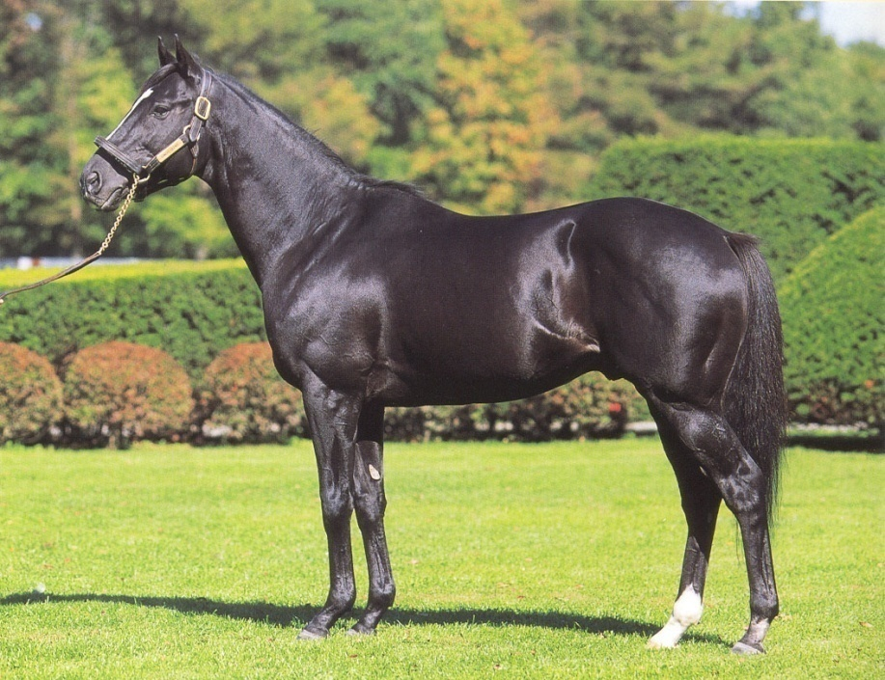
This is a:
Fermentation vat on four legs
  with an attitude
aka a continuous grazing apparatus used to gleam pastures of high quality forage
Sunday Silence

