Slide 1
Equine Nutrition
Digestion & Microbes

Slide 2
Passage of Digesta
Muscle contractions in G.I Tract allow for what?
  Peristalsis to move digesta towards anus
  Mixture with digestive juices
  Allowing for absorption
During digestive upsets:
  Movements may stop
  Gasses of fermentation may accumulate

Slide 3
Passage through Cecum
Peristalsis allows passage
Passage Rate of Digesta is ~
  20% per hour
  Rumen = 2-8% per hour

Slide 4
Microbial Digestion
Three main distinctions in microbial fermentation and simple stomach digestion:
  ß-1,4-linked polymers of cellulose are degraded
  During their growth, microorganisms synthesize essential amino acids
  Bacteria are net producers of B vitamins & vitamin K

Slide 5
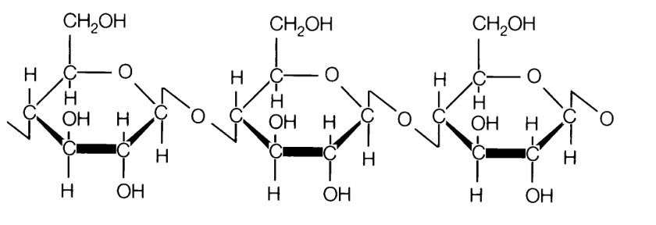
Structure of Cellulose

Slide 6
Microbial Numbers
In the fundic region (pH = ~5.4)
  Bacteria = 10⁸ to 10⁹/g
Those present can withstand moderate acidity
  Lactobacilli
  Streptococci
  Veillonella gazogenes

Slide 7
Microbial Numbers
Jejunum and Ileum
  Anaerobic Gram-Positive bacteria
    10⁸ to 10⁹/g
Cereal diet influences the amount of
  lactic acid versus VFA’s that are produced as an end products

Slide 8
Microbial Numbers
Cecum and Colon
  Much higher amounts of bacteria
    0.5 x 10⁹ to 5 x 10⁹/g
Difference between hind gut fermentation and rumen fermentation
  Lower starch content of the hindgut
  Generally equates to lower rate of fermentation
  However, starch content of cecum is variable
Variable suppression of cellulolytic bacteria
  As grain ↑ cellulolytic bacteria ↓
  What happens when forage is increased?

Slide 9
Microbial Numbers
One study revealed about Cecum:
  Cellulolytic bacteria = 2 - 4% of total
  Fungal and protozoal units were also found to be present
  Optimal pH in cecum for these constituents =
    5-6

Slide 10
Fauna
Protozoa in equine L.I. =
  0.5 x 10⁵ to 1.5 x 10⁵/ml
Much larger than bacteria
Contribution to metabolism is less
~72 species / different from rumenal
Removal caused only slight decrease in DM digestibility
  No effect on bacteria

Slide 11
Flora
Bacteria
  Highest populations in cecum and ventral colon
  Only 20% of bacteria can degrade protein
  Specific organisms may change by 100 fold in 24 hour period
  Caused by
    Feeding Frequency
    Forage/Grain Ration
    pH

Slide 12
Flora
Effects on Bacteria
  Feeding frequency can have large influence on digestive disorders
  Large concentrate meals may cause:
    Elevated glycemic responses
    Abnormal behaviors
    Fibrous feeds can lower these responses
High fiber diets also stimulate peristalsis
  Decreasing risk of metabolic acidosis

Slide 13
Flora
Horses on high grain diets
  Are less efficient at digesting hay…why?
What about horses on high forage diets?
Abrupt changes in a diet may cause problems
  Gradual change in diets is suggested

Slide 14
Products of Fermentation
Microbial fermentation of fiber, starch, & protein yields:
  Volitile Fatty Acids
    Acetic
    Propionic
    Butyric
Fermentation and VFA absorption are promoted by:
  The buffering effect of bicarbonate and Na⁺ derived from ileum
  Anaerobic Environment
  Normal motility to ensure adequate fermentation time and mixing

Slide 15
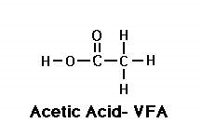
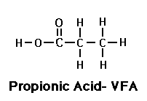
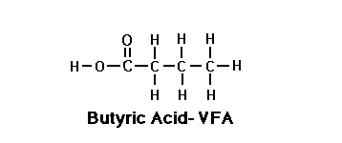
VFA’s
Acetate
Propionate
Butyrate

Slide 16
Products of Fermentation
Major Products of Fiber Digestion
  Acetate
  Butyrate
Proportion of propionate increases with
  Increasing proportions of undigested starch from S.I.

Slide 17
Absorption
Water
Largest is absorbed at the ileocecal junction
  Water content of S.I. digesta amounts to
  87-93%
  Feces of healthy horse contains
  58-62% water

Slide 18
Absorption
Electrolytes are absorbed from the cecum and L.I.
  Phospate is efficiently absorbed from both small and large intestine
  Ca and Mg are not
    Absorbed mainly in S.I.
  Why do we care?

Slide 19
Absorption
Microbial Degradation occurs faster
  In the cecum & ventral colon than in the dorsal colon
Rate is also faster when
  Starches are degraded rather than structural CHO’s
Optimum pH of 6.5 exists for microbial activity
  Promotes VFA absorption
As pH moves closer to the pK of a particular VFA
  More is absorbed

Slide 20
Absorption
H⁺ ions are required for VFA absorption
  Derived from mucosal cells in exchange for Na⁺
Bicarbonate is secreted in exchange for Cl⁻
Absorption of VFA’s is accompanied by
  A net absorption of NaCl
  Major determinant of water absorption

Slide 21
Absorption
VFA’s pass readily in the blood
Lactic acid produced in the stomach is not well absorbed in S.I.
  Upon reaching L.I.
    Some absorbed
    Most is metabolized by bacteria to propionate

Slide 22
Absorption
Microbial activity also produces gas
  Carbon Dioxide, Methane, and Hydrogen
    Each are either
      Absorbed
      Ejected from the anus
      Participate in further metabolism
Can create problems
  If production exceeds expulsion

Slide 23
Protein Degradation
Microbial growth requires N
Protein breakdown much greater in S.I.
  Than cecum
Death and breakdown of microorganisms also
  Release proteins and amino acids
Generally thought that amino acid absorption in cecum is
  Minimal when compared to dietary requirements

Slide 24
Urea Production
Principle end product of protein catabolism
Generally thought to not be utilized efficiently in the horse
Mostly excreted through kidneys

