Slide 1
Horse Industry
History and Economic Impact
Lecture 3

Slide 2
Domestication & Early Use
Who was responsible for bringing horses back to North America?
  Spanish (1500’s)
Some of these horses returned to the wild and became known as?
  Mustang

Slide 3
Colonization of North America
By the late 1800’s
  Towns and cities had growing needs for horses
  Central element in urban life
Horses created much
  Revenue throughout the country
Exploration of the new frontier
  Further increased the needs for the horse

Slide 4
Colonization of North America
1800’s
  Horse population grew rapidly
Rural horse populations estimated
  ~ 8 million
Mules also increased in numbers due to
  Bigger and heavier farm equipment
  Especially valued in coal mines

Slide 5
Urban Growth
In the 1850’s
  Became an essential part of urban fire protection
  Transportation
  Agriculture
  Military

Slide 6
Urban Growth
Significant role in the growth of urban America?
  Draft horse
First means of public transit
  Horse cars
By 1886
  Over 100,000 horses and mules used in >300 cities

Slide 7
Modern Day Use
What has occurred in the last 100 years?
  Work → Pleasure
According to USDA how many horses in US in 1915?
  ~23 million
  > 95% used for work

Slide 8
Modern Day Use
How many horses in U.S> in 1960’s?
  < 3 million
Present Day Numbers?
  Exceed 10 million
  Used mostly for what?
    Pleasure

Slide 9
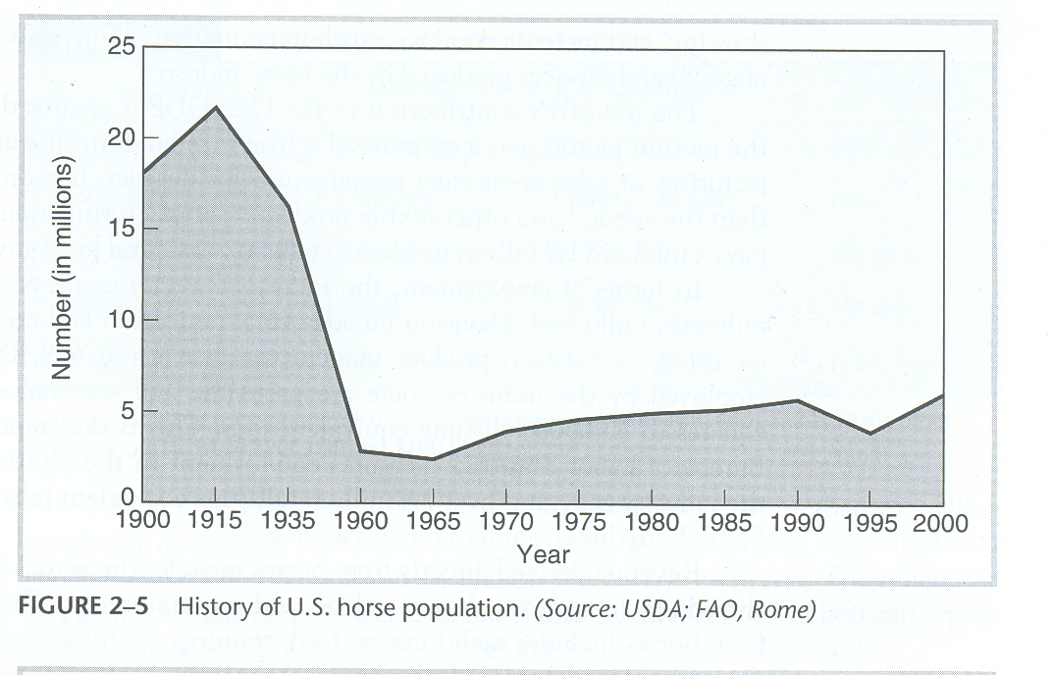

Slide 10
Status and Future of the Horse Industry
Majority of the world’s horses, donkeys, and mules
  Not found in the U.S
What % of horses in U.S.?
  8%
What % of donkeys and mules
  >1%

Slide 11
Status and Future of the Horse Industry
How many horses in the world?
  ~60 million
Where are the majority found?
  More than half are found in
    Asia and South America
Mexico, Europe, and U.S.
  All have significant populations

Slide 12
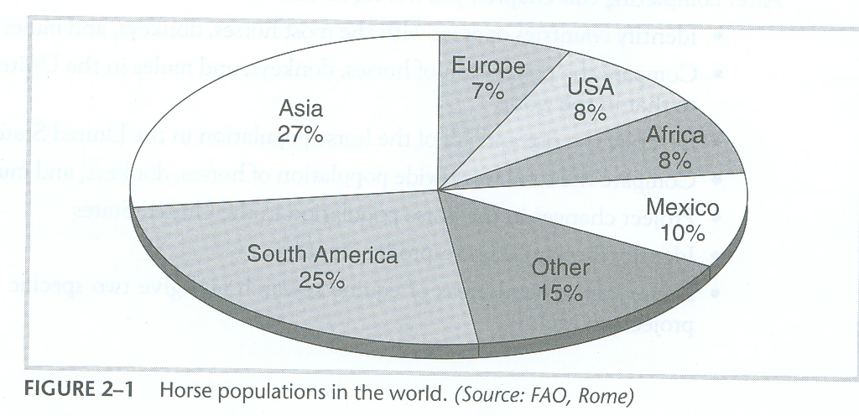

Slide 13
Distribution of Donkeys and Mules
Donkeys
  Most are found in Africa and Asia (~80%)
  Worldwide population is ~43 million
  Only ~ 54,000 in U.S.
Mules
  Worldwide population ~15 million
  84% located in Mexico, S. America, and Asia
  U.S. has ~28,000

Slide 14
U.S. Domestic Horse Industry
Number of owners, service providers, & employees?
  4.6 million
Equine Spectators?
  Tens of millions
Owners?
  2 million

Slide 15
U.S. Domestic Horse Industry
Direct economic effect on U.S.?
  $39 billion annually
Number of full time equivalent jobs?
  460,000 annually
Amount of taxes paid by industry?
  $1.9 billion annually

Slide 16
U.S. Domestic Horse Industry
Annual household income of horse owners
  34% <$50,000
  28% >$100,000
  46% $25,000 - $75,000
70% of horse owners live in communities of
  50,000 or less

Slide 17
Texas Horse Industry
Texas is home to how many horses?
  ~1 million
Texas leads the nation in what breeds?
  AQHA, APHA, ApHC, AMHA
Texas is only second to who in total Arabian and Thoroughbred stallions
  CA

Slide 18
Texas Horse Industry
How many horse owners in Texas?
  ~300,000
  ~ 1 million horse industry participants
> 43,000 FT jobs in Texas
  Compares with:
    Rubber Products, Ag. Forestry and Fishery Services, Wood Products, and Transportation

Slide 19
Texas Horse Industry
Participants associate horses with what?
  Quality of Life, Pleasure, and Recreation
How much do Texas Horse owners have invested in
  Barns, vehicles, trailers, tack, and all other related equipment?
$13 billion !!!!

Slide 20
Texas Horse Industry
Annual maintenance?
  $2.1 billion
Annually spent attending events?
  $3 billion
Annual cash receipts for horses bought and sold?
  $354 million

Slide 21
Texas Horse Industry
Texas Horses are valued at $4.2 billion
Total impact to Texas economy exceeds
  $5.2 billion annually

Slide 22
Primary Careers Requiring Daily Contact with Horses
Veterinarian
Extension Horse Specialist
Trainer
Geneticist
Stable Manager/Foreman
Nutritionist
Riding Instructor/Coach
Veterinarian's Assistant
College Professor
Breeder
Pedigree Analyst
Auctioneer
County Agriculture Agent
Tour Guide
Artificial Inseminator
Veterinary Technician
Horse-Buyer
Youth Director
Farrier-Corrective Shoeing
Bloodstock Agent
College Instructor
Stallion Manager
Rehabilitation Therapist
Broodmare Manager
Clinician
Foaling Crewman
Farm/Ranch Manager
Stunt Rider or Double in Movies
Technical School Teacher

Slide 23
Support Positions Without Daily Contact with Horses
Real Estate
Attorney
Clothing Designer
Accountant
Boot Manufacturer
High School Teacher
Commercial Artist
Research
Illustrator
Insurance
Advertising
Public Relations
Reporter/Journalist
Director of Technical School
Horse Trailer Designer
Pest Control Specialist
Laboratory Technician
Feed Store Operator
Tack and Equipment Maker
Author
Carpenter
Author
Leather Dealer
Sales of Timing Equipment
Wholesale Tack Sales
Sales of Agricultural Equipment
Wholesale Clothing Sales
Pharmaceutical Sales
Feed Sales
Feed Manufacturer

Slide 24
Careers In Racing Industry
Track Veterinarian
Racing Chemist
Marketing and Publicity
Judge
Track Maintenance
Timing Equipment Engineer
Racing Steward
Paddock Judge
Director of Mutuels
Stable Superintendent
Racing Commissioner
Publicity Staff
Grounds Manager
Turf Club Director
Track Photographer
Horse Identifier
Track Manager
Announcer
Program Director
Facility Maint. Engineer
Trainer
Jockey
Exercise Rider

