Slide 1
Equine Nutrition
Macro Minerals

Slide 2
Minerals
What are minerals?
What are macro minerals?
Are they more important than micro minerals?
Organic or inorganic?
Importance?

Slide 3
Introduction
Involved in a number of functions including:
  Acid-base balance
  Formation of structural components
  Enzymatic cofactors
  Energy Transfer
Examples of necessary body components?
  Amino acids
  Hormones
  Vitamins

Slide 4
Introduction
Where do horses obtain most minerals?
  Forages
  Concentrates
What effects availability?
  Soil mineral concentrations
  Plant species
  Stage of maturity
  Conditions of harvesting

Slide 5
Introduction
Seven Macro-minerals:
  Generally expressed as % in the diet
    Ca & P
    Mg & K
    Na & Cl
    S
  Why should ratios of minerals be considered?
    Often influence: absorption, metabolism, and excretion

Slide 6
Calcium
99% of Ca in body is found where?
  Bones and teeth
Makes up ~35% of bone structure
Also involved in what?
  Muscle contraction
  Function of cell membranes
  Blood coagulation
  Regulation of enzymes

Slide 7
Calcium
What are some common inorganic forms of Ca?
  Calcium carbonate
  Calcium sulfate
  Calcium oxide
Studies have shown that organic calcium
  did not differ in absorption rate from calcium carbonate

Slide 8
Calcium
True absorption efficiency declines with what?
  Age
Where does absorption take place?
  Small Intestine
Absorption Efficiency of Young Horse?
  70%
Absorption Efficiency of Mature Horse?
  50%

Slide 9
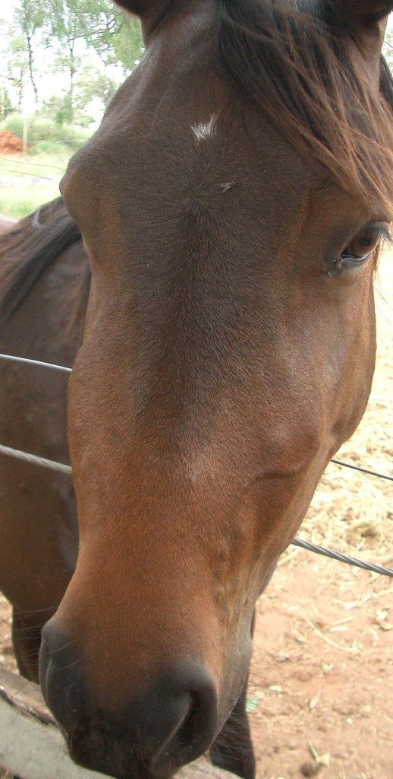
Big Head Disease
What other factors effect Ca absorption?
  Dietary concentration of Ca & P
  Presences of Oxalate & Phytate
    Could lead to hyperparathyroidism
    1% oxalic acid in the diet reduced absorption ~66%
    More can create a negative Ca balance

Slide 10
Calcium
Other factors affecting Ca absorption include:
  ↑ on alfalfa diet when compared to Bermudagrass
  ↑ dietary Mg, ↑ Ca absorption in S.I.
  ↑ dietary P, ↓ Ca absorption in S.I.

Slide 11
Calcium
Deficiencies?
  Can lead to rickets in the foal
    Characterized by poor mineralization of the osteoid tissue and probable enlargement of the joints
  In mature horses, deficiencies can result in
    Weakening of the bones and lameness

Slide 12
Calcium
Excesses:
  Research has shown no differences between
    Growing horses on diets that contain:
      1.16:1 and 4.12:1 Ca:P diets
  Some proposed ostechondrosis when feeding high Ca diets
  However, Ca has been fed 5 times normal dose without
    Ill effects as long as P levels were adequate

Slide 13
Calcium
Any ↑ in Ca associated with work
  Appears to be readily met by ↑ DM consumption
Needs ↑ in 9, 10, and 11 month of gestation
Requirements ↓ from late gestation to late lactation

Slide 14
Phosphorus
Makes up what % of the skeleton?
  14-17%
Required for:
  Many energy transfer reactions – ATP and ADP
  Synthesis for:
    Phospholipids
    Nucleic acids
    Phosphoproteins

Slide 15
Phosphorus
Efficiency of true absorption ~30 to 55
What causes variation in absorption efficiency?
  Other dietary constituents
  How much and what type of P fed
  Age of horse
↑ NaCl diets ↑ P from 1 to 5% absorption
High dietary Ca depresses P absorption
  .89% Ca reduces P absorption to 25%

Slide 16
Phosphorus
Oxalates depress P absorption
Phytate
  Predominant form of P in plants
    Poorly absorbed
    May be partially available due to phytase in lower gut
To meet P requirements
  Inorganic phosphates are often added to the diets
  Phytase has been found to be
    ineffective on phytate absorption

Slide 17
Phosphorus
Absorption is likely to be higher in foals fed milk
It is assumed that true absorption efficiency for P is
  35% in idle, gestating, & working horses (primarily plant sources)
  45% for lactating mares – supplemented sources
  8 mo. of age ↑ requirement than 12 mo.
  Horses housed in warm barns ↓ requirement than cold barn
  ↑ efficiency when demand for P ↑

Slide 18
Phosphorus
Deficiencies?
  Bone problems
Excesses?
  Reduces rate of Ca absorption
    Hyperparathyroidism
What is the maximum tolerable in total diet?
  1%

Slide 19
Calcium-Phosphorus Ratio
Why is it important that Ca intake is not lower than P?
  Ratios < 1:1 are detrimental to Ca absorption
  Excess P can also be very detrimental
Ratios of Ca to P as high as 6:1 in diets of
  Growing foals may not be detrimental
    If P intake is adequate

Slide 20
Magnesium
Constitutes what % of body mass?
  ~ 0.05%
    ~ 60% is associated with skeleton
    ~ 30% found in muscle
Importance?
  Ion in the blood
  Co-enzyme factor
  Muscle contraction

Slide 21
Magnesium
Absorption range?
  40 - 60% in feedstuffs
Inorganic supplemental sources include:
  Magnesium oxide
  Magnesium sulfate
  Magnesium carbonate
    70% absorption rate
      Higher than natural sources

Slide 22
Magnesium
Absorption ↑ when fed
  ALF rather than concentrate
Oxalates do not affect absorption
Excess P caused ↓ in Mg absorption
Absorbed from both the S.I. and L.I.
  Majority in S.I.

Slide 23
Magnesium
Deficiencies and Excess:
  5 to 6 mg/kg of BW/d resulted in hypomagnesia
  20mg/kg of BW/d resulted in normal serum levels
  Deficiencies will result in?
    Nervousness and muscle tremors
    Ataxia (lack of muscle coordination)
      After initial signs:
        Collapse, profuse sweating, convulsive paddling, and death in some instances

Slide 24
Magnesium
Hypomagnesemia induces
  Ca and P mineralization in the aorta
  Histological changes occur within 30 d
Pastures that are conducive to Mg deficiency (tetany)
  Death in ruminants do not affect horses similarly
However:
  Tetany in transported horses has been attributed to hypomagnesemia

Slide 25
Magnesium
Maximum tolerable levels are estimated at 0.3%
However, some alfalfa hays with 0.5% have been
  Fed without any negative affects
Other research has indicated that as high as .86% has been fed from MgO sources for 1 month
  Without negative affects

Slide 26
Potassium
Major intracellular cation
Most body K found in skeletal muscle
Involved in the maintenance of
  Acid-base balance and osmotic pressure
Forages and oilseeds generally contain
  1 to 2% K (DM basis)
Cereal grains typically contain 0.3 to 0.4%

Slide 27
Potassium
Required concentration in a purified-type diet for growing foals ~ 1%
Mature horses require ~0.4%
Because forages usually makeup a significant portion of the diet
  K requirements should be easily met

Slide 28
Potassium
Deficiencies:
  Foals fed K deficient diets
  Gradually refused to eat and lost weight
  Also became unthrifty in appearance
  After K was entered back into the diet, normal feed intake resumed

Slide 29
Potassium
Excesses:
  Excreted readily via urine
  Adequate water very important
  Excesses not heavily studied
  Assumed that extreme excesses could lead to hyperkalemia
    Would be expected to cause cardiac arrest

Slide 30
Sodium
Major extracellular cation
Major electrolyte involved in
  Maintenance of acid-base balance
  Osmotic regulation of body fluids
Typical concentrations of feedstuffs are > 0.1%
NaCl is often added to concentrates at
  0.5 to 1.0% or fed free choice

Slide 31
Sodium
Endogenous losses in the idle adult horse
  ~15 to20 mg/kg of BW/d
Prolonged exercise and elevated temperatures
  ↑ Na requirements
Na concentrations in maintenance diet should be
  At least 0.1%

Slide 32
Sodium
Deficiencies:
  Chronic depletion results in
    ↓skin turgor
  Slowed rate of eating
  Decreased water intake
  Eventual cessation of eating

Slide 33
Sodium
Deficiencies:
  Acute depletion lead to muscle contractions
  Uncoordinated chewing
  Unsteady gait
Excesses have not been reported

Slide 34
Chloride
Important extracellular anion
  Normally accompanies Na
Involved in
  Acid-base balance
  Osmotic regulation
Essential component of
  Bile
  HCl

Slide 35
Chloride
Requirements have not been specifically established
Presumed to be adequate when
  Na requirements are met
Common feedstuffs range from
  0.05% in corn to 3.0% in molasses

Slide 36
Chloride
Deficiencies:
  Not been described in horses
  However, if occurred, would result in
    Blood alkalosis because of compensatory ↑ in bicarbonate
  Clinical signs would include
    ↓ food intake, weight loss, muscle weakness, ↓ milk production, dehydration, and constipation

Slide 37
Chloride
Horses are considered tolerant to
  High levels of salt in their diets
  Given ad-libitum water
High salt concentrations are
  sometimes used to limit feed intake
  Example: supplements
↑ salt ↑ water intake

Slide 38
Sulfur
In the form of:
  Sulfur-containing amino acids
  Biotin
  Heparin
  Thiamin
  Insulin
  Chondroitin sulfate
Make up ~0.15% of BW

Slide 39
Sulfur
Requirements not established
High quality dietary protein usually provides
  At least 0.15% organic sulfur
    Appears to meet requirements
Deficiencies and maximum tolerable levels not described
Research reports that excessive sulfur
  May lead to ill effects including death

