Slide 1
Equine Nutrition
Energy Requirements

Slide 2
Energy Requirements for Maintenance
Maintenance?
  Not pregnant, lactating, growing, or working
Definition:
  The amount of dietary energy needed to prevent a change in the total energy contained in the body

Slide 3
Energy Requirements for Maintenance
So how do you determine energy requirements for maintenance?
≤ 600kg:
DE(Mcal/d) = 1.4 + 0.03W(kg)

Slide 4
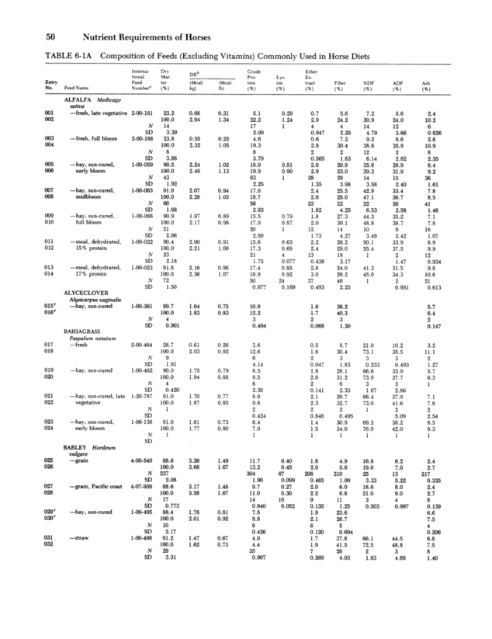
See Handout

Slide 5
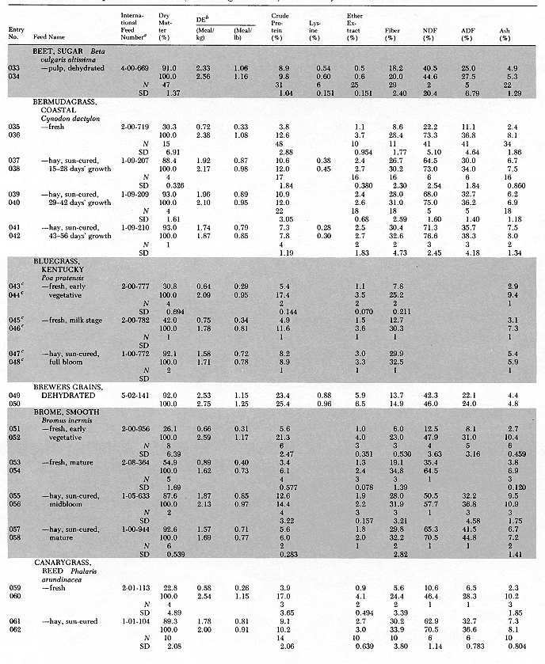
See Handout

Slide 6
Energy Requirements For Maintenance
What about horses that weigh over 600kg?
  The activity factor included in the previous equation appears to overestimate the energy needs for larger horses due to their reduced voluntary activity
Therefore:
DE(Mcal/d) = 1.82 + 0.0383W – 0.000015W²

Slide 7
Energy Requirements For Growth
Growth:
  Equation for Maintenance + Growth:
  DE(Mcal/d) = maintenance DE(Mcal/d) +
  (4.81 + 1.17X – 0.023X²)(ADG)
  X = age in months

Slide 8
Energy Requirements For Growth
Growth:
  Optimum growth rate and energy intake for:
    Productivity and longevity have not been established
  Some research has suggested that high intakes of soluble CHOs have been associated with:
    DOD (Developmental Orthopedic Disease)

Slide 9
Energy Requirements For Growth
Other research has stated that:
  Starch feeding can cause changes in:
    Serum insulin, thyroxin, and thiiodothryonine
    Can lead to retardation of cartilage maturation
  There are links between above-average weight gains and the onset of bone abnormalities
  Excessive force on bone tissue from heavy body weights can impair normal cartilage development

Slide 10
Energy Requirements For Growth
However, other research states that:
No orthopedic problems were discovered in rapidly growing foals
    Vitamins and minerals also play significant roles in proper skeletal development
    Environment and genetics may also play a role

Slide 11
Energy Requirements for Breeding Stallions
Generally considered to have higher maint. requirements than mares or geldings
Will depend on what?
  How many mounts per week
DE estimates to be 20% higher than maintenance

Slide 12
Energy Requirements For Reproduction
Breeding:
  The body condition score of mares at the time of breeding can influence what?
    Rate of conception
  Research states that:
    Thin mares gaining weight at the time of breeding were twice as likely to conceive as thin mares maintaining weight

Slide 13
Energy Requirements For Reproduction
Breeding:
  Mares in good to fat condition have:
    Higher conception rates even when losing or maintaining BW
    Thus, the dietary energy needs for reproduction depends on what?
      The body condition of the mare

Slide 14
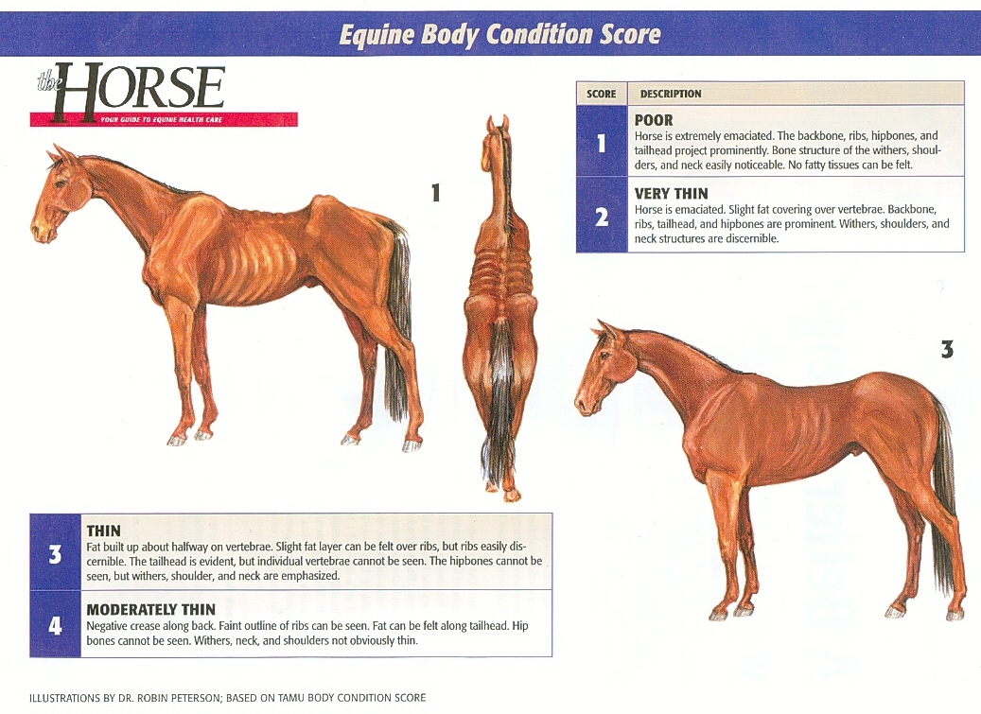

Slide 15
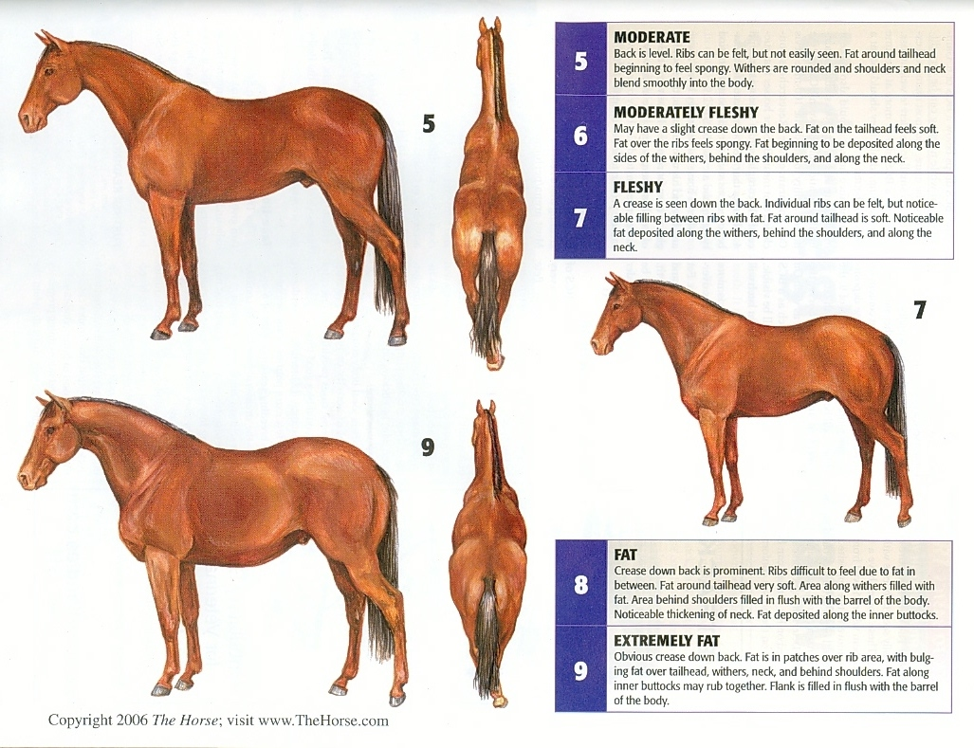

Slide 16
Energy Requirements For Reproduction
Breeding:
  QH mares at breeding time should have a minimum score of what?
    5
  ↑ energy intake 10 to 15 % above the requirement should cause:
    Weight gain

Slide 17
Energy Requirements For Reproduction
Gestation:
  DE requirements for fetal development are not greatly ↑ until:
    3rd trimester
  Estimates of DE in 9th, 10th, and 11th month are formulated by:
    Multiplying maintenance requirements by
    1.11, 1.13, and 1.20

Slide 18
Energy Requirements For Reproduction
Lactation:
  Depends on the composition and amount of milk being produced
  Mares of light breeds produce amounts of milk equivalent to
    3% BW (1-12 wks)
    2% BW (13-24 wks)
  DE increased needs during lactation:
    792 kcal of DE/kg of milk

Slide 19
Energy Requirements For Reproduction
How much alfalfa hay would a 900 lb lactating horse need to receive to satisfy her daily DE requirements (assume she is producing 3% of her BW in milk/d)? Also, what % BW in hay would she be receiving?
900lb / 2.2046 = 408kg
DE(Mcal/d) = 1.4 + 0.03W(408) = 13.64 Mcal
408 x .03 = 12.24 kg of milk produced
12.24kg x 792kcal = 9694 kcal
9694kcal = 9.6 Mcal/d
13.64 + 9.6 = 23.24Mcal/d
23.24/2.24=10.375 kg Alf hay/d
10.375 x 2.2046 = 22.87 lbs Alf hay/d
10.375/408kg = 2.5% BW/d

Slide 20
Energy Requirements for Work
What does DE for work depend on?
  Duration and intensity of exercise
    Duration is easy to measure
    What about intensity?
  What are factors that influence intensity of exercise?
    Speed of travel
    Ground resistance
    Incline
    Number and height of jumping efforts
    Performance of extended and collected gaits
    Amount of weight carried or pulled

Slide 21
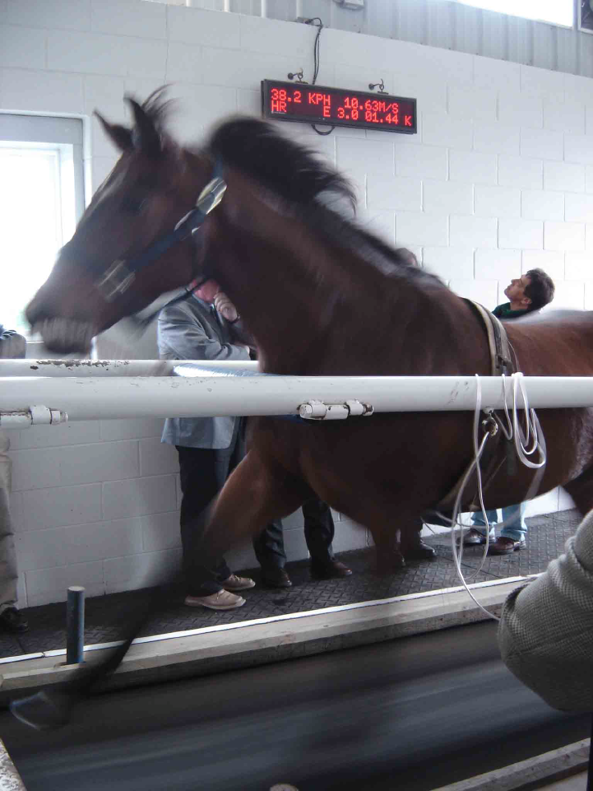
Energy Requirements for Work
So how do we measure energy expended during work?
  Often by O2 consumption
    Research shows a relationship between O2 consumption and speed of travel
    As the incline increases
      O2 needs increase

Slide 22
Energy Requirements for Work
What factors may cause differences in DE requirements for work?
  Individuals
  Level of training
  Type of exercise
  Rider weight and experience
  Climate
  Ground conditions

Slide 23
Energy Requirements for Work
So how do we calculate DE require. for work?
  Break level of work into 4 categories
    Light Work
    Moderate Work
    Heavy Work
    Very Heavy Work
These estimates are requirements above maintenance

Slide 24
Energy Requirements for Work
Light work:
  DE (Mcal/d) = (0.0333 x BW) x 1.20
Moderate work:
  DE (Mcal/d) = (0.0333 x BW) x 1.40
Heavy work:
  DE (Mcal/d) = (0.0333 x BW) x 1.60
Very Heavy work:
  DE (Mcal/d) = (0.0363 x BW) x 1.90

Slide 25
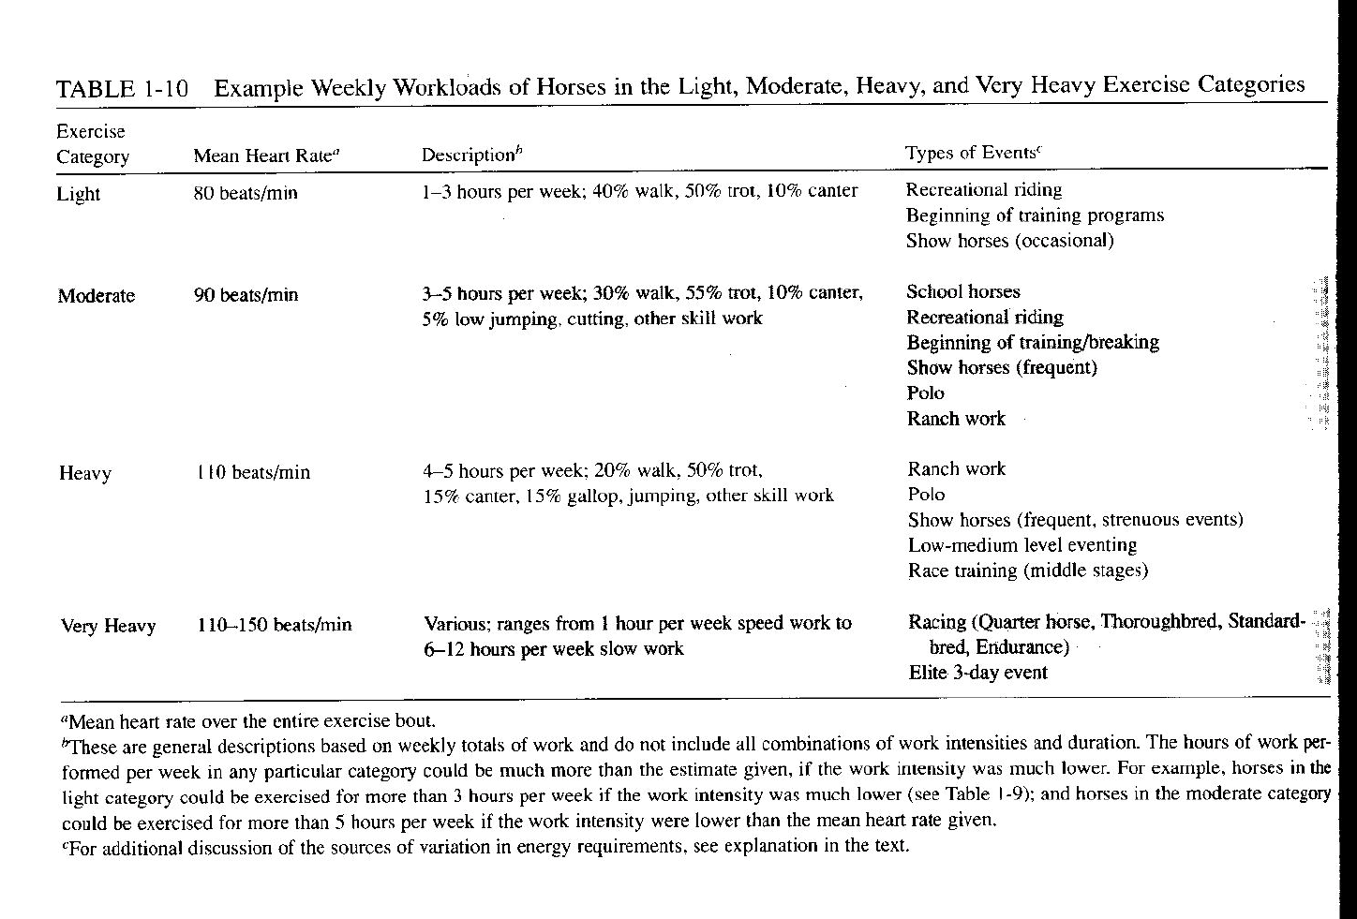
Energy Requirements for Work
So what’s the difference between all of them?

