Slide 1
Terms Related to Livestock Harvest

Slide 2
Objectives
Define anatomical terms important to livestock slaughter
Describe Market Readiness and the appropriate time to harvest each species

Slide 3
Types of Fat
Internal (Perinephric) – Fat around the kidneys and repro organs
Seam ( Intermusular) – Fat between muscles
External (Subcutaneous) – Fat underneath the skin
Marbling (Intramuscular) – fat within the muscle – improves flavor and tenderness

Slide 4
Types of Muscle
Red Fibers – Small diameter, continuous contraction (red meat)
White Fibers – Large diameter, rapid contraction (poultry)
Striated – Voluntarily controlled skeletal muscles
Non-Striated – Involuntary muscles (diaphragm, intestines)
Cardiac – Heart muscles

Slide 5
Bone and Connective Tissue
Bone – structure, support, protection, locomotion
Tendon – connect muscles to bone
Ligament – connect bone to bone
Bone ossification is used to determine the age of a carcass

Slide 6
Market Readiness
Market readiness describes the ideal time to harvest an animal determined by the meat packer’s and consumer’s preferences.

Slide 7
Hogs
Top prices currently offered for 240-260 lbs
Lean meat decreases with age, but dressing percent increases
Lean meat is desirable in hogs. Hogs are slaughtered before they become too large to handle easily

Slide 8
Lamb
Lean lamb is the most desirable.
98% of lamb grades as Choice or above
Lambs do not marble, they have fat streaks within muscle
Lamb fat has an undesirable flavor

Slide 9
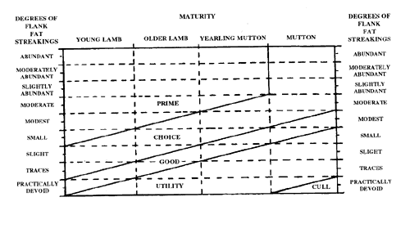
Lamb

Slide 10
Beef
Beef should be slaughtered before two years of age.
Older beef is less tender and less lean
Marbling is highly desirable in beef

Slide 11
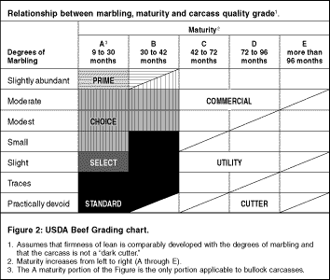
Beef

Slide 12
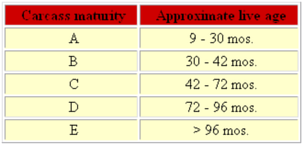
Beef Maturity

Slide 13
Chicken
Slaughtered at 6 weeks
All meat chickens are the same breed, therefore chicken is highly uniform in quality

Slide 14
Objectives
Define anatomical terms important to livestock slaughter
Describe Market Readiness and the appropriate time to harvest each species

Slide 15
Review
What are the color types of muscle?
What type (striated, non-striated, cardiac) do we eat?
Why are chickens uniform?
Why should lambs be lean?
What is the most desirable form of fat?
Should hogs be lean or fat?

Slide 16
Sources
http://www.extension.org/pages/Marketing_Slaughter_Hogs:_Where,_When_&_How#Marketing_Slaughter_Hogs:_Where.2C_How_.26_When
http://jas.fass.org/cgi/content/abstract/81/10/2448
http://www.vdacs.virginia.gov/livestock/lambcarcass.shtml
http://www.ag.ndsu.edu/pubs/ansci/beef/as1163-2.htm
http://www.thecattlesite.com/articles/751/beef-quality-and-yield-grades

