Slide 1
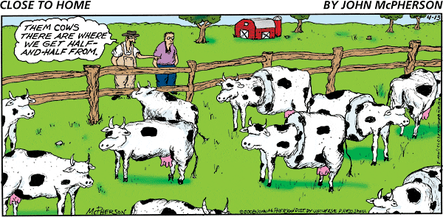
Sex-Linked Characteristics
PowerPoint presentation created by Dr. Kyle Stutts
Sam houston state university

Slide 2
Objectives
Students will be able to:
Comprehend how inheritance plays a role in sex-linked genes
Explain the difference between sex- linked, limited, and influenced inheritance
Compare the difference between simply-inherited and polygenic traits

Slide 3
Randomness of Inheritance
First off genetics are random in nature
Prior to Mendel’s findings, the most widely accepted thought involved a blending theory of inheritance
No way to predict the combination of genes in a gamete
Randomness of inheritance is critical from an evolutionary standpoint and important to the success of artificial selection

Slide 4
Inheritance
For a number of traits, gene expression differs in males and females
The causes fall under 3 categories:
Sex-Linked
Sex-Limited
Sex-Influenced

Slide 5
Sex-Linked Traits
The pattern of inheritance for genes located on sex chromosomes
Females- XX Males- XY
X and Y chromosomes are members of a pair, but are quite different from each other
- lacking corresponding regions of DNA
- Males are hemizygous
*having only one gene of a pair

Slide 6
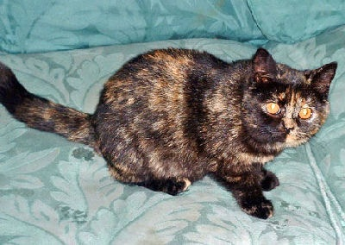
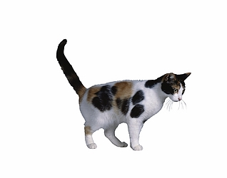
Sex-Linked Inheritance
Ex- Tortoise shell color in cats
- mixture of color that appears in patches
* orange, white, black, gray, tabby
* much white called calico
- always female (almost)
- Locus for orange color occurs on the X chromosome

Slide 7
Sex-Linked Inheritance
Females OO | Males Oo
OO = Orange | O = Orange
Oo = Tortoiseshell | o = non-orange
Oo = non- orange

Slide 8
Sex- Influence Inheritance
Modes of gene expression differ between males and females
An allele may be expressed as a dominant in one sex and a recessive in the other
Scurs on cattle is a sex-influenced inheritance
The allele for scurs is dominant in males and recessive in females
A male with one copy will be scurred, but a female must have 2 copies

Slide 9
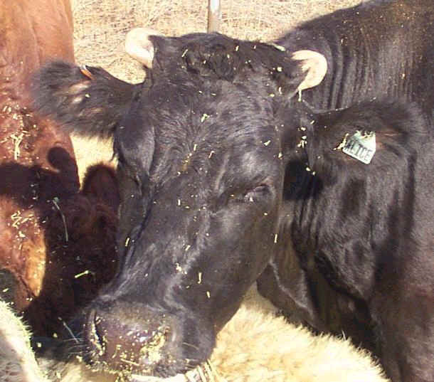
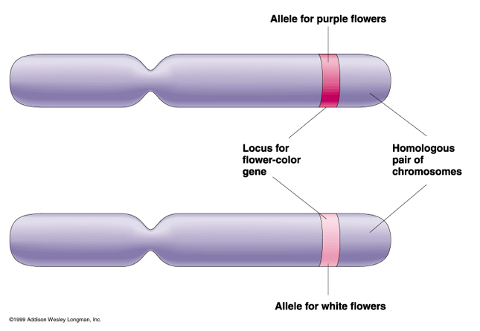

Slide 10
Sex-Limited inheritance
Phenotypic expression is limited to one sex
Ex. Milk production, and scrotal circumference
These genes are not necessarily on the sex chromosomes but are only expressed in the male or female
Thought to be hormonally conditioned

Slide 11
Traits
Simply- Inherited and Polygenic traits
Simply Inherited are traits that are affected by only a few genes
- Coat Color, Horns
Qualitative or categorical
- Either/ or expression
- Measured with numbers or continuous
- white- spotting in cats (1-9 numerical rating)
Typically affected very little by environment

Slide 12
Traits
Polygenic traits;
Affected by many genes with no gene having an occurring influence
-Growth rate, milk production, ribeye area
Typically quantitative or continuous in expression
- phenotypes are usually described by numbers
- weaning weights, milk yield, ribeye area
Greatly influenced by environment
- Lack of fed, Heat/cold stress

Slide 13
What is more important
Polygenic traits are more important
- Growth rate, fertility, milk production
- traits that determine productivity and profitability
But, Some markets are sensitive to simply- inherited traits
- Coat/feather color, Polled, Genetic defects are usually simply-inherited

