Slide 1
Selection and Judging of Swine
Objectives
Identifying Parts of a Live Hog
Select High-quality Breeding Stock
Correctly Place and Give Oral Reason for Placing a Ring of Four Market Hogs.

Slide 2
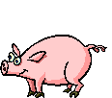

Parts of Live Hog

Slide 3
Ear neck shoulder back loin rump tail
Ham
Stifle
Hock
Rear leg
Dew Claw
Foot
eye face
Fore rib fore flank
Belly rear flank
Jowl front leg knee pastern Forearm

Slide 4
Selecting a Herd Boar
Factors to consider in selecting the herd boar
Reproductive soundness
Type and quality
Performance testing results
Pedigree
Health
Age
Show ring performance

Slide 5
Reproductive Soundness
Select a boar that has visibly sound reproductive organs.
The testicles should be well developed and of equal size.
Do not select boars that have umbilical or scrotal hernias.
Select boars that are aggressive and show a desire to mate.

Slide 6
Type and Quality
A boar that has traits of the meaty hog
Length, loin-eye area and back fat have high heritability
Look for soundness of feet and legs
Flat underline, trimness and muscling
Frame and body capacity

Slide 7
Performance Testing
Typically 2 or three from the same litter will be tested
Age at 230 pounds
Amount of back fat
Average daily gain
Feed efficiency
Carcass quality
Loin-eye area
Weaning weight

Slide 8
Pedigree
A pedigree shows the ancestry of the boar.
It can be helpful in determining the potential breeding value of the boar.
You can possibly check performance testing on close ancestors.

Slide 9
Health
You should check the health of the herd from where the boar comes.
Buy only healthy boars from healthy herds.
Boar should have a negative blood test for brucellosis, leptospirosis, and pseudorabies.
He should be vaccinated for erysipelas.
Should be free of external and internal parasites.

Slide 10
Age
Boars should not be used for breeding purposes before they are nine months of age.
Replacement boars should be bought 60 to 90 days before using.

Slide 11
Show Ring Performance
Carcass shows test approximately 50 head to see how growth and other traits are.
Performance shows identify lines that are producing good traits that are in demand in the meaty hog.

Slide 12
Selecting Gilts and Sows
Factors to be considered when selecting gilts and sows
Soundness
An animal that is sound is free from defects.
Gilts with small vulvas should not be kept.
Look for at least 6 good teats on each side.
Udder sections need to be well spaced.
Look for strong pasterns, sound feet and legs.
Cull sows that have problems farrowing.

Slide 13
Conformation
Have adequate length
Smooth muscling in the ham and shoulders
Select only for standards of meaty hogs
Gain
Goal is 230 lbs in 175 days or less
Obtain information on gain and feed efficiency of the breed

Slide 14
Litter size
Select gilts from large litters.
The ability of the sow to raise large litters is an indication of mothering ability.
Cull sows from small litters, that have difficulty farrowing or poor milking ability.
Health
Select only health gilts and sows.
Gilt should be tested for brucellosis, Leptospirosis, and pseudorabies.
Select replacement gilts from home herds.

Slide 15
Selecting Feeder Pigs
Factors to Consider When Buying Feeder Pigs are:
Health
Type
Size
Uniformity

Slide 16
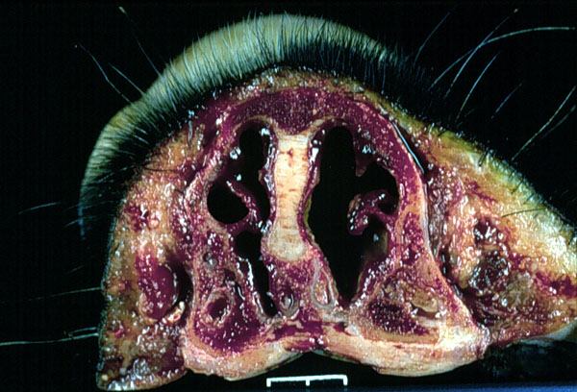
Health
A pig with atrophic rhinitis
Do not select pigs that have signs such as coughing, infected eyes, rough hair coats, pot bellies, gauntness, listless acting.
Pigs should be wormed, tail docked, and castrated.
Do not select if they show signs of external parasites.

Slide 17
More Factors
Type
Choose meaty type
Lengthy and not too fat
Uniformity
Choose pig uniform in age, size, condition and type.
When these traits are uniform, they will tend to reach market weight at the same time.
Size
Select feeder pigs from 35 to 80 lbs.
Select large pigs for their age.
Size for their age is more important than fat or condition.

Slide 18
Judging Hogs
You must know the parts of a live hog to judge a hog.
Look at them from a distance of about 15 feet.
Judge them as they walk around the ring.
Take notes for reference while judging.
Compare each hog with the ideal hog and with others in the class.

Slide 19
Judging Market Hogs
Look for these traits
Type
Muscling
Finish
Fill
Yield of lean cuts
Quality
Balance
Style
Smoothness

Slide 20
Type
Type refers to the conformation of the hogs body.
It is judged on the basis of length of side and skeletal size. (To estimate length, look the the distance from a point in the center of the ham to the forepart of the shoulder.) A two hundred pound hog should be 26 to 33 inches.
A meaty hog would be 29.5”.
A short hog is never considered a good meaty hog regardless of muscling, finish or balance.

Slide 21
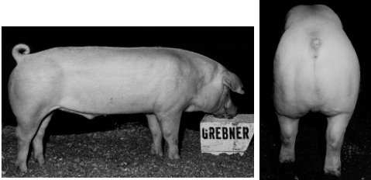
Muscling
Best observed by examining the hog from the rear.
The hog should show a wide back and loin and a deep rump.
Width must be due to muscling and not fat.
There is greater width in the ham and loin and not the back.

Slide 22
Finish
Refers to the amount of fat on the hog.
Is measured by the amount of backfat at three points on the top of the hog.
1. Over the shoulder (the first rib).
2. Over the loin (the last rib).
3. Over the rump.
The average backfat on a 230 lb. Hog ranges from .9 – 3.0”.
#1 hogs have less than 1/5”.
Visible signs of too much fat are: heavy, wasty jowl; Shaky middle; Square top; Looseness in the ham and crotch; Or a roll of fat over the shoulder.

Slide 23
Fill
Refers to the middle of the hog.
If the hog has too much middle, it has a lower dressing percentage.
The lean cuts will also be lower.
This lowers the value of the hog.

Slide 24
Yield of Lean Cuts
Important factor in the value of a market hog.
The wholesale cuts with a greater value are the ham (leg), loin, picnic shoulder. Boston shoulder, and bacon.
The meaty hog yields more than 40% of its liveweight in lean cuts.

Slide 25
Quality
Refers to the degree of refinement of the head, hair, and bone.
The head and bone should be moderate in refinement.
Hogs that are too coarse or too refined are not desirable.
The hair coat should be smooth.
The hide should be smooth and free of wrinkles.

Slide 26
Balance
Balance is how the body parts are proportioned.
All parts of the body should be in proportion to one another.
A well balanced hog will by tight framed.

Slide 27
Style
Style refers to how the hog appeals to the eye.
Balance influences style.
A tight framed hog that moves well, with the correct arch, has style.

Slide 28
Smoothness
Means possessing correct skeletal structure and a skin free of wrinkles.
The correct arch and a smooth shoulder are important points to look for.
Pigs with rough skins or roughness over the shoulder are undesirable.

Slide 29
Breeding Hogs
Breeding hogs should have the same body traits as market hogs.
In addition, the following points are used in judging.
1. Underline: The mammary development. A minimum of 6 teats per side. None inverted or scarred.
2. Breed character: Traits of the breed. Gilt should show femininity, boars, masculinity.
3. Soundness: The feet and legs are important. They must have good feet and legs. Legs should be strong and straight and should set out well on the corners of the hog.

Slide 30
Judging Terms for Market and Breeding Hogs
Longer, bigger framed
Typier, meatier
Longer and deeper in the ham
Higher Quality
Higher quality
Firmer, heavier muscled ham
Squarer rump
Thicker through the rump
Meatier and wider at the loin
More natural thickness down the top
Cleaner, trimmer along the loin edge.

Slide 31
More General Terms
Trimmer Jowl
Larger skeletal structure
Heavier Muscled
Trimmer Finish
Smoother
sounder on front legs
Heavier bone
Nicer turn over loin
Longer, more correct muscle structure
More correct turn over the top
Trimmer underline

Slide 32
Market Hog Terms
Longer, larger framed
Heavier muscled
Longer, stretchier side
Firmer Finished barrow
Smoother Side
More uniformed rump
Longer rump
Trimmer middled
More uniform arch
Typier, meatier barrow
Longer, deeper, fuller in the ham
Cleaner top
0ore correctly finished
More muscling over the top
Thicker loin
Trimmer in jowl and underline

Slide 33
Breeding Hog Terms
Sounder underline
Stands and walks more correctly
More evenly spaced nipples
Shows more femininity
Wider Fronted
Meatier gilt
roomier-middled gilt
Shows more size & scale
More desirable set to legs
Broodier
More breed character
Straighter front or hind legs
More rugged, heavier bone
Longer, deeper sides
Growthier
Deeper, wider sprung

Slide 34
Review Time
Please fill out your worksheets

Slide 35
Review Worksheet
1. Name three highly inherited traits in a hog.
2. Why is selection of a herd boar so important to the hog breeder?
3. Name three things that are very important in selecting a herd boar.
4. At what age should you start using a boar for breeding purposes?
5. What is a pedigree and why is it helpful when selecting a boar for your herd?
6. Name three traits that you should look for when selecting a replacement sow or gilt?

