Slide 1
Proper Handling and Facilities
Advanced Animal Science- Safety
Prepared by: Ben Black

Slide 2
Review
What is the difference between hazards and risks?
What are some reasons for childhood agriculture injuries?
What are some ways to prevent injuries?

Slide 3
Objectives
Identify appropriate handling procedures
Examine animal characteristics

Slide 4
Handling
Animals have difficulty judging distances
Animals sense their surroundings differently than humans.
Differences exist between the vision of cattle, swine, and horses.

Slide 5
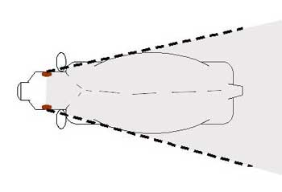
Handling
Ex) A quick movement behind cattle may “spook” them

Slide 6
Handling
Animals have extremely sensitive hearing.
Loud noises frighten animals.
This is why animals are often skittish and balky.

Slide 7
Handling
Watch for signs of aggressiveness
Warning signs include:
  Raised or pinned ears
  Raised tail or hair on the back
  Teeth showing
  Pawing the ground or snorting

Slide 8
General rules for working animals
Be calm and deliberate
Avoid quick movements or loud noises
Be patient
Gently touch animals rather than shoving or bumping them
Always have an escape route when working with animal in close quarters

Slide 9
Objectives
Identify appropriate handling procedures
Examine animal characteristics

Slide 10
Resources
AgriLife Extension- http://fcs.tamu.edu/health/healthhints/2009/dec/index.php#section5
California Agricultural Teachers’ Essential Guide to Safety- Page 98

Slide 11
Lab
Students will get into groups and will research basic information and draft and describe the facility that is to be developed.
Next class will start with presentations

