Slide 1
SUPERVISED AGRICULTURE EXPERIENCE
SAE

Slide 2
SAE POINTS
EACH STUDENT MUST COMPLETE A MINIMUM OF 110 HOURS TO GET CREDIT FOR AN AG SCIENCE CLASS
75 HOURS ARE AQUIRED DURING CLASS
35 HOURS MUST COME FROM OUTSIDE CLASS ACTIVITIES.

Slide 3
WHY HAVE AN SAE?
OBTAIN KNOWLEDGE IN ADDITION TO THAT LEARNED IN THE CLASSROOM.
PROGRESS TOWARD AN OCCUPATION
RECEIVE AWARDS AND RECOGNITION IN THE FFA
OPPORTUNITY TO PROGRESS TO AN OCCUPATION
EARN MONEY!!

Slide 4
HOW TO GET YOUR 35 OUTSIDE CLASS HOURS
HAVE AN ANIMAL PROJECT AND RECEIVE 20 POINTS AUTOMATICALLY
APPLIED ACTIVITIES – REPORTS ON THE TOPICS FROM THE UNIT OF INSTRUCTIONS FOR THE CLASS
PARTICIPATE IN FFA ACTIVITIES

Slide 5
POINTS FOR ACTIVITIES
1 POINT PER ACTIVITY – IF YOU BUILT A 5 STRAND BARBED WIRE FENCE ON SATURDAY, BREAK IT DOWN INTO SEVERAL ACTIVITIES SUCH AS DRIVING THE POSTS, FASTENING AND TIGHTENING THE WIRE, ETC. IF YOU WORK WITH YOUR ANIMAL BREAK IT DOWN TO WALKING, WEIGHING, GROOMING, WORMING, ETC.

Slide 6
POINTS FOR FFA ACTIVITIES
ATTENDING DISTRICT CONVENTION:
3 HOUR MAX
ATTENDING AREA CONVENTION:
6 HOUR MAX
ATTENDING STATE FFA CONVENTION:
20 HOUR MAX
LEADERSHIP CAMPS:
10/ CAMP WITH 20 HOUR MAX

Slide 7
FFA POINTS CONTINUED
TRAINING FOR CONTESTS: 20 POINTS MAXIMUM
COMPETING IN CONTEST 4 HOURS PER CONTEST – 20 HRS. MAX
LIVESTOCK SHOWS: 4 HOURS/SHOW WITH20 HOURS MAX

Slide 8
ADDITIONAL FFA POINTS
ONE HOUR MAY BE ADDED FOR EACH SPECIFIC ACTIVITY BEYOND JUST ATTENDING THE EVENT. FOR EXAMPLE: IF A STUDENT ATTENDS THE AREA CONVENTION, THAT IS WORTH 6 POINTS. IF THE STUDENT IS A VOTING DELEGATE, ADD ANOTHER POINT. IF THE STUDENT INTERVIEWS FOR A SCHOLARSHIP, ADD ANOTHER POINT.
THESE TWO ADDITIONAL ACTIVITIES ARE WRITTEN AS SEPARATE ENTRIES.

Slide 9
SUMMARY OF SAE REQUIREMENTS
EVERY STUDENT IS REQUIRED TO HAVE AN SAE
MINIMUM TOTAL OF POINTS REQUIRED IS 110
35 POINTS MUST COME FROM OUTSIDE CLASS ACTIVITIES.
BE CREATIVE AND HAVE FUN WITH YOUR SAE
BE ACTIVE IN THE FFA AND GET MANY MANY POINTS!!

Slide 10
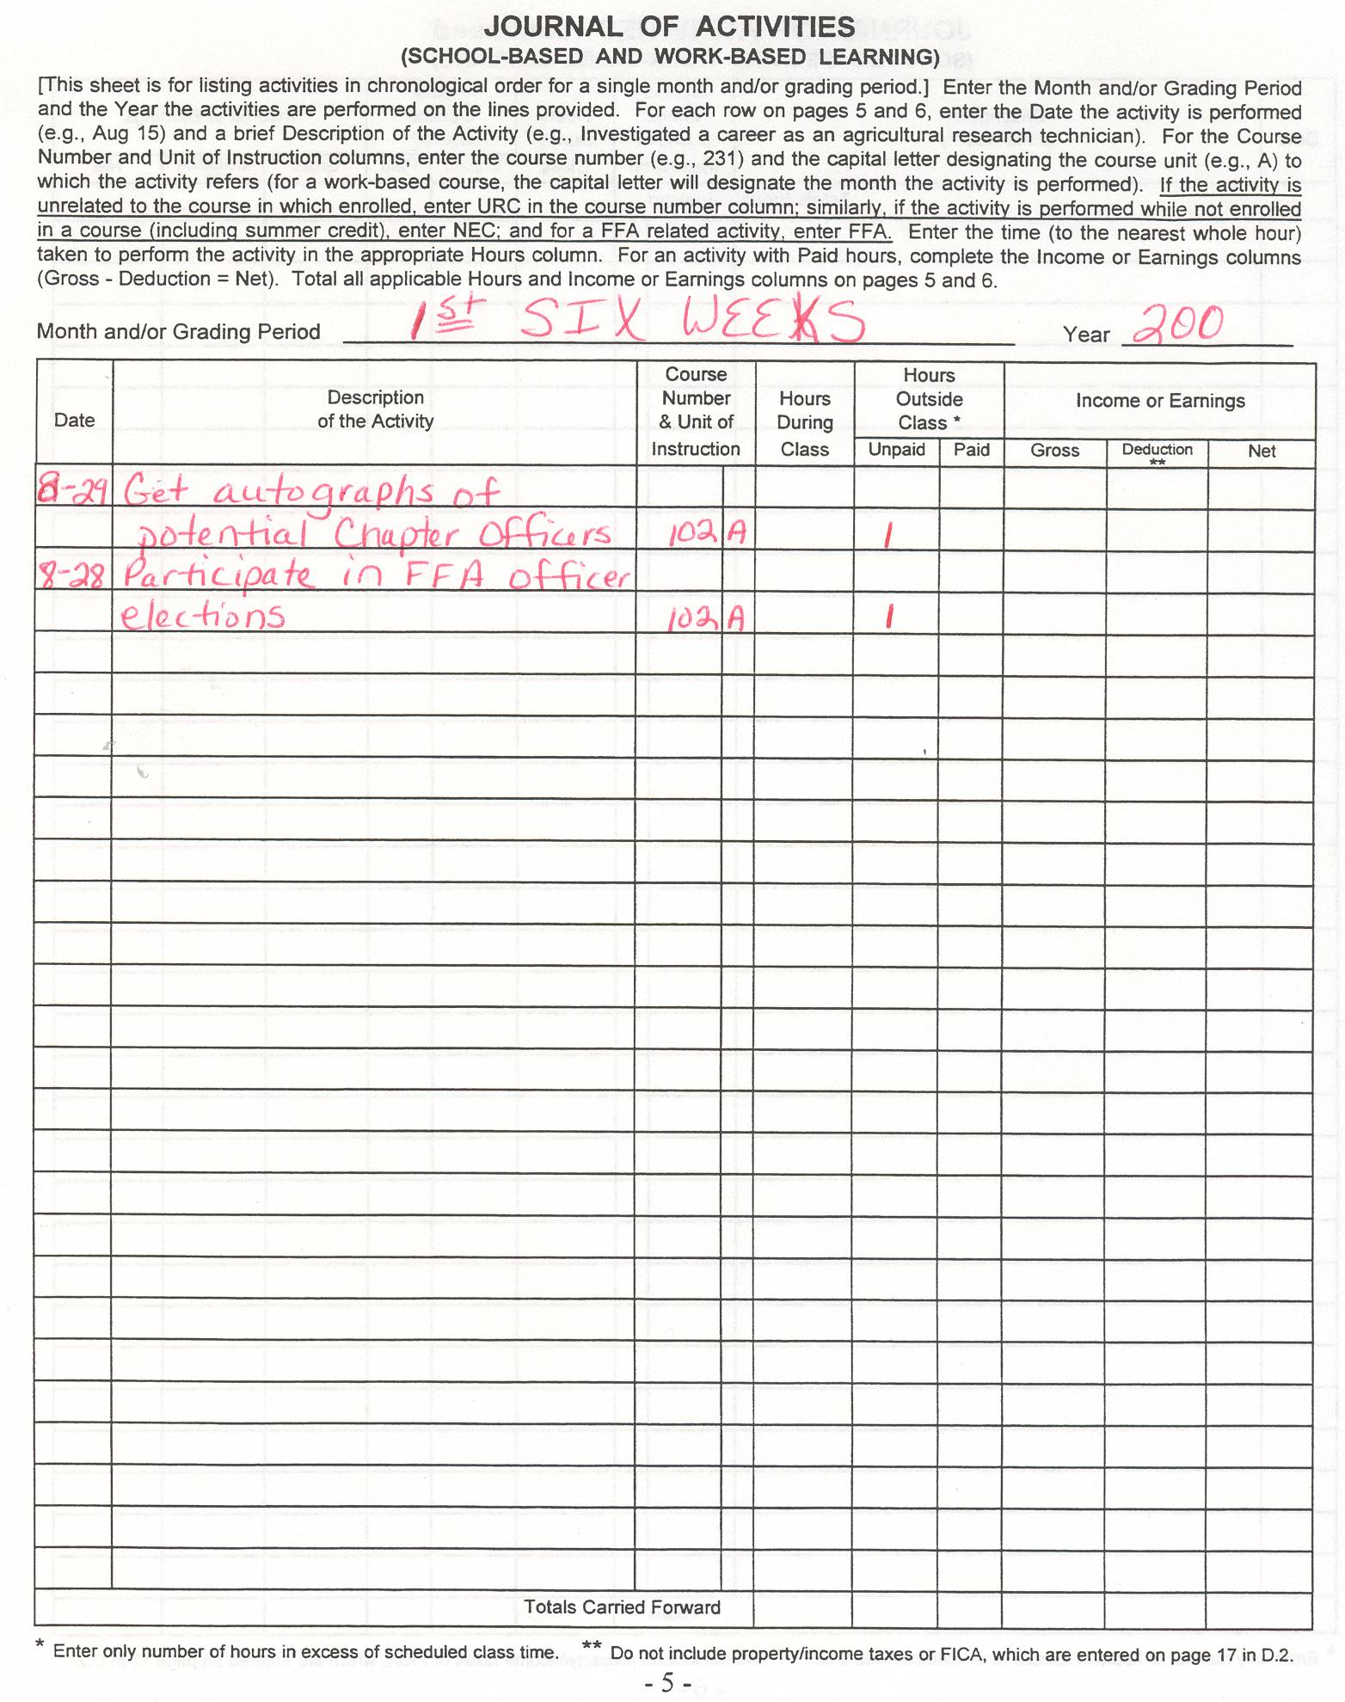

Slide 11
