Slide 1
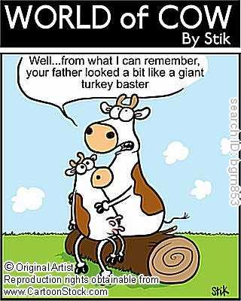
Reproductive cycles and how they relate to breeding systems

Slide 2
Objectives
Be able to Define terms used in A.I. and synchronization.
Be able to consider the different factors that coincide with different breeding processes
Identify the process of Synchronization

Slide 3
Terms you need to know
Gestation- Length of time from conception to birth
  Cows - 281 days
  Pigs- 114 days (3 months 3 weeks and 3 days)
  Horses- 336 days
  Sheep- 148 days
  Goats- 151 days

Slide 4
Terms Continued
Parturition- Birth
Ovary- Releases eggs and produces hormones
Estrogen-produced by the follicle in non pregnant female and placenta in late pregnancy, induces heat.
Progesterone-hormone that keeps female out of heat, relaxes uterus

Slide 5
More terms!
CIDR- Slowly releases progesterone until removed, the drop in progesterone triggers estrus and ovulation.
Synchronization- Using hormones to control when groups of normally cycling females come into heat.

Slide 6
female hormones:
The female hormones are:
FSH-Follicle Stimulating Hormone, causes the ovaries to produce estrogen
estrogen- causes the female to come into heat.
LH- cause the formation of the corpus luteum
progesterone- produce by the Corpus Luteum and is for the maintenance of pregnancy. Relaxes the uterus

Slide 7
Why do I synchronize?
Beef Cattle- A.I. becomes easier and more timely. In show cattle there is the ability to choose reputable sires or lower birthing weights for first calf heifers. Less time will be spent worrying when you cow will be coming into heat.

Slide 8
Synchronizing and A.I. vs. Natural breeding
Synchronizing and A.I. Pro’s
  Herd Uniformity
  Ability to pick and choose reputable sires
  Time spent on heat detection can be greatly shortened
  Synchronization Facilitates A.I. for Faster Genetic Improvement
  Greater Opportunity to Get More Females Pregnant During the Breeding Season

Slide 9
Synchronization Con’s
Classes and clinics are highly recommended to decrease the chance of fatal herd injuries.
Equipment costs more than natural breeding.
Person administrating drugs and semen must be very attentive of herd.

Slide 10
Natural breeding Pro’s
Growing market for all natural beef
Not as much hassle with all the hormones and heat detection
Easier for old timer farmers.

Slide 11
Natural breeding Con’s
Inability to obtain reputable sires from other ranches
No risk of large bulls mounting and hurting smaller heifers and cows
Calving and estrous is more of a gamble.

Slide 12
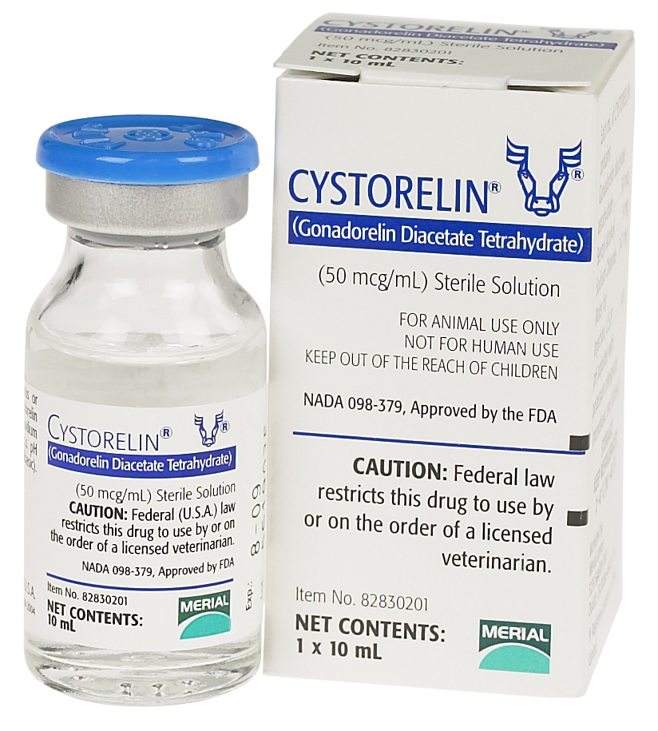
How do I synchronize?
Start off by injecting Cystorelin ( Artificial GnRH) which releases the oocyte

Slide 13
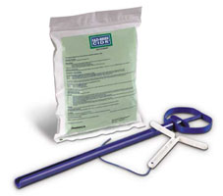
Insert CIDR

Slide 14
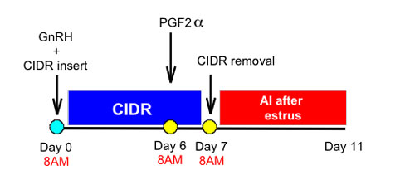
Remove CIDR 7 days later

Slide 15
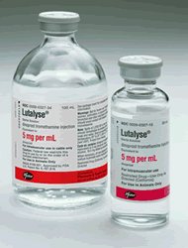
Inject Lutalyse (Starts Estrous synchronization process)

Slide 16
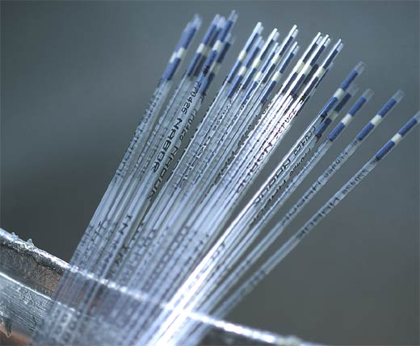
Administer Semen 60 Hours later

Slide 17

How can I start synchronizing
Start by attending an A.I./Palpation class
Many of the tools and equipment can also be aquired from this company.

Slide 18
