Slide 1
Protein Folding
By C. Kohn, Waterford, WI
Stolen and Edited by: Keith King

Slide 2
Objectives
Review central dogma of molecular biology.
Discuss type of protein.
Assess amino acids.

Slide 3
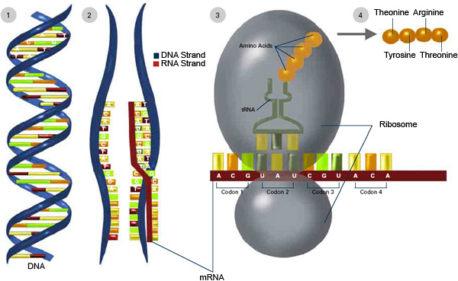
Review – Central Dogma of Molecular Biology
DNA is copied by mRNA in a 5 → 3 direction
mRNA is read in groups of three (codons) by a ribosome
Each codon codes for a specific amino acid
That particular amino
acid is delivered by
tRNA
A string of amino
acids creates a
peptide, and
peptides join to
form a protein.

Slide 4
So what’s next?
We left off with very little follow-up. You might wonder…
  How does a string of amino acids turn into a functional protein?
  How does a protein know what to do?
  How does a protein know what shape to take?
Proteins are the molecular machines of the body; each has a specific job to perform
  The job of each protein is largely determined by its 3-dimensional shape
  The shape a protein takes depends directly on what kind of amino acids are in that particular protein.

Slide 5
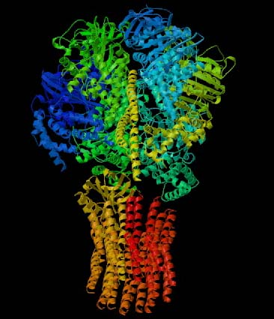
ATP Synthase

Slide 6
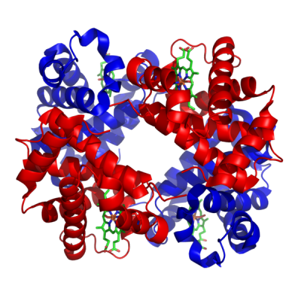
Hemoglobin

Slide 7
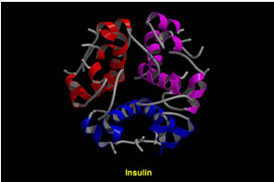
Insulin

Slide 8
Shape Determines Function
Again, the shape of a protein comes from its amino acids, and this shape determines its function.
  The amino acids that are used depends directly on the codons in mRNA copied from DNA.
Proteins are made from 20 amino acids
Each amino acid has a specific set of properties that help create the shape of the protein
  For example, some amino acids are negative charged
  Some are positively charged
  Some are neutral
  Some like water; some hate it
  Some really like other amino acids that are the same

Slide 9
Amino Acid Terminology
Amino acids can be written in a number of ways
The first amino acid discovered was asparagine
  This was because it was isolated from asparagus
We can just write ‘asp’ or even just the letter ‘N’
  Why N? Because we already used A for Alanine
  Each amino acid has its own one-letter code (just like each atomic element has a one- or two letter code; e.g. Oxygen is O, Carbon is C, Gold is Au)

Slide 10
Rules of Protein Folding
When amino acids are assembled in a line to make a protein, they do not stay in an even, straight line.
This is similar to a line at lunch sometimes…
  A couple might move closer to each other without leaving the line
  Two friends fighting might move away from each other
  That one kid who really likes pizza might move on one side of the line or the other
  That other kid who ate too much raw cookie dough might move to the side of the line with the trash can
    Everyone else would probably move to the opposite side!
So even though all of the students might stay in the same order, the line might twist and tangle its way through the cafeteria.
  It rarely, if ever, stays in an even straight line.

Slide 11
Amino Acids – the Teenagers of Molecules
Amino Acids are similar to teenagers.
Some amino acids are attracted to each other; others are repelled by each other
In general, there are a couple of factors that affect how amino acids shape the protein.

Slide 12
Amino Acid Charge
The first of these factors is charge
An amino acid can be negatively charged, positively charged, or neutral (no charge)
Opposite charges attract; a negative will move closer to a positive charge and form a bond
Similar charges repel each other; two positive charges will move away from each other
  Ditto for two negative charges

Slide 13
Amino Acid Hydrophobicity
Hydrophobicity is a long word that simply means whether or not a molecule is attracted to or repelled by water
  For example, oil is hydrophobic – it does not mix with water
  Salt is hydrophilic – it easily dissolves in water
  Hydrophobic – water hating (it has a ‘phobia’ of water)
  Hydrophilic – loves water (Philadelphia is the city of Brotherly Love)
Hydrophobic amino acids will move to the inside to get away from water
Hydrophilic amino acids will move to the outside to move towards water

Slide 14
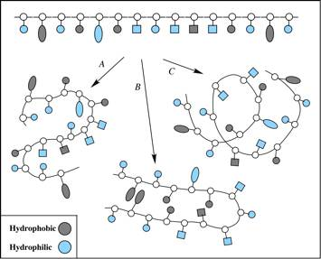

Slide 15
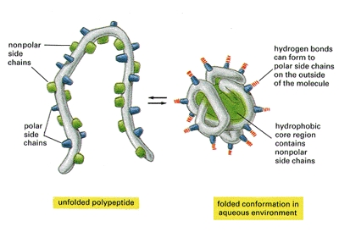

Slide 16
Cysteine Bonds
Cysteines are one of the 20 amino acids
Cysteines are like the obnoxious couples that are always together – they can’t stand to be apart
Two cysteines will always move closer to each other
When they move close, they will form what is called a “disulfide bond” or “disulfide bridge”

Slide 17
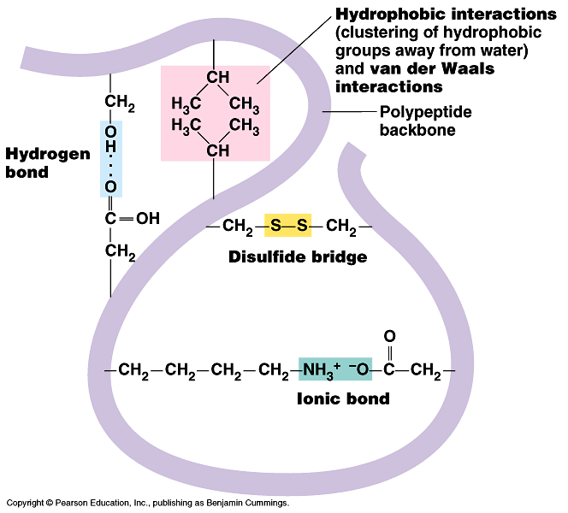

Slide 18
Summary
So, three major factors affect how amino acids change from a straight line to a 3D protein
  Charge – like charges repel, opposite charges attract
  Hydrophobicity – some amino acids are attracted to water and move to the outside; others are repelled by water and move to the inside
  Cysteine bonds – two cysteine amino acids will form a disulfide bond together

Slide 19
cys
-
-
-
+
Hydrophilic Amino Acids on the Outside
Hydrophobic Amino Acids on the Inside
-
Disulfide Bond between Cys
+
cys
Neg & Pos attraction

Slide 20
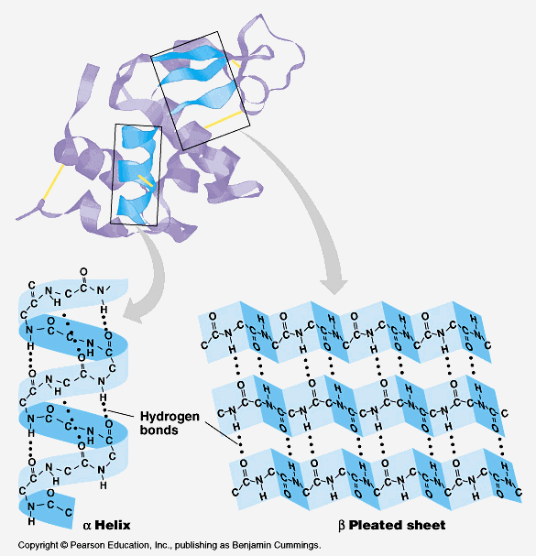
Shapes of Proteins
There are two kinds of shapes that can result because of the factors that affect protein shapes
  α helix (pronounced “alpha helix”)
  β sheet (pronounced “beta sheet”)

Slide 21
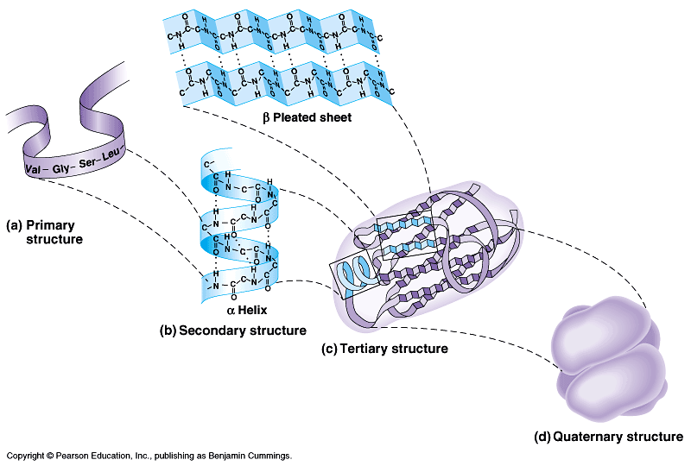
Levels of Protein
Organization
The primary level of protein
organization is the order of
amino acids as determined
by mRNA and DNA
The secondary level of protein organization is the shape created by these amino acids
  Only two shapes occur - α helix or β sheet
The tertiary level is the overall shape created by the entire string of amino acids
  This will be a mix of α helixes and β sheets
The final level, the quaternary level, is the mixture of proteins (subunits) to create a functional protein

Slide 23
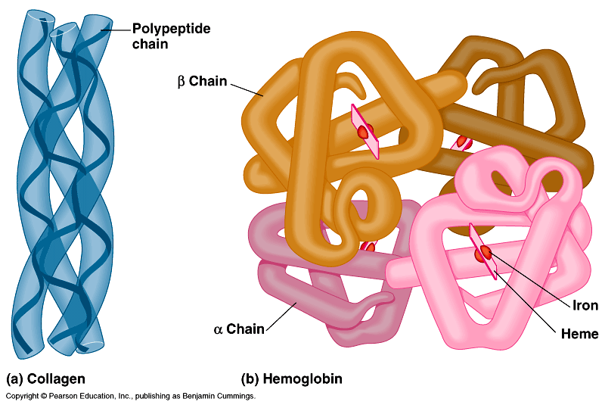

Slide 24
The Impact of Mutations
By C. Kohn, Waterford, WI

Slide 25
Mutations
Any change to the DNA is called a mutation
The effect of a mutation is usually harmful, but it can also be beneficial or even have no impact whatsoever
  Whether or not a mutation is helpful, harmful, or neither depends on how the protein created from that gene is affected.
Mutations are responsible for genetic diseases such as cancer and inheritable disorders.
While genetic mutations can be bad, they can also be good and are responsible for all of the diversity we see in living organisms
  Mutations drive both evolution by natural selection in nature as well as improvements by artificial selection in agriculture

Slide 26
Types of Mutations
Different types of mutations exist
Deletion mutations occur when a base is completely lost from DNA
  E.g. GATCTA might become GATTA
Insertion mutations occur when a base is added
  E.g. GATCTA might become GATACTA
Substitution mutations occur when one base is switched for another
  E.g. GATCTA might become TATCTA
If a mutation causes all of the bases downstream to change, it is called a Frameshift Mutation
  Deletion and Insertion mutations are frameshift mutations

Slide 27
Impact on Proteins
So how does a mutation affect a living organism?
First, a mutation may cause a dramatic change to the codons (groups of 3 bases)
For example, a deletion mutation in
5’-GAT-TAC-CTA-TAT-GGA-3’
would turn it into
5’-ATT-ACC-TAT-ATG-GA…3’
Entirely new amino acids would be added to make a protein because each codon was changed downstream of the mutation
  This again would be a frameshift mutation

Slide 28
Normal mRNA Strand
Arginine
Arg
C
G
A
U
C
G
A
U
C
G
A
U
Ser
Protein
Serine
Iso
Isoleucine
Asp
Asparagine

Slide 29
Mutated mRNA Strand (Frameshift)
Arginine
Arg
C
G
A
C
G
A
U
C
G
A
U
Arg
Arginine
Ser
Serine
-----

Slide 30
Impact of Mutations at Each Level
At the primary level of protein organization, the order of amino acids will change, and possibly most or all of the amino acids will be different
  This will cause a major shift in the shape of the protein
At the secondary level, the arrangement of α helixes and β sheets will be different
At the tertiary level, the final look of the protein subunit will be completely different
At the quaternary level, the protein will have a completely different shape and will not be able to perform its original function
  This can all happen because of one change in one base!

Slide 31
Objectives
Review central dogma of molecular biology.
Discuss type of protein.
Assess amino acids.

