Slide 1
Muscles used for meat

Slide 2
Objectives
Identify tender, intermediate, and tough muscles
List specific muscles in various steaks

Slide 3
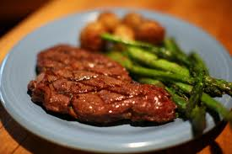
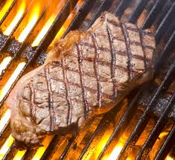
What steaks are the most tender?

Slide 5
Tender Muscles
Examples:
Psoas major-
Loin, on the back
Longissimus dorsi
Back, along backbone

Slide 6
Intermediate Muscles
Examples:
Biceps femoris
In the leg
Rectus femoris
In the leg

Slide 7
Tough Muscles
Examples:
Cutaneous trunci
Exterioir Abdominal
Trapezius
Connects the shoulder
and neck

Slide 8
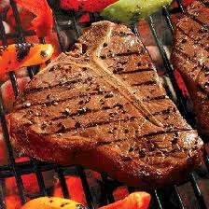
Porterhouse Steak
Muscles:
Psoas major
Longissimus dorsi
Gluteus medius
Multifidus dorsi

Slide 9
Sirloin Steak
Muscles:
Tensor fascia latae
Vastus lateralis
Biceps femoris
Gluteus medius
Psoas major
Vastus medialis
Rectusfemoris

Slide 10
Rib Steak
Muscles:
Multifidus dorsi
Spinalis dorsi
Longissimus dorsi
Longissimus costarum

Slide 11
Objectives
Identify tender, intermediate, and tough muscles
List specific muscles in various steaks

