Slide 1

Mitosis & Meiosis
Yvonne Norman
Edited By: Ms. Ethridge, Ms. Myers, Ms. Milstead, and Ms. Palermo

Slide 2
Objectives
Define mitosis.
Define meiosis.
Analyze function of mitosis and meiosis in cell differentiation.

Slide 3
Mitosis:
If a cell wants to make a duplicate of itself, it first must copy its DNA (part of a chromosome).
The copies then must be separated & sorted into two sides of the cell.
The cell then splits in two. Part of each parent is carried to the two new cells.
Results in cells such as internal organs, skin, bones, blood, etc.

Slide 4
Meiosis:
As in mitosis, if a cell wants to make a duplicate of itself, it first must copy its DNA (part of a chromosome).
Results in reproductive cells (sperm, eggs, etc).
Part of each parent is carried to the four new cells.
Meiosis has evolved to solve a problem.
The problem is this: some organisms mate with other organisms – that is, they combine their genes together (creating genetic diversity).
Why would this be a problem?

Slide 5
Use this to remember these terms:
MITosis takes the cell and Makes It Two (diploid)
Meiosis has to do with sexual reproduction
From the cell’s point of view:
  mITosis results in Identical Twins
  mEioSis results in Egg and Sperm (haploid)
  Clyde Freeman Herreid – Dept. of Biological Sciences: Buffalo State Univ. of New York

Slide 6
Mitosis: Meiosis:
Each resulting cell still has chromosomes from mom & dad
Notes:
Explain the randomness in meiosis
End of first class

Slide 7
Mitosis
Mitosis animations:
http://www.youtube.com/watch?v=2WwIKdyBN_s&feature=related
http://www.youtube.com/watch?v=VlN7K1-9QB0
Notes:
Beginning of second class

Slide 8
Vocabulary
Diploid
Haploid
Interphase
Prophase
Metaphase
Anaphase
Telophase
Cytokinesis

Slide 9
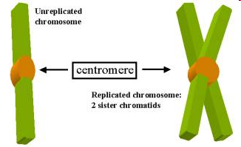
Interphase occurs just before Mitosis begins:
DNA is replicated along with organelles and other cellular components and the cell prepares for division.
http://www.bioweb.uncc.edu/1110Lab/notes/notes1/lab6.htm

Slide 10
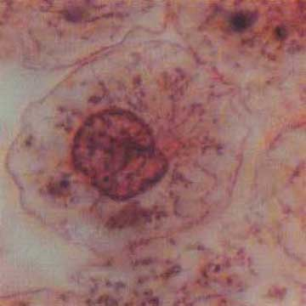
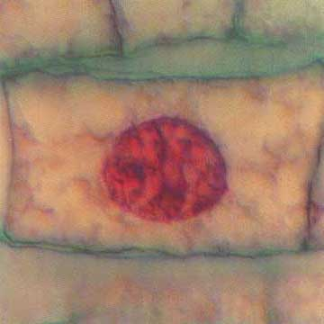
Mitosis Interphase
Animal cell
Plant cell
Photographs from: http://www.bioweb.uncc.edu/biol1110/Stages.htm

Slide 11
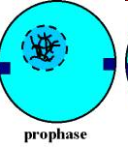
1st step in Mitosis:
Prophase (preparation phase)
The DNA recoils, and the chromosomes condense; the nuclear membrane disappears, and the mitotic spindles begin to form.
http://www.bioweb.uncc.edu/1110Lab/notes/notes1/lab6.htm

Slide 12
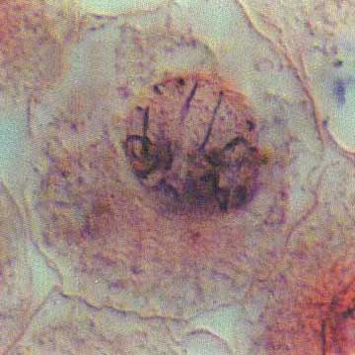
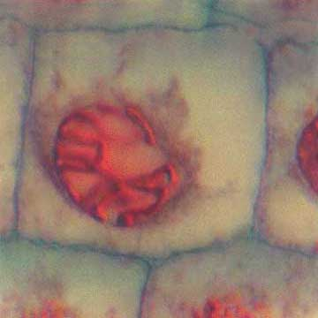
Mitosis Prophase
Animal cell
Plant cell
Photographs from: http://www.bioweb.uncc.edu/biol1110/Stages.htm

Slide 13
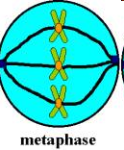
2nd step in Mitosis: metaphase (organizational phase)
The chromosomes line up the middle of the cell with the help of spindle fibers attached to the centromere of each replicated chromosome.
http://www.bioweb.uncc.edu/1110Lab/notes/notes1/lab6.htm

Slide 14
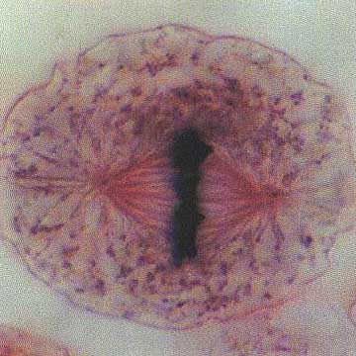
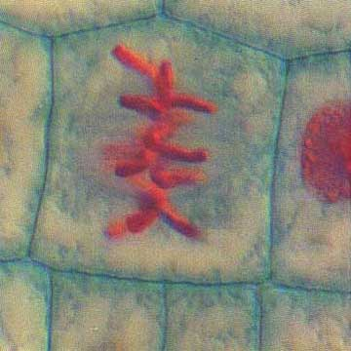
Mitosis Metaphase
Animal cell
Plant cell
Photographs from: http://www.bioweb.uncc.edu/biol1110/Stages.htm

Slide 15
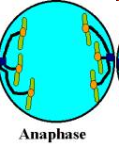
3rd step in Mitosis:
Anaphase (separation phase)
The chromosomes split in the middle and the sister chromatids are pulled by the spindle fibers to opposite poles of the cell.
http://www.bioweb.uncc.edu/1110Lab/notes/notes1/lab6.htm

Slide 16
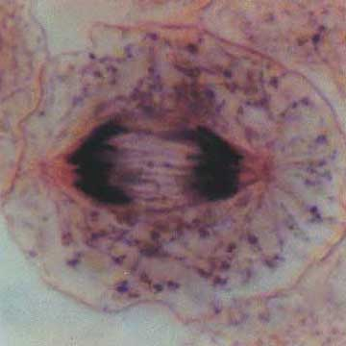
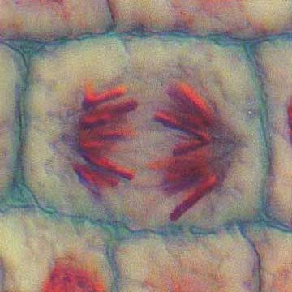
Mitosis Anaphase
Animal cell
Plant cell
Photographs from: http://www.bioweb.uncc.edu/biol1110/Stages.htm

Slide 17
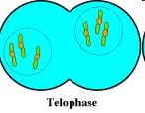
4th step in Mitosis:
Telophase
The chromosomes, along with the cytoplasm and its organelles and membranes are divided into 2 portions. This diagram shows the end of telophase.
http://www.bioweb.uncc.edu/1110Lab/notes/notes1/lab6.htm

Slide 18
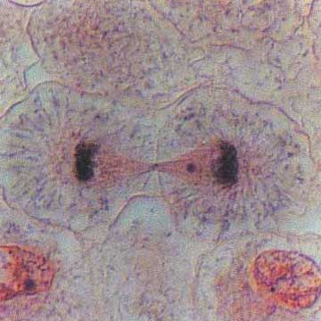
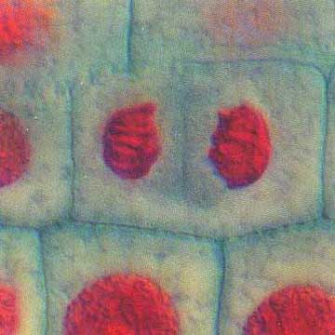
Mitosis Telophase
Animal cell
Plant cell
Photographs from: http://www.bioweb.uncc.edu/biol1110/Stages.htm

Slide 19
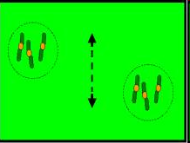
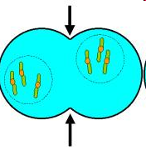
After Mitosis:
Cytokinesis
Beginning of cytokinesis in a plant:
The actual splitting of the daughter cells into two separate cells is called cytokinesis and occurs differently in both plant and animal cells.
Beginning of cytokinesis in an animal:
http://www.bioweb.uncc.edu/1110Lab/notes/notes1/lab6.htm

Slide 20
REMEMBER!
Interphase
Prophase
Metaphase
Anaphase
Telophase
Cytokinesis
IPMATC
I Pray More At The Church
Julie Camp’s mitosis power point - http://sciencespot.net/Pages/classbio.html#Anchor-mitosis
Notes:
20
A mnemonic to help remember the stages of mitosis.
Now do the mitosis flip books
End of second class

Slide 21
Meiosis
Meiosis animation:
http://www.youtube.com/watch?v=D1_-mQS_FZ0&NR=1
Notes:
Beginning of third class

Slide 22
Vocabulary
Diploid
Haploid
Germ cell
Somatic cell
Interphase
Prophase
Metaphase
Anaphase
Telophase
Cytokinesis

Slide 23
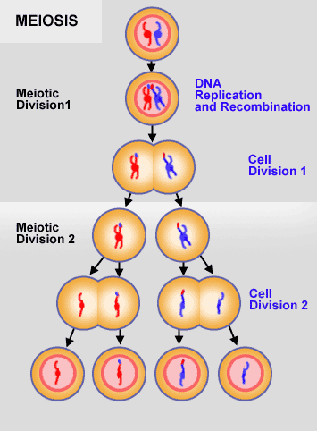

Slide 24
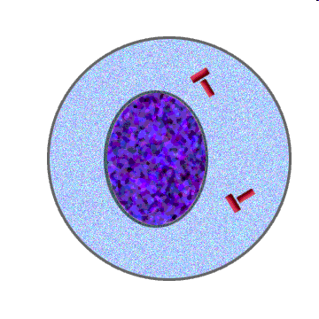
Meiosis Interphase
Meiosis is preceded by interphase. The chromosomes have not yet condensed.
http://morgan.rutgers.edu/MorganWebFrames/Level1/Page7/meiosis1.html

Slide 25
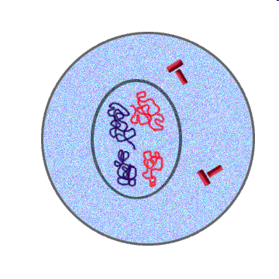
Meiosis Interphase
The chromosomes have replicated, and the chromatin begins to condense.
http://morgan.rutgers.edu/MorganWebFrames/Level1/Page7/meiosis1.html

Slide 26
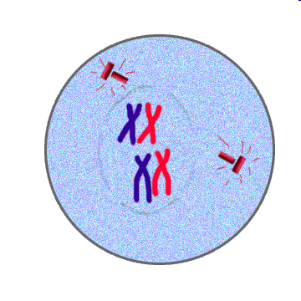
Meiosis Prophase I
The chromosomes are completely condensed. In meiosis (unlike mitosis), the homologous chromosomes pair with one another
http://morgan.rutgers.edu/MorganWebFrames/Level1/Page7/meiosis1.html

Slide 27
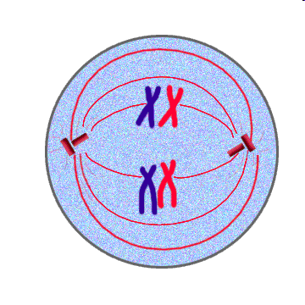
Meiosis Metaphase I
The nuclear membrane dissolves and the homologous chromosomes attach to the spindle fibers. They are preparing to go to opposite poles.
http://morgan.rutgers.edu/MorganWebFrames/Level1/Page7/meiosis1.html

Slide 28
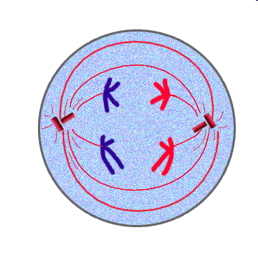
Meiosis Anaphase I
The chromosomes move to opposite ends of the cell.
http://morgan.rutgers.edu/MorganWebFrames/Level1/Page7/meiosis1.html

Slide 29
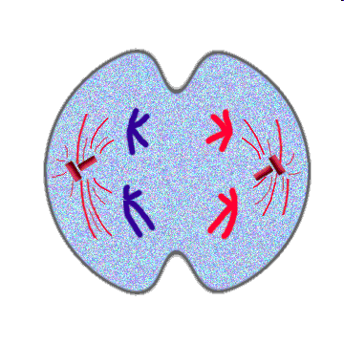
Meiosis Telophase I & Cytokinesis
The cell begins to divide into two daughter cells. It is important to understand that each daughter cell can get any combination of maternal and paternal chromosomes.
http://morgan.rutgers.edu/MorganWebFrames/Level1/Page7/meiosis1.html

Slide 30
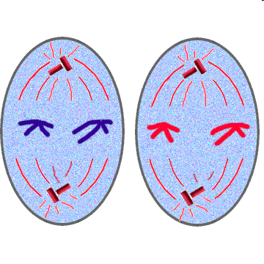
Meiosis Prophase II
The cell has divided into two daughter cells.
http://morgan.rutgers.edu/MorganWebFrames/Level1/Page7/meiosis1.html

Slide 31
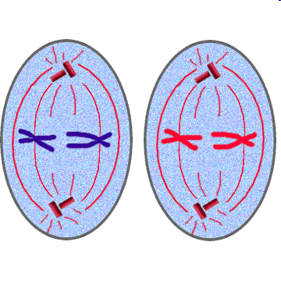
Meiosis Metaphase II
As in Meiosis I, the chromosomes line up on the spindle fibers.
http://morgan.rutgers.edu/MorganWebFrames/Level1/Page7/meiosis1.html

Slide 32
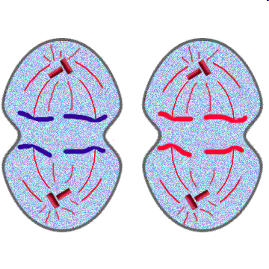
Meiosis Anaphase II
The two cells each begin to divide. As in Meiosis I, the chromosomes move to opposite ends of each cell.
http://morgan.rutgers.edu/MorganWebFrames/Level1/Page7/meiosis1.html

Slide 33
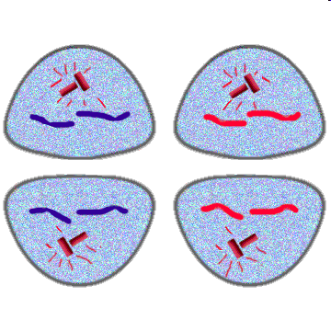
Telophase II & Cytokinesis
With the formation of four cells, meiosis is over. Each of these prospective germ cells carries half the number of chromosomes of somatic cells.
http://morgan.rutgers.edu/MorganWebFrames/Level1/Page7/meiosis1.html

Slide 34
Review of Objectives
Define mitosis.
Define meiosis.
Analyze function of mitosis and meiosis in cell differentiation.

Slide 35
Yvonne Norman
G410 (Life Sciences for Middle School Educators)
Senior – Portland State University
February 2009
Edited by: Ashlee Palermo
Sam Houston State University
Spring 2012

