Slide 1
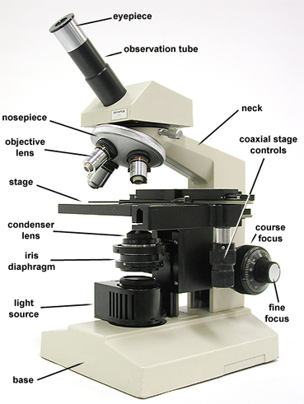
THE MICROSCOPE
http://biology.unm.edu/ccouncil/Biology_203/Summaries/Microscopes.htm

Slide 2
How To Use a Microscope
1. When moving your microscope, always carry it with both hands. Grasp the arm with one hand and place the other hand under the base for support.
2. Turn the revolving nosepiece so that the lowest power objective lens is clicked into position (This is the shortest objective lens).
3. Your microscope slide should be prepared with a coverslip over the specimen. This will help protect the objective lenses if they touch the slide. Place the microscope slide on the stage and fasten it with the stage clips.
4. Look at the objective lens and the stage from the side and turn the coarse focus knob so that the stage moves upward. Move it as far as it will go without touching the slide!

Slide 3
5. Look through the eyepiece and adjust the illuminator and diaphragm for the correct amount of light necessary for your test.
6. Slowly turn the coarse adjustment so that the objective lens goes up (away from the slide). Continue until the image comes into focus. Use the fine adjustment for fine focusing.
7. Move the microscope slide around so that the image is in the center of the field of view and readjust the mirror, illuminator or diaphragm for the clearest image.
8. Now, you should be able to change to the next objective lenses with only minimal use of the fine adjustment. Do not allow the objective lens to touch the slide!

Slide 4
9. The proper way to use a microscope is to look through the eyepiece with both eyes open to help avoid eye strain.
Remember, everything is upside down and backwards. When you move the slide to the right, the image goes to the left!
10. When finished, click the low power lens into position, lower the stage (or raise the tube), and remove the slide.
11. Do not touch the glass part of the lenses with your fingers. Use only special lens paper to clean the lenses. Clean after every use.
http://www.microscope-microscope.org/basic/how-to-use-a-microscope.htm

