Slide 1
Marketing Livestock and Poultry

Slide 2
Objectives
Describe the methods used to market livestock and poultry
Compare methods of marketing livestock.
Critique methods of marketing livestock.
Create a method of marketing livestock.

Slide 3
Marketing
Marketing is an important aspect of any livestock system.
Definition: producers exchange livestock and products for cash.

Slide 4
Price Determination and Discovery
Price Determination
is the broad forces of supply and demand establishing a market clearing price for a commodity.
Price Discovery
is the process by which buyers and sellers arrive a a specific price for a given lot of produce at a given location for a specific time period.
Notes:
Reading Assignment
Understanding Livestock Pricing Issues

Slide 5
Livestock Marketing Decisions
What to sell
Live, carcass, grid
Where to sell
Type of market
Location
When to sell
Weight, grade, costs

Slide 6
Price Discovery
A human process, subject to relative bargaining power of the buyer and seller.
Two stage process
Evaluate S&D and Pe
Estimate the price for the specific trade.

Slide 7
Methods of Marketing
Terminal Markets
Central markets on public stockyards
Livestock are consigned to a commission firm to bargain with buyers for a certain fee

Slide 8
Methods of Marketing
Auction Markets
Public bidding
Sell to the buyer that bids the highest

Slide 9
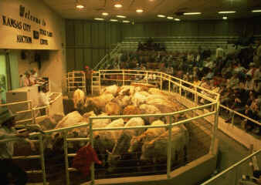
Auction Block

Slide 10
Methods of Marketing
Direct selling
No middle person
Producer sells straight to the buyer
No commission or fees

Slide 11
Methods of Marketing
Electronic marketing
auctioning on-line using computers
Futures marketing and hedging
legal document
calls for the delivery in the future
prices are locked in to a futures price

Slide 12
Vertical Integration
Definition
Two or more steps of production, marketing and processing are linked together usually by a contract between the producer and feed manufactures or between producers and processors including all three

Slide 13
Vertical Integration
Holly Farms, Case, Purdue
Poultry Farmer or producer
Grain producer
Hatchery

Slide 14
Vertical Integration
About 99% of all broilers and a very high percentage of turkeys, laying hens and swine are grown and marketed through vertical integration contracts

Slide 15
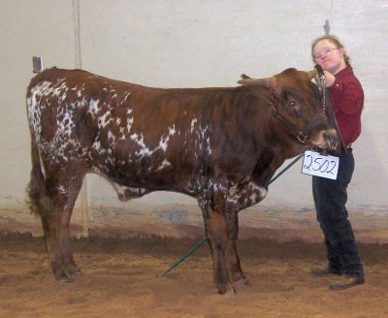
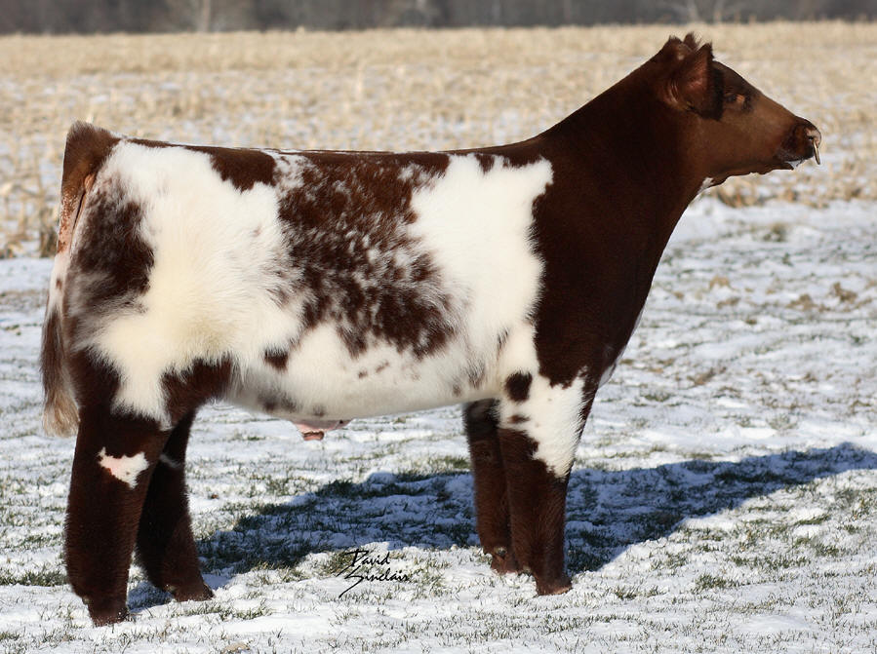
Which would you prefer?

Slide 16
Review!
Describe the methods used to market livestock and poultry
Compare methods of marketing livestock.
Critique methods of marketing livestock.
Create a method of marketing livestock.

Slide 17
Student Work
Now you will research different methods of marketing
Then you will create your own marketing plan for your livestock herd

