Slide 1

Judging Meat Goats
Principals of Agriculture, Food, and Natural Resources
Made By: Mr. Michael Baca
Edited By: Charolette Atkinson

Slide 2
Objective
Discuss and Identify techniques of judging meat goats.

Slide 3
Steps to Judging Meat Goats
Slide 1
1. Evaluate goats from the ground up and from the rump (rear) forward
2. Rank the traits for their importance
3. Evaluate the most important traits first
4. Eliminate any easy placings in the class
5. Place the class based on the volume of the important traits

Slide 4
Ranking of Traits for Meat Goats
Slide 2
1. Degree of muscling
2. Structural correctness
3. Degree of finish (fat cover)
4. Capacity
5. Balance
6. Style
7. Freshness

Slide 5
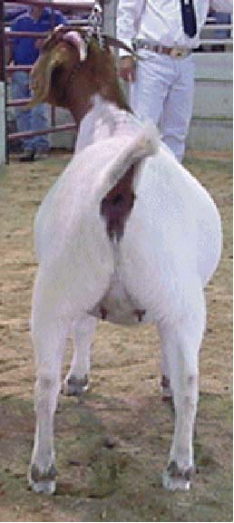
Evaluating Degree of Muscling
Slide 3
Degree of muscling in meat goats is best determined by evaluating:
1. Thickness through the center of the leg
2. Width between rear feet when the goat stands or walks
3. Width, thickness, and length of the loin

Slide 6
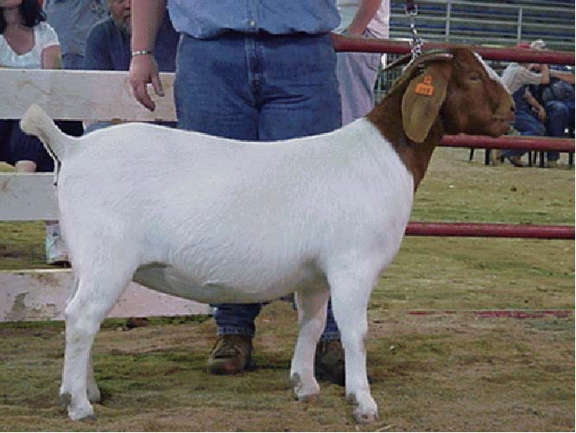
Evaluating Degree of Muscling
Slide 4
Also compare length of hind saddle to that of front saddle
Hind Saddle
Front Saddle
Hind saddle should be at least as long as front saddle

Slide 7
Evaluating Degree of Muscling
Slide 5
Thick
Average
Average
Thin

Slide 8
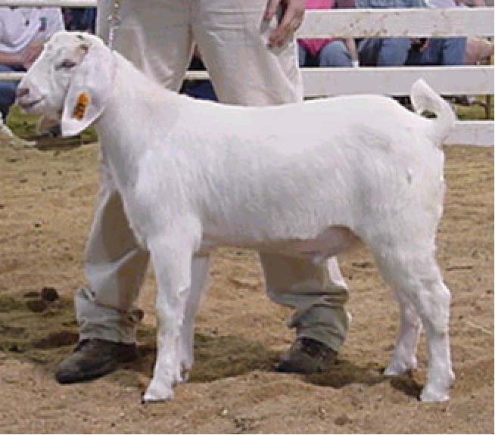
Evaluating Structural Correctness
Slide 6
Level topped
Excellent Structure
160 degree hock angle
Straight knee
Strong pasterns

Slide 9
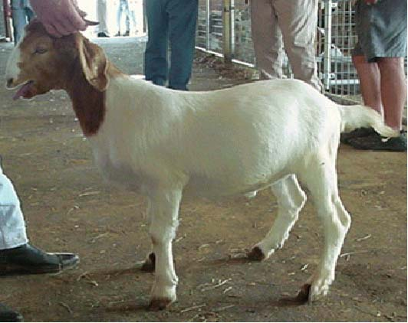
Evaluating Finish
Slide 7
Meat goats should be trim and lean, but should also have bloom.
Trim with bloom
Lean, but unthrifty

Slide 10
Evaluating Capacity
Slide 8
Capacity in meat goats refers to the combined volume of:
1. Body width (open rib shape, base width)
2. Body depth
3. Body length

Slide 11
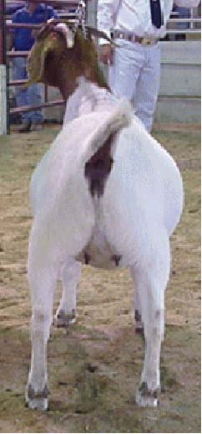
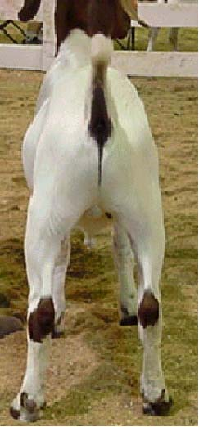
Evaluating Capacity
Slide 9
Wide and open ribbed
Narrow width (flat ribbed)

Slide 12
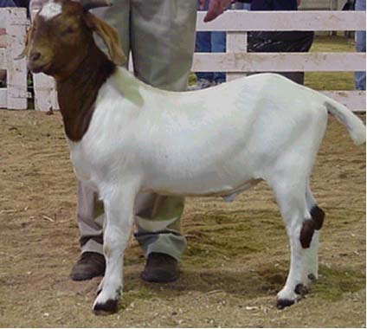
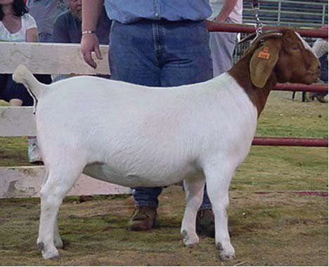
Evaluating Capacity
Slide 10
Shallow Bodied
Deep Bodied

Slide 13
Evaluating Capacity
Slide 11
Short Bodied
Long Bodied

Slide 14
Evaluating Balance
Slide 12
Balance in meat goats refers to having the correct proportions of:
1. Body width
2. Body depth
3. Body length

Slide 15
Evaluating Balance
Slide 13
Unbalanced Alert
Narrow body width
Shallow body depth
Short bodied

Slide 16
Evaluating Balance
Slide 14
Nicely
Balanced
Good body width
Good depth of body
Good length of body

Slide 17
Evaluating Style
Slide 15
A meat goat with style will exhibit the following:
1. A long, level top line
2. A long neck that sits high on the shoulders
3. A clean breast
4. A smooth, neat shoulder that blends smoothly from the neck to fore rib

Slide 18
Evaluating Style
Slide 16
Excellent Style
Long, level top line
Long neck sitting high on the shoulders
Clean breast
Smooth shoulder blending nicely from neck to foreribs

Slide 19
Evaluating Freshness
Slide 17
Freshness in meat goats refers to having:
1. An appearance of being healthy (not unthrifty)
2. A smooth, slick haircoat

Slide 20
Evaluating Freshness
Slide 18
I’m not
very fresh appearing

Slide 21
Evaluating Freshness
Slide 19
Fresh is
my middle name

Slide 22
Example Meat Goat Judging Class
Slide 20

Slide 23
Slide 21
1
2
3
4
Official Placing: 1 - 2 - 3 - 4
Cuts: 2 - 4 - 6

Slide 24
Objectives
Discuss and Identify techniques of judging meat goats.

