Slide 1
Genetics and Heredity
Predicting Genotypes and Phenotypes using the Punnett Square

Slide 2
Objective
Recognize genotypes and phenotypes and predict genetic outcomes of an animal through use of the Punnett Square.

Slide 3
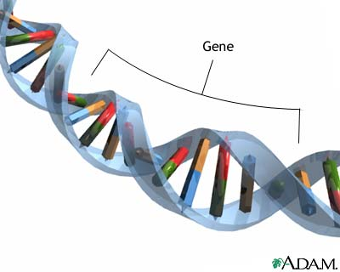
Gene
The basic physical unit of heredity
Taken from: www.topnews.in

Slide 4
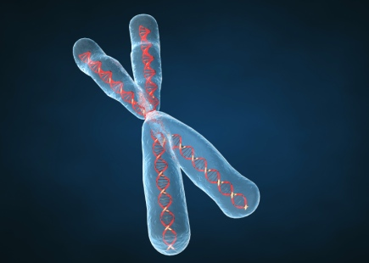
Chromosomes
Long strands of DNA and associated proteins present in the nucleus of every cell
Taken from: www.wmworia.wordpress.com

Slide 5
Locus
The specific location of a gene on a chromosome.

Slide 6
Allele
Any of the possible forms in which a gene for a specific trait can occur.
Ex: A, a

Slide 7
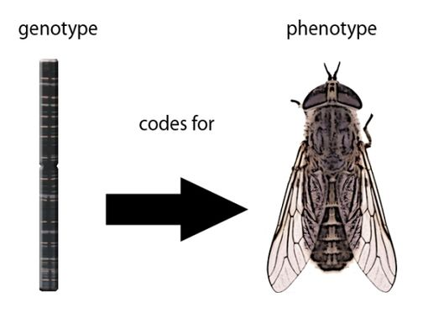
Genotype
The genetic constitution of an organism.
Determines the phenotype.
www.biotechlearn.org.nz

Slide 8
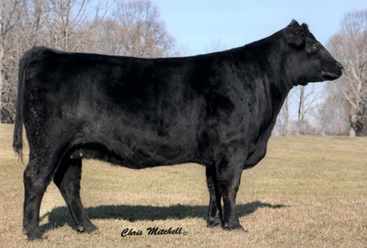
Phenotype
Physical characteristics of an animal.
Examples:
-Horned/Polled
-Black/Red
jandbcattlecompany.com

Slide 9
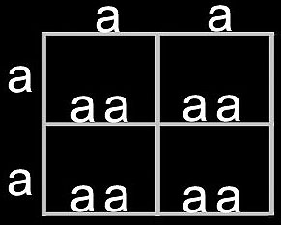
Homozygous
A one-locus genotype containing functionally identical genes.
Example:
-BB, bb, GG, gg

Slide 10
Heterozygous
A one-locus genotype containing functionally different genes.
Example:
-Rr, Gg, Bb

Slide 11
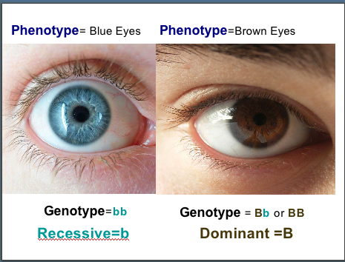
Dominant
A gene that is expressed phenotypically.
Example:
-Black / Red
-Brown / Blue
Taken From: www.learnscape.org

Slide 12
Recessive
A gene that is phenotypically expressed in the homozygous state but has its expression masked in the presence of a dominant gene.
The “weaker” gene

Slide 13
Punnett Square
B B
B
b
BB
BB
Bb
Bb
B=Black b=Red

