Slide 1
Basic Genetics and Selection
agriportal.info/Ag%20Documents/Genetics%20and%20Breeding.ppt

Slide 2
Basic Genetics
The basic unit of inheritance is the gene, located on chromosomes which are made up of strands of complex molecules called DNA.
In mammals, these chromosomes contain about 60,000 genes, the entire set of which is called a genome.

Slide 3
Different forms of the same gene are called alleles. If an individual’s two alleles (one from each parent) are the same they are homozygous. If different they are heterozygous. This genetic makeup is called genotype. What can be seen or measured is called phenotype.
Progeny are created by the union of gametes (sperm from the male and egg from the female). Each gamete produced by an individual is unique. Patterns of inheritance depend on:
The gametes produced by the parents.
The possible combination of gametes.
The action of different alleles.

Slide 4
Types of Inheritance
Qualitative - One pair or relatively few alleles generally involved. Traits have distinct differences in phenotype, such as color, horns, etc. Usually not influenced by the environment.
Quantitative - Many pairs of genes involved, acting additively. There is continuous variation in phenotypes. Virtually all of the economically important traits result from this type of inheritance. Generally influenced by the environment.

Slide 5
Causes of Phenotypic Variation
Heredity:
Animals genetic background for phenotype
Environment:
Conditions under which the animals are born and raised; climate, nutrition, disease, general management, etc.

Slide 6
Heritability
Degree of relationship between genotype and phenotype. Generally reported as a percentage.
Production traits vary in heritability. Most reproductive traits (conception rate, etc.) are low (< 20%), production traits (weight, etc.) are medium (20% to 40%), and product traits (lean tenderness, etc.) are high (> 40%).

Slide 7
SELECTION
Process that determines which individuals become parents, how many offspring they produce, and how long they remain in the population.
Man practices “artificial” selection. Nature (the environment) practices “natural” selection, which is always present and may be the major influence on phenotype in some instances.
Single trait selection
Most rapid genetic progress
May be least adapted to the environment
Multiple trait selection
The more traits the less progress
Animals raised outside of confinement will need more multiple trait selection

Slide 8
Factors Affecting Rate of Improvement Through Selection
Heritability level
Selection differential
difference between performance of individuals selected as parents and the average of the group they were selected from. Relatively few sires are needed, so they have more effect than dams
Generation interval – average age of parents when progeny are born
cattle > sheep and goats > rabbits
Rate of improvement per year from selection =
(heritability x selection differential) / generation intervals

Slide 9
Selection Methods
Selection on appearance is strictly subjective.
Selection on pedigree is done strictly on the basis of an individual’s ancestors.
Selection on individual performance relies on measuring production traits, and selecting on that basis.
Selection on progeny performance can be more accurate but also is the slowest.
Combining pedigree, individual performance, and progeny performance, using Expected Progeny Difference (EPD, discussed later), is most effective.

Slide 10
Matching Genetic Programs to Existing Conditions

Slide 11
THOSE CONDITIONS ARE:
Climate
Topography
Pests
Forage
Labor
Management skill
Markets

Slide 12
Genetics and Forage
Forage availability is the main determinant of optimum mature body size. Larger animals need more forage.
Forage quality is the main determinant of optimum milking ability. Higher-milking females need higher-quality forage.

Slide 13
Mating Plans and Breeding Systems

Slide 14
Mating Plans
Random – no effort to control relationship of parents.
Inbreeding – mating animals more closely related than the average of the population. Main use is linebreeding, to increase genetic influence of superior sires or dams.
Outbreeding – mating animals less closely related than the average of the population. Outcrossing is outbreeding within a breed. Crossbreeding is outbreeding of animals of different breeds.

Slide 15
Effects of Mating Plans
Inbreeding is often detrimental to overall vigor and fitness. It tends to result in more homozygous gene pairs. Does not increase the number of possibly undesirable recessive genes, just increases the chance they will be expressed in progeny.
Outbreeding, especially crossbreeding, generally improves vigor and fitness. Tends to result in more heterozygous gene pairs.

Slide 16
Continuous Systems
Straightbreeding - same breed of sire and dam, can be carried out in one breeding group.
True rotation - two or more breeds, same number of breeding groups, females bred to breed of sire to which they are least related.
Sire rotation - two or more breeds, one breeding group, one sire breed used at a time, changed periodically, before breeding back to daughters.

Slide 17
Example 2-Breed True Rotation
Start with Angus females, breed to Hereford.
Rotate saved Hereford-sired heifers to another breeding group using Angus sires.
Rotate saved Angus-sired heifers to original breeding group using Hereford sires.
Females rotated once in their life, to group using sire breed they are least related to. Once the rotation is completed, both breeding groups are maintained. After several generations, each group contains about 2/3 of the influence of breed of sire and 1/3 of the other breed.

Slide 18
Benefits of Crossbreeding
1) Heterosis or “hybrid vigor”
Difference in performance of crosses relative to the average of purebred parents.
Highest in progeny of parents least related genetically (for example, higher in Hereford X Brahman than Hereford X Angus)
Highest in reproduction/maternal traits, medium in production traits, lowest in product traits.
Can not be transmitted from parent to offspring.

Slide 19
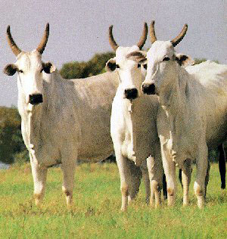
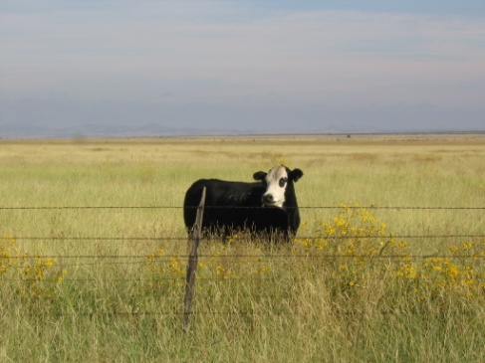
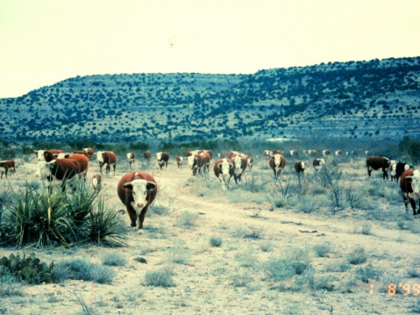
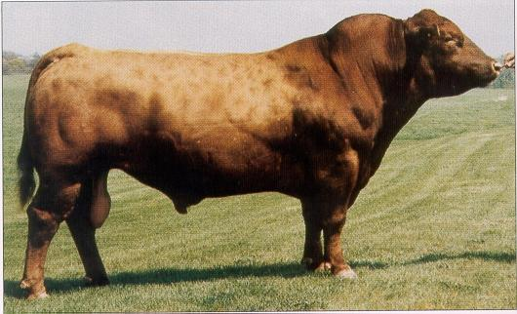
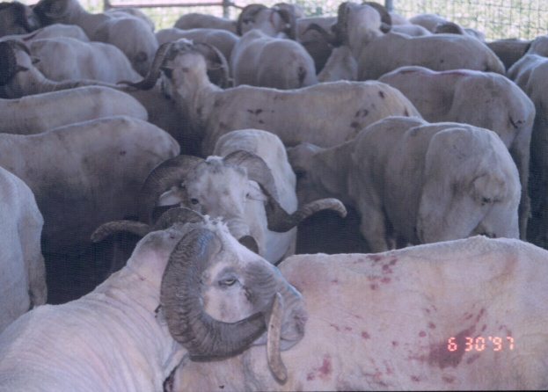
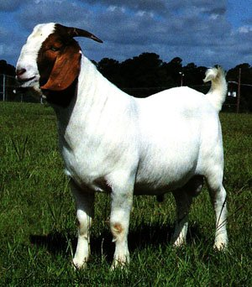
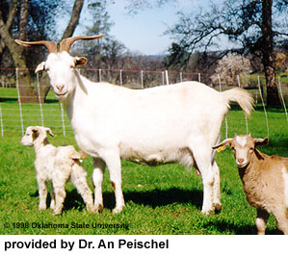
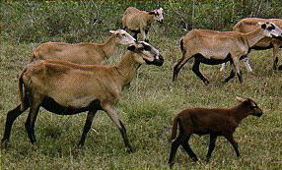
Choosing Applicable Genetic Types and Breeds

Slide 20
Genetic Classes
Cattle: Genetic Classes
Bos taurus - non-humped types, originating in Continental Europe and the British Isles, most cold tolerant
Bos indicus - humped types, also called Zebu; originating in south central Asia, most heat tolerant
Sheep: Genetic Classes
Hair Sheep
Wool Sheep
Over 200 breeds world-wide

Slide 21
Types and Breeds
Can be placed into functional-type breed groups based on genetic classification, body size, milking potential, and body composition (lean-to-fat ratio).

Slide 22
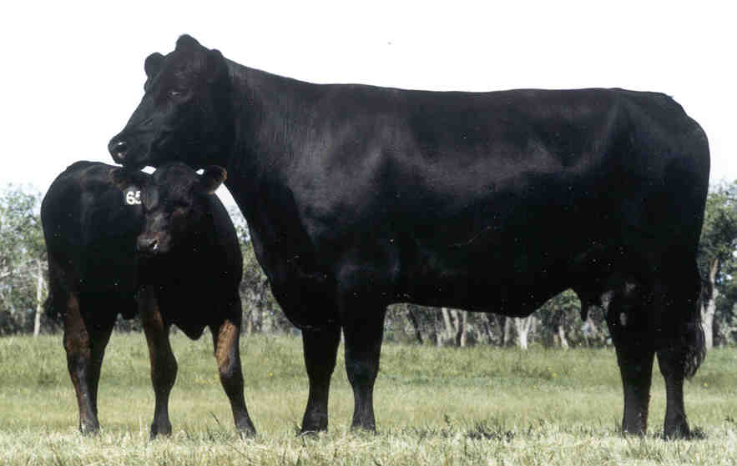
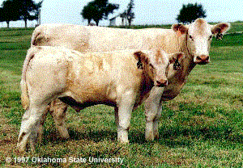
Functional Breed Groups of Cattle
BRITISH BEEF - Bos taurus, moderate size, low to moderate milk, low to medium lean-to-fat. (Examples: Angus, Hereford, shorthorn)
CONTINENTAL BEEF - Bos taurus, moderate to very large size, low to moderate milk, high to very high lean-to-fat. (Examples: Chianina, Charolais, Limousin)

Slide 23
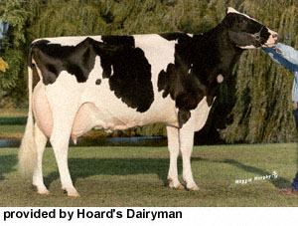
Functional Breed Groups
DAIRY - Bos taurus, small to large size, high to very high milking, very low to low lean-to-fat. (Examples: Holstein, Jersey)

Slide 24
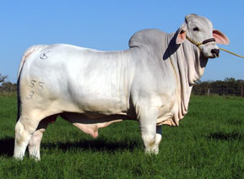
Functional Breed Groups
BOS INDICUS - Bos indicus, moderate to large size, low to medium milking, low to medium lean-to-fat. (Example: American Brahman)

Slide 25
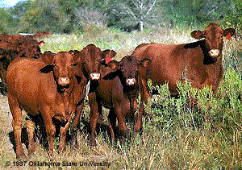
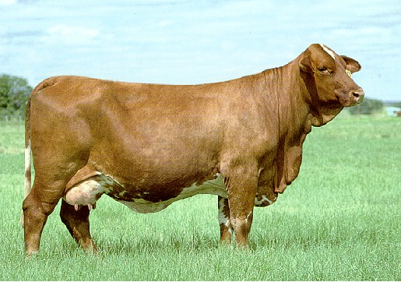
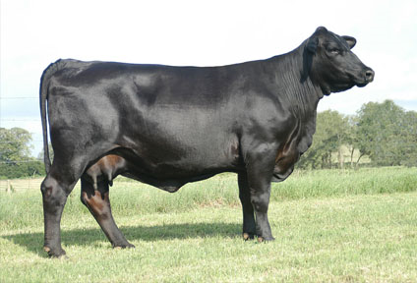
Functional Breed Groups
AMERICAN - Bos taurus X Bos indicus, moderate to large size, medium to high milking, low to medium lean-to-fat. (Examples: Beefmaster, Brangus, Santa Gertrudis, Simbrah)

Slide 26
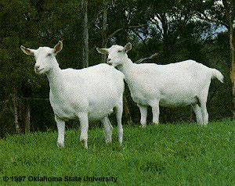
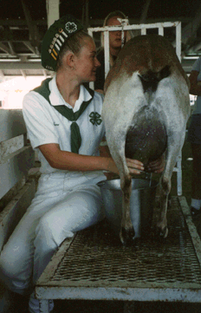
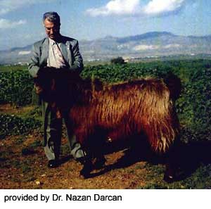
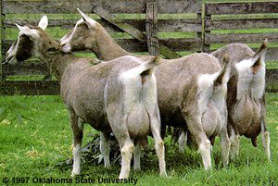
Functional Breed Groups: Example Goats
Dairy – Examples: Alpine, Nubian, Saanen, Damasus, Toggenburg

Slide 27
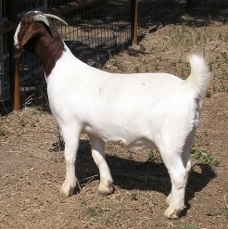
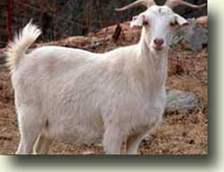
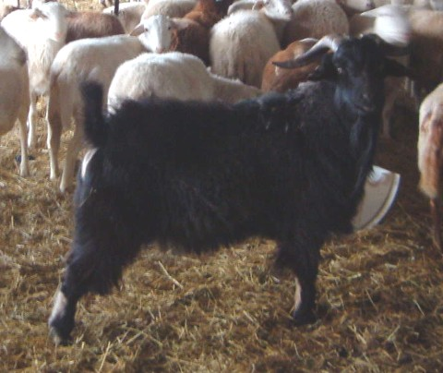
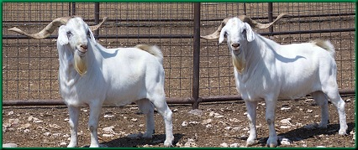
Meat Goats
Examples: Boer, Spanish, Hejazi (Arabia), Kiko (New Zealand)

Slide 28
Dual purpose goats: meat and milk
Probably most of the species in the world are dual purpose

Slide 29
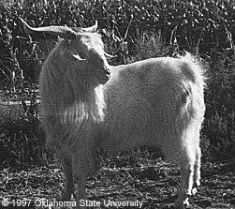
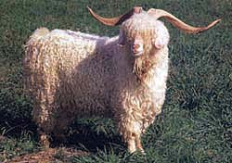
Fiber Goats: Cashmere, Angora

Slide 30
For more complete information on breeds of livestock go to the Oklahoma State University breeds page at:
http://www.ansi.okstate.edu/breeds/

Slide 31
Matching Breeds to Markets
Breeds should be chosen primarily on the basis of climatic adaptability and compatibility with other production conditions, but performance and marketability should also be considered.

Slide 32
Selection of Individuals for Breeding

Slide 33
Select only for traits that have some bearing on herd or flock profit or objectives.
Use the most objective measures when available.
If there are no objective measures, be sure any visual methods are meaningful and affect profit.

Slide 34
Most Important Traits
Reproductive performance - highest economic value
Maternal ability - including milk production
Growth and efficiency - weaning weight, postweaning gain, yearling weight, feed conversion
Market price - with traditional live methods by weight, or carcass grids, or by the head as replacements
Temperament (cattle) Flocking instinct (sheep goats) - ease of handling
Longevity - length of productive life

Slide 35
In dairy and beef cattle, selection can be most accurate and most effective using Expected Progeny Difference (EPD)

Slide 36
EPD
Adjusts for differences in environment, such as climate and nutrition.
Can be compared within a breed for all individuals (males and females) in all locations and management systems across all years. Also can be used to compare EPDs within one breed for crossbreeding, such as comparing Angus sires to be used on Hereford cows.
Procedures have been developed for comparing EPDs of different breeds, but these are less reliable than within-breed EPD.

Slide 37
EPD ACCURACY
Every EPD has a value for Accuracy.
Accuracy is a measure of confidence that the EPD is the true genetic value.
Accuracy ranges between 0 and 1.
High Accuracy requires significant number of progeny records on an individual. Young animals with pedigree data only have low Accuracy, but the EPD is still useful for selection.

Slide 38
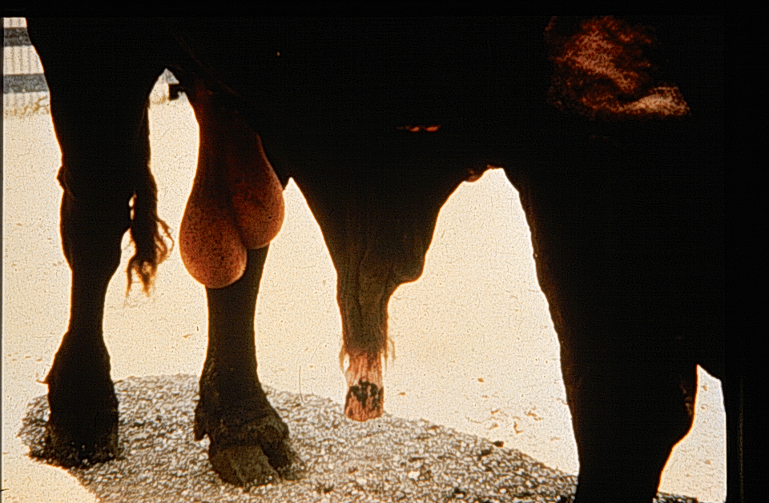
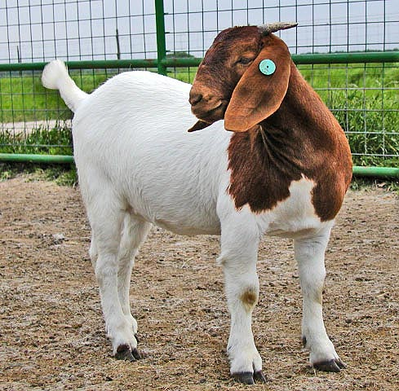
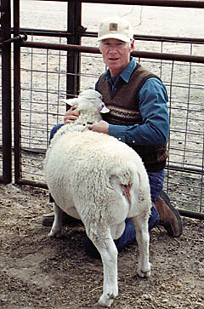
SELECTING WITHOUT GENETIC DATA
Use visual appraisal for:
- Structural soundness
- Breeding soundness
- Udder capacity and soundness
- Indicators of productivity and adaptability (such as
body capacity, fleshing ability)
- Visible factors affecting market price (such as color,
muscle thickness, breed/type)

