Slide 1
What’s the difference? Plant, animal, and bacterial cells
Dana Ethridge
Anna Milstead
Ashley Myers
Ashlee Palermo

Slide 2
Objectives
Identify elements of eukaryotic cells
Identify elements of prokaryotic cells.
Compare plant cells to animal cells.
Investigate the components of bacterial cells.

Slide 3
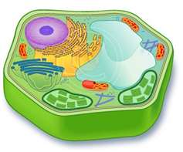
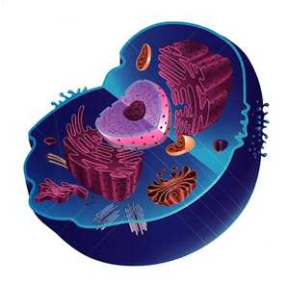
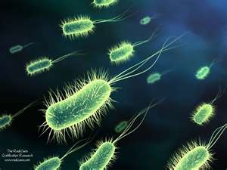
What’s the difference?
Living cells are divided into two types:
Eukaryotic (Plant & Animal cells)
Prokaryotic (Bacteria)

Slide 4
Eukaryotic
Eukaryotic
These cells tend to be larger than the cells of bacteria (prokaryotic)
Have a defined nucleus
Found in organisms made up of many cells
Example: Plant and Animal cells
Structure:
Cell Membrane
Cell Wall (plant cells only)
Centrosome
Centriole (animal cells only)
Chloroplast (plant cells only)
Cytoplasm
Cytoskeleton
Cytosol
Golgi
Lysosome
Mitochondria
Nucleus
Nucleolus
Peroxisome
Reticulum
Ribosomes
Rough Endoplasmic Secretory Vesicle
Smooth Endoplasmic
Vacuole

Slide 5
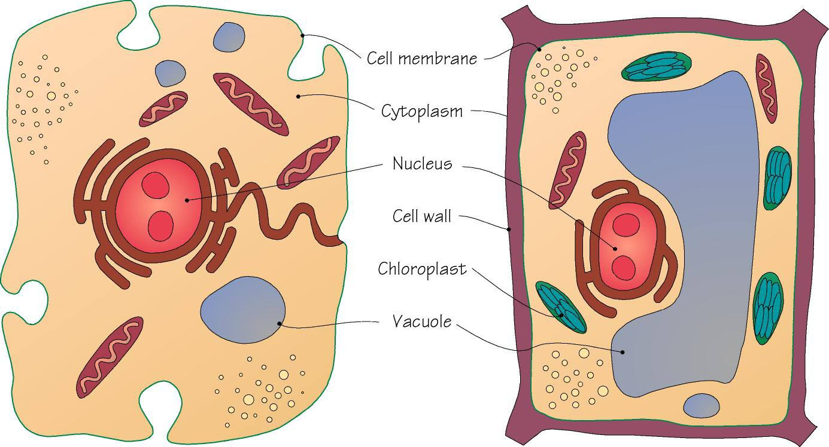
Animal cell plant cell

Slide 6
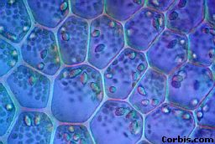
Actual plant cells

Slide 7
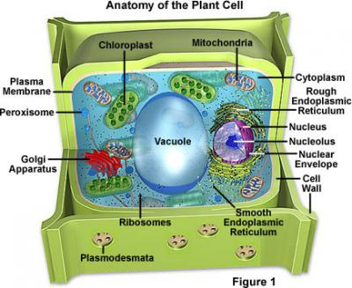
Plant cell (eukaryotic)
Unique parts of the plant cell
Cell wall – a feature of plants cells that functions like stiff lattice-like wall which helps plant cells maintain their structure and shape
Chloroplast – a feature of plant cells that allows plants to do photosynthesis and make their own glucose from sunlight, water and carbon dioxide

Slide 8
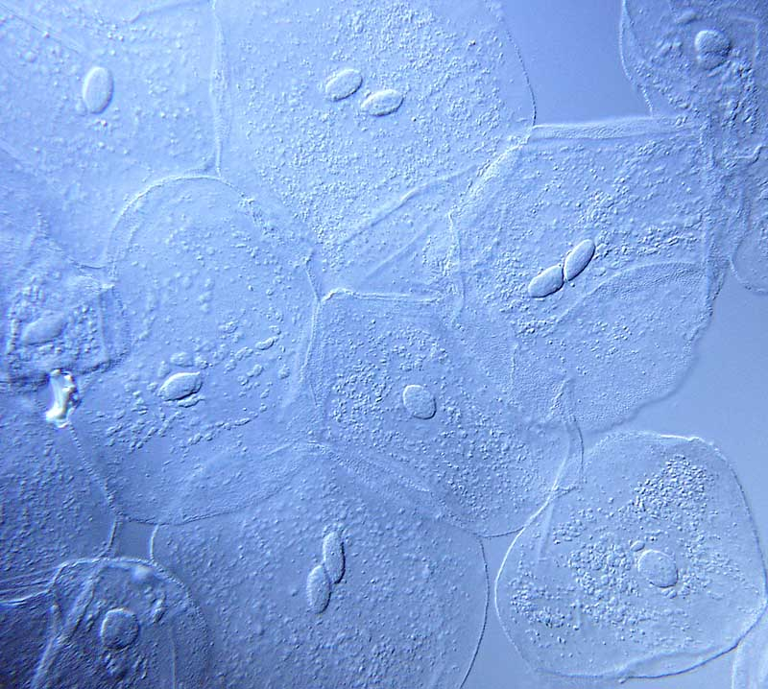
Actual animal cells

Slide 9
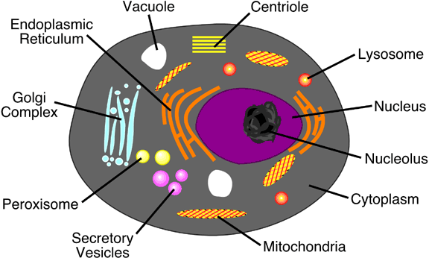
Animal cell (eukaryotic)
Unique parts of the animal cell
Centriole – a feature of animal cells important for coordinating cell division

Slide 10
Prokaryotic
Prokaryotic
These cells are simple in structure
No structured nucleus
Exist as single-celled organisms
Bacteria is both helpful and harmful to us and the environment.
Example: Bacterial cells
Structure:
Capsule (bacterial cells only)
Cell wall
Chromosomes
Cytoplasm
Flagellum (bacterial cells only)
Inner membrane
Outer membrane
Pili (bacterial cells only)
Ribosomes

Slide 11
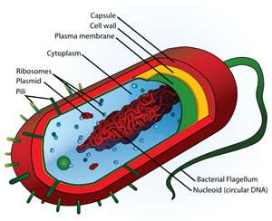
Bacterial cell (prokaryotic)
Unique parts of the bacterial cell
Capsule - Protects the bacterial cell and serves as a barrier against phagocytosis by white blood cells.
Flagellum – “Mobility”. Flagella are long appendages which rotate by means of a "motor" located just under the cytoplasmic membrane. Bacteria may have one, a few, or many flagella in different positions on the cell.
Pili - These hollow, hair-like structures allow bacteria to attach to other cells.

Slide 12
similarities
Similarities DESCRIPTION | Bacterial Cells | Plant Cells | Animal Cells
1. DNA/ Chromosomes | Yes | Yes | Yes
2. Cell membrane | Yes | Yes | Yes
3. Structures to produce energy for cell- Cell Respiration | No-occurs near cell membrane | Yes- in organelle called mitochondrion | Yes- in organelle called mitochondrion
4. Structures that make proteins and enzymes for the cell | Yes-poly- (many) ribosomes | Yes- endoplasmic reticulum (organelle) | Yes- endoplasmic reticulum (organelle)
5. Cytoplasm | Yes | Yes | Yes

Slide 13
differences
Differences DESCRIPTION | Bacterial Cells | Plant Cells | Animal Cells
1. Cell Wall | Yes | Yes | No
2. Nucleus-nuclear membrane | No | Yes | Yes
3. Fimbria-DNA transfer | Some | No | No
4. Vacuoles | No | Yes | Yes
5. Chloroplasts (organelles) (for photosynthesis) | Yes-blue-green bacteria has a green pigment that makes its own food. | Yes | No
6. Flagella-mobility | Yes | No | No
7. Capsule | Some | No | No

Slide 14
Objectives
Identify elements of eukaryotic cells
Identify elements of prokaryotic cells.
Compare plant cells to animal cells.
Investigate the components of bacterial cells.

