Slide 1
Employability Characteristics of A Successful Worker
Ms. Fleming

Slide 2
Objectives
Identify employer expectations.
Discuss appropriate work habits.
Identify good citizenship skills.
Identify career development and entrepreneurship opportunities in the field of animal systems.
Apply competencies related to resources, information, interpersonal skills, and systems of operation in animals systems.

Slide 3
Why is this Important??
In Agriculture we practice and learn leadership, life, and good citizenship skills. These skills are used to help achieve employment and make money!! We all love MONEY.

Slide 4
(7) Ways to Reach Success
Punctuality
Appearance
Respectfulness
Trustworthiness
Appropriate Language
Dependability/Reliability
Attitude

Slide 5
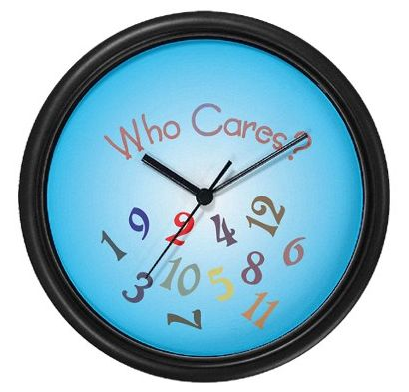
1. Punctuality
* Be on time
a.) Arrive a few minutes early
b.) Work the designated time
c.) Not staying past the designated lunch time

Slide 6
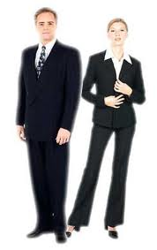
2. Appearance
*Professional looks
a.) Clean cut & Well groomed
b.) Well Dressed
-matching attire
-clean attire
c.) Body Language
-posture (proper sitting)
-no slouching
-be aware of facial expressions

Slide 7
Appearance continues…
d.) Appropriately Dressed
-no loud colors (neon)
-shirts tucked in
-appropriate length of clothing (females)
-no cleavage showing
-hair pulled back (males)
-no slander/ obscene pictures on clothing
-tattoos and piercings should not be visible

Slide 8
3. Respectful
a.) Appreciate customers business
b.) Value customers
-their possible suggestions
c.) Company property/ materials
-don’t damage
-don’t vandalize
d.) Carry company name well
-what you do at the workplace affects customers opinion of the workplace

Slide 9
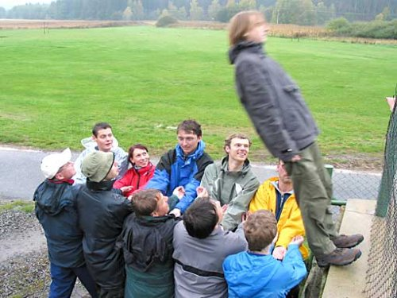
4. Trustworthiness
a.) Not taking company items
b.) Not stealing company money
-giving inappropriate discounts
-not charging All items
c.) Not stealing time on the clock
-leaving while still clocked in
-not working on task until it’s time to clock out, so that you may stay extra time

Slide 10
5. Appropriate Language
a.) No profanity
b.) Body language
-gestures
c.) Appropriate word choice
d.) No slang
e.) No sexual harassment
-verbal
-physical

Slide 11
6. Dependability/ Reliability
*Knows Unwritten Rules
a.)The boss can depend on you to get the job done
b.) Diligently work on task
-even if supervisor is not present
c.) Be careful not to promote competing companies

Slide 12
7. Attitude
*Should always be Positive!!
a.) Don’t let others negativity affect you
b.) Support co-workers
c.) Work well with others
d.) Be a role model
e.) Help others when capable

Slide 13
Review of Objectives
Identify employer expectations.
Discuss appropriate work habits.
Identify good citizenship skills.
Identify career development and entrepreneurship opportunities in the field of animal systems.
Apply competencies related to resources, information, interpersonal skills, and systems of operation in animals systems.

