Slide 1
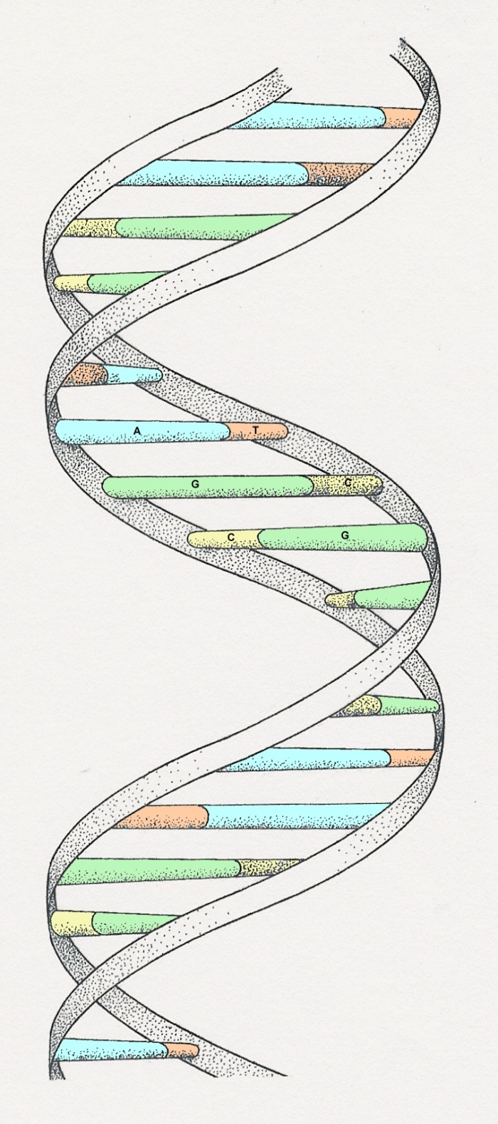
1
DNA
Notes:
The illustration is a ‘model’ of the double helix forming part of a DNA molecule
(Slide 14)

Slide 2
DNA
2
DNA stands for deoxyribose nucleic acid
This chemical substance is present in the nucleus
of all cells in all living organisms
DNA controls all the chemical changes which
take place in cells
The kind of cell which is formed, (muscle, blood,
nerve etc) is controlled by DNA
The kind of organism which is produced (buttercup,
giraffe, herring, human etc) is controlled by DNA

Slide 3
DNA molecule
3
DNA is a very large molecule made up of a long
chain of sub-units
The sub-units are called nucleotides
Each nucleotide is made up of
a sugar called deoxyribose
a phosphate group -PO₄ and
an organic base

Slide 4
Ribose & deoxyribose
4
Ribose is a sugar, like glucose, but with only five
carbon atoms in its molecule
Deoxyribose is almost the same but lacks one
oxygen atom
Both molecules may be represented by the symbol

Slide 5
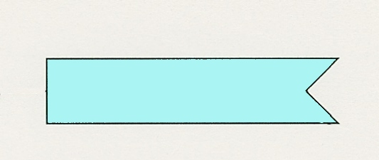
The bases
5
The most common organic bases are
Adenine
(A)
Thymine
(T)
Cytosine
(C)
Guanine
(G)

Slide 6
Nucleotides
6
The deoxyribose,
the phosphate
and one of the bases
Combine to form a nucleotide
PO₄
adenine
deoxyribose
Notes:
It is the phosphate group which gives DNA its acidic properties

Slide 7
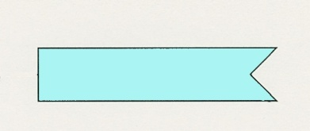
Joined nucleotides
7
PO₄
A molecule of DNA is formed by millions of nucleotides joined together in a long chain
PO₄
PO₄
PO₄
sugar-phosphate
backbone
+ bases

Slide 8
8
In fact, the DNA usually consists of a double
strand of nucleotides
The sugar-phosphate chains are on the outside
and the strands are held together by chemical
bonds between the bases

Slide 9
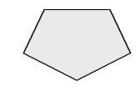
2-stranded DNA
9
PO₄
PO₄
PO₄
PO₄
PO₄
PO₄
PO₄
PO₄
PO₄
PO₄
PO₄
PO₄
PO₄
PO₄
PO₄
PO₄

Slide 10
Bonding 1
10
The bases always pair up in the same way
Adenine forms a bond with Thymine
Adenine
Thymine
and Cytosine bonds with Guanine
Cytosine
Guanine

Slide 11
Bonding 2
11
PO₄
PO₄
adenine
thymine
PO₄
PO₄
cytosine
guanine
PO₄
PO₄
PO₄
PO₄

Slide 12
Pairing up
12
PO₄
PO₄
PO₄
PO₄
PO₄
PO₄
PO₄
PO₄
PO₄
PO₄
PO₄
PO₄
PO₄
PO₄
PO₄
PO₄

Slide 13
13
The paired strands are coiled into a spiral called
A DOUBLE HELIX

Slide 14
THE DOUBLE HELIX
14
bases
sugar-phosphate
chain

Slide 15
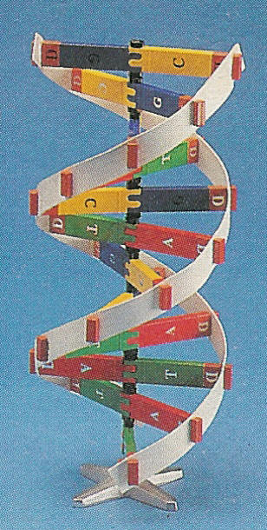
A DIY model of part of a DNA molecule
15
Notes:
This is a teaching model. The colours of the bases do not conform to the accepted
scheme today

Slide 16
replication
16
Before a cell divides, the DNA strands unwind
and separate
Each strand makes a new partner by adding
the appropriate nucleotides
The result is that there are now two double-stranded DNA molecules in the nucleus
So that when the cell divides, each nucleus
contains identical DNA
This process is called replication

Slide 17
The strands separate
17
PO₄
PO₄
PO₄
PO₄
PO₄
PO₄
PO₄
PO₄
PO₄
PO₄
PO₄
PO₄
PO₄
PO₄
PO₄
PO₄

Slide 18
18
Each strand builds up its partner by adding the appropriate nucleotides
PO₄
PO₄
PO₄
PO₄
PO₄
PO₄
PO₄
PO₄
PO₄
PO₄
PO₄
PO₄
PO₄
PO₄
PO₄
PO₄
PO₄
PO₄
PO₄
PO₄
PO₄
PO₄
PO₄
PO₄
PO₄
PO₄
PO₄
PO₄
PO₄
PO₄
PO₄
PO₄
Notes:
The nucleotides are present in the nucleoplasm. The nuclear equivalent of cytoplasm

Slide 19
Genetic code 1
19
The sequence of bases in DNA forms the
Genetic Code
A group of three bases (a triplet) controls
the production of a particular amino acid in
the cytoplasm of the cell
The different amino acids and the order in which they are joined up determines the sort of protein being produced

Slide 20
Genetic code 2
20
This is a small, imaginary protein molecule showing
how a sequence of 5 different amino acids could determine the shape and identity of the molecule
Ser-Cyst-Val-Gly-Ser-Cyst Ala
Val
Val-Cyst-Ser-Ala-Ser-Cyst-Gly
Val- Cyst-Ala-Ala-Ser-Gly
Each amino acid (Serine, Cysteine, Valine, Glycine and
Alanine) is coded for by a particular triplet of bases

Slide 21
Coding
21
For example
Cytosine
Adenine
Codes for
Valine
Thymine
Cytosine (C)
Codes for
Alanine
Guanine (G)
Adenine (A)

Slide 22
Triplet code
22
This is known as the triplet code
Each triplet codes for a specific amino acid
CGA - CAA - CCA - CCA - GCT - GGG - GAG - CCA -
Ala
Val
Gly
Gly
Arg
Pro
Leu
Gly
The amino acids are joined together in the correct
sequence to make part of a protein
Ala
Val
Gly
Gly
Arg
Pro
Leu
Gly
Notes:
Although the DNA in the nucleus specifies the amino acids and their sequence, it is in the cytoplasm that the protein build-up takes place. The DNA of the nucleus makes a single strand of messenger RNA (ribo-nucleic acid) which leaves the nucleus and builds up the protein in the cytoplasm. The RNA code is complementary, but not identical, to the nuclear DNA. Text books usually give the coding for the RNA but in this presentation it is for the DNA itself

Slide 23
DNA and enzymes
23
The proteins build the cell structures
They also make enzymes
The DNA controls which enzymes are made and
the enzymes determine what reactions take place
The structures and reactions in the cell determine
what sort of a cell it is and what its function is
So DNA exerts its control through the enzymes

Slide 24
Genes
24
A sequence of triplets in the DNA molecule may
code for a complete protein
Such a sequence forms a gene
There may be a thousand or more bases in
one gene

Slide 25
Question 1
Which of the following are components of
nucleotides?
(a) deoxyribose
(b) amino acids
(c) phosphate
(d) enzymes
(e) organic bases

Slide 26
Question 2
Which of the following represent a correct
pairing of bases?
(a) adenine with thymine
(b) adenine with guanine
(c) thymine with adenine
(d) guanine with cytosine
(e) thymine with thymine

Slide 27
Question 3
DNA molecules are formed from
(a) organic bases
(b) amino acids
(c) deoxyribose
(d) nucleotides

Slide 28
Question 4
Which of the following are organic bases?
(a) Valine
(b) Guanine
(c) Thymine
(d) Serine

Slide 29
Question 5
Replication of DNA occurs
(a) During cell division
(b) before cell division
(c) at any time

Slide 30
Question 6
A nucleotide triplet codes for
(a) a protein
(b) an amino acid
(c) an enzyme
(d) an organic base

Slide 31
Answer
CORRECT

Slide 32
Answer
INCORRECT

