Slide 1
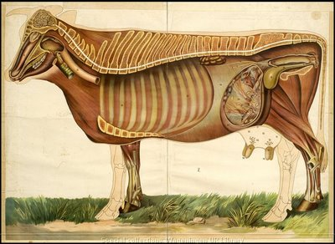
Advanced Animal Science Consumption Patterns Relative to Diet (c)(5)(B) Created By: Rodree Carlile

Slide 2
Objectives
Define what a consumption pattern is.
Evaluate consumption patterns relative to diet.

Slide 3
Overall U.S. Meat Consumption
On Average, Americans Consume 197 lbs of meat annually.
% of beef consumed in diet. 63.5 pounds
% of Chicken consumed in diet. 84.9 pounds
% of pork consumed in diet. 48.2 pounds

Slide 4
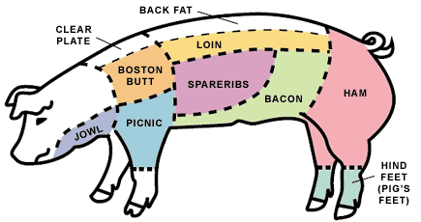
Pork
Pork is one of the most widely eaten meats in the world,
Accounts for about 38% of meat production worldwide
United States consumed 9 million tons in 2007.
Consumption increased by 18% from 2006 worldwide.

Slide 5
Total U.S. beef Consumption
Consumption Growth 2002: 27.9 billion pounds 2003: 27.0 billion pounds 2004: 27.8 billion pounds 2005: 27.8 billion pounds 2006: 28.0 billion pounds 2007: 28.1 billion pounds 2008: 27.3 billion pounds 2009: 26.9 billion pounds *Mad Cow Epidemic

Slide 6
Consumption Fluctuation
Caused by:
Price – as price per lbs. increases consumption will decrease.
Perception- media refers to “Pork the other white meat” causing fluctuation in consumption.
Outbreaks- swine flu, Salmonella and mad Cow.
Availability-supply and demand

Slide 7
Swine Flu(H1N1)
The 2009 flu pandemic was a global outbreak of a new strain of H1N1 influenza virus, often referred to as "swine flu".
Despite being informally called "swine flu", the H1N1 flu virus cannot be spread by eating pork or pork products

Slide 8
H1N1 Effects
The U.S. pork industry suffered through one of its
worst economic times in nearly 20 years.
Producers lost $22 for every animal marketed, according to Iowa State University
In November and December losses were estimated to be $40 and $45 per head,
Overall, it is estimated that producers have lost 35 percent of their equity

Slide 9
Salmonella
August 2010- authorities ordered more than half a billion eggs off the shelves at American supermarkets due to fears of salmonella.
It was one of the largest salmonella outbreaks ever recorded in the U.S
Later the FDA recalled 500 million more eggs produced by two closely-linked farms.

Slide 10
Effects
Egg consumption in America declined do to the outbreak.
The outbreak has caused many consumers to think twice before purchasing eggs.
Producers were required to recall over 380 million eggs.

Slide 11
Mad Cow
Known as: Bovine spongiform encephalopathy
Causes a spongy degeneration in the brain and spinal cord.
BSE has a long incubation period, about 30 months to 8 years
Affects adult cattle at a peak age onset of four to five years
All breeds being equally susceptible

Slide 12
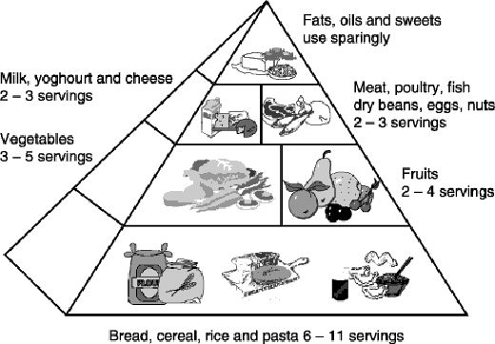
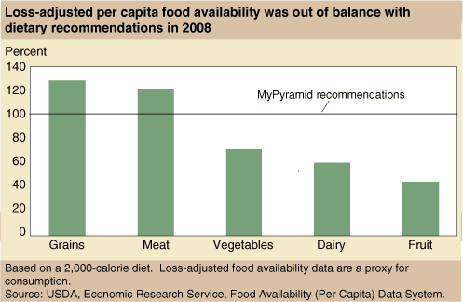
Recommended Consumption vs. Actual

Slide 13
Projections
Annual per capita consumption of red meats and poultry falls from 223 pounds in 2007 to a projected low of 213 pounds in 2012
This is anticipated, do to higher feed cost.
In years to come, the USDA projects thatnred meats and poultry will resume growth
Projections estimate a per capita gain reaching about 219 pounds in 2016.

Slide 14
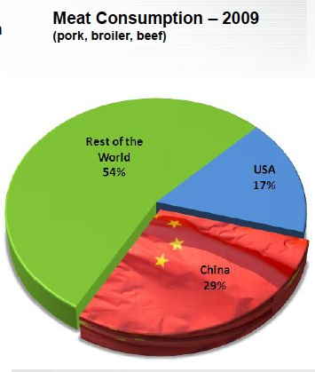
Global Prospective
Where We Stand.

Slide 15
Review
Objectives:
Define what a consumption pattern is.
Evaluate consumption patterns relative to diet.

