Slide 1
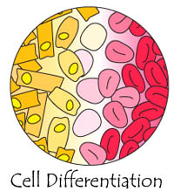
Cell Differentiation
Ms. Ethridge
Ms. Milstead
Ms. Myers
Ms. Palermo

Slide 2
Objectives
Define Cell Differentiation.
Explore terms related to cell differentiation.
Recognize structures within cell differentiation.

Slide 3
Think-Pair-Share!
Get with a partner and discuss together what you think happens in cell differentiation. Begin filling out your KWL chart – fill in what you already know and what you want to know.
There will be time at the end of class to fill in what you learned.

Slide 4
What is Cell Differentiation?
A process by which a less specialized cell matures to a more specialized cell.
Forms a more distinct form and function.

Slide 5
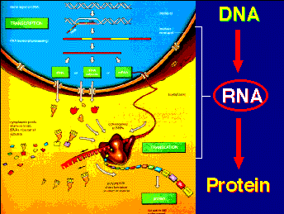
New Vocabulary
Protein synthesis: formation of protein cells within your body to aid in the formation of bodily organs such as hair, skin, and blood.

Slide 6
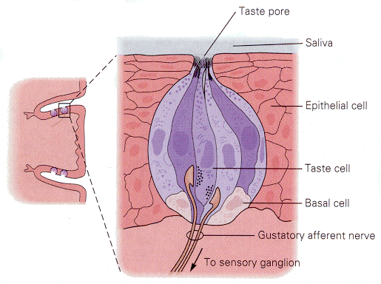
New Vocabulary Continued
Sensory receptor cells: develops nervous system and allows use of senses such as taste, smell, and feeling.

Slide 7
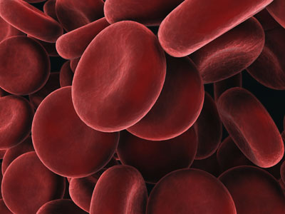
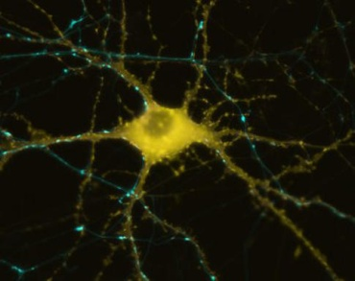
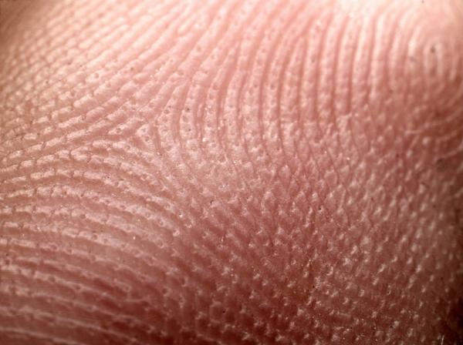
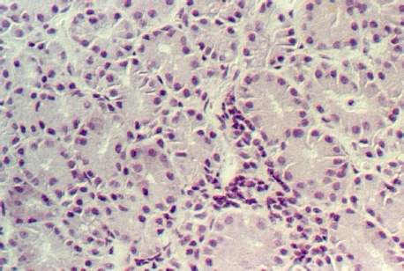
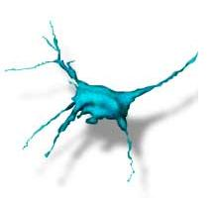
Types of specialized cells
Blood cells
Red and white
Nerve cells
Skin cells
Gland cells
Sensory receptor cells
Bacteria

Slide 8
So, how does a cell turn into a specialized cell?
Cell Division
Meiosis and mitosis
Genes/DNA
Protein Synthesis
Collagen in skin
Keratin in hair
Hemoglobin in blood
http://www.wisc-online.com/Objects/ViewObject.aspx?ID=AP1302

Slide 9
Cells “talk” to each other!
Embryo develops and cells know exactly where they are.
Chemical messages are sent from cell to cell.
Messages spread from cell to cell to the nucleus which turns genes on or off.
Chemical messages tell the cells exactly what to do according to their location.
Heart beating, lining of intestines, skin, etc.
This is how organs are formed from cells.

Slide 10
Lab Activity
Groups of 3-4
Each group will be assigned an organ
Construct your organ using materials I have provided
Must include:
At least 5 cells
Nucleus (5)
Mitochondria (5)
Cell wall/membrane
Golgi
Examples of proteins it produces
Must identify whether it is prokaryotic or eukaryotic

