Slide 1
Careers in the Agricultural Industry
Ms. Kozel
Mrs. O’Brien
Advanced Animal Science
Fall 2011

Slide 2
What are the Career Areas?
Production Agriculture
Agriculture Mechanics
Agriculture Sales & Service
Agriculture Processing
Forestry
Horticulture
Rural Recreation & Natural Resources
Agriculture Marketing & Business Management

Slide 3
Which career fields will we cover?
Advanced animal science, will cover agriculture processing as this field deals mainly with animal science related work.

Slide 4
Agriculture Processing
What does this career field include?
Processing and distributing food sources worldwide
Jobs in this field include:
Meat Processors
Meat Distributors
USDA Graders/Inspectors

Slide 5
Chicken Processors
Work in Poultry Plants
Assigned job on assembly line
Unload live birds from trailer
Slaughter, dress, cut, and prepare birds
Pack processed poultry into cartons to be shipped
Maintain clean and hygienic environment
Write delivery orders
Keep detailed records

Slide 6
Chicken Processor Cont.
Salary on average
$20,000- $35,000
Work Environment
Indoor/Outdoor career
Long periods of standing
Loading and unloading

Slide 7
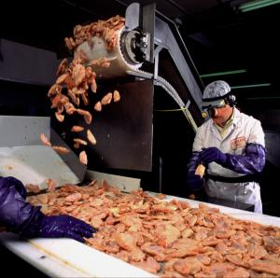
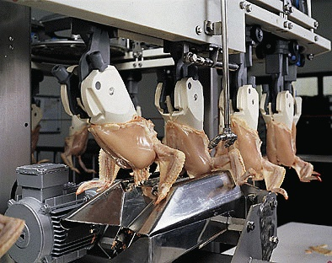
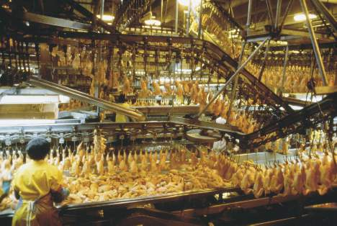
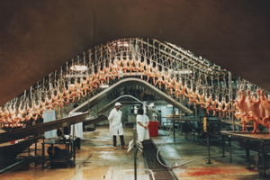

Slide 8
Consumer Safety Inspector
Employed by the USDA
Work in a privately owned meat, poultry, or egg processing plant
Ensure plant is operating within HACCP standards
Ensure sanitation is maintained at all times
Also ensure consumer protection in errors such as mislabeling products

Slide 9
Consumer Safety Inspector Cont.
Must have Bachelor’s Degree and one year of job related experience
Salary ranges from $24,000 to $56,000
Work Conditions
Indoor/Outdoor
Long periods of standing
Possible travel from plant to plant

Slide 10
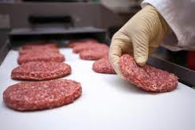
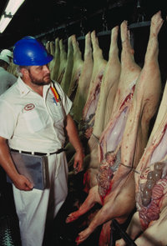

Slide 11
What career will you choose?

