Slide 1
Artificial Insemination Part 2
Created By Haley Vrazel

Slide 2
Objectives
Evaluate the handling qualities for semen.
Identify the Reproductive system.
Objective 3: Analyze the AI process.

Slide 5
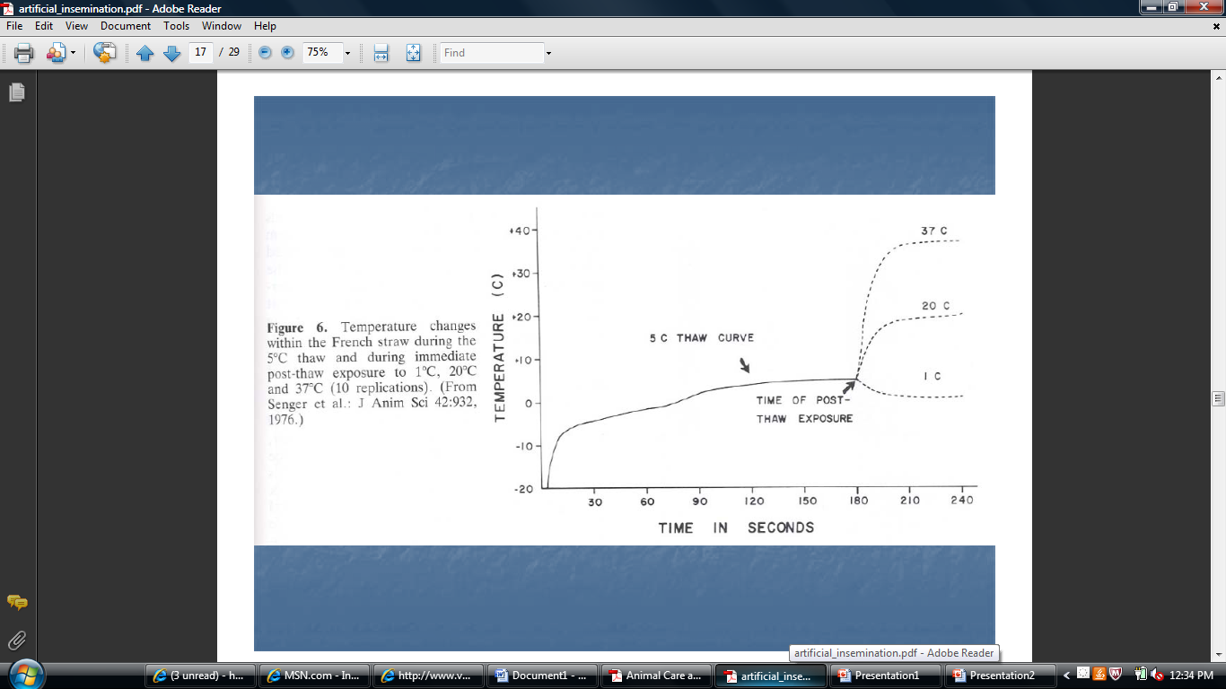

Slide 10
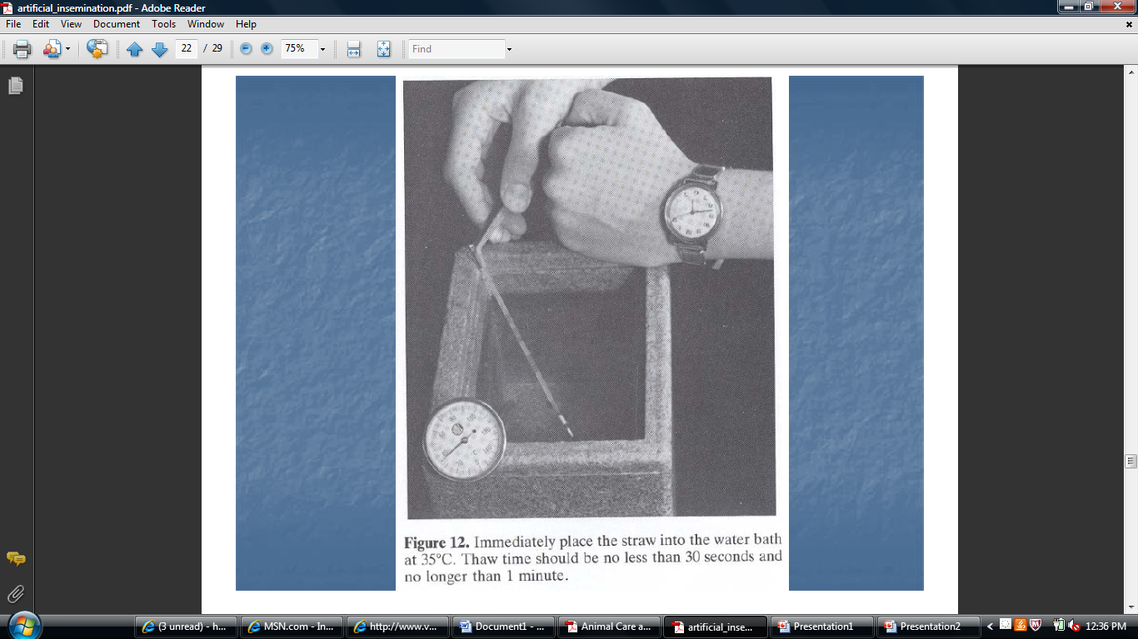

Slide 12
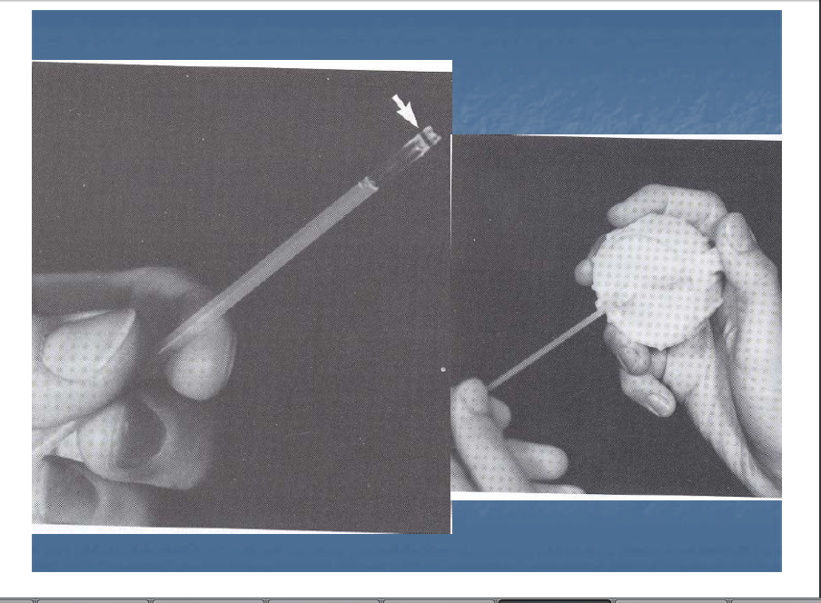

Slide 17
Resources
http://www.vet.k-state.edu/studentorgs/bovine/pdf/artificial_insemination.pdf
http://www-naweb.iaea.org/nafa/aph/resources/technology-ai.html
http://www.thebeefsite.com/articles/721/artificial-insemination-for-beef-cattle

Slide 18
Objectives
Evaluate the handling qualities for semen.
Identify the Reproductive system.
Objective 3: Analyze the AI process.

