Slide 1
Botany Basics - Stems
By C. Kohn

Slide 2
Stems
Stems are a crucial part of plant physiology and perform the following functions for plants
Offer physical support for the leaves
Serve as conduits for moving water, minerals, and food throughout the plant

Slide 3
Stem Terminology
Shoot – a young stem (1 year old or less) with leaves
Twig – A young stem (1 year old or less) that is in the dormant winter stage (no leaves)
Branch – A stem that is more than 1 year old typically with lateral stems radiating from it
Trunk – A woody plant’s main stem

Slide 4
Stem Vasculature
The vasculature system of a stem includes 3 main components –
Xylem – carries water and dissolved minerals up the plant
Phloem – carries food down the plant
Vascular Cambium – the cambium is a layer of meristematic tissue that separates xylem and phloem
The Cambium also produces the xylem and phloem tubes and creates the new tissue that is responsible for the change in girth of a stem
E.g. cambium would create the rings of a tree trunk

Slide 5
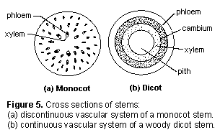
Importance to Gardeners
The vascular cambium is important to gardeners
For example, in grafting, the tissues must line up so that phloem is to phloem and cambium is to cambium
Addtionally, careless weed trimming can strip the bark off of a tree, injuring the cambium and causing tree or shrub death

Slide 6
Monocots vs. Dicots
In a monocot, the xylem and phloem are arranged in bundles and dispersed throughout the stem
In dicots, the vascular system forms continuous rings inside the system
The ring of phloem is near the bark and eventually becomes part of the bark in mature woody stems
The xylem forms the inner ring; in woody plants, it becomes the sapwood and heartwood
This information is key to gardeners; for example, herbicidal action is specific to monocots and dicots
E.g. 2 4-D kills only dicots by targeting the continuous vascular system

Slide 7
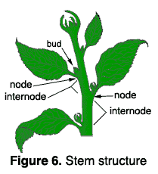
Nodes
A node is an area on a stem where the buds are located
Nodes are a site of great cellular activity and growth, where small buds develop into leaves, stems, or flowers
When pruning, it is important to locate a plant’s nodes
Generally you want to cut just above, but not too close to a node
This encourages the buds at that node to begin development
The area between two nodes is called an internode

Slide 8
Internodal length
Internodal length can be an easy visible indicator of a plant’s health and productivity
Several factors can affect internode length
Reduced soil fertility decreases internode length
Applications of high-nitrogen fertilizer can greatly increase internode length
Lack of sunlight, or too low intensity of lighting, can increase internode length, causing a spindly stem
A situation where plants have a spindly stretched stems is called Etiolation
This often occurs in seedlings started indoors and in houseplants that get too little light
Internode length varies with the season
Early-season growth has long internodes; late season growth has longer internodes
If a stem’s energy is divided among three or four side stems, or is diverted into fruit growth and development, internode length is shortened
Plant growth regulators and herbicides will also change internode length

Slide 9
Types of Stems
All stems must have buds to be classified as stem tissue
This distinction is important because stems can run underground, making them sometimes easy to confuse with roots
Some plants have specialized aboveground stems known as crowns, spurs, or stolons
Crowns are compressed stems with leaves and flowers on short internodes
Spurs are short, stubby side stems that arise from the main stem
These are the fruit bearing stems on a pear, apple, and cherry tree
If major pruning is done close to the fruit bearing spurs, they can revert to non-fruiting stems, eliminating that year’s crop
Stolons are elongated horizontal stems that often lie along the soil surface.
E.g. the runners of a strawberry are stolons
Roots often develop from these stolons, creating daughter plants
If left unchecked, this is an easy way to increase the size of a strawberry patch

Slide 10
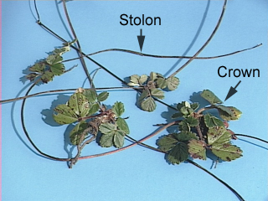

Slide 11
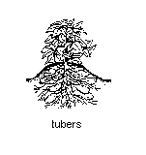
Below-ground Stems
Potato-tubers, iris rhizomes, and tulip bulbs are actually underground stems that store food for the plant
The nodes of these structures are what make them stems and not roots
E.g. the eyes of a potato are actually the stems nodes; each eye contains a cluster of buds
When growing potatoes from seed, it is important that each piece contain at least one eye and be about the size of a golf balls so that there will be early energy from shoot and root growth and development

Slide 12
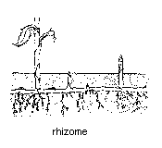
Rhizomes
Rhizomes resemble stolons because they grow horizontally from plant to plant
Rhizomes can make some invasive weeds especially hard to fight
E.g. Canadian thistle can literally spread underground, sending up new plants at random intervals from its rhizomes
Johnsongrass is an insidious weed as well because of its rhizomes
Few options short of Roundup and manual digging are effective in fighting these types of nuisances
In some cases, Rhizomes can be effective methods of increasing the size of perennials such as irises

Slide 13
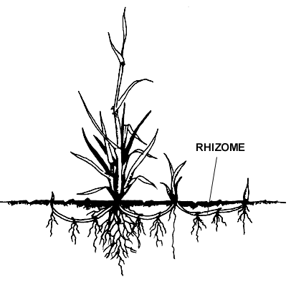

Slide 14
Bulbs
Tulips, lilies, daffodils, and onions produce bulbs
Bulbs are shortened, compressed, underground stems surrounded by fleshy scales (leaves) that envelop a central bud at the tip of the stem
A tulip bulb cut in half in November will have all the flower parts in miniature
After a bulb-producing plant flowers, its phloem transports food reserves from its leaves to the bulb’s scales
When the bulb begins growing in spring, it utilizes the stored food
For this reason, it is important not to remove the leaves from daffodils and other bulb-producing plants until after they have turned yellow and withered
When yellowing/withering occurs, the plant has completed food production and storage necessary for next year’s flowering

Slide 15
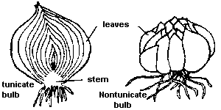
Types of Bulbs
There are two types of bulbs – tunicate and nontunicate
Tunicate bulbs (e.g. daffodils, tulips, onions) have a thin, papery covering (modified leaves)
These help protect the bulb from damage during digging and from drying out when it is out of the soil
Nontunicate bulbs (e.g. lilies) lack the paper covering (think tunicate, like what the Romans would wear)
More care must be used with nontunicate bulbs since they are so much more susceptible to damage and drying out

Slide 16
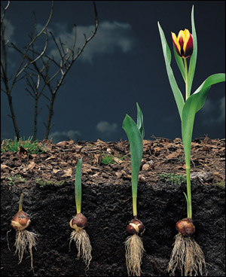
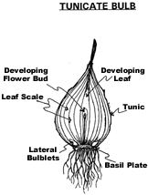

Slide 17
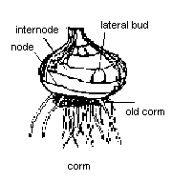
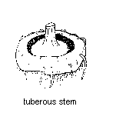
Corms & Tuberous Stems
Corms are another kind of below-ground stem
While both bulbs and corms are composed of stem tissue, corms lack fleshy leaf-scales
Gladiolus and crocuses produce corms instead of bulbs
Plants such as tuberous begonias and cyclamen produce a modified underground stem called a tuberous stem
These stems are short, flat, and enlarged
Buds and shoots arise from the top (crown) and fibrous roots grow from the bottom
Tuberous stems should not be confused with the tuberous roots of plants like sweet potatoes; these structures lack nodes and internodes

Slide 18
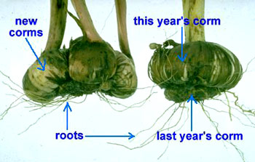
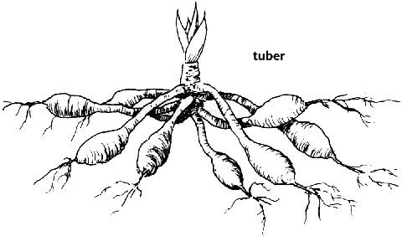

Slide 19
Stems and Propogation
Stems often are used for vegetative plant propagation.
Using sections of aboveground stems that contain nodes and internodes is an effective way to propagate many ornamental plants.
These stem cuttings produce roots and, eventually, new plants.
Below-ground stems also are good propagative tissues.
You can divide rhizomes into pieces; remove small bulblets or cormels from their parent; and cut tubers into pieces containing eyes and nodes.
All of these tissues will produce new plants.

Slide 20
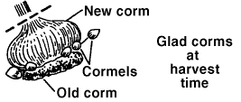
After a gladiolus corm has been planted, a new corm begins to grow from the top of the old one. A corm lasts only one year.
In addition to the new corm, smaller corms or "cormels" usually develop at the new corm base.
These cormels can be removed and stored for planting the next spring.
They will be identical to the mother corm in color and flower type.

Slide 21
Stems as Food
The edible portion of several cultivated plants, such as asparagus and kohlrabi, is an enlarged, succulent stem.
The edible parts of broccoli are composed of stem tissue, flower buds, and a few small leaves.
The edible tuber of a potato is a fleshy underground stem.
Although the name suggests otherwise, the edible part of cauliflower actually is proliferated stem tissue.

