Slide 1
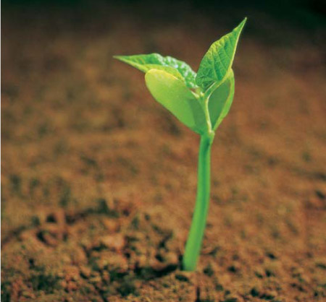
Seed Germination
By C. Kohn, Waterford WI

Slide 2
Outside, In
When you look at a seed, what you are actually seeing is the seed coat.
The seed coat performs much of the same work that your own coat performs …
It provides protection against entry of parasites,
It protects against mechanical injury
In some seeds, it buffers against unfavorably high or low temperatures.
It stops germination until the right time
What would happen if the seed coat failed in fall?

Slide 3
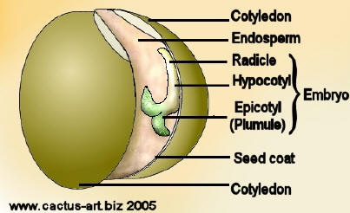
Parts of a seed

Slide 4
Inside…
Inside of the seed coat, an embryo is protected.
The embryo is an immature plant with all of the parts of an adult plant.
A close looks shows leaves and roots, albeit very small leaves and roots
The leaves of the embryo are called plumules
The leaves are sheathed by a cotyledon
The embryonic roots are called radicles
The embryonic stem is called the hypocotyl
The seed is filled with nourishment for the new plant; this source of nutrition is called the endosperm.

Slide 5
Parts of a seed

Slide 6
Germination
The first step of germination is the absorption of water – a lot of water
Absorption of water activates enzymes in the seed that stimulate growth.
These enzymes break down starches in the endosperm into sugars that can be used for energy
The deciding factor in whether or not a seed germinates is whether or not energy is available for growth and cell division.

Slide 7
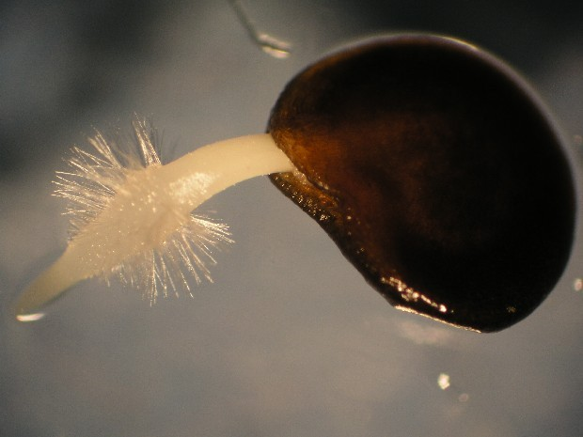
Stages leading to cell division
Respiration
Initially anaerobic
Later aerobic
Mitchondria reconstituted
Soluble sugars
ATP
RNA activated
Polysomes
Protein synthesis (0.5h)
Enzymes (proteins)
DNA synthesis (45h)
http://www.rbgsyd.nsw.gov.au/
Mitosis (70h)
© 2008 Paul Billiet ODWS

Slide 8
Seed Dormancy
If moisture is the key to starting seed germination, it should be clear what is necessary for seed dormancy
A waterproof seed coat
No oxygen
Chemical inhibitors
For germination to occur, these must be negated
Coat broken down; oxygen available
Water absorbed
Growth promoters activated, inhibitors are inhibited.

Slide 9
Germination
STAGE | EVENTS
PREGERMINATION | Rehydration – imbibition of water. RNA & protein synthesis stimulated. Increased metabolism – increased respiration. Hydrolysis (digestion) of food reserves by enzymes. Changes in cell ultrastructure. Induction of cell division & cell growth.
GERMINATION | Rupture of seed coat. Emergence of seedling, usually radicle first.
POST GERMINATION | Controlled growth of root and shoot axis. Controlled transport of materials from food stores to growing axis. Senescence (aging) of food storage tissues.
© 2008 Paul Billiet ODWS

Slide 10
Germination Factors
Water is clearly the most important factor in germination; an adequate continuous supply of water is necessary for complete emergence.
Water functions a triggering enzyme for starch conversion into sugar, turgor pressure for moving the radicle root down and the cotelydons up, and for transporting nutrients and enzymes within the seed

Slide 11
Germination Factors
Light is another key germination factor; light can either stimulate or inhibit seed germination
Some crops have a requirement for light to assist seed germination (e.g. begonias, impatiens, lettuce)
Others germinate best in the dark
This is determined by how the seed would naturally be sown
Small seeds must sprout on the surface of soil because they lack a suitable endosperm to supply the needed nutrients; these are typically aided by light exposure
Large seeds contain enough nutrition to grow underground when photosynthesis is not possible. These seeds are more likely to germinate in dark conditions.

Slide 12
Germination Factors
Oxygen is a third factor
Cellular respiration is necessary for plants to grow; oxygen is necessary to complete respiration
Oxygen removes metabolic waste from the cell
Without oxygen, waste is not removed and the cellular metabolism is slowed.
If oxygen supply is limited during germination, emergence may not occur due to inhibited growth.

Slide 13
Germination Factors
A favorable temperature is necessary to allow for plant growth
Temperature not only affects the germination percentage but also the rate of germination
For every species of seed, there is an optimal soil temperature for germination
At that temperature, the maximum number of seeds will germinate and in less time than at any other temperature.
Many seeds germinate best around room temp.

Slide 14
The Process of Germination
Germination is a complex process
A pre-formed plant (embryo) inside of the seed coat must turn the endosperm (starch) into sugar
This sugar powers cell division (mitosis); the addition of cells will cause the embryonic roots, leaves, and stems to grow, expand, and develop.

Slide 15
Germination
During germination, the radicle (embryonic root) emerges due to mitosis fueled by the breakdown of starch into sugar
Under warm conditions, this process will take 4-5 days
Under cool conditions, this process takes longer
Initially the radicle grows in what direction the kernel tip is pointing.
Later, smaller roots will emerge from the radicle at varying angles
These roots will absorb the nutrients necessary for growth and development when the endosperm is completely consumed.

Slide 16
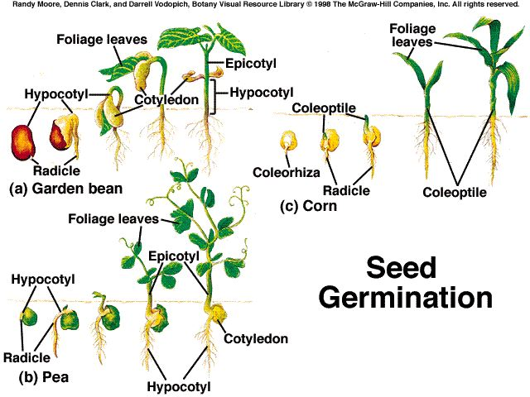

Slide 17
Germination
The coleoptile, a protective sheath covering the shoot, pushes through the soil until it reaches light.
Upon reaching light, the plumule emerges
If the kernel is planted too deep, emergence will not occur
The time between planting and emergence is determined mostly by temperature; warmer temps = reduced emergence time.
This is only true to an extent; excessively high temps can also increase emergence time.
Soil compaction can increase the time to emergence
Lack of moisture can also increase emergence time

Slide 18
Sprouting Time
Many temperate-zoned species use chemical inhibitors to induce dormancy in seeds
In fall the seeds are exposed to abscisic acid (ABA) by the plant to prevent the seeds from sprouting before winter
Over winter, enzymes in the seed degrade the abscisic acid and by spring it is gone

Slide 19
Vernalization
Seeds of some species can be caused to sprout earlier by exposure to cool or cold temperatures
Seeds of temperate species that were exposed to the cold will sprout earlier in a greenhouse than those planted directly.
This process is called vernalization
Vernalization is the intentional exposing of seeds to cool conditions to increase the breakdown of chemical inhibitors and stimulate the production of growth or flowering enzymes.
Many annuals are facultative – vernalization is not necessary for development but does speed it up

Slide 20
Hot climate vernalization
If vernalization, or exposure to cold, is necessary or helpful for seed growth and development, how does vernalization work in warmer climates?
TPS

Slide 21
Phenolic Compounds
Desert plants typically have long dry seasons and short wet seasons
When the rains come, phenolic compounds are leached from seeds
Phenolic compounds inhibit growth and development in the seed
Because they are water soluble, phenolic compounds are washed out of the seed when growth is most likely – after a rain.

