Slide 1
Soil Chemistry
By C. Kohn, Waterford, WI

Slide 2
Basic Chemistry
A chemical element is the building block of all matter.
Examples: nitrogen, oxygen, carbon, hydrogen
The smallest indivisible unit of matter is an atom
Atomic structure is universal among all atoms – atoms are comprised of…
a negatively charged electron that orbit the inner nucleus
An inner nucleus consisting of
a positively charged proton
a neutrally charged neutron
When atoms combine, they form molecules

Slide 3
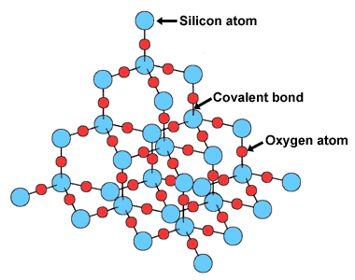
Molecules, Compounds, etc.
For example, water is a molecule consisting of two hydrogen atoms and one oxygen atom
A collection of similar molecules is a compound
Pure solid compounds found in the earth’s crust are called minerals
For example, the most abundant mineral in soil is quartz, a mineral compound consisting of silicon dioxide
As you can see, quartz is a mineral compound because it is made of repeating units of the SiO₂ molecule

Slide 4
Minerals, Rocks, and Organic Compounds
Minerals are pure compounds
Pure solid compounds are rare; usually minerals are found in a mixture
Rocks are mixtures of minerals
E.g. granite consists of feldspar, quarts, and others
Minerals are inorganic
Organic compounds must contain carbon and hydrogen and make up the chemical structure of living tissues
Organic compounds are not necessarily alive; they may have been a part of something living at one time.

Slide 5
Ions
A normal atom or molecule has an equal number of negative electrons and positive protons.
Imbalances can occur; when this does, the results atom/molecule is called an ion
For example, if we take salt (NaCl) and dissolve it in water, the molecule will break apart
The sodium ions will be short one positive charge, giving the ion a positive charge (Na⁺)
The chloride ions will have a negative charge (Cl⁻)
An ion is classified by its charge
Positive ions are called cations
Having a cat was a positive experience
Negative ions are called anions
Smelling the onion was a negative experience

Slide 6
Chemical and Physical Reactions
Chemical reactions involve the rearrangement of atoms to form new molecules and compounds
E.g. Na⁺ and Cl⁻ combine to create salt, a molecule with entirely new properties
Physical reactions cause the physical properties to change, but the chemical components remain the same.
E.g. solid quartz must be broken down by weathering to create topsoil; the chemical components are the same
E.g. water freezes to become ice, but it is still H₂O

Slide 7
Oxidation-Reduction Reactions
An oxidation occurs when an element loses an electron in a chemical reaction
A reduction occurs when an element gains an electron during a chemical reaction
The Reds won last night, beating the Oxens by a narrow score of one electron
The best-known Redox reaction is the formation of rust from iron and oxygen.
4 Fe + 3 O₂ → 2Fe₂O₂
In soil, key oxidized elements include carbon dioxide, nitrogen, sulfur, and iron.

Slide 8
Energy
Energy is the capacity to do work; the greater the energy, the more work that can be done
Everything that happens in soil (growth, decomposition, aeration) cannot happen without energy
Energy has many forms – heat, light, motion

Slide 9
Rules of Energy
Energy has some rules –
1. energy can change forms – radiant photons in light can be transformed into chemical energy in sugar through photosynthesis
2. matter tries to achieve the lowest possible energy state
e.g. water always runs downhill – it will never run uphill unless additional energy is added to its system
3. energy can neither be created nor destroyed, only changed
These rules control all the physical and chemical processes of the soil. They are particularly important in regards to hydrological cycles and erosion.

Slide 10
Origins of Soil

Slide 11
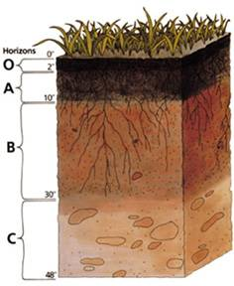
A sort of Renewable Resource
Soil is constantly being made, but it is being made awfully slowly
Soil conservation is about ensuring that soil is not lost more quickly than it can be made
So where does soil come from?
Many people mistakenly assume that it came from the planet Zipdon in 3041 BC from the alien overlords controlled by Emperor Kronzike
This is simply not true
This is also a very good thing because if it did, we would have to rely on Emperor Kronzike to supply us with more soil each year (and he lives 213 million light years away!)

Slide 12
If not from Zipdon, then where?
So where does topsoil come from?
Picture a section of bare rock. Over time, freezing and thawing will cause the rock to break into chunks.
Physical weathering, wind, and rain will break apart each rock into smaller and smaller pieces
Over time, these fragments will become finer and finer and collect on top
Plants will further break up the rock with their roots, causing even more surface area on which weathering can act
Weathering and plants are the major agents responsible for forming soil from rock

Slide 13
Weathering
Physical weathering refers to the effects of climatic factors on rock.
As rocks heat during the day they expand; they then cool and shrink at night – this can cause fractures
When water goes into cracks and freezes, it expands, breaking apart rock
Windblown dust, running water, and rain also wear away at rock
Chemical weathering changes the chemical makeup of rock
E.g. some minerals dissolve in water; others react to form softer, more easily weathered compounds

Slide 14
Weather (cont.)
Biological weathering mostly occurs because of plants
E.g. lichens form mild acids that react with the minerals to break down the rock; when the lichen dies, the dissolve rock and the organic debris add to topsoil
Plants will begin to grow in the crevices and their roots will widen cracks and fissures in the rock, enabling more chemical, physical, and biological weathering to occur

Slide 15
Steps in Creating Soil
The formation of soil begins with rock in the earths crust
Rocks can be formed in 3 ways
Igneous – created by cooling and hardening of the molten mantle under the earth’s crust
Examples: granite, quartz
Sedimentary – formed when loose materials like mud or sand become cemented by chemical agents and/or pressure
Examples: limestone; sandstone
Metamorphic – if igneous and sedimentary rocks undergo great changes in heat and pressure, they can become new kinds of rock
Examples: marble (formerly sandstone that is heated to extreme temperatures under extraordinary pressure)

Slide 16
Parent Material of Soils
Soils can come from two sources –
1. Residual Soils: From currently existing bedrock (less common)
2. Transported Soils: From another area(more common)
Residual soils form very slowly because they must first be weathered from the existing rocks
Transported soils grow from rock that has already been weathered and then carried somewhere else
E.g. glacial ice carried parent materials from northern Canada and deposited them in the Midwest (it’s no accident that much of the world’s farming occurs in glacial regions)
For one area to gain transported soils, another area has to lose.

Slide 17
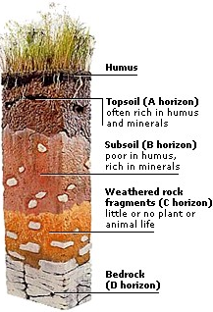
Soil Horizons
As soils develop and age, they form layers.
6 soil layers are identified by the USDA; 5 will be considered here – O, A, B, C, and D (or R)
O = organic layer; decayed plant and animal debris
A = topsoil; mixture of mineral and organic matter
B = subsoil; low in organic matter and high in minerals; area of most root growth
C = parent material; weathered, fragmented rock
D/R = Bedrock (limestone, sandstone, etc.)

Slide 18
Soil Chemistry

Slide 19
Soil – The Interface of Life
If texture is the most important physical property of soil, pH is the most important chemical property of soil
pH is the most important determinant of the growing capabilities of a soil sample
pH indicates the acidity or alkalinity of soil
The pH scale goes from 0-14, with 7 being neutral
The further from 7 a pH sample is, the more reactive it is; below 7 is acidic and above 7 is basic, or alkaline
For example, the acid in your stomach has a pH of 2; it could dissolve a metal razor blade because it is extremely acidic
Lye has a pH of 13 and would dissolve the skin off your finger; it is extremely alkaline.

Slide 20
Effects of pH
Soil pH (or soil reaction) is most responsible for determining the availability of nutrients and minerals.
14 of 17 essential plant nutrients are obtained from the soil – pH determines how available these nutrients are
These nutrients are most available in a slightly acidic soil as compared to neutral or alkaline (basic)
A pH between 6 and 7 is usually most ideal for plant growth (although some plants have adapted for different pH’s)

Slide 21
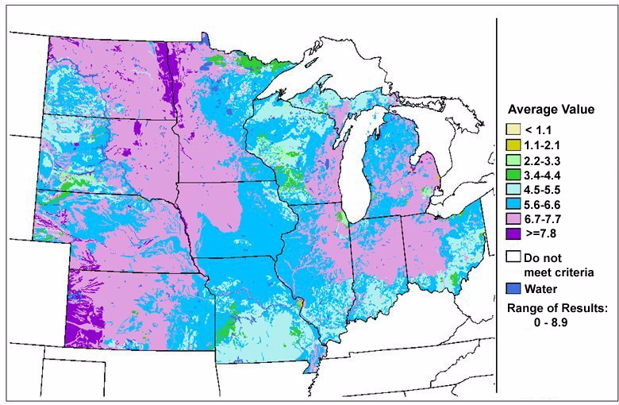

Slide 22
pH simplified
The pH scale is based on the number of hydrogen ions.
A hydrogen ion is a cation – it has a positive charge
H⁺
The pH number is based on the hydrogen concentration
When hydrogen cations are completely balanced by hydroxide (OH⁻) anions, you have a neutral, unreactive subtance (such as water)
The more imbalanced the solution, the more reactive it is.

Slide 23
Soil pH
Soil pH results from the interaction of soil minerals, ions, and cation exchange
A soil with a high, alkaline pH results due to the reaction of water with calcium, magnesium, and sodium
These minerals “steal” hydrogen ions, leaving hydroxide (OH⁻) ions behind that make the soil alkaline. These kind of soils are very common in areas with large amounts of limestone (such as Wisconsin)
This situation can also result around roadways, particularly in spring
A soil with a low, acidic pH is most often caused by acidic rain, carbon dioxide from decomposition, and acidic fertilizers

Slide 24
Effect of pH on Plants
Again, most plants do well at a pH range of 6.0-7.0
Blueberries and evergreens are among the few that do well in acidic soils
Alfalfa is one of only a few that does well in basic soils
The actual number of hydrogen cations does not actually affect plant growth that much.
pH itself is usually does not have a direct effect
Rather, other soil conditions can lessen or increase the impact of soil pH on plant growth. They are…
Nutrient availability
Aluminum toxicity
Soil microbes

Slide 25
pH and Nutrients
A good example of soil pH and its impact on nutrients is phosphorus
Phosphorus is one of three key nutrients for plant growth (NPK), and is a main ingredient of ATP
When soil pH falls below 5.8, phoshphorus reacts with iron to produce an insoluble iron compound.
Plants obtain their nutrients through absorbing groundwater
If a nutrient is insoluble, it is unobtainable by plants
When pH rises above 6.0, the reaction reverses and phosphorus dissociates from iron
At a high pH, phosphorus undergoes a similar reaction with calcium
Phosphorus may be present in the soil and may provide a good test result, but will be unavailable because of the pH

Slide 26
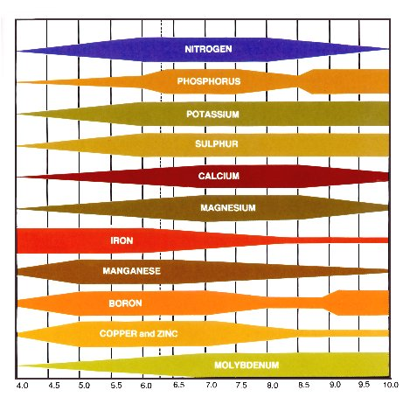

Slide 27
pH and Toxicity
If the soil pH drops below 5.5, aluminum begins to dissociate from the soil particles, especially in soils high in clay.
Normally aluminum is “held” by soil particles.
In clay-heavy soils, the clay and humus particles form a structure called a micelle.
The micelle structure has a negative charge
This negative charge attracts positively charged elements including metals such as aluminum as well as other elements such as hydrogen cations and sodium
This can help negate the impacts of road salt and other environmental assaults.

Slide 28
Cation Exchange Capacity
The ability of a soil to negate these often-harmful assaults on the environment is called the soil cation exchange capacity (or Soil CEC)
cation exchange capacity (CEC): ability of a soil particle to attract positively charged ions
If the pH drops too low, the strength of the chemical charge of the micelle is negated by the surrounding environmental conditions
Aluminum becomes soluble; in this case, the solubility is bad because it can form a metal toxicity when absorbed by the roots of a plant
Iron and manganese can have similar effects

Slide 29
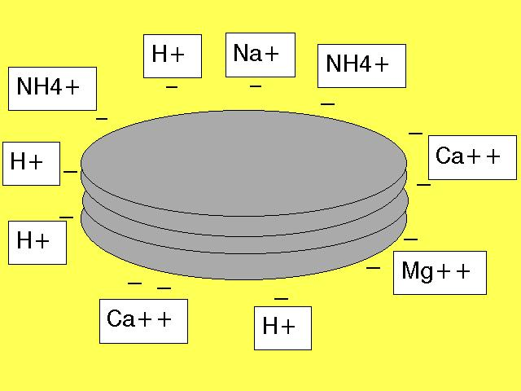
MICELLES AND CEC
micelles: clay and humus form a complex together known as the clay-humus micelle.

Slide 30
A Word on Soil CEC
CEC can be thought of as the ability of soil to hold on to nutrients.
Clay-based soils have a very high CEC
Sand has a very low CEC
The more cation exchange a soil has the more likely the soil will have a higher fertility level.
Could CEC be too high?
Why do you suppose manure pits must be clay-lined?

Slide 31
pH and Soil Organisms
As we discussed last week, the biodiversity of the soil is the most important biological property of the soil
Again, soil pH is the most important chemical property and texture is the most important physical property
Soil organisms grow best in near-neutral soil
Acidic soil mostly inhibits the growth of organisms at the base of a soil food chain, particularly microbes and earthworms
This reduces their crucial activities, including nitrogen fixation and decomposition

Slide 32
Soil Acidification
Soil Acidification is a natural process that is a part of all landscapes
Clearing land and replacing native vegetation with crops and pasture accelerates acidification
The addition of lime can raise the pH to more productive levels
The addition of sulfur can lower pH is the soil is too alkaline; ashes can also work

