Slide 1
Soils and Gardening
Based on “Sustainable Soil Management” from the National Sustainable Ag. Information Service
By C. Kohn

Slide 2
What is Soil?
Take a moment and create your own definition of soil.
When instructed, discuss your definition with a partner. Try to come to a consensus definition that both you and your partner can agree on.
Be prepared to share.

Slide 3
Soil, Defined
Soil is a mixture of minerals and organic material that sustains the growth of plants by providing nutrients and structure needed for root development and cellular function
Dirt is the inorganic portion of soil
Humus is the organic portion of soil
Plants need physical support, air, water, and nutrients. Soil provides all four.

Slide 4
What is Good Soil?
If you owned a small plot of land, how would you decide where to put a garden?
Make a list of characteristics you would look for in deciding where to plant a garden.
When instructed to do so, combine your list with a partners and be prepared to share.

Slide 5
Characteristics of Good SOil
Feels soft; crumbles easily but holds a shape
Drains well…doesn’t hold water like a sponge
Holds some water during a rain
Doesn’t form clods or pack tightly
Doesn’t erode easily
Smells “earthy”
Doesn’t need a lot of fertilizer
Has lots of organic material

Slide 6
But wait a moment…
Is all soil like what we just described on the previous slide?
  Of course not!
How is it that for hundreds of thousands of years, the American plains produced vast amounts of grass without fertilizer or plowing?
How can forests sustain huge trees without any human interference but crops like alfalfa or corn would never grow without fertilizer and tilling and crop rotation?
TPS – answers later

Slide 7
The Basics
Soils are made of 4 basic characteristics:
  45% inorganic minerals
    Sand, Silt, or Clay
  25% air
  25% water
  2 - 5% organic matter

Slide 8
Soil Minerals
Sand is composed largely of the mineral quartz.
  Quartz cannot hold nutrients – each rainfall causes nutrients to be leached out of the soil into groundwater
  Quartz particles are large; the larger the particle, the lower its ability to hold onto water
Silt particles are also made of quartz but are much smaller.
  Silt is better at holding onto water

Slide 9
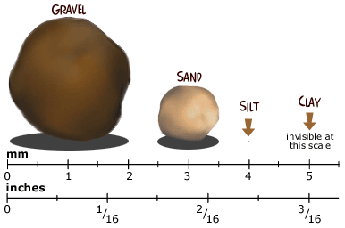
Soil Minerals
The smallest of all soil particles is clay
  Most clay particles contain appreciable amounts of organic material
  Clay particles are shaped like ‘plates’.
    This increased surface area allows clay to form strong bonds with water
    This allows clay to hold tightly onto water like a sponge

Slide 10
Soil Texture
Soil Texture refers to the percentages of sand, silt, and clay in the soil
A loam soil contains all three kinds of minerals in similar proportions
A sandy loam would contain all three but slightly more sand than the rest; ditto for clay loam and silt loam.

Slide 11
Soil Structure
Soil Structure refers to the “clumping” ability of soil.
If you grab a handful of soil and it holds no shape, that soil is mostly sand
If you grab a handful of soil and it doesn’t fall apart easily, that soil is mostly clay
If you grab a handful of soil and it crumbles, that soil is mostly silt.

Slide 12
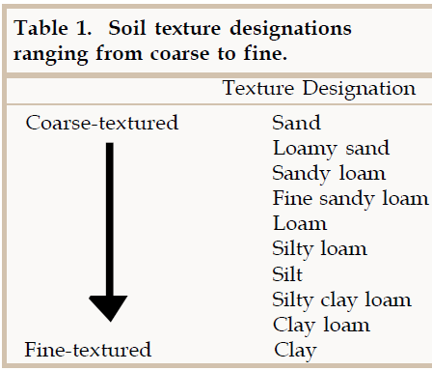

Slide 13
Texture and Structure
Texture = percentages of sand, silt, and clay
Structure = clumping ability of soil
Texture and structure together determine the pore space for water and air circulation, as well as erosion, ease of tillage, and root penetration.
  Texture cannot be changed; this makes site selection a key priority.
  Structure can be improved by proper practices

Slide 14
Describe your Garden Site
If you were to plant a garden, what would the soil be like?
  Describe your garden plot.
  Be sure to describe how you know the soil is good soil
  Explain what you are looking for in your soil.

Slide 15
Soil – Alive or Inorganic?
How many of you would classify soil as “alive”?
  Show of hands, how many think “alive”?
  Show of hands, how many think “not alive”
What is necessary for something to be alive?

Slide 16
The Biology of Soil
One acre of topsoil contains –
  900 lbs. of earthworms
  2400 lbs. fungi
  1500 lbs. bacteria
  133 lbs. protozoa
  890 lbs. arthropods (mostly insects)
  890 lbs. algae
  Various small mammals

Slide 17
Living Soil
Soil is a living community, not a collection of inorganic minerals
  Soil has to have living and organic components in order to sustain plant growth
  You cannot add a mixture of minerals and “create” soil
  Organic material can be alive (e.g. roots), dying (e.g. fallen leaves) and decomposing (manure and waste)

Slide 18
Humus
A key component in soil health and nutrition is humus.
Humus is the dark colored organic material in soil in the final stages of decomposition
Both organic material and humus serve as reservoirs of plant nutrients
They also help to create soil structure
Typically, the darker the soil, the better
  E.g. Black Earth, Wisconsin

Slide 19
Good Soil
Good soil is…
  High in humus
  Balanced in nutrients
  Has high biodiversity of soil organisms
Good soil will…
  Produce healthy, productive plants
  Minimize the success of weed growth
  Minimize susceptibility of plants to disease
  Minimize susceptibility of plants to insect predation

Slide 20
So how DID they do it?
Remember our question about the prairies and forests that existed prior to European settlement?
These soils were tilled and fertilized by natural processes –
  Native soils are covered with a layer of plant litter each fall
  Beneath the surface, soil organisms decompose and stir soil slowly over time.
Soil is the most biologically diverse part of earth!

Slide 21
The Life of Soil
Soil-dwelling organisms release bound-up minerals and nutrients when they decompose organic material from plants and other organisms.
Plants absorb these nutrients when they diffuse into the water present in the soil
When plants die and decompose, the nutrients are once again made available.

Slide 22
Earthworms
Earthworms enhance the abilities of soil to provide water and air to plants through their tunneling
  Soil with earthworms is able to absorb 4-10 times more water, reducing runoff and increasing groundwater supplies
Soil is tilled by earthworm activity
  **This increase microbial activity, increasing nutrient cycling and productivity in soil while providing aeration and increased water absorption**

Slide 23
Earthworms and Tillage
Tillage reduces the ability of earthworms to thrive
Over-tilled soil can reduce earthworm numbers by as much as 90%
Earthworm numbers can be increased by reducing tillage, using manure, and maintaining near-neutral pH in the soil.

Slide 24
Arthropods
Soil Arthropods include sowbugs, millipedes, centipedes, slugs, and snails.
These insects eat and shred large particles of plant and animal residues
Their waste is rich in plant nutrients and their activities increase the availability of soil nutrients

Slide 25
Soil Bacteria
Bacteria are the most numerous kind of soil organism
Soil bacteria return minerals and nutrients to their most basic state
Some bacteria also produce plant growth hormones, stimulating root growth and development

Slide 26
Nitrogen-Fixing Bacteria
Some bacteria play an especially-key role in soil nutrition
Several species of bacteria can “fix” nitrogen from the air (which is not available for plant use), turning it into a form that plants can use for growth and production
  Nitrogen is the most important soil nutrient

Slide 27
Nitrogen-Fixing Bacteria
Some bacteria are symbiotic with plants
  This means that they have an interdependent relationship with another species
  They are housed in the roots of these plants, where they receive nutrition in exchange for fixing nitrogen so that the plant can absorb it for its own growth
  For example, Rhizobium live in root nodules of bean plants
  Other species of bacteria do this independent of plants
Without these bacteria, plants would have far less available nitrogen for production.
Algae also plays a role in fixing nitrogen

Slide 28
Soil bacteria
Other benefits provided by soil bacteria
  Increased solubility of nutrients
  Improved soil structure
  Reduced root disease
  Processing of soil toxins from pollution

Slide 29
Soil Fungi
Yeasts, molds, and mushrooms are all fungi
They are a separate kingdom of life (like plants or animals)
Fungi also aid plants by breaking down organic matter
Some fungi produce plant hormones and/or penicillin
Other fungi trap predatory nematodes (microscopic worms that prey on roots)

Slide 30
mycorrhizae
Mycorrhizae are an especially important kind of fungi that live on or in the roots of some plants
Mycorrhizae fungi increase the rate of uptake of water and nutrients, especially phosphorus.
  These fungi are especially important in poor or degraded soil
Mycorrhizae protect roots from nematode predation, produce antibiotics for harmful bacteria, and produce growth-improving plant hormones.
Mycorrhizae benefit from this increased production by receiving nutrients and carbohydrates from the host.

Slide 32
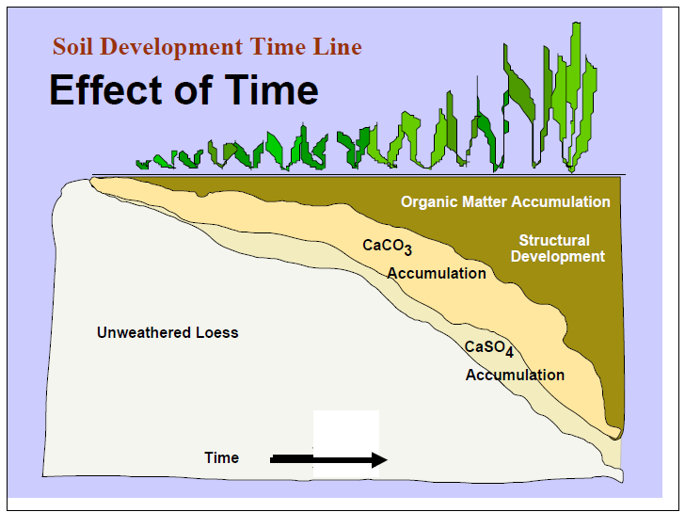
pHoto courtesy of http://faculty.washington.edu/clh/whitepapers/roleofsoils.pdf

