Slide 1
Horticultural Responses to Temperature
C. Kohn, Waterford, WI

Slide 2
Your Mother’s Roses
“As a kid, I can distinctly remember that when September came, my mother would begin covering her rosebushes at night with plastic sheeting. While I appreciated her commitment to her rosebushes, I couldn’t help but shake my head at the stupidity of my mother. After all, how could a thin, plastic sheet protect those flowers from 30-degree weather? I guess I just realized that sometimes, you just have to let parents learn from their mistakes. The problem was, this always worked!” - the teenage Mr. Kohn

Slide 3
So, wait a minute…
So we clearly have some inconsistencies here…here’s a couple questions to consider:
Why is it that sometimes a plant will suffer frost damage at temperatures above freezing (e.g. 36º)
How is it that ice can melt at sub-freezing temperatures?
E.g. on the roof of your house or on a salted-sidewalk
Why are some plants better at surviving frost than others?
If plants aren’t ‘warm-blooded’, how can they survive in winter when cold-blooded animals have to hiberate?
Do plants hibernate?

Slide 4
The Big Question
The BIG question here is…
How do temperature changes affect the ability of a plant to grow and produce a crop (food, flowers, etc.)?
The ‘slightly less big but still pretty good sized’ question is…
Knowing how temperature affects a plant, how can we respond as horticulturalists to maximize plant productivity in a given environment?

Slide 5
The Plant Cell
To answer these questions, we have to know a little bit about the plant cell before we can continue.
Things to keep in mind…
Plant cells are very different from animal cells, but face the same kind of challenges
For example, both animal cells and plant cells have to eliminate cellular waste and toxins; if animals have a bloodstream and kidneys to filter out waste, how to plants do it?
Plants don’t ‘feel’ things – i.e. they don’t feel cold or pain or hunger but they do still respond to it.

Slide 6
Fact 1: Selective Cell Membranes
Plants have cell membranes that are selectively permeable.
Selectively permeable: the membranes of plant cells let some things in but not others; they can choose what solutes come in and which solutes don’t
To make this possible, plant cells use specialized proteins that block or allow solutes.
Some proteins are just like gates that passively let some solutes flow in
Some proteins are like pumps that actively move these solutes into the cell

Slide 7
Fact 2: Osmolarity & Osmosis
Osmolarity is simply how concentrated a solution is
It is based on the number of particles in the volume of fluid (not by weight or mass).
Osm = number of particles in a solution
Osmosis is the movement of water from a solution with low osmolarity to a solution with high osmolarity
i.e. water tries to dilute things, so it wants to go from a watered down solution to a highly concentrated solution

Slide 8
Low Solutes
High Solutes
Selectively Permeable Membrane
Osmosis: Water will move from an area with low solutes (low osmolarity) to an area with high solutes (high osmolarity)

Slide 9
Fact 3: Turgor Pressure
Because of osmolarity-induced osmosis, living plant cells have a property called Turgor Pressure.
Turgor Pressure: the pressure within a cell due to movement of water into that cell
The turgor pressure of a plant cell is about 11 atmospheres
1 atm (atmosphere) of pressure is equivalent to the air pressure at the earth’s surface at sea level
The pressure inside of a plant cell is 11 x the air pressure at sea level
This enables a plant to send shoots up and roots down

Slide 10
Turgor Pressure and Cell atm
Turgor pressure can change within the cell as a result of the osmolaric conditions around that cell
High osm (cell H2O out) Low osm (cell H2O in)

Slide 11
Turgor Pressure & Cells
For example, imagine you have packed a salad for lunch.
If you pour salty salad dressing on your salad before you leave, what will happen to the salad?
Well, when lunch comes, you lettuce will be a disgusting, limpy mush
If you pour your salad dressing on right before you eat it, your salad will still be crisp and crunchy
The salt in the salad dressing sucks the water out of the lettuce leaf cells, causing them to collapse
Turgor pressure makes lettuce crisp and juicy

Slide 12
Fact 4: Plasmolysis
Plasmolysis: if a cell is placed in a highly concentrated solution (hypertonic), water moves out of the cell, causing it to shrink and lyse (burst).
Lysis: bursting a cell; Lysol kills bacteria by bursting it
Deplasmolysis: if a cell is placed in a diluted solution (hypotonic), water moves into the cell, causing it to swell.
Salty Drink: cells shrink - plasmolysis
Pure & Clear: cells swell - deplasmolysis

Slide 13
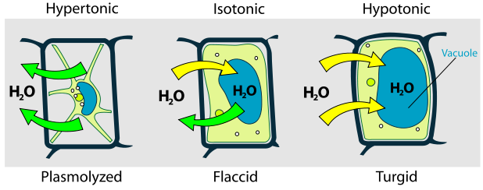
Hyper, Hypo, and Iso
Hypertonic solution = hyper concentrated outside
Isotonic solution = same concentration inside and out
Hypotonic solution = low concentration outside

Slide 14
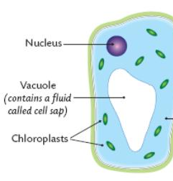
Fact 5: Vacuoles
Plants do not have kidneys or livers to process their cellular waste
To eliminate this waste and prevent it from reaching levels of toxicity, each plant cell has a large central vacuole.
The plant vacuole comprises roughly 80% of the cell volume

Slide 15
A little more about vacuoles
The central vacuole is enclosed by a membrane called the tonoplast
The fluid inside the vacuole is called the cell sap.
The color of some flowers, the smell and flavor of fruits, veggies, and berries, and the taste of many plants comes from the cell sap

Slide 16
Roles of the Vacuole
Storage – not just for waste, but also for salts, minerals, nutrients, pigments, proteins, and others.
Growth – the vacuole is a catch-all and materials can be retrieved if needed
Structure – osmolarity and osmosis cause the vacuole to swell, preventing wilting
Regulation – the vacuole can assist in regulating the rigidity of the cell and change the osmotic pressure
Defense – toxins and bitter-tasting compounds that protect a plant from predation can be found here

Slide 17
Summary
Fact 1: plant membranes are lined with protein channels that are selective
Fact 2: plant cells are affected by osmolarity (how concentrated a solution is) and osmolarity (water moves from low conc. to high conc.)
Fact 3: the movement of water into cells due to osmolarity and osmosis creates a turgor pressure inside the cell of 11 atm
Fact 4: when a cell is immersed in highly concentrated water, it shrinks as water is pulled out – plasmolysis
Fact 5: the plant’s storage organ, the vacuole, can regulate turgor pressure to keep it at 11 atm

Slide 18
So wait, isn’t this about temp?
You might wonder when temperature will make its way into our discussion about plants and temperature
Well, here it is…

Slide 19
Plant Responses to Freezing
On a chilly night, cooling temperatures will cause the following changes to a plant cell…
Protein pumps require energy; plant cells will be less able to build up the osmolarity of plant cells, reducing turgor pressure
The vacuoles will begin to shrink as they are less able to increase the osmolarity inside the cell
As ice crystals form inside the cell, water will be drawn out of the vacuole and into the ice causing plasmolysis
Ice also acts like a monkey wrench in the delicate machinery of the inside of a plant cell
Finally, ice formation will cause the cell to lyse, interrupting the flow of water through the plant via the xylem tubes
The water column inside the plant will be interrupted, causing irreparable damage

Slide 20
Irreparable Frost Damage
While plants can tolerate chilling or freezing to varying extents, at low enough temperatures all face the following outcomes as water is pulled out of the cell
Protein Pump Shutdown
Lost Turgor Pressure (as water moves out of the cell to form ice – frost damage is dehydration damage)
Buildup of toxicity – as water is lost, concentration of waste increases inside the cell
Interrupted cell function and stopped cell metabolism
Cell damage from the cell membrane pulling away from the cell wall during plasmoylsis
Cell lysis (rupture) and cell death
Disrupted water flow via the xylem

Slide 21
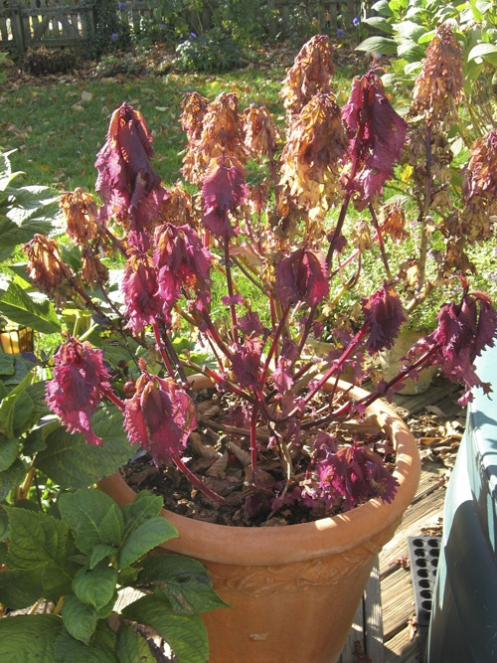
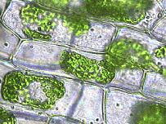
Frost Damage

Slide 22
Plant Adaptations to Chilling and Freezing
C. Kohn, Waterford, WI

Slide 23
So could we…?
Could we ever have banana plantations or groves of oranges here in Wisconsin?
Probably not
So why is it that we do have oodles of apple orchards, cherry trees, and even peaches?
Where are these crops located in Wisconsin?
Why is Door County most famous for these crops?
Why is it that an apple tree can survive cold Midwestern winters but a banana can’t survive in the fridge?

Slide 24
Acclimation vs. Deacclimation
Through natural selection, plants in high latitudes and developed cellular responses to cold weather that enable them to tolerate or avoid cold weather
Acclimation: a plant’s transition from sensitive to hardy (usually in fall, or when moved from a greenhouse)
Deacclimation: a plant’s transition from hardy to sensitive (usually in summer)
Deacclimation is faster than acclimation, which is why an extended spring thaw is very bad – takes longer to become hardy again

Slide 25
Strategy 1: High osm
High osmolarity (high conc) lowers the freezing and boiling temperatures
e.g. if you want your pasta to boil quicker, add salt to it
e. g. if you want to melt ice on your sidewalk, you add salt
A high solute concentration increases the atmospheric pressure, and this makes it so that a lower temperature is needed for ice to form.

Slide 26
Strategy 2: Super Cooling
Ice forms when water gets below freezing, right?
WRONG!
Ice forms when impure water gets below freezing!
Pure water can be cooled to -40 F/C before it will freeze!
-40 is the same in both F and C
Ice needs something to ‘hold onto’ in order for crystals to form.
This ‘something’ for ice to form is called a nucleator.
Without any impurities, ice will not form at temperatures above -40.

Slide 27
Strategies 1 and 2 together
Inside the cell, high osm lowers the freezing point at which ice would form because of increased atms
Outside the cell, pure water can remain ice-free up to a temperature as low as -40 because of an absence of nucleators
For example, the newly formed leaf buds in fall are kept ice-free by the pure water around them within the bud structure
Both hypertonic water and pure water have lowered freezing points, but for different reasons
I know, weird!

Slide 28
Strategy 3: Osmotic Alterations
Some plants survive the cold by tolerating the formation of ice inside the cell, but limit the loss of water from the cell
By pumping up the osmolaric concentration of the cells ‘innards’, it can reduce the loss of water caused by freeze-induced dehydration
This can be via salts, sugars, or other solutes
For example, some frost-tolerant crops become sweeter with cold weather because of Strategy 3

Slide 29
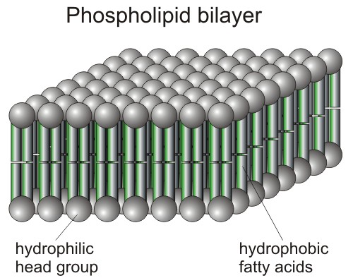
Strategy 4: Membrane Changes
We mentioned earlier that protein pumps can shut down if the lipid cell membrane freezes (solidifies)
Quick Biology Review: the membrane of living cells is called a ‘phospholipid bilayer’
This simply means that the cell membrane is double-layered with phosphate heads on the outside and lipid tails on the inside.

Slide 30
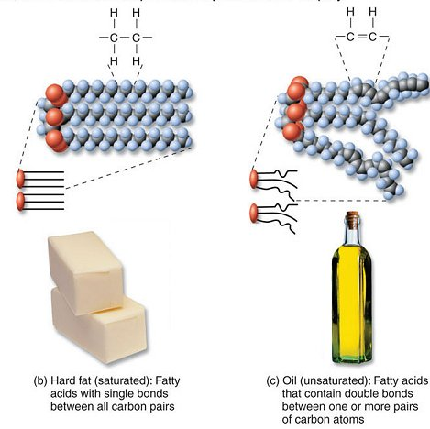
Unsaturated vs. Saturated
When we talk about a ‘saturated fat’, we mean that the fat molecules have the maximum amount of hydrogen
They are saturated with hydrogen molecules
If we replace some of the hydrogen in the lipid (fat or oil) with double bonds in the carbon, the molecules form a “kink”
More kinks = more fluidity

Slide 31
Kinked Unsaturated Lipids
This should be familiar to you
Animal fats tend to be solid at room temp because they are usually found at body temperature (e.g. butter)
This is also true for warm weather plants
Cold weather plants tend to have unsaturated fat because they need to be kinked to prevent solidification
E.g. Vegetable oil is a liquid at room temperature
Solidification basically ‘freezes’ the cell and stops the cell metabolism
The kinked unsaturated lipids prevent this from happening by maintaining a liquid state at low temps

Slide 32
Strategy 5: Cutin Wax
You probably remember that the cuticle is the outer layer of the epidermis that produces cutin.
Cutin is a waxy layer that prevents the plant from dehydration and disease
An increased cutin layer will reduce the damage caused to a plant by chilling and freezing by preventing water loss
Again, frost damage is dehydration damage
Plants exposed to cool weather have more waxy cutin

Slide 33
Summary
Strategy 1: High intercellular osmolarity = high atm = reduced freezing temperature
Strategy 2: Absence of nucleators (pure water) outside the cells = reduced freezing temperature (to -40 degrees)
Strategy 3: Osmotic alterations = reduced loss of water to ice (e.g. Snow peas sweeten after each frost)
Strategy 4: Unsaturated lipids in the phospholipid bilayer of the cell’s membrane
Stays liquid at lower temps
Strategy 5: Increased cutin production

Slide 34
Prevention of Temperature Damage
C. Kohn, Waterford, WI

Slide 35
Human mechanisms
Horticultural crops are aided by humans when fighting off the effects of chilling and freezing damage
To understand why human responses to cold weather work, we have to better understand how temperature works.

Slide 36
2 Kinds of Frost
There are two kinds of frost that can damage plants:
1. Advection Frost: a cold front brings lower temperatures with the new weather pattern
2. Radiation Frost: these are characterized by clear skies, calm or no wind, and gradual drops in temperature as the heat of the previous day is gradually lost
More heat is radiated away than received, so temp drops
Without anything to slow its loss (such as clouds, downward wind, or a cover), the temp continues to drop

Slide 37
Temperature
Temperature is the measure of degree heat
This is a really dumb definition because it’s like saying moisture is a measure of the degree wetness – it doesn’t mean that much to the average person
A better way to think of temperature is as a type of energy that enables a plant to do what it does, including…
Photosynthesis and Respiration
Enzymatic Activity (biochemistry, sorta)
Maintain a liquid state where needed (vs. solidification)
Uptake water via transpiration, xylem, and stomata

Slide 38
Temperature = Energy
The energy of heat can be transferred to a plant in one of 4 ways
1. Radiation – transfer of energy through open space (e.g. those red lights that keep your food warm)
2. Conduction – transfer of energy by contact (e.g. touching a hot kettle)
3. Convection – transfer of heat through mass movement (e.g. a hot air blower in your car)
4. Latent Heat Exchange – chemical transfer of heat (e.g. sweat absorbing heat to evaporate cools you)

Slide 39
The 4 Methods in nature
All four processes naturally affect temperature changes in plants
1. Radiation from the sun strikes plants and warms them
2. Warm soil conducts heat into the plant cooled by the night air
3. A light breeze blows warm air from high places into low areas where cold air has settled
4. For water vapor to condense, it must give up energy; it will transfer latent heat to a plant to form dew in the a.m.

Slide 40
Horticultural Strategies
These four methods are actively employed in horticulture to minimize heat loss from plants
Warming: greenhouse, cold frames, hot beds, hotcaps
Cultural: sloped beds, waterfronts, plastic sheeting
Frost protection: avoidance of low areas, covering plants, moist soil, air movement, sprinklers
Cooling: misting; wrapping trunks in white wrap
Minimizing temp swings: mulching
See next slides for explanations

Slide 41
Warming Methods
Greenhouses – Mr. Blake, on a tour, asked how much it cost to heat the greenhouse on that particular day; I replied “Nothing”. How was this possible if it was almost freezing outside and balmy inside the GH?
The greenhouse effect is when radiation (light energy) from the sun or other source is absorbed by an object and transferred into heat energy.
The panes of the greenhouse allow light energy to pass through but limits the flow of heat energy.

Slide 42
Greenhouses aside…
Most people do not have their own greenhouse, but this does not mean they cannot benefit from the radiation benefits of the greenhouse effect
Hot beds: covered boxes with heating elements to warm the soil and plants inside
Cold frames: a frame with a southern-facing clear covering that traps solar radiation and converts it to heat
Hotcaps: sort of a one-plant greenhouse; e.g. cutting the top off a clear 2-liter bottle for a tomato seedling

Slide 43
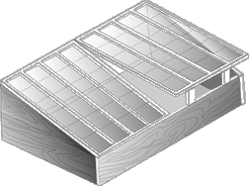
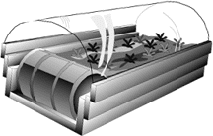
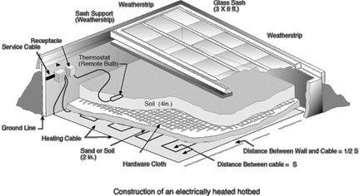
Cold frames
Hotbed
Hot cap

Slide 44
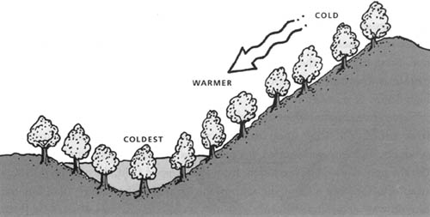
Cultural Practices
A cultural practice in this case is the method of raising crops
One cultural practice for temperature maintenance is to plant your crop on a slope
For example, orchards and vineyards are usually found on the side of a hill
This enables the cool air to sink below the crop, reducing the likelihood of chilling/freezing damage

Slide 45
Cultural Practices
Location near water is also key.
Water has a high specific heat
Specific Heat: the amount of energy (calories) required to increase the temperature of a substance
Water has a specific heat of 1 calorie/gram of water
This is why we have the term “cooler by the lake” – the temperature of the water will rise slower than the temperature on land
In the fall, this reverses to “warmer by the lake”, as the land around the water cools faster than the water does.

Slide 46
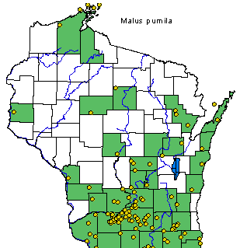
Peninsulas Are Ideal for Fruit
Much of the nation’s fruit production occurs on peninsulas for this reason
The temperature fluctuations are minimized when you are surrounded by water because it takes the temperature of water does not change as easily
Water forms a buffer against severe temperature swings
This is why Door Co. by Green Bay is known for its apple and cherry orchards and why Bayfield along Lake Superior can grow fruit

Slide 47
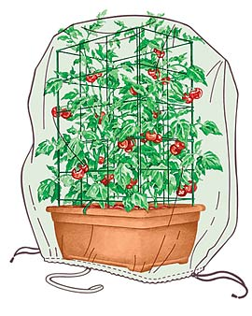
Frost Protection
Plastic sheeting works for frost protection because it traps the heat radiating from the earth
Like water, the earth will cool more slowly than the air around it; it will radiate heat, which will be lost to the sky and eventually space unless it is trapped
Plastic sheeting can trap the rising warm air and form a buffer between the plant and the cool night air.

Slide 48
Frost Protection
Sprinklers are also effective in frost protection.
When the ice forms on the surface of the plant, it must give up energy to become ice (a solid is at a lower energy state than a liquid)
The energy is transferred from the liquid water to the plant so that ice can form
This both provides additional energy to the plant while insulating the plant against more severe temperature drops
This would be latent heat exchange

Slide 49
Moist Soil
For the same reasons previously mentioned, wet soil will maintain a warm temperature longer than dry soil
Watering your plants before a cool night can offer protection both in terms of
A) reduced heat loss (which would also be increased heat radiation into the air and conduction from the soil) and in terms of…
B increased gains from latent heat transferred as the condensation forms around the plant

Slide 50
UC Davis – Avg. Energy Fluxes During a Radiation Frost
Energy Transfer | Flux Density
 | Watts per square meter
Conduction (from the soil) | +28
Convection (from the air) | +39
Downward Radiation (from the sky) | +230
Upward Radiation (from the orchard) | -315
Net Energy Loss from the crop | -18
TOTAL | -36 W/m²
http://biomet.ucdavis.edu/frostprotection/Principles%20of%20Frost%20Protection/FP005.html

Slide 51
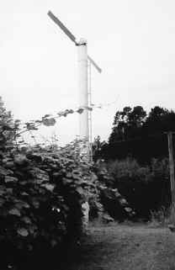
Frost Protection – Top Gun Style
You may have noticed that heat can be gained from the sky
This might seem confusing given we were losing heat to the sky
Often that lost heat will form a layer of warm air above a field.
A large fan or helicopter can push this warm layer back down onto the crops
Wind machine for kiwi crops →

Slide 52
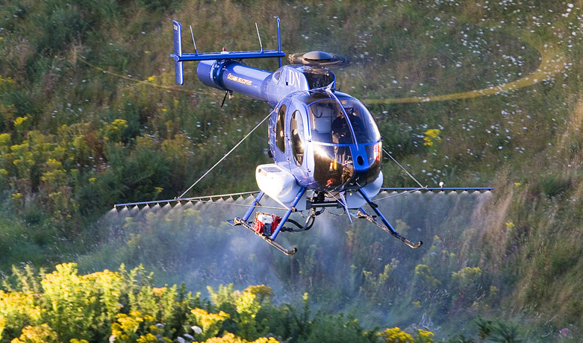
Helicopter & Ice Frost Protection

Slide 53
Wind Machines & Helicopters
← During the day, the air temperature at the surface of th soil is warmer than the air temperature 10 meters above because light energy is converted to heat energy when it strikes the ground
→ On a calm night, the air 10 meters above the ground is warmer than the ground itself because radiation inversion
Radiation inversion: a layer of cool air at ground-level created by rapid loss of heat from the ground after sunset
A helicopter or wind machine can push this layer of warm air back down
Click to see the helicopter

Slide 54
Minimizing Temp Swings
Mulching is a very effective method for minimizing temperature fluctuations
For example, it is a very good idea to provide mulch around the base of perennials
During a winter thaw, the melting and refreezing of water around the roots of the perennial can push it out of the ground, damaging the roots and possibly killing the plant
Mulch can reduce the temperature fluctuations that cause this problem

Slide 55
Minimizing Temp Swings
Wind buffers are also a good idea at very low temperatures
Wind Chill is the phenomena wherein something will cool at a faster rate at the same temperature due to the wind
The item losing heat cannot form a ‘heat island’ that slows the loss of heat, and more heat is lost more quickly
Windbreaks can reduce the rate at which heat is lost
The rate of temperature change is as important as the total change itself!

Slide 56
Growing Degree Days (GDD)
Agriculturalists are able to determine plant requirements using a measure called the Growing Degree Days (GDD)
GDD is based on the idea that plants have a minimum need at which growth and development will occur.
That said, there are three crucial temperatures for plants:
1. T_{min} - The minimum temperature at which growth occurs
2. T_{opt} – The temperature at which max growth occurs
3. T_{max} – The temperature above which growth stops

Slide 57
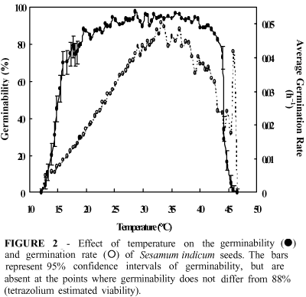
T_{opt}
T_{max}
T_{min}

Slide 58
GDD Formula
GDD is calculated by –
Min Daily Temp + Max Daily Temp = Daily Avg 2
Daily Avg– the T_{min} = GDD

Slide 59
E.g. Corn
For example, the T_{min} for corn is 50º F
Below 50, corn does not really grow at all
T_{max} is 86º F
T_{opt} is in the upper 70s
Growing degree days can then be used to calculate the growing needs of corn in terms of temperature
Example: If a low temperature was 60°F and the high was 90°F, the GDD would be 60 + 86 = 146 divided by 2 = 73 – 50 = 23 GDD.
86 + 60 = 73 – 50 = 23 Growing Degree Day units 2

Slide 60
Corn
Each GDD accumulates each day
If a variety of corn requires 2450 units GDD, it would require 107 days to mature if each day had a low of 60 and a high of 90
2450/23 = 107
If the high was 100 and the low was 70, what would our GDD be?

Slide 61
New GDD
86 + 70 = 78 2
78 – 50 = 28 GDD
2450 / 28 = 87.5 Days to Maturity

Slide 62
Forecast for Tuesday, 4-27
High – 57
Low – 36
57+ 36 = 46.5; 46.5 – 50 = 0 degree days 2
This is why we would typically wait to plant until April!
On the other hand, lettuce as a base temp (T_{min} ) of 40
46.5-40 = 6.5 GDDs
Most GDD calculations use 50 as a base temp.

Slide 63
Vernalization
Some plants require a cold treatment for physiological processes to occur.
This is known as vernalization.
Tulips and narcissus require vernalization to flower.
Some cereal grains, including winter wheat, also require vernalization.
Apples require 1,000 to 1,200 hours of temperatures between 32°F and 45°F to break their rest period.

Slide 64
Stratification
Seeds of some plants have a dormancy mechanism that is broken by a cold period.
The seeds do not germinate until the seed has undergone a cold period.
This cold requirement for seeds is known as stratification.

